Slide 1
STAT 2 – inference
Adam Brentnall

Slide 2
Intended Learning Objectives
After STAT2 students should be able to :
1. Understand the logic of statistical inference
2. Explain p-values and confidence intervals
3. Interpret analysis that reports inferential statistics

Slide 3
Outline
1. Brief review of p-values and confidence intervals
2. Class exercise

Slide 4
STAT 2 – lecture recap
Adam Brentnall

Slide 5
Question: which is correct?
A valid P-value is the chance the chosen test statistic (e.g. a proportion, t-statistic, chi-squared statistic) would be
1. equal to
2. greater
3. as or more extreme
4. Less extreme
than observed, given all the assumptions (i.e. the model) used to compute it.

Slide 6
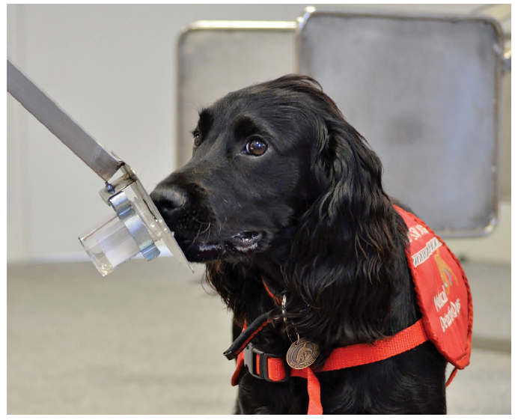
Hypothesis testing
1. Null and Alternative Hypotheses (or model)
2. Test statistic (T)
3. Compare test statistic with reference distribution under the null hypothesis
4. p-value: results this extreme (T) or more occur with probability P under null model
Null hypothesis
True state of nature?
Alternative hypothesis
True state of nature?
?
DATA
01010100101010010010101010101010101010101111010100111010101001010

Slide 7
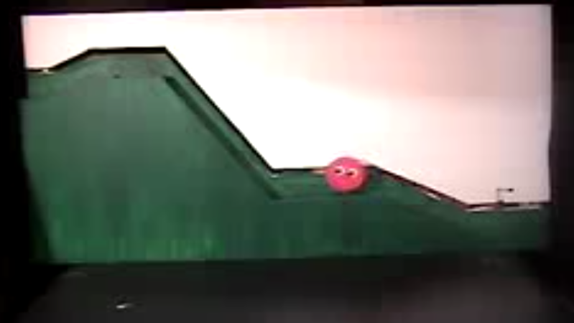
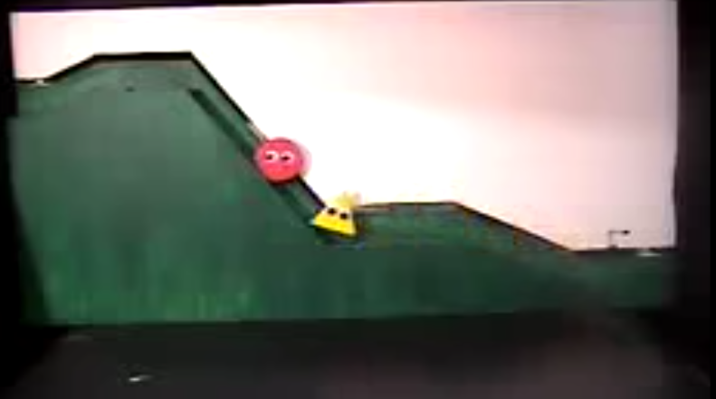
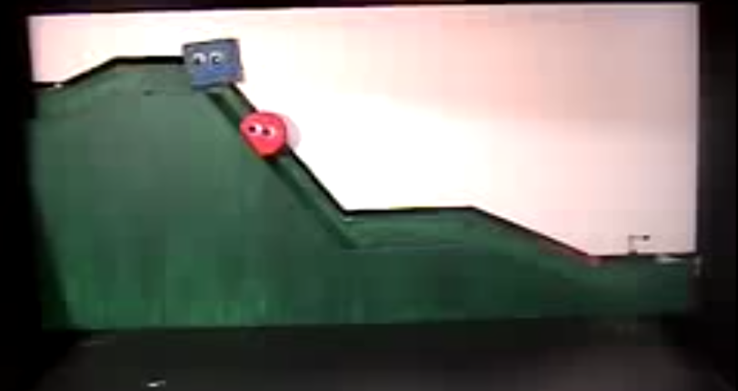
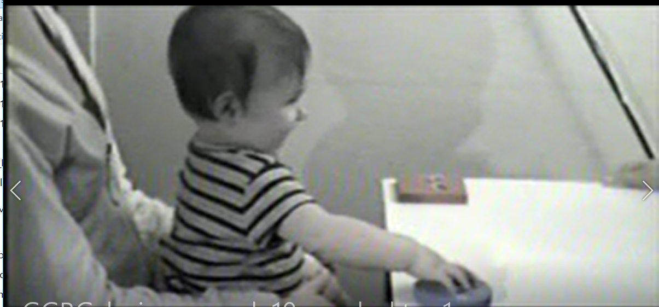
Example
In 2007 study (Hamlin et al., Nature) asked 10-month old infants to watch videos of “helping” and “hindering” toys and then asked which they would prefer to play with
14 of 16 infants chose the “helping” toy

Slide 8
Population and sample
Population
all 10-month old infants
Study design
Sample
16 infants in study

Slide 9
Population and sample
Parameter proportion prefer helping toy
Population
Study design
Sample
Estimate
14/16 (87.5%)

Slide 10
Statistics vs parameters
Parameter: children select the helping toy with true parameter
Statistic: 14 of 16 (87.5%) selected helping toy
i.e. We don’t know what parameter is, the statistic helps us to assess

Slide 11
Question: is this a one or two-sided alternative hypothesis?
Probability that an infant chooses a helping
toy is less than a half (parameter < 0.5)

Slide 12
One-sided vs two sided
Null: probability choose helping toy is half
(parameter = 0.5)
Alternative (one-sided): probability choose helping
Toy is more than a half (parameter > 0.5)
Alternative (two-sided): probability choose helping
Toy is NOT a half (parameter > 0.5 or < 0.5)

Slide 13
Measuring uncertainty
Best estimate 14/16 = 87.5%
What range of parameter?
How precise is our estimate?

Slide 14
Question
To test the null hypothesis that parameter p = 0.4, if the 95%CI = 0.20 to 0.35, which of below is correct regarding the equivalent p-value?
1. p-value <0.05
2. p-value = 0.05
3. p-value > 0.05
4. p-value = 0.5

Slide 15
Confidence interval construction
Null hypothesis: parameter = X
Alternative hypothesis: parameter > X or < X
95%CI = Range of X, such that p-value >= 0.05

Slide 16
Confidence interval summary
If 95%CI contains a value, then p-value >0.05 if testing the hypothesis that the parameter equals that value with a two-sided test.
Conversely, if 95%CI does not contain the value, the p-value < 0.05
If value on 95%CI boundary, p-value = 0.05

Slide 17
Conclusion
P-value a measure of “surprise” from data if the null hypothesis is true
  Probability see test statistic as extreme or more as observed, if null hypothesis is true
Confidence intervals are a measure of precision of the parameter, closely related to p-values
  Eg. 95%CI = range of parameter where null hypothesis test has p-value <=0.05

Slide 18
STAT 2 – class exercise
Adam Brentnall

Slide 19
Exercise
In this investigation you will do a basic statistical investigation using ideas from STAT1 (examining distributions of data) and STAT2 (inference) to help assess the statistical “surprise” of observations under a null model.

Slide 20
Get ready to vote
Load mentimeter

Slide 21
Is the person on the right Bob or Tim?

Slide 22
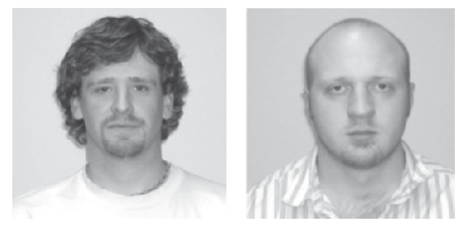
Is the person on the right Bob or Tim?

Slide 23
Investigation: facial profiling
The experiment follows results from a study in Psychonomic Bulletin and Review (Lea, Thomas, Lamkin, & Bell, 2007) that presented evidence that “people use facial prototypes when they encounter different names.” Similar to one of the experiments they conducted, you were asked to match photos of two faces to the names Tim and Bob.
The researchers wrote that their participants “overwhelmingly agreed” on which face belonged to Tim. We have just done a similar study in class to see whether your class also agrees with which face is Tim’s more than you would expect from random chance (if there is no facial prototyping and people pick a name for the face on the left at random).

Slide 24
Small groups
Discuss in small groups (10min)
(a) Describe in words the null model for this study.
(b) How many subjects participated in your study? What proportion of the respondents agreed that the face with the beard was Tim? Does this appear to be an “overwhelming majority” to you?
(c) Produce a bar graph of the results. Make sure the axes are well-labelled.
(d) Suggest some explanations for why the majority result might have occurred.

Slide 25
Plausible explanations
Truth =
(1) There is something to the theory of facial prototyping.
(2) People choose randomly and we happened to get “lucky” and find results that matched the prediction / theory.
For the two explanations we are still considering, how might you choose between them? In particular, how might you convince someone whether or not option (2) is plausible based on this study?

Slide 26
Small groups
Simulation (10 min)
We can easily simulate what “could have happened” if you were randomly choosing. Our analysis is going to assume the rational for the experiment is wrong (for the moment) and that you really were just blindly picking one image or the other without facial profiling.
(f) Suggest a method for carrying out this simulation of you picking equally between the two images.
(g) Explain why looking at such “could have been” results will be useful to us.

Slide 27
Dice

Slide 28
Pairs, simulation! (10 min)
(h) Roll your die n times, representing the n students who just participated in the experiment (one trial or repetition from this random process). Let a result of an even number mean that the hypothetical student choosing at random chooses Tim, and an odd number for Bob.
Tally the results below and count how many of the n chose the helper toy:
“Could have been” distribution
Even (Tim):
Odd (Bob):
Total number of odd number in n rolls of die:
(i) Repeat this two more times. Keep track of how many students, out of the n, choose Bob.
Record this number for all three of your repetitions (including the one from the previous question):
Repeat | Number (simulated) student choose Bob
1
2
3

Slide 29
Post results to menti

Slide 30
Small group discussion
Analyse results
(i) Did everyone get the same number of odd numbers every time? What is the average? Is this what you expected? Explain.

Slide 31
Group discussion
Analyse results
(j) How is it looking so far – is the actual study result consistent with the outcomes that could have happened under the null model?
Which explanation [null or alternative] do you think is more plausible based on this null distribution? Explain your reasoning.

Slide 32
Group discussion
Analyse results
(i) Did everyone get the same number of odd numbers every time? What is the average? Is this what you expected? Explain.
(j) How is it looking so far – is the actual study result consistent with the outcomes that could have happened under the null model?
Which explanation [null or alternative] do you think is more plausible based on this null distribution? Explain your reasoning.

Slide 33
More generally..
Need to simulate this hypothetical random selection process hundreds, preferably thousands of times.
This would be very tedious and time-consuming with dice!
Let’s turn to technology.

Slide 34
In pairs
Computer activity (15min)
https://www.rossmanchance.com/applets/OneProp/OneProp.htm
Enter the null model (probability heads = 0.5)
Number tosses = class size
Number repetitions = 1000
Count samples “as extreme as” number we observed
Record your p-value

Slide 35
Reporting back -menti
(p) Did everyone in your class get the same proportion? Does this surprise you?

Slide 36
Reporting back
(q) Based on the proportion you found in the computer simulation, would you say that the actual result obtained in our experiment is
very rare
somewhat rare
not very rare
under the null model that you all had no preference and so choose blindly?

Slide 37
Reporting back
(r) So, based on these more complete simulation results, would you say that we have have very strong evidence that your class’s selection process is not like choosing at random, and instead the more plausible explanation is that some of you (at least) unconsciously associate different names to different facial features?

Slide 38
Think – pair – share
Study conclusions
(s) Can we reasonably claim that it was the images of the faces that influenced your choices or is “random luck” still a plausible (believable) explanation? Explain.
(t) Can we reasonably extend this conclusion beyond this class? Explain.

Slide 39
Study conclusions
Review: If we assume this class chose between the two images with equal probability, then we can model this (random process) with coin tossing. Approximating the p-value, we found that getting (number of observed Bobs) or more, if the class are choosing at random, is (insert qualitative description) by chance alone (P=?).
This means that the data provide (insert qualitative description) statistical evidence to reject this “no preference” model and conclude that the class choices are actually governed by a process where there is a genuine preference for bob (or at least that it’s more complicated than each student flipping a coin to decide).
Of course, the scientific question is more about whether people in general (not just your class in this study) have such a preference.
Extending the results to a larger group of people depends on whether it’s reasonable to believe that your class is representative of a larger target population..

Slide 40
Post to QM+ forum
Homework: extension activity
(a) Does your class constitute a random sample of students from QMUL? Explain why or why not.
(b) Suggest a variable for which your class should not be considered a representative sample of all students at QMUL. Explain why not.
(c) Suggest a variable for which it might be reasonable to consider your class to be representative of all students at QMUL. Justify your choice.

Slide 41
Q+A

