Slide 1
Adaptive Websites Using a Genetic Algorithm
Brent Newey
Anitra Setchell
Michael Wicks

Slide 2
Outline
Purpose & Goals
Background
Website Design
Experiment Design
Genetic Algorithm
Results

Slide 3
Purpose & Goals
Purpose
  To improve a website using a genetic algorithm
Goals
  Implement genetic algorithm
  Significantly adapt a website
  Select metrics for comparison

Slide 4
Adaptive Websites
“Adaptive websites automatically improve their organization and presentation by learning from visitor access patterns” [Perkowitz & Etzioni, 1997]
Methods
  promoting/demoting links
  linking
Usefulness
  benefit – how much the site improved for those who use it
  impact – how many users actually benefit from the changes

Slide 5
Genetic Algorithms
“Survival of the fittest”
Start with initial population of chromosomes
Select two chromosomes to mate
Apply mutation and crossover
Repeat

Slide 6
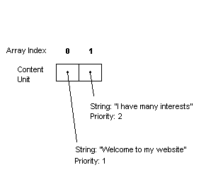
Website Design
Representing a Website
  The array structure
  Priorities
  Crossover

Slide 7
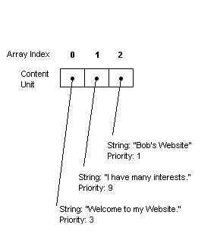
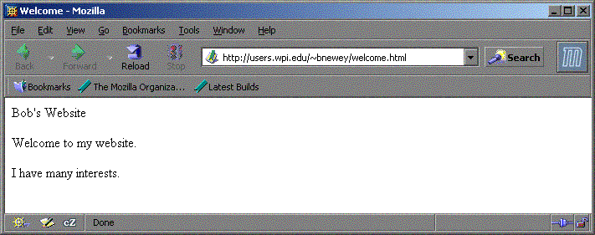
Website Design

Slide 8
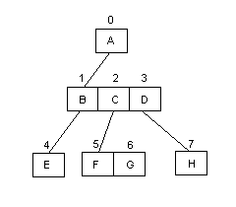
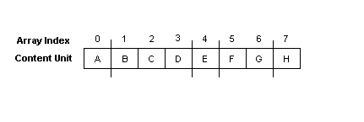
Website Design
Hierarchies
  Building the hierarchy
  Binary Flags

Slide 9
Website Design
Website Design & the Experimental Format
  Design limitations
  Support for the Experiment

Slide 10
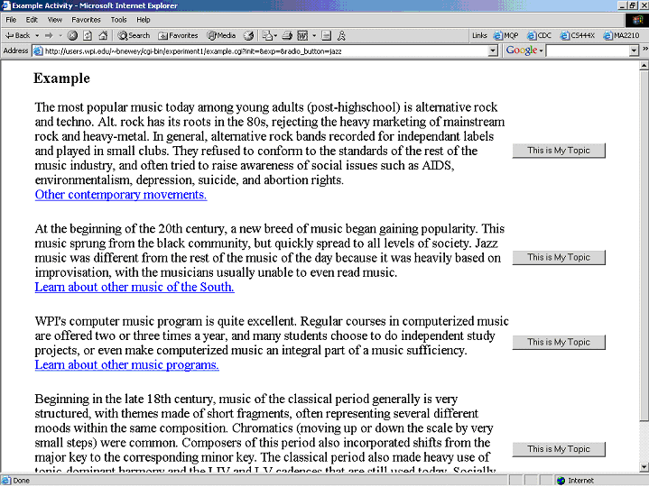
Experiment Design
Experiment #1
  Word count vs. time
Experiment #2 & #3

Slide 11
Genetic Algorithm Design
Population size: 30 [Oliver 2002; Davis 1991]
500 generations
Mutation
Crossover
Fitness function

Slide 12
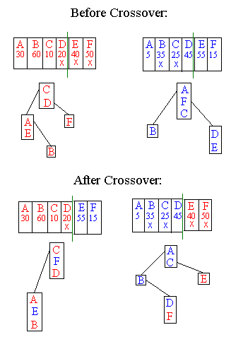

Slide 13
Fitness Function:
∑ F(W + c E P)
For each of the topics on the site:
  F = frequency from Experiment 2
  W = wordcount leading to that topic
  E = error rate for the topic in Experiment 2
  P = pagecount = number of links to get to the topic

Slide 14
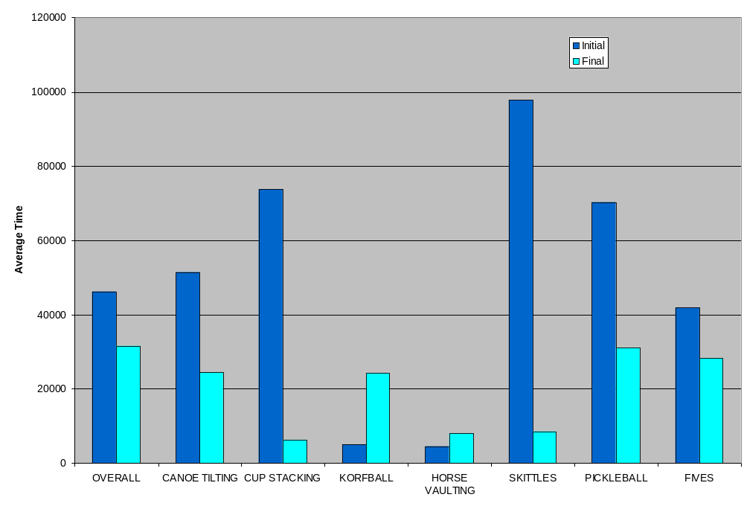

Slide 15
Results
90% confidence level
Times improved significantly on 3 of the topics.
No significant change with other topics.
No significant change in average time.

Slide 16
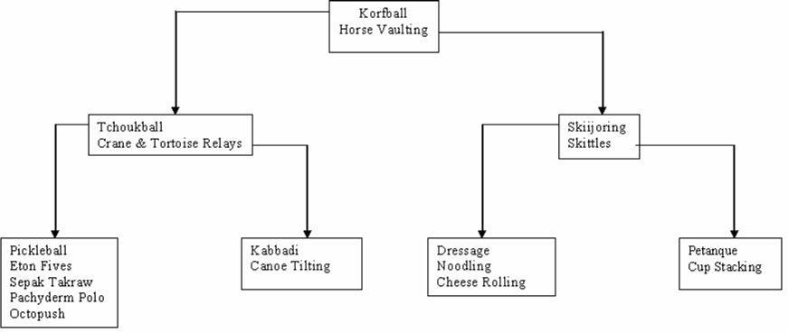
Original Site

Slide 17
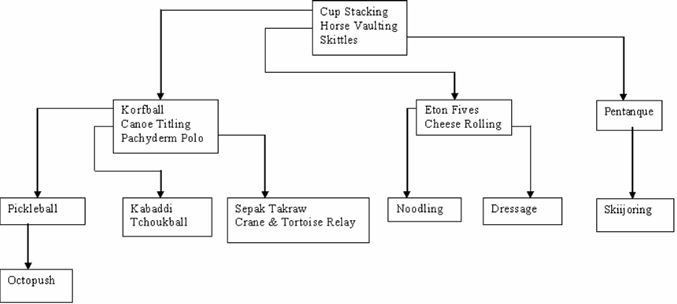
Modified Site

