Slide 1

CrewCares
Caregiving coordination, reimagined.
Seed round · April 2026
Brent O'Malley
Founder · brent@crewcares.com

Slide 2
63 million people coordinate care via group text.
It's chaos — and it's invisible.
63M
$600B
78%
unpaid family caregivers in the US
unpaid care value per year
use group text or email only
AARP / NAC, 2025
AARP
Caregiver Survey 2024
"We spent more time figuring out who was doing what than actually caring for Dad."
CrewCares
2 / 11

Slide 3


Why now
Three forces converging in 2026.
01
02
03
Aging baby boomers
AI inflection point
Incumbents are moving
10,000 Americans turn 65 every day. Their adult children are the first generation caregiving while working full-time.
LLMs finally reliable enough to parse natural language into real actions. Coordination tasks that needed humans now don't.
Caring Village shipped an AI assistant ("Julia") in late 2025. Category is shifting from community tools to agentic tools.
CrewCares
3 / 11

Slide 4
The insight
Existing apps treat caregiving like a medical records problem.
Families don't want Epic. They want a group text that gets things done.
CARING VILLAGE / LOTSA
CREWCARES
Medical records pretending to be a family app.
A family app that happens to coordinate care.
Feature-dense clinical dashboard
Medication logs, care plans, documents
Slow, desktop-first UX
Optimized for professional caregivers
Chat-first, mobile-native
Family coordination as the core loop
AI handles the friction, not the family
Built for the siblings, not the nurse
CrewCares
4 / 11

Slide 5
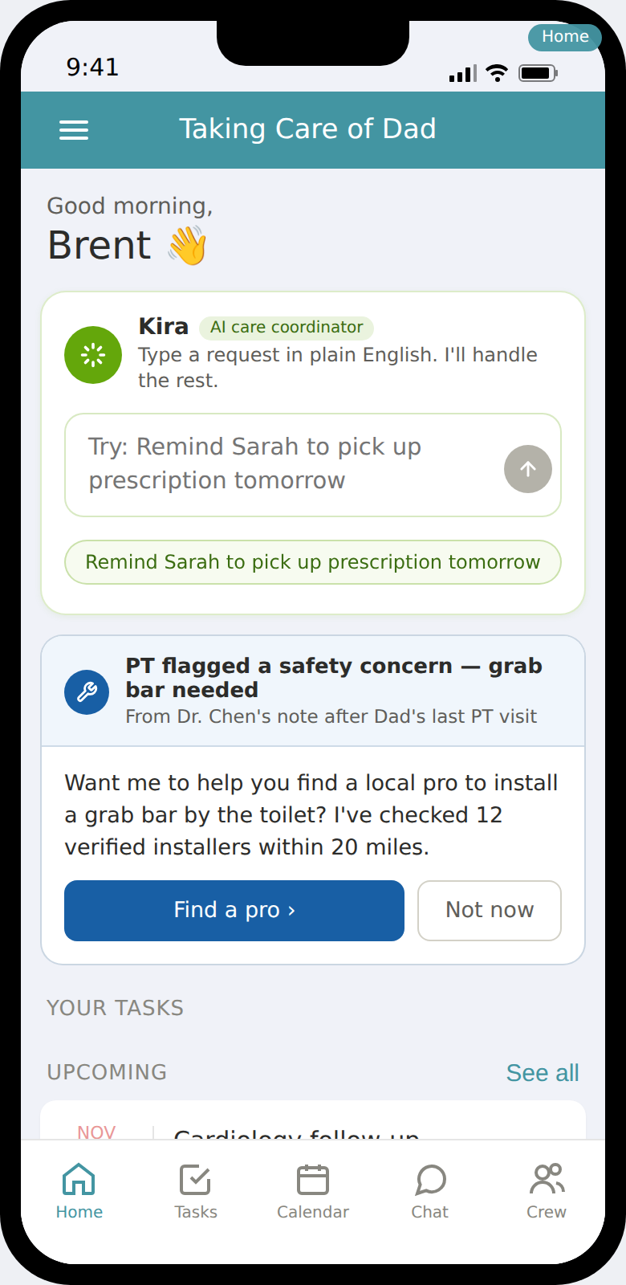
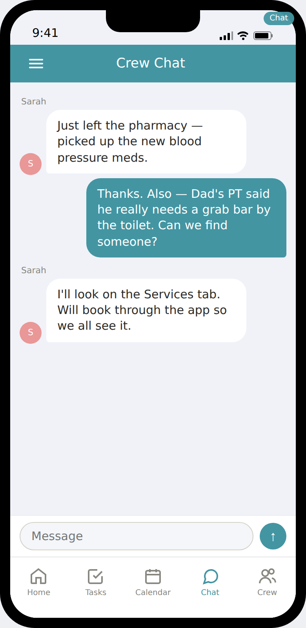
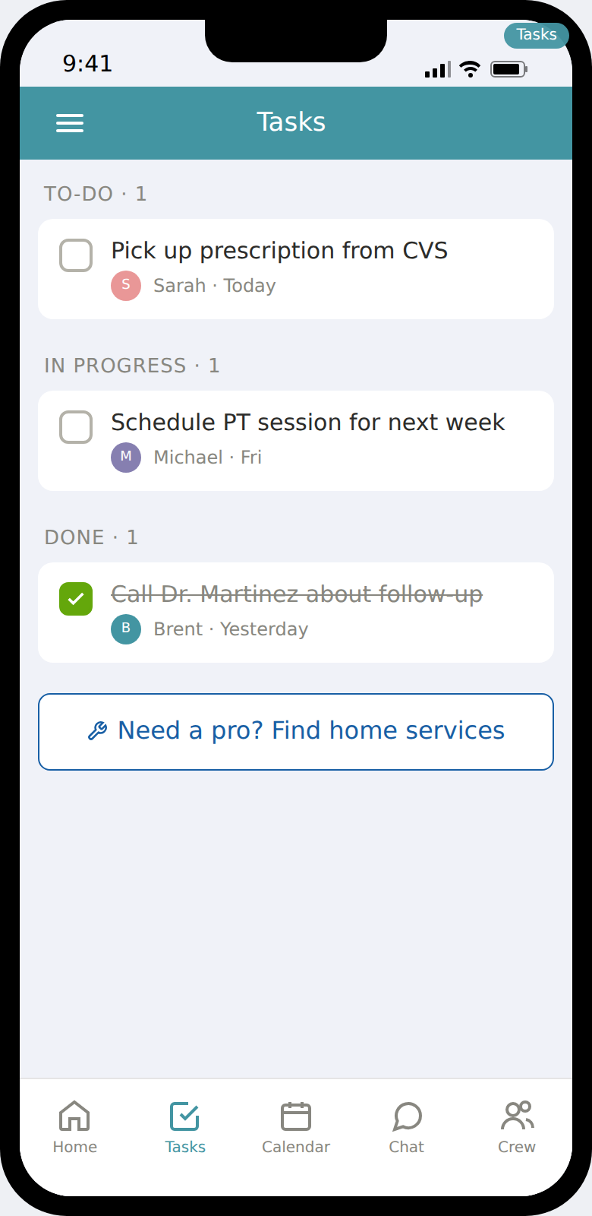




The product
Crew, tasks, calendar, chat. One focused set of tools.
Home
Daily care overview
Chat
Family-first, not a bolt-on
Tasks
Who's doing what, when
Calendar
Appointments, shared
CrewCares
5 / 11

Slide 6
Meet Kira.
The AI care coordinator living on the home screen.
1
Embedded, not hidden
Primary input on the home screen, not a separate tab. Becomes the default way to do anything.
2
Does things, not just answers them
Julia gives advice. Kira creates tasks, schedules events, books services, posts to chat.
3
Visible to the whole crew
Every Kira action posts a note in crew chat. Transparent, coordinated, trustworthy.
CrewCares
6 / 11

Slide 7
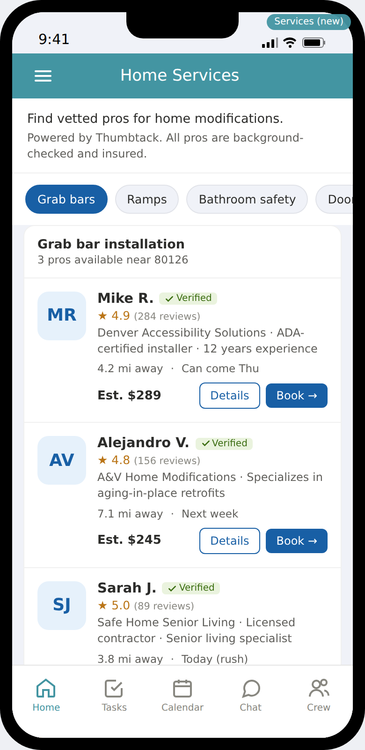
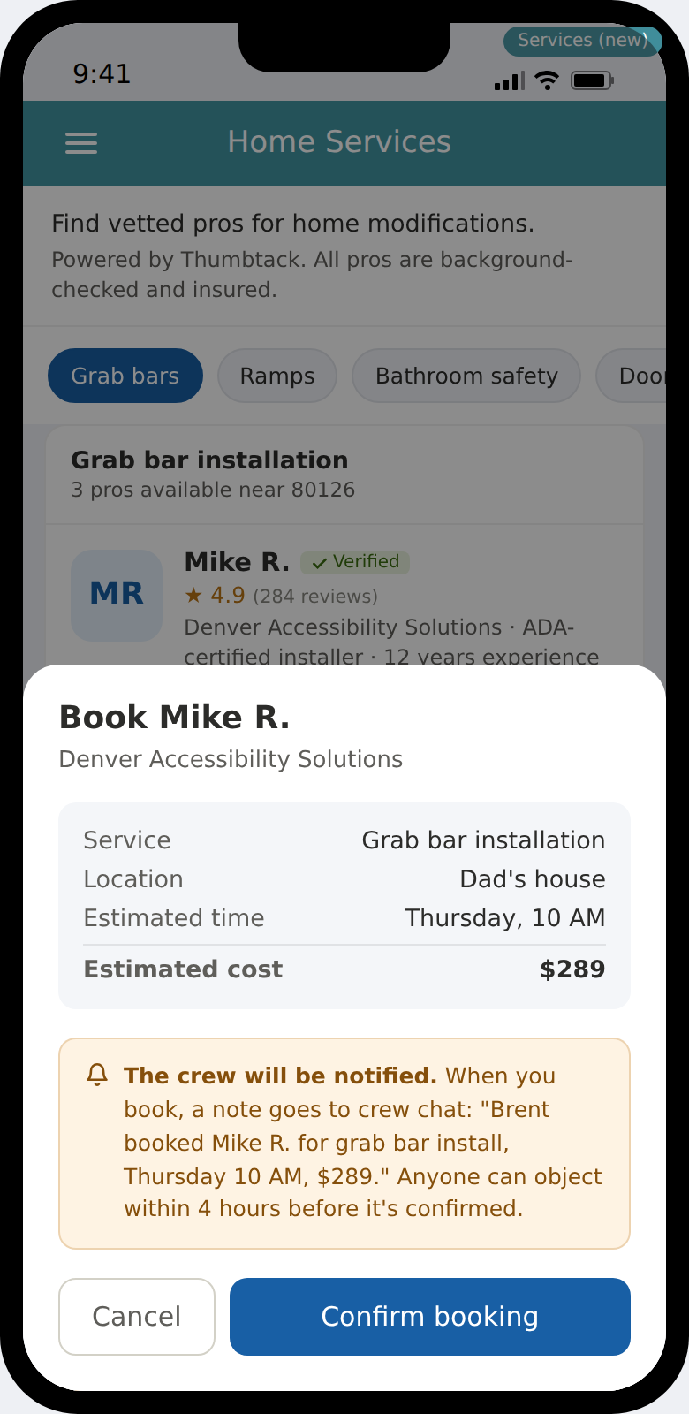
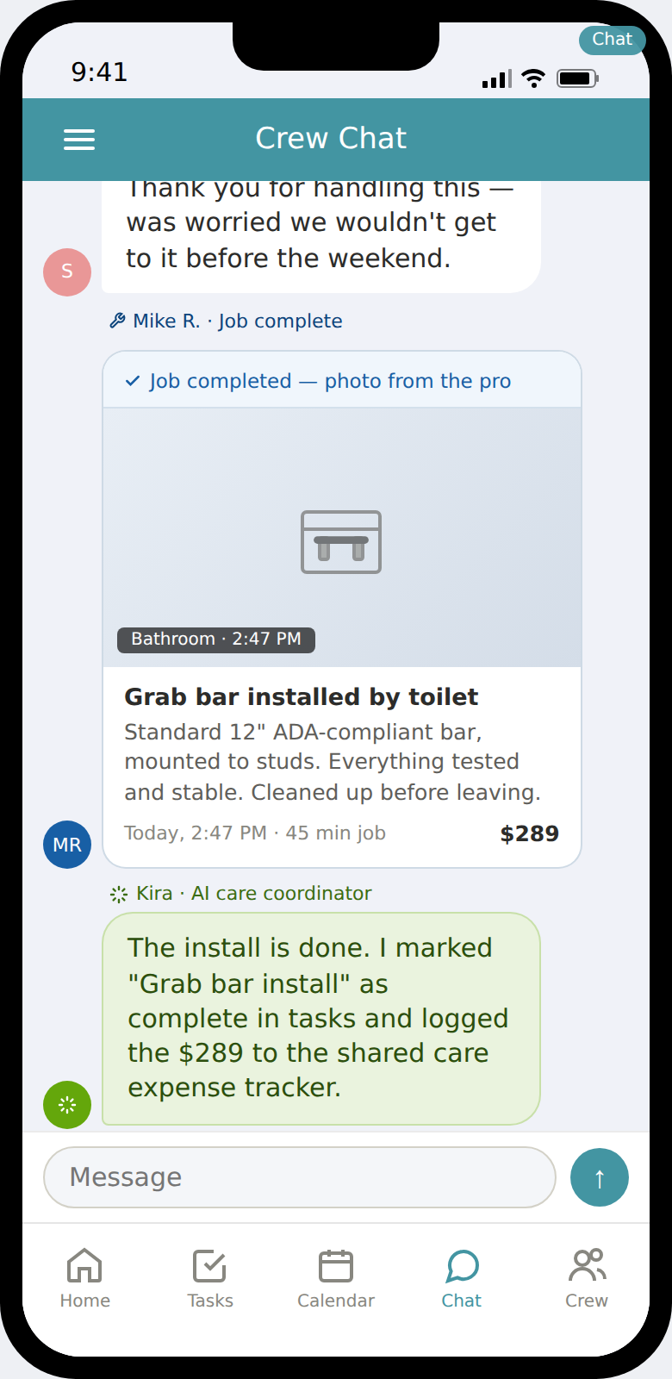
The full loop: need → pro → completion → crew.
Sarah finds the pro. Mike installs the grab bar. The photo lands in crew chat. Kira logs the expense. Nobody sends a text.
1. Find
2. Book
3. Close the loop
Vetted local pros surfaced by Kira after PT's safety note.
Anyone can book. Crew gets notified with a 4-hour objection window.
Pro sends photo to crew chat. Kira marks task done, logs $289.
CrewCares
7 / 11

Slide 8
The moat
Kira is the product, not a feature. Everything else is an expression of it.
Tasks & events
Products
Create from natural language
Amazon commerce, context-driven
Kira
AI care coordinator
the primary input
Services
Weekly summaries
Thumbtack booking + completion photos
Catch-up for absent crew members
Competitors can bolt an AI assistant onto a feature-dense app. We can't be bolted anywhere — Kira is the surface.
CrewCares
8 / 11

Slide 9
Competitive landscape
The category is unconsolidated. Everyone is positioned differently. Nobody is where we are.
Competitor | Positioning | Chat-first? | AI agent? | Commerce? | Services?
Caring Village | Medical records dashboard | No | Julia (tab) | No | No
Lotsa Helping Hands | Community-based scheduler | No | No | No | No
CaringBridge | Journal + GoFundMe | No | No | No | No
ianacare | B2B2C, employer-sold | Partial | Human (not AI) | No | No
CrewCares | Chat-first, Kira is primary input | Yes | Yes (home) | Yes | Yes
Source: CrewCares competitive analysis, April 2026
CrewCares
9 / 11

Slide 10
Market + business model
Large TAM, multi-line revenue. Subscription primary.
TAM
Three revenue lines
$19B
Total family caregiving software + services
Subscription
Primary. Family of 4+ shares one plan.
$8-12 / crew / month
SAM
Digital-native caregivers, US + Canada
$3.2B
Commerce (Amazon)
Context-driven product recs, fully disclosed.
~$3.80 / active crew / month
SOM
5-year addressable, modest share
Services (Thumbtack)
Home mods, grab bars, aging-in-place.
$180M
~$66 / active crew / year
At 50K crews: ~$5.8M ARR blended. Subscription is primary revenue at every scale.
CrewCares
10 / 11

Slide 11
The ask.
$1.5M
seed round · 18-month runway
45%
35%
20%
Engineering
Growth
Runway & ops
Rebuild backend · Kira v1 · ship iOS + Android
First 10K crews · content · caregiver partnerships
Infra, tools, contractors, founder salary
Brent O'Malley
Founder · Highlands Ranch, CO · built CrewCares after caring for his own parents
brent@crewcares.com

