Slide 1



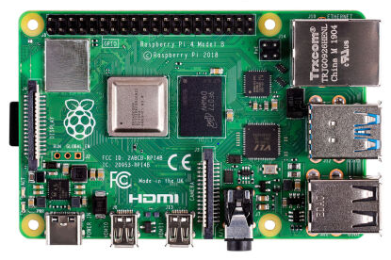
Internet
DSL Modem
DNS / DHCP Server and Load Balancer
192.168.178.1
192.168.178.5
192.168.178.0/24
Network Attached Storage (NAS)
TrueNAS Core
(TrueNAS Scale soon) ☺
Desktop PC
oc Client
AMD Ryzen PC with VMWare vSphere
Hostname | IP Address
bootstrap | 192.168.178.200
master0 | 192.168.178.210
master1 | 192.168.178.212
master2 | 192.168.178.220
worker0 | 192.168.178.220
worker1 | 192.168.178.220
worker2 | 192.168.178.220

