Slide 1
Intro, big O and arrays
Kiril Kuzmin
January 11, 2022

Slide 2
Read the syllabus
Come to classes and labs
Use iCollege
Have fun
Office hours:
Fridays, 10–11:55am
621, One Park Place
Grading
7 lab assignments | 1 is dropped | 30%
4 homeworks | 1 is dropped | 30%
Mid-term | No make-ups | 20%
Final | No make-ups | 20%

Slide 3
What is a data structure?
Data structure is a data organization that enables efficient access and modification...
©wiki

Slide 4
Examples
array
list
stack
queue
set
hash
heap
tree

Slide 5
Run-time: how to count?
Set a timer
Use run-time complexity concept
We want to make it:
Machine independent
Compiler independent
Implementation independent

Slide 6
Big O
Ignore multiplicative constants
Mind the order of the function growth

Slide 7
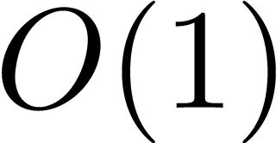
How many operations?
public static void function(int[] array) {
System.out.println(array[0]);
}

Slide 8
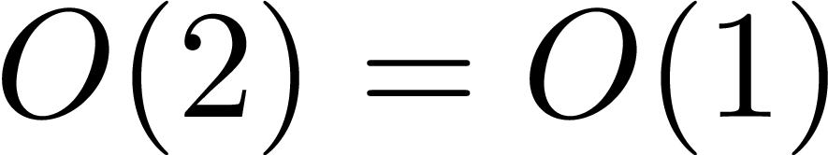
How many operations?
public static void function(int[] array) {
System.out.println(array[0]);
System.out.println(array[1]);
}

Slide 9
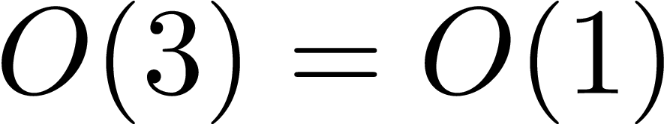
How many operations?
public static void function(int[] array) {
System.out.println(array[0]);
System.out.println(array[1]);
System.out.println(array[2]);
}

Slide 10
In case you wonder how to use function
public static void main(String[] args) {
int[] arr = {1,2,3};
int[] arr2 = new int[10];
for(int i = 0; i < arr2.length; ++i) {
arr2[i] = i * i;
}
function(arr);
function(arr2);
}

Slide 11
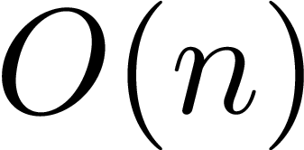
What about now?
Any kind of loop (e.g., while, do-while) produces the same complexity
public static void function(int[] array) {
for(int i = 0; i < array.length; ++i) {
System.out.println(array[i]);
}
}

Slide 12
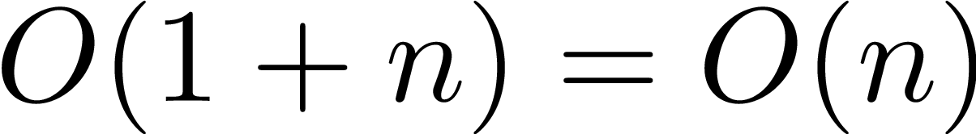
And now?
public static void function(int[] array) {
System.out.println(array[0]);
for(int i = 0; i < array.length; ++i) {
System.out.println(array[i]);
}
}

Slide 13
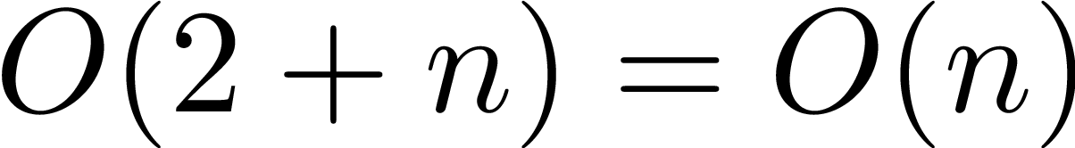
Now?
public static void function(int[] array) {
System.out.println(array[0]);
System.out.println(array[1]);
for(int i = 0; i < array.length; ++i) {
System.out.println(array[i]);
}
}

Slide 14
Two loops
public static void function(int[] array) {
for(int i = 0; i < array.length; ++i) {
System.out.println(array[array.length - i]);
}
for(int i = 0; i < array.length; ++i) {
System.out.println(array[i]);
}
}

Slide 15
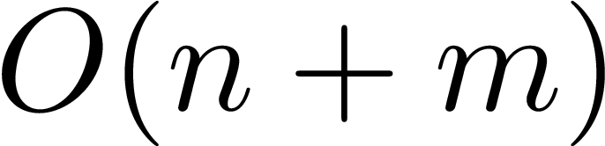
Two loops: a bit tricky
public static void function(int[] arr1, int[] arr2) {
for(int i = 0; i < arr1.length; ++i) {
System.out.println(array[array.length - i]);
}
for(int j = 0; j < arr2.length; ++j) {
System.out.println(array[j]);
}
}

Slide 16
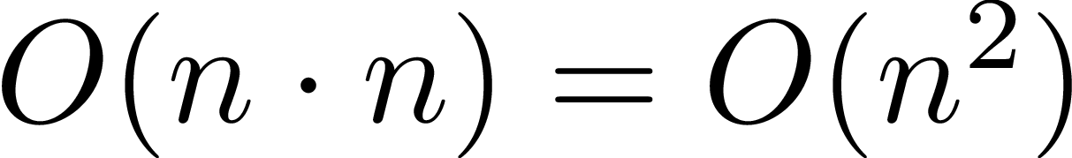
Nested loops
public static void function(int[] array) {
for(int i = 0; i < array.length; ++i) {
for(int j = 0; j < array.length; ++j) {
System.out.println(j + array[i]);
}
}
}

Slide 17
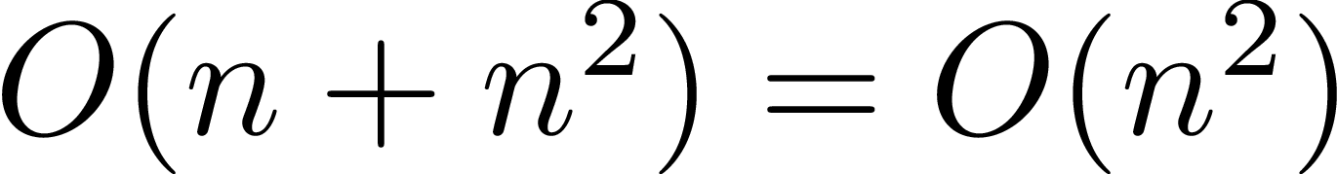
Nested loops
public static void function(int[] array) {
for(int i = 0; i < array.length; ++i) {
System.out.println(i);
for(int j = 0; j < array.length; ++j) {
System.out.println(j + array[i]);
}
}
}

Slide 18
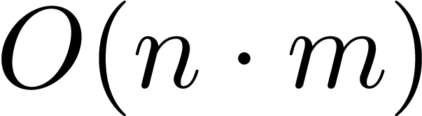
Nested loops (n,m)
public static void function(int[] arr1, int[] arr2) {
for(int i = 0; i < arr1.length; ++i) {
for(int j = 0; j < arr2.length; ++j) {
System.out.println(arr1[i] + arr2[j]);
}
}
}

Slide 19
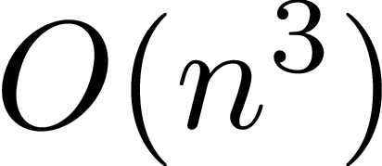
3 nested loops
public static void function(int n) {
for(int i = 0; i < n; ++i) {
for(int j = 0; j < n; ++j) {
for(int k = 0; k < n; ++k) {
System.out.println(i+j+k);
}
}
}
}

Slide 20
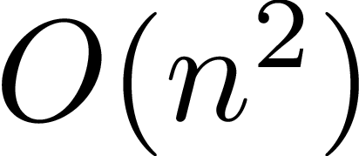
With if: worst case
public static void function(int[] arr1, int[] arr2) {
for(int i = 0; i < arr1.length; ++i) {
for(int j = 0; j < arr2.length; ++j) {
if (arr1[i] > arr2[j]) {
System.out.println(arr1[i]);
}
}
}
}

Slide 21

Space complexity
how much additional memory we use
public static void function(int n) {
for(int i = 0; i < n; ++i) {
System.out.println(i);
}
}

Slide 22

Space complexity
how much additional memory we use
public static void function(int n) {
int[] arr = new int[n];
for(int i = 0; i < n; ++i) {
arr[i] = i*i - i;
System.out.println(arr[i]);
}
}

Slide 23

Space complexity
how much additional memory we use
public static int function3(int n) {
int sum = 0;
int[] arr = new int[n];
for(int i = 0; i < n; ++i) {
arr[i] = i*i - i;
sum += arr[i];
}
return sum;
}

Slide 24
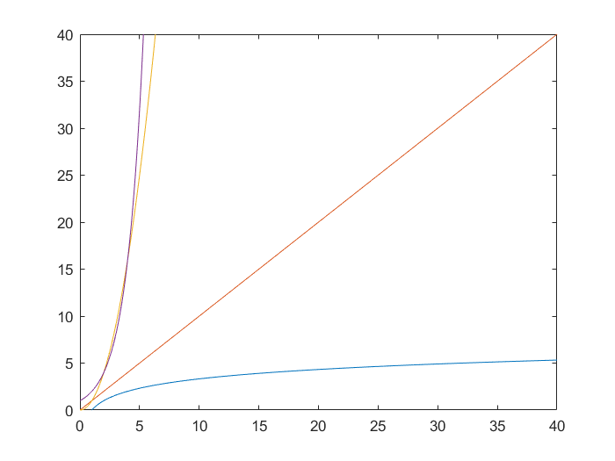
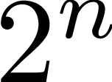
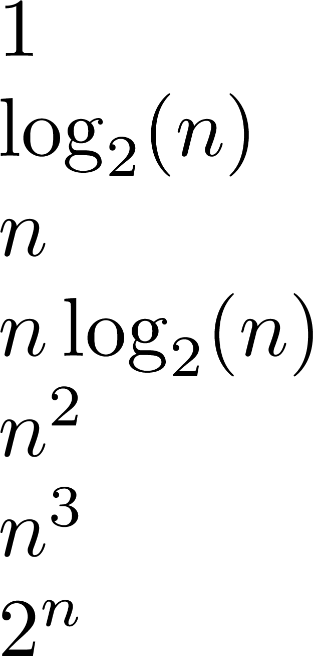
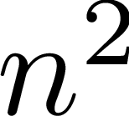

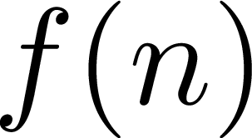
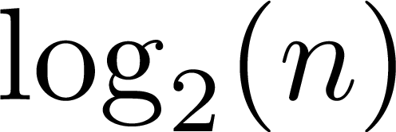
Types of growth
Getting larger

Slide 25
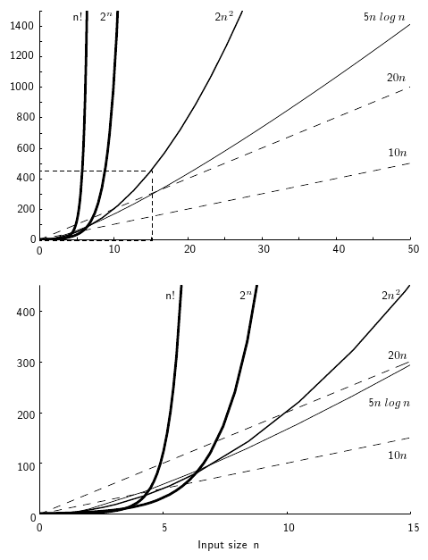
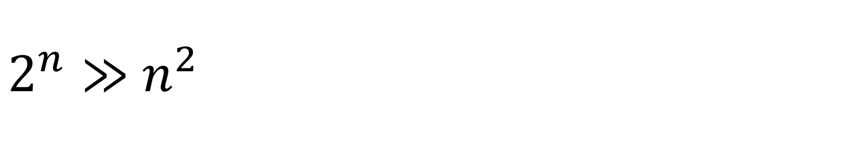
$2^{n}≫$ $n^{2}$

Slide 26
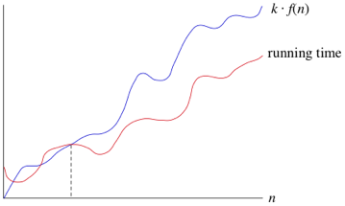
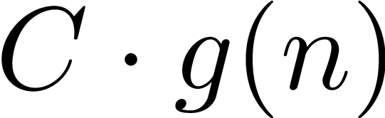


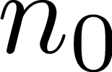
Big O: formal definition

Slide 27
Big O is not alone
 | Meaning
O | asymptotic upper bound
Θ | asymptotic exact bound
Ω | asymptotic lower bound

Slide 28
Worst case is not alone as well
Worst case | Average case | Best case
Very often used | Occasionally used | Very rarely used

Slide 29
Big O, Theta, Omega in Worst, Average, Best cases
 | Worst case | Average case | Best case
O | ☺☺☺ | ☺ | ×
Θ | ☺ | ☺ | ×
Ω | × | × | ×
☺☺☺ – used very often
– used occasionally
× – almost never used

Slide 30
What is an array?
Array is a collection of elements (of the same type) stored at contiguous memory locations
1 | 4 | 2 | 0 | 3 | 7
Items
addresses
100 | 104 | 108 | 112 | 116 | 120

Slide 31
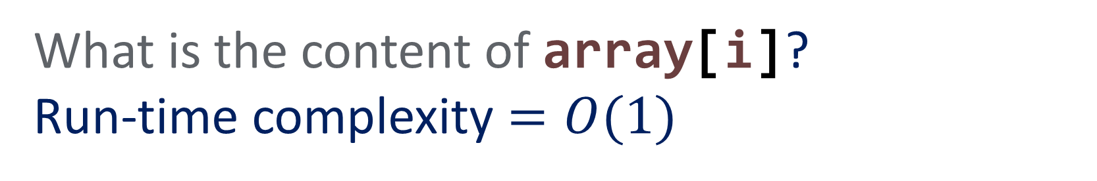
Find an element by its index (lookUp)
What is the content of array[i]?
Run-time complexity $=O(1)$
1 | 4 | 2 | 0 | 3 | 7
100 | 104 | 108 | 112 | 116 | 120
i = 4

Slide 32
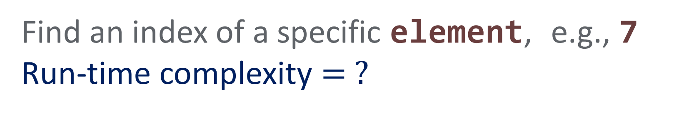
Find an index by its value (indexOf)
Find an index of a specific element, e.g., 7
Run-time complexity $= ?$
1 | 4 | 2 | 0 | 3 | 7
100 | 104 | 108 | 112 | 116 | 120

Slide 33
Find an index by its value
Find an index of a specific element, e.g., 7
Run-time complexity $= ?$
1 | 4 | 2 | 0 | 3 | 7
100 | 104 | 108 | 112 | 116 | 120

Slide 34
Find an index by its value
Find an index of a specific element, e.g., 7
Run-time complexity $= ?$
1 | 4 | 2 | 0 | 3 | 7
100 | 104 | 108 | 112 | 116 | 120

Slide 35
Find an index by its value
Find an index of a specific element, e.g., 7
Run-time complexity $= ?$
1 | 4 | 2 | 0 | 3 | 7
100 | 104 | 108 | 112 | 116 | 120

Slide 36
Find an index by its value
Find an index of a specific element, e.g., 7
Run-time complexity $= ?$
1 | 4 | 2 | 0 | 3 | 7
100 | 104 | 108 | 112 | 116 | 120

Slide 37
Find an index by its value
Find an index of a specific element, e.g., 7
Run-time complexity $= ?$
1 | 4 | 2 | 0 | 3 | 7
100 | 104 | 108 | 112 | 116 | 120
i = 5

Slide 38
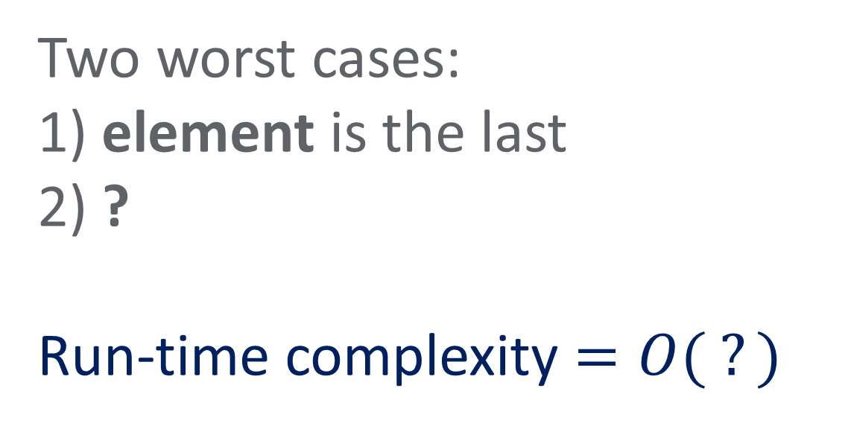
Find an index by its value
Two worst cases:
1) element is the last
2) ?
Run-time complexity $=O( ?)$

Slide 39
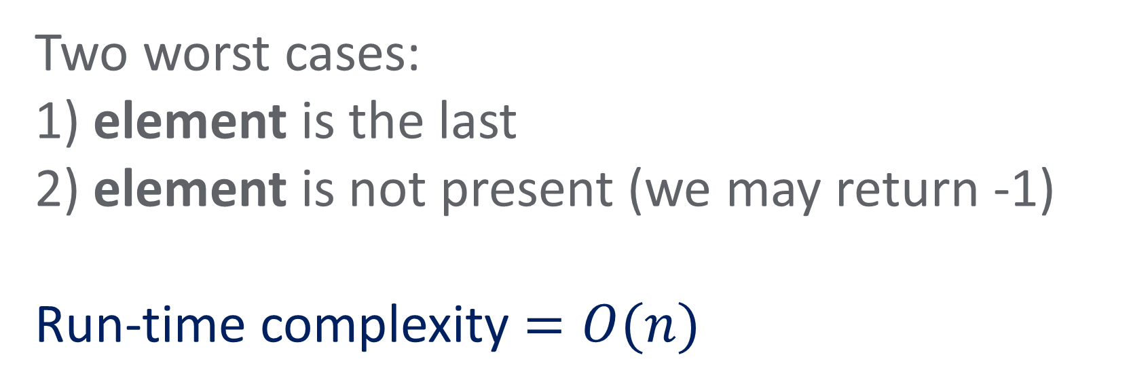
Find an index by its value
Two worst cases:
1) element is the last
2) element is not present (we may return -1)
Run-time complexity $=O(n)$

Slide 40
Find an index by its value
public int indexOf(int element) {
for(int i = 0; i < nElements; ++i) {
if (theArray[i] == element) {
return i;
}
}
return -1;
}

Slide 41

Can we do better than $O(n)$?

Slide 42
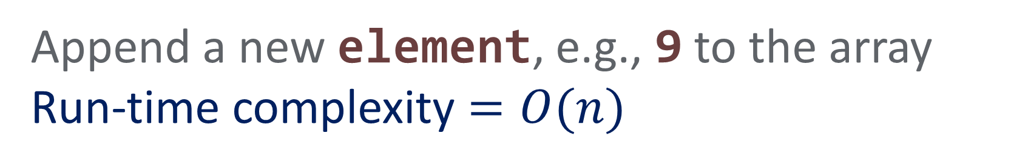
Add an element (insert)
Append a new element, e.g., 9 to the array
Run-time complexity $=O(n)$
1 | 4 | 2

Slide 43
Add an element (insert)
Append a new element, e.g., 9 to the array
Run-time complexity $=O(n)$
1 | 4 | 2 | 9

Slide 44
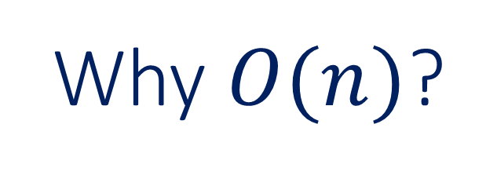
Why $O(n)$?

Slide 45

Add an element (insert)
Worst case:
not enough memory allocated $⟹$ need to resize (create a new larger array)
1 | 4 | 2 | 0

Slide 46
Add an element (insert)
1 | 4 | 2 | 0

Slide 47
Add an element (insert)
1 | 4 | 2 | 0
1

Slide 48
Add an element (insert)
1 | 4 | 2 | 0
1 | 4

Slide 49
Add an element (insert)
1 | 4 | 2 | 0
1 | 4 | 2

Slide 50
Add an element (insert)
1 | 4 | 2 | 0
1 | 4 | 2 | 0

Slide 51
Add an element (insert)
1 | 4 | 2 | 0
1 | 4 | 2 | 0 | 9

Slide 52
Add an element (insert)
1 | 4 | 2 | 0 | 9

Slide 53
Add an element (insert)
public void insert(int element) {
if (theArray.length == nElements) {
int[] doubledArray = new int[nElements * 2];
for(int i = 0; i < nElements; ++i) {
doubledArray[i] = theArray[i];
}
theArray = doubledArray;
}
theArray[nElements] = element;
nElements++;
}

Slide 54
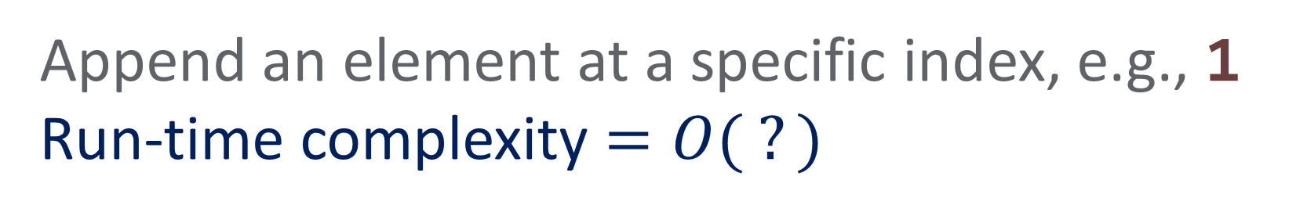
Remove an element (removeAt)
Append an element at a specific index, e.g., 1 Run-time complexity $=O( ?)$
1 | 4 | 2 | 6

Slide 55
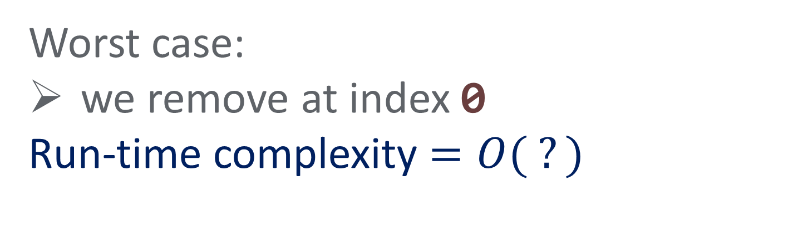
Remove an element (removeAt)
Worst case:
we remove at index 0
Run-time complexity $=O( ?)$
1 | 4 | 2 | 0

Slide 56
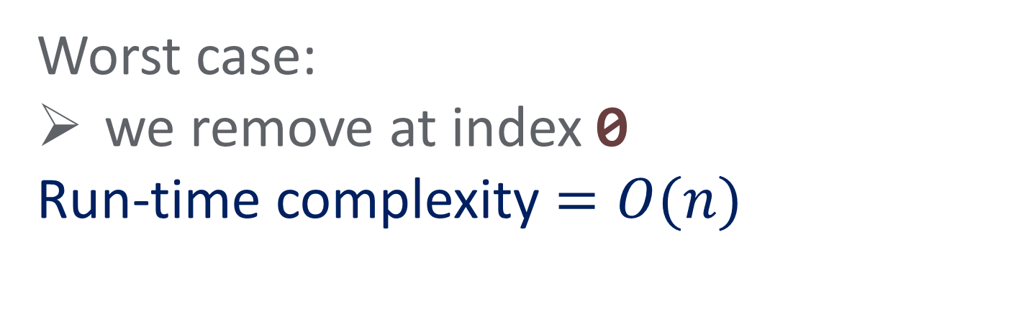
Remove an element (removeAt)
Worst case:
we remove at index 0
Run-time complexity $=O(n)$
1 | 4 | 2 | 0

Slide 57
Remove an element (removeAt)
1 | 4 | 2 | 0

Slide 58
Remove an element (removeAt)
1 | 2 | 2 | 0

Slide 59
Remove an element (removeAt)
1 | 2 | 0 | 0
The last element

Slide 60
Remove an element (removeAt)
1 | 2 | 0 | 0

Slide 61
Remove an element (removeAt)
public void removeAt(int index) {
if (index < 0 || index >= nElements) {
throw new IllegalArgumentException();
}
else {
for(int i = index; i < nElements; ++i) {
theArray[i] = theArray[i+1];
}
nElements--;
}
}

Slide 62
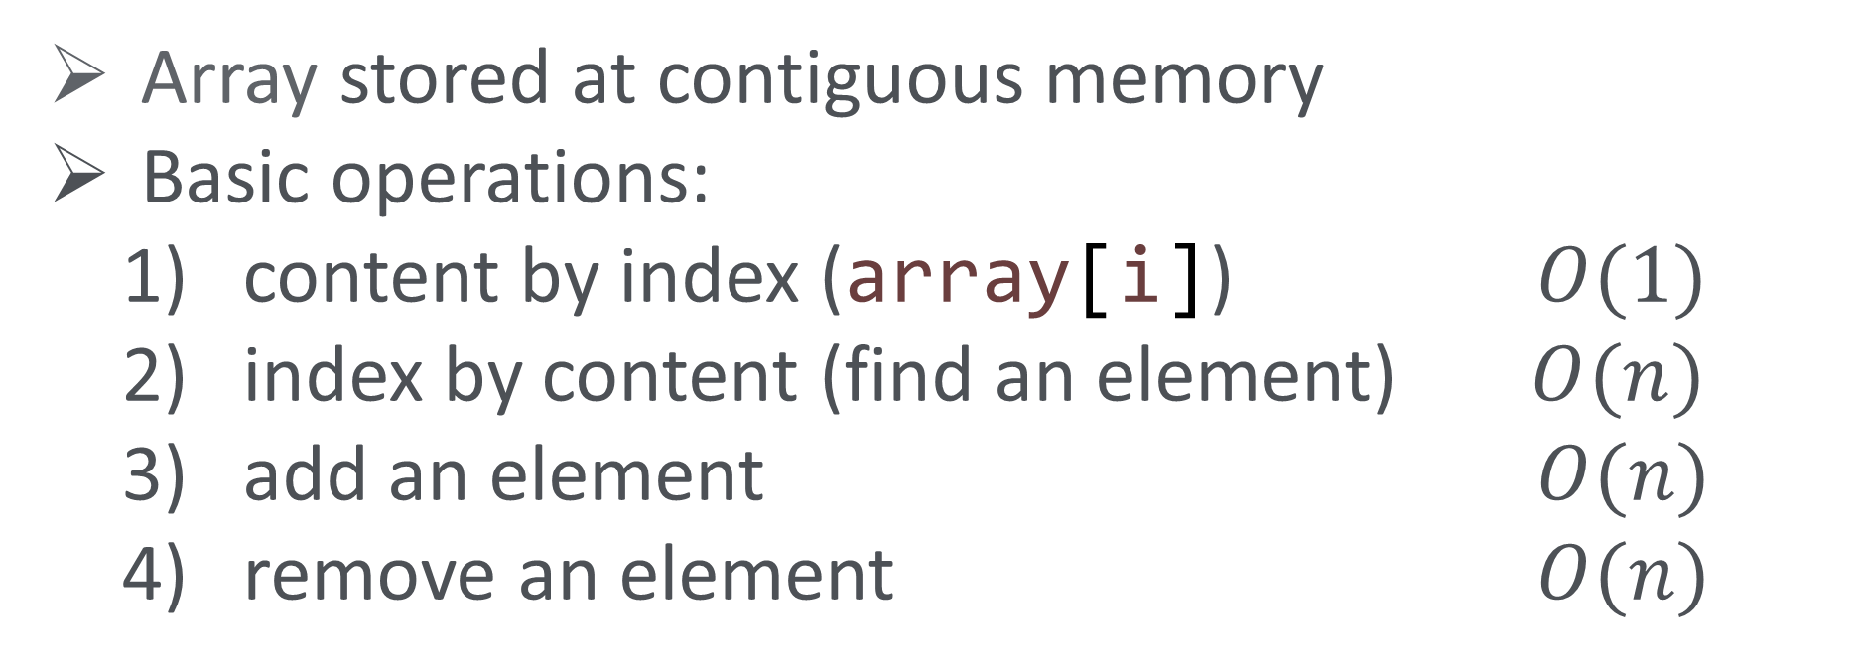
Arrays: recap
Array stored at contiguous memory
Basic operations:
content by index (array[i]) $O(1)$
index by content (find an element) $O(n)$
add an element $O(n)$
remove an element $O(n)$

Slide 63
Two good problems to think of
Find an index of a largest element in the array
Find an indices of a largest and second largest element in the array

Slide 64
And that’s it…

