Slide 1
Arrays & Linked lists
Kiril Kuzmin
January 13, 2022

Slide 2
Main textbook (optional)
Data Structures and
Algorithm Analysis in Java,
(3rd ed) by
Mark Allen Weiss
Extra reading (very optional)
Introduction to Algorithms
by
Thomas H. Cormen, Charles E. Leiserson, Ronald L. Rivest, Clifford Stein

Slide 3

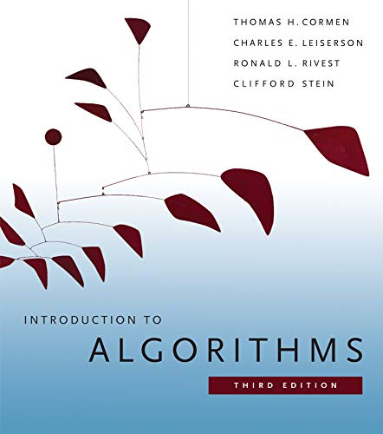






Slide 4

Warm-up
for(int i = 0; i < n; ++i) {
System.out.println(array[i]);
}
Can we say that it is in
$O(2^{n})$,
$O(n^{2})$,
$O(n)$,
$O(log n)$?
Yes
Yes
Yes
No

Slide 5
Two build-in array classes in Java
ArrayList<>
when full, grows by 50%
unsynchronized (multiple threads can access)
Vector<>
when full, grows by 100%
synchronized (only 1 thread can access)

Slide 6
ArrayList
ArrayList<Integer> arr = new ArrayList<>();
arr.add(2);
arr.add(4);
arr.add(8);
System.out.println(arr);
System.out.println(arr.get(1));
System.out.println(arr.size());
System.out.println(arr.contains(9));
System.out.println(arr.indexOf(4));
System.out.println(arr.lastIndexOf(4));

Slide 7
ArrayList (cont’d)
arr.add(9); // Inserts the specified element
arr.add(2,88); // Inserts the specified element at the specified position
arr.remove(3); // Removes the element at the specified position
var array = arr.toArray();
System.out.println(Arrays.toString(array));

Slide 8
Vector
Vector<Integer> vect = new Vector<>();
vect.add(2);
vect.add(4);
vect.add(8);
System.out.println(vect);
System.out.println(vect.get(1));
System.out.println(vect.size());
System.out.println(vect.contains(9));
System.out.println(vect.indexOf(4));
System.out.println(vect.lastIndexOf(4));

Slide 9
Vector (cont’d)
vect.add(9); // Inserts the specified element
vect.add(2,88); // Inserts the specified element at the specified position
vect.remove(3); // Removes the element at the specified position
var array = vect.toArray();
System.out.println(Arrays.toString(array));

Slide 10
Problem 1
Find an index of a largest element in the array

Slide 11
Problem 1: use the libraries
Find an index of a largest element in the array
ArrayList<Integer> arr = new ArrayList<>();
arr.add(2);
arr.add(4);
arr.add(8);
Integer maxVal = Collections.max(arr);
Integer maxIdx = arr.indexOf(maxVal);

Slide 12
Problem 1: do it yourself
Find an index of a largest element in the array
int maxVal = 0;
int maxIdx = 0;
for(int i = 0; i < arr.size(); ++i) {
if (arr.get(i) > maxVal) {
maxVal = arr.get(i);
maxIdx = i;
}
}
Is everything OK here?

Slide 13
Problem 1: do it yourself
Find an index of a largest element in the array
int maxVal = arr.get(0);
int maxIdx = 0;
for(int i = 0; i < arr.size(); ++i) {
if (arr.get(i) > maxVal) {
maxVal = arr.get(i);
maxIdx = i;
}
}
Is it a good solution?

Slide 14
Index of the [first from the left] largest element in the array
Integer minusInf = Integer.MIN_VALUE;
int maxVal = minusInf;
int maxIdx = -1;
for(int i = 0; i < arr.size(); ++i) {
if (arr.get(i) > maxVal) {
maxVal = arr.get(i);
maxIdx = i;
}
}

Slide 15
Index of the [first from the left] largest element in the array: v2
double minusInf2 = Double.NEGATIVE_INFINITY; int maxVal = (int) minusInf2;
int maxIdx = -1;
for(int i = 0; i < arr.size(); ++i) {
if (arr.get(i) > maxVal) {
maxVal = arr.get(i);
maxIdx = i;
}
}

Slide 16
Find indices of a largest and second largest elements in the array
Problem 2
int[] array = {1,6,9,-2,-5,10};
int max1Val = minusInf;
int max2Val = minusInf;
int max1Idx = -1;
int max2Idx = -1;
for(int i = 0; i < array.length; ++i) {
if (array[i] > max2Val) {
if (array[i] <= max1Val) {
max2Val = array[i];
max2Idx = i;
}
else {
max1Val = array[i];
max1Idx = i;
}
}
}

Slide 17
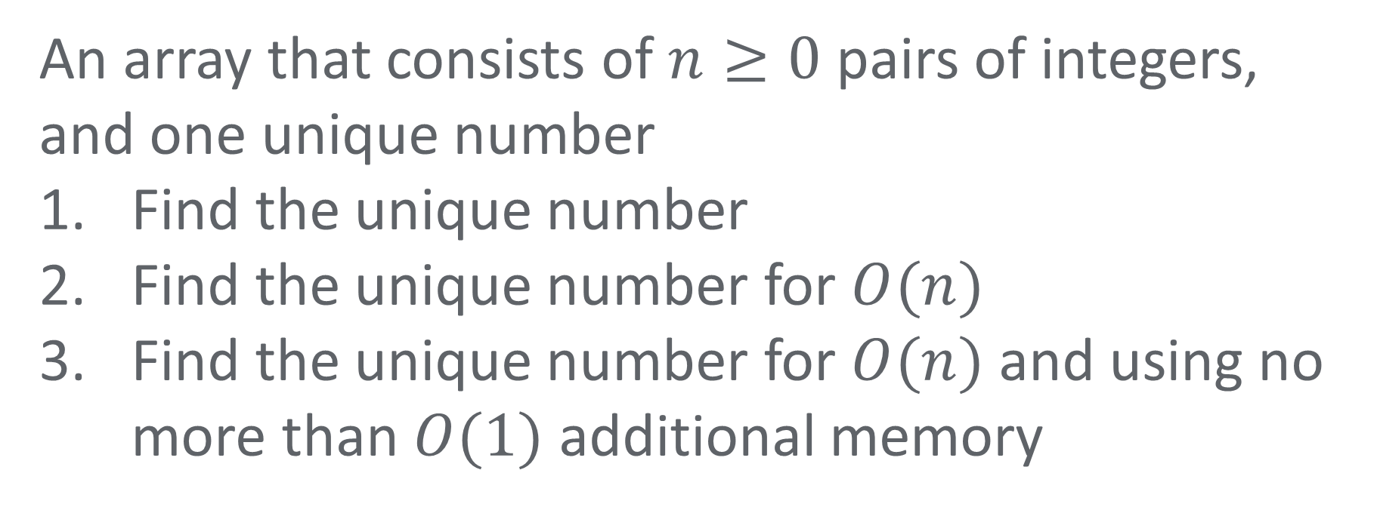
Fun problem from Lab 1
An array that consists of $n≥0$ pairs of integers, and one unique number
Find the unique number
Find the unique number for $O(n)$
Find the unique number for $O(n)$ and using no more than $O(1)$ additional memory

Slide 18
Why this solution is not good?
public static int uniqueElem(int[] items) {
for(int i = 0; i < items.length; ++i) {
if (isUnique(items[i], items)) {
return(items[i]);
}
}
return minusInf;
}
public static boolean isUnique(int element, int[] items) {
boolean sawOnce = false;
for(int i = 0; i < items.length; ++i) {
if (element == items[i]) {
if (sawOnce) {
return false;
}
else {
sawOnce = true;
}
}
}
return true;
}

Slide 19
Surprising solution
int uniqueItem = 0;
for(int i = 0; i < array.length; ++i) {
uniqueItem ^= array[i];
}

Slide 20
Double traversal: the rain problem
The walls are represented by an array of integers, each number in the array is the height of the wall. If it starts to rain, how much water can the puddles between the walls hold?
5
4
2
2
3
2
2
2
1
2
1
1

Slide 21
What is a linked list?
Linked list is a sequence of elements (called nodes) connected by links
The elements
may have different types;
do not need to be stored at a contiguous memory location

Slide 22
What is a linked list?
node #1
node #2
node #3
680
200
440
1 | 200
5 | 440
7 | null
object / value
address
object / value
address
object / value
address
Each node points to (references) the next node

Slide 23
What is a linked list?
head
tail
680
200
440
1 | 200
5 | 440
7 | null
object / value
address
object / value
address
object / value
address

Slide 24
LookUp
Find an element by
value
index*
Run-time complexity
?
?
680
200
440
1 | 200
5 | 440
7 | null
object / value
address
object / value
address
object / value
address
*index = specified position in the list

Slide 25
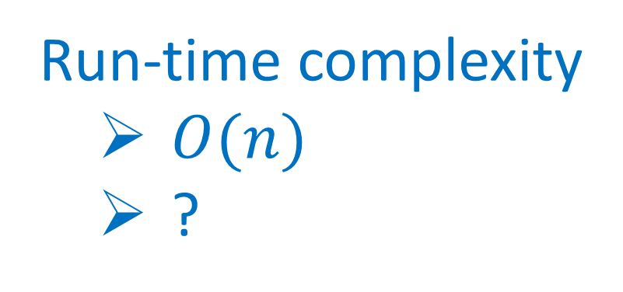
LookUp
Find an element by
value
index
Run-time complexity
$O(n)$
?
680
200
440
1 | 200
5 | 440
7 | null
object / value
address
object / value
address
object / value
address

Slide 26

LookUp
Find an element by
value
index
Run-time complexity
$O(n)$
$O(n)$
680
200
440
1 | 200
5 | 440
7 | null
object / value
address
object / value
address
object / value
address

Slide 27
Insert
924
8 | ?
at the beginning
680
200
...
1 | 200
5 | 440

Slide 28
Insert
at the beginning
924
8 | 680
head
680
200
...
1 | 200
5 | 440

Slide 29
Insert
Run-time complexity
?
at the beginning
head
head
924
680
200
...
8 | 680
1 | 200
5 | 440

Slide 30

Insert
Run-time complexity
$O(1)$
at the beginning
head
924
680
200
...
8 | 680
1 | 200
5 | 440

Slide 31
Insert
at the end
924
8 | ?
tail
200
440
5 | 440
7 | null
...

Slide 32
Insert
at the end
924
8 | null
tail
200
440
5 | 440
7 | null
...

Slide 33
Insert
at the end
tail
tail
200
440
924
5 | 440
7 | ?
8 | null
...

Slide 34
Insert
Run-time complexity
?
at the end
tail
200
440
924
5 | 440
7 | 924
8 | null
...

Slide 35

Insert
Run-time complexity
$O(1)$*
at the end
tail
200
440
924
5 | 440
7 | 924
8 | null
...

Slide 36
Insert
in the middle (after a specific node)
924
8 | ?
200
440
...
5 | 440
7 | 720
...

Slide 37
Insert
in the middle (after a specific node)
200
924
440
...
5 | 924
8 | 440
7 | 720
...

Slide 38
Insert
Run-time complexity
?
in the middle
200
924
440
...
5 | 924
8 | 440
7 | 720
...

Slide 39

Insert
Run-time complexity
$O(n)$
in the middle
200
924
440
...
5 | 924
8 | 440
7 | 720
...

Slide 40
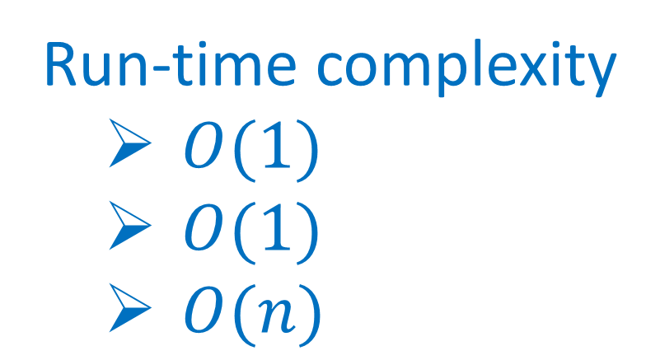
Insert
Run-time complexity
$O(1)$
$O(1)$
$O(n)$
at the beginning
at the end
in the middle

Slide 41
Delete
from the beginning
head
head
924
680
200
...
8 | 680
1 | 200
5 | 440

Slide 42
Delete
Run-time complexity
?
from the beginning
924
8 | null
head
680
200
...
1 | 200
5 | 440

Slide 43

Delete
Run-time complexity
$O(1)$
from the beginning
924
8 | null
head
680
200
...
1 | 200
5 | 440

Slide 44
Delete
from the end
tail
200
440
924
5 | 440
7 | 924
8 | null
...

Slide 45
Delete
from the end
tail
tail
200
440
924
5 | 440
7 | null
8 | null
...

Slide 46
Delete
from the end
924
8 | null
tail
200
440
5 | 440
7 | null
...

Slide 47
Delete
Run-time complexity
?
from the end
924
8 | null
tail
200
440
5 | 440
7 | null
...

Slide 48

Delete
Run-time complexity
$O(n)$
from the end
924
8 | null
tail
200
440
5 | 440
7 | null
...

Slide 49
Delete
from the middle
200
924
440
...
5 | 924
8 | 440
7 | 720
...

Slide 50
Delete
from the middle
924
8 | null
200
440
...
5 | ?
7 | 720
...

Slide 51
Delete
Run-time complexity
?
from the middle
200
440
...
5 | 440
7 | 720
...

Slide 52
Delete
Run-time complexity
$O(n)$
from the middle
200
440
...
5 | 440
7 | 720
...

Slide 53
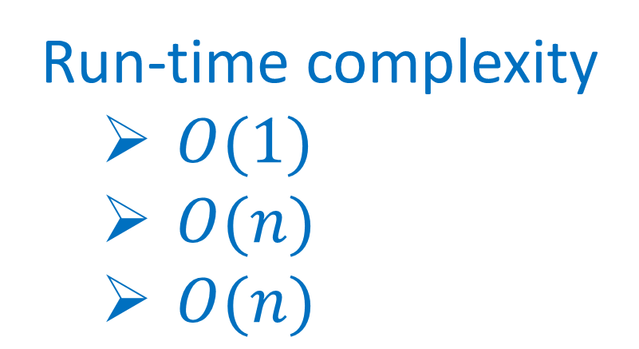
Delete
Run-time complexity
$O(1)$
$O(n)$
$O(n)$
from the beginning
from the end
from the middle

Slide 54
LinkedList
LinkedList<Integer> theList = new LinkedList<>();
theList.addLast(2);
theList.addLast(4);
theList.addLast(8);
System.out.println(theList);
System.out.println(theList.size());
System.out.println(theList.contains(9));
System.out.println(theList.indexOf(4));

Slide 55
LinkedList (cont’d)
theList.addFirst(9);
theList.add(10);
theList.remove(3);
theList.removeLast();
theList.removeFirst();
System.out.println(theList);
var array = theList.toArray();
System.out.println(Arrays.toString(array));

Slide 56
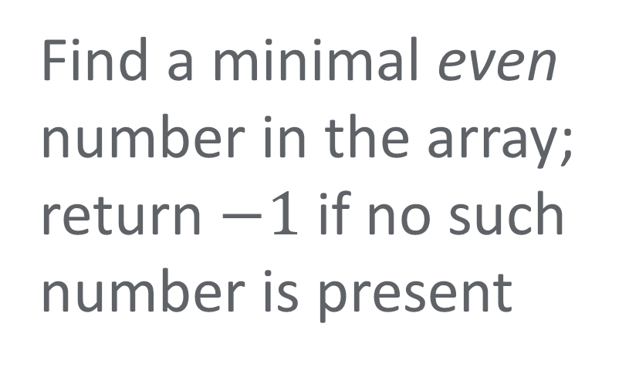
Two good problems to think of
Find a minimal even number in the array; return $−1$ if no such number is present
Find the most frequent element in the array

Slide 57
And that’s it…

