Slide 1
Implementation of linked lists
Kiril Kuzmin
January 18, 2022

Slide 2
Warm up
Which is better to use an array or a linked list if we want
to perform the following as quickly as possible:
look up an element by its index?
delete the last element?
delete the first element?
add two elements at the end?
add n elements at the end?
Array
Array
Linked list
Linked list
Array*
Array
Linked list

Slide 3

Problem 1
Find a minimal even number in the array; return $−1$ if no such number is present
private static Integer plusInf = Integer.MAX_VALUE;
public static int evenMin(int[] arr) {
int currentMin = plusInf;
for (int i = 0; i < arr.length; ++i) {
if (arr[i] % 2 == 0 && arr[i] < currentMin) {
currentMin = arr[i];
}
}
return currentMin;
}
What is wrong here?

Slide 4
Fix 1
public static int evenMin(int[] arr) {
int currentMin = plusInf;
for (int i = 0; i < arr.length; ++i) {
if (arr[i] % 2 == 0 && arr[i] < currentMin) {
currentMin = arr[i];
}
}
if (currentMin == plusInf) {
return -1;
}
return currentMin;
}

Slide 5
Fix 2
public static int evenMin(int[] arr) {
int currentMin = plusInf;
boolean noEven = true;
for (int i = 0; i < arr.length; ++i) {
if (arr[i] % 2 == 0 && arr[i] < currentMin) {
currentMin = arr[i];
noEven = false;
}
}
if (noEven) {
return -1;
}
return currentMin;
}

Slide 6
Fix 3
public static int evenMin(int[] arr) {
int currentMin = -1;
for (int i = 0; i < arr.length; ++i) {
if (arr[i] % 2 == 0 && (arr[i] < currentMin || currentMin == -1)) {
currentMin = arr[i];
}
}
return currentMin;
}

Slide 7
Fix 4
public static int evenMin(int[] arr) {
int currentMin = -1;
boolean noEven = true;
for (int i = 0; i < arr.length; ++i) {
if (arr[i] % 2 == 0 && (arr[i] < currentMin || noEven)) {
currentMin = arr[i];
noEven = false;
}
}
return currentMin;
}

Slide 8
Problem 2
Find the most frequent element in the array
public static int mostFrequent(int[] arr) {
int bestFreq = 0;
int bestElement = arr[0];
for (int i = 0; i < arr.length; i++) {
int currentFreq = 0;
for (int j = 0; j < arr.length; j++) {
if (arr[j] == arr[i]) {
currentFreq++;
}
}
if (currentFreq > bestFreq) {
bestFreq = currentFreq;
bestElement = arr[i];
}
}
return bestElement;
}
Complexity?
Potential problems
with this solution?

Slide 9
Problem 2: what if?
Would it help us if
the array was sorted?
we could quickly calculate frequencies for all elements?
more than a half of the elements were identical?*
* i.e., the frequency of the most frequent element (called majority element) was $>\frac{n}{2}$

Slide 10
Problem 2: sorted array
public static int mostFrequent(int[] arr) {
int bestFreq = 0;
int currentFreq = 0;
int bestElement = arr[0];
int current = arr[0];
for (int i = 0; i < arr.length; i++) {
if (current == arr[i]) {
currentFreq++;
if (currentFreq > bestFreq) {
bestFreq = currentFreq;
bestElement = current;
}
} else {
current = arr[i];
currentFreq = 1;
}
}
return bestElement;
}

Slide 11
Problem 2: quickly calculate frequencies
It can be done with a hash table!
Coming soon...

Slide 12
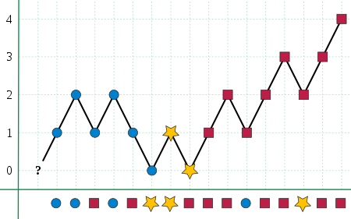
Problem 2: majority element
Boyer–Moore (1981)
majority vote algorithm!

Slide 13

Majority vote algorithm
©National Geographic

Slide 14
Problem 2: majority element
For each arr[i] do:
if (count == 0)
majorityElem = arr[i]
count = 1
else
if (majorityElem == arr[i])
count++
else
count--

Slide 15
Problem 2: majority element
public static int majorityVote(int[] arr) {
int majorityElem = arr[0];
int count = 0;
for (int i = 0; i < arr.length; i++) {
if (count == 0) {
majorityElem = arr[i];
count = 1;
} else {
if (majorityElem == arr[i]) {
count++;
} else {
count--;
}
}
}
return majorityElem;
}

Slide 16
Linked Lists Implementation

Slide 17
Node
public class Node {
private int value;
private Node next;
}

Slide 18
Node + LinkedList
public class Node {
private int value;
private Node next;
}
public class LinkedList {
private Node head; // first
private Node tail; // last
}

Slide 19
Node: better way
public class LinkedList {
private Node head; // first
private Node tail; // last
public class Node {
private int value;
private Node next;
}
}

Slide 20
Node: better way
public class LinkedList {
private Node head; // first
private Node tail; // last
private class Node {
private int value;
private Node next;
}
}

Slide 21
AddLast
public void addLast(int value) {
Node node = new Node();
}
How to transfer the value (set value for node)?

Slide 22
AddLast
public class LinkedList {
private Node head; // first
private Node tail; // last
private class Node {
private int value;
private Node next;
}
}
public void addLast(int value) {
Node node = new Node();
}

Slide 23
AddLast
public class LinkedList {
private Node head; // first
private Node tail; // last
private class Node {
private int value;
private Node next;
public Node(int value) {
this.value = value;
}
}
}
public void addLast(int value) {
Node node = new Node(value);
}

Slide 24
AddLast
public void addLast(int value) {
Node node = new Node(value);
if (head == null) {
head = node;
tail = node;
} else {
}
}
?

Slide 25
AddLast
public void addLast(int value) {
Node node = new Node(value);
if (head == null) {
head = node;
tail = node;
} else {
tail.next = node;
tail = node;
}
}

Slide 26
AddLast: final improvements
private boolean isEmpty() {
return (head == null);
}
public void addLast(int value) {
Node node = new Node(value);
if (isEmpty()) {
head = node;
tail = node;
} else {
tail.next = node;
tail = node;
}
}

Slide 27
AddLast: final improvements
public void addLast(int value) {
Node node = new Node(value);
if (isEmpty()) {
head = tail = node;
} else {
tail.next = node;
tail = node;
}
}

Slide 28
public class LinkedList {
private Node head; // first
private Node tail; // last
private class Node {
private int value;
private Node next;
public Node(int value) {
this.value = value;
}
}
private boolean isEmpty() {
return (head == null);
}
public void addLast(int value) {
Node node = new Node(value);
if (isEmpty()) {
head = tail = node;
} else {
tail.next = node;
tail = node;
}
}
}
All together
We are going to add other methods here

Slide 29
AddFirst
public void addFirst(int value) {
Node node = new Node(value);
if (isEmpty()) {
head = tail = node;
} else {
}
}
?

Slide 30
AddFirst
public void addFirst(int value) {
Node node = new Node(value);
if (isEmpty()) {
head = tail = node;
} else {
node.next = head;
head = node;
}
}

Slide 31
IndexOf
public int indexOf(int value) {
int index = 0;
Node current = head;
while (current != null) {
}
}
?

Slide 32
IndexOf
public int indexOf(int value) {
int index = 0;
Node current = head;
while (current != null) {
if (current.value == value) {
return index;
}
}
}
?

Slide 33
IndexOf
public int indexOf(int value) {
int index = 0;
Node current = head;
while (current != null) {
if (current.value == value) {
return index;
}
index++;
current = current.next;
}
return -1;
}

Slide 34
Contains
public boolean contains(int value) {
...
}

Slide 35
Contains
public boolean contains(int value) {
return (indexOf(value) != -1);
}

Slide 36
DeleteFirst
public void deleteFirst() {
if (isEmpty()) {
...
}
if (head == tail) {
...
}
head.next = null;
}
?!

Slide 37
DeleteFirst
public void deleteFirst() {
if (isEmpty()) {
...
}
if (head == tail) {
...
}
Node second = head.next;
head.next = null;
head = second;
}

Slide 38
Add imports:
DeleteFirst
import java.util.NoSuchElementException;
public void deleteFirst() {
if (isEmpty()) {
throw new NoSuchElementException();
}
if (head == tail) {
head = tail = null;
return;
}
Node second = head.next;
head.next = null;
head = second;
}

Slide 39
DeleteLast
public void deleteLast() {
if (isEmpty()) {
throw new NoSuchElementException();
}
if (head == tail) {
head = tail = null;
return;
}
// find the last but one
// change the links
}

Slide 40
DeleteLast
public void deleteLast() {
if (isEmpty()) {
throw new NoSuchElementException();
}
if (head == tail) {
head = tail = null;
return;
}
// find the last but one
lastButOne.next = null;
tail = lastButOne;
}

Slide 41
DeleteLast
public void deleteLast() {
if (isEmpty()) {
throw new NoSuchElementException();
}
if (head == tail) {
head = tail = null;
return;
}
Node current = head;
while (current.next.next != null) {
current = current.next;
}
Node lastButOne = current;
current.next = null;
tail = current;
}

Slide 42
DeleteLast: introduce previous
public void deleteLast() {
if (isEmpty()) {
throw new NoSuchElementException();
}
if (head == tail) {
head = tail = null;
return;
}
Node lastButOne = previous(tail);
lastButOne.next = null;
tail = lastButOne;
}

Slide 43
public void deleteLast() {
if (isEmpty()) {
throw new NoSuchElementException();
}
if (head == tail) {
head = tail = null;
return;
}
Node lastButOne = previous(tail);
lastButOne.next = null;
tail = lastButOne;
}
public Node previous(Node node) {
if (isEmpty()) {
throw new NoSuchElementException();
}
Node current = head;
while (current.next != node) {
if (current.next == null) {
throw new NoSuchElementException();
}
current = current.next;
}
return current;
}

Slide 44
public void deleteLast() {
if (isEmpty()) {
throw new NoSuchElementException();
}
if (head == tail) {
head = tail = null;
return;
}
Node lastButOne = previous(tail);
lastButOne.next = null;
tail = lastButOne;
}
private boolean hasNext(Node node) {
return (node.next != null);
}
public Node previous(Node node) {
if (isEmpty()) {
throw new NoSuchElementException();
}
Node current = head;
while (current.next != node) {
if (!hasNext(current)) {
throw new NoSuchElementException();
}
current = current.next;
}
return current;
}

Slide 45
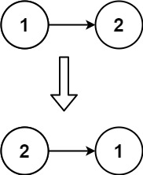
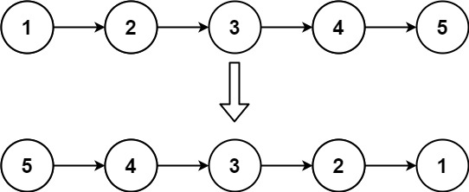
Reverse

Slide 46
Reverse
head
tail
680
200
440
1 | 200
5 | 440
7 | null
INPUT:
680
200
440
1 | null
5 | 680
7 | 200
OUTPUT:
tail
head

Slide 47
Reverse
head
tail
680
200
440
1 | 200
5 | 440
7 | null
INPUT:
1240
460
578
7 | 460
5 | 578
1 | null
OUTPUT:
head
tail

Slide 48
Reverse
Ideas:
Use the methods you already have
mirror the list to the left
delete the right part of the mirrored list
Use temporality nodes to reassign links
initialize three pointers: previous, current, next
reassign links as the pointers move from left to right
do not forget about limit cases
A new list
create a new list = reversed version of the original
delete the original list
put the reversed list in place of the original

Slide 49
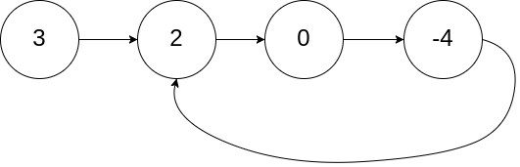
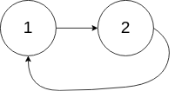
Good problem to think of
Given a linked list, determine if it has a cycle

Slide 50
Move a line (a few lines) up/down
be in the line (select the lines)
press Alt + ↑ / Alt + ↓
System.out.println()
type sysout
press Ctrl + Space
Include imports
press Ctrl + Shift + O
Rename a variable (within its scope)
select the variable
press Alt + Shift + R
change its name
press Enter
Generate getters and setters
right click on your code
Source->Generate getters and setters
Eclipse shortcuts
Check out the video

Slide 51
And that’s it…

