Slide 1


NibSV
Group 1 : Fritz, Eric, Chris, Zev, Peter, Brent

Slide 2
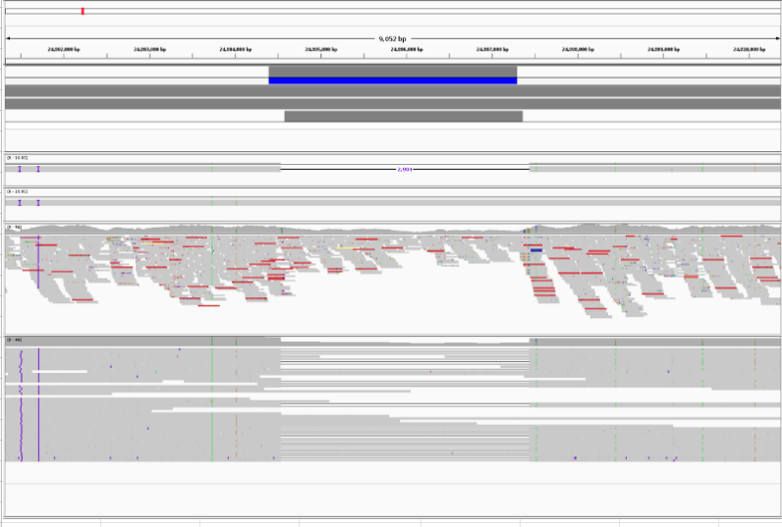
The question
Long accurate reads (PacBio HiFi) reads are phenomenal at sequence resolving structural variants. Can we use long-read SV calls as a prior to boost the power of detection in short reads?
Credit: Mark Chaisson

Slide 3
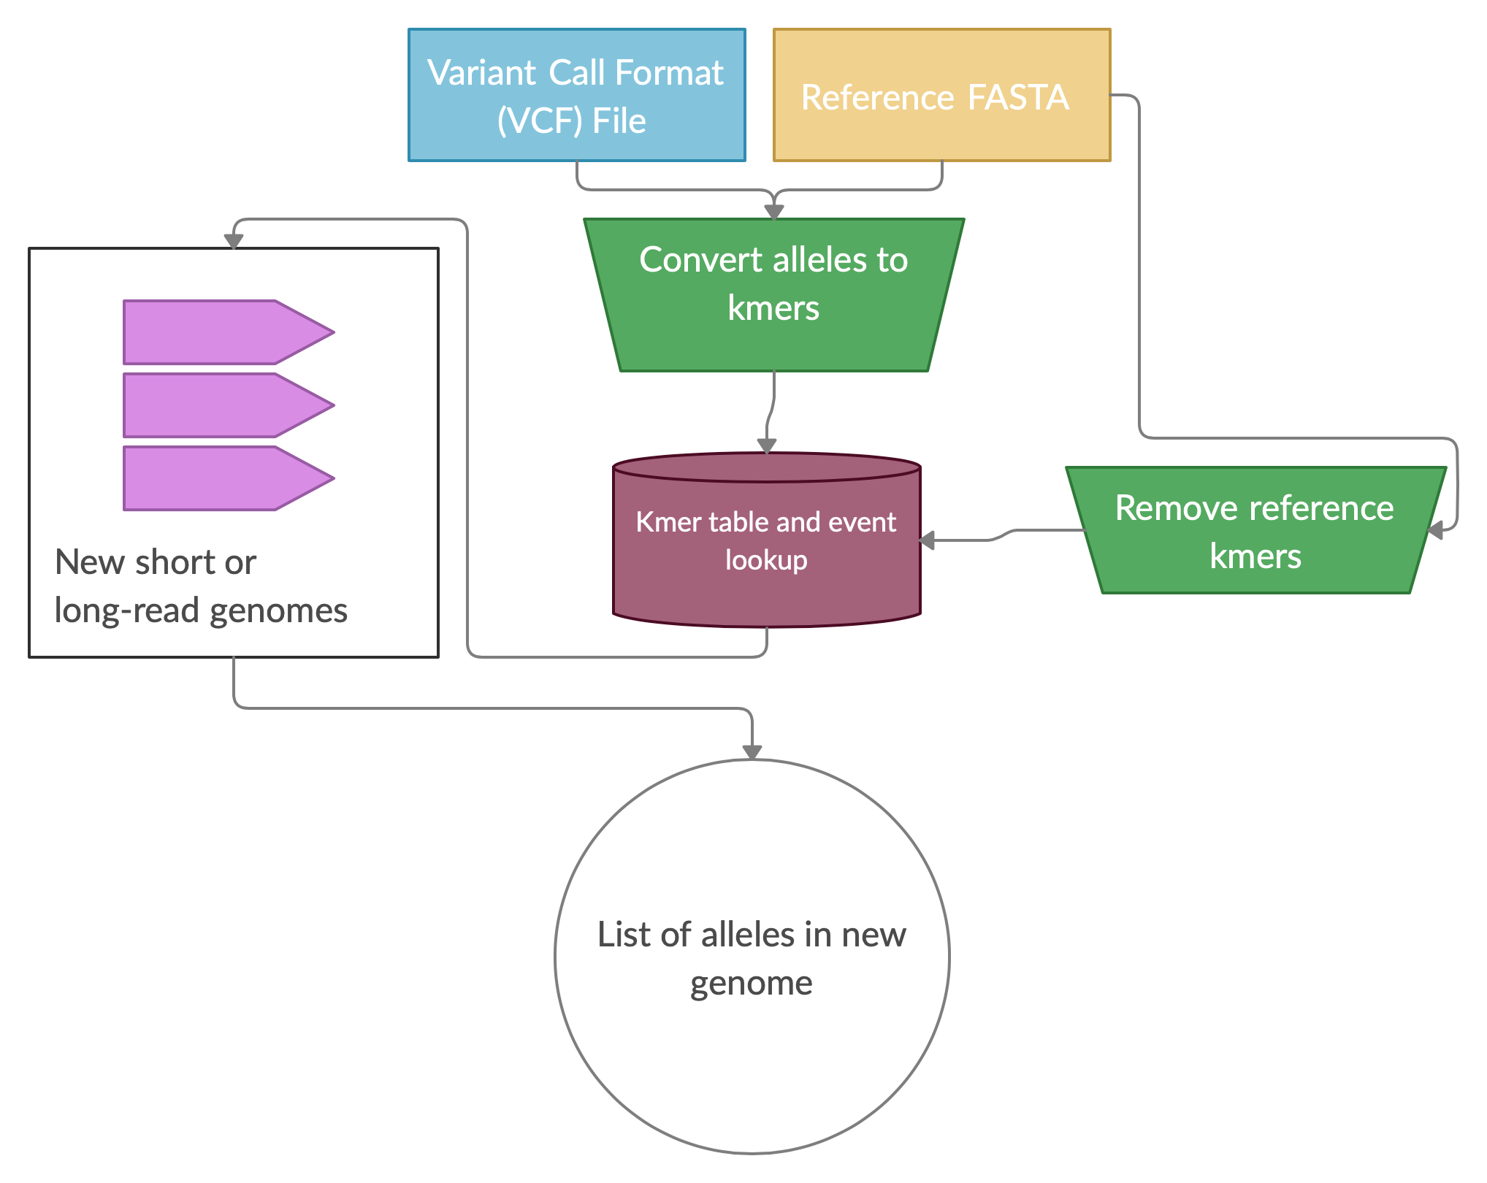
The approach
Digest long-read sv alleles into kmers
Remove reference kmers
Read new sequencing file
Type SV specific alleles

Slide 4
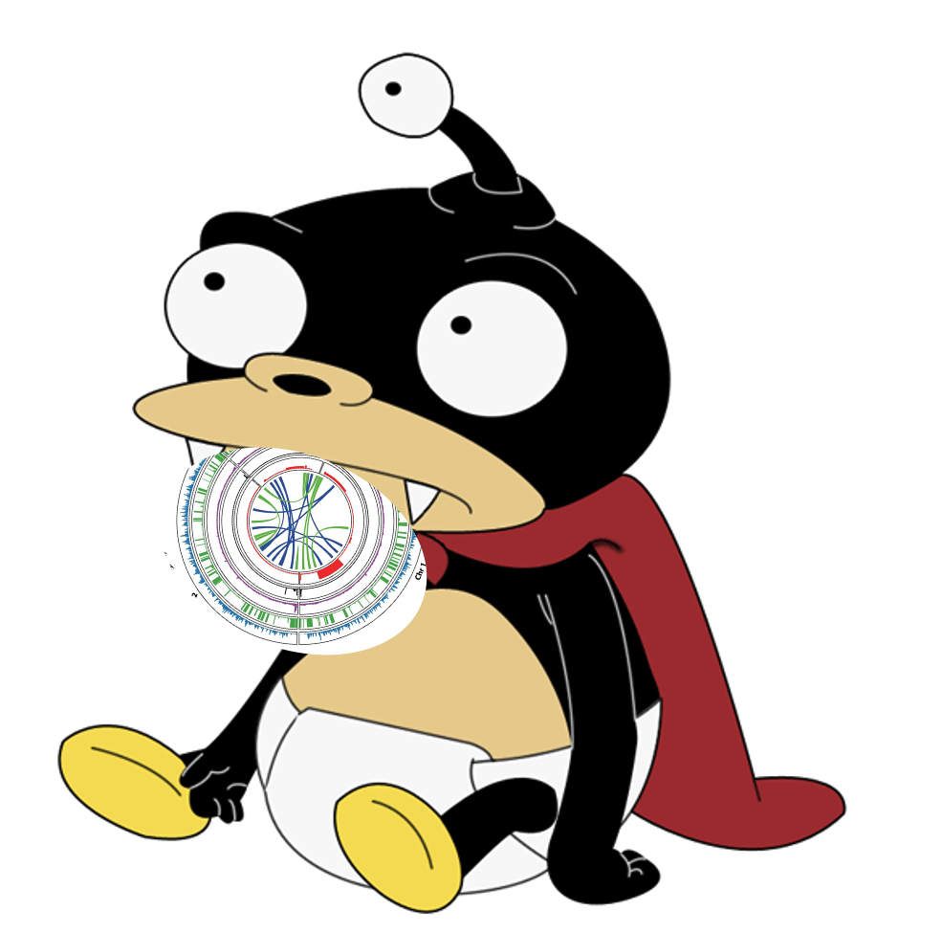
NibSV – A single tool
Written in NIM
Trivial Install
SV kmer database can be shipped to others for genotyping
1,334 lines of code in three days
Chromosome 22 runtime (no threading)
Build ref + type | Type
12m24.835s | 2m8.916s

Slide 5
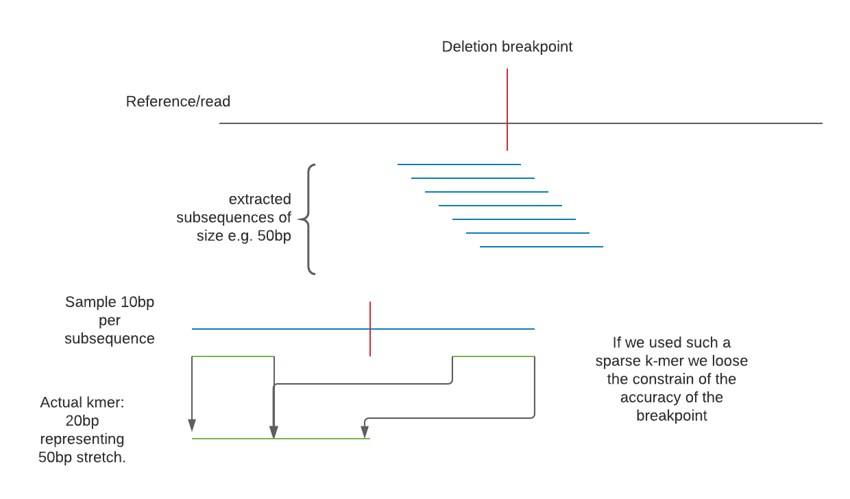
Spaced kmers for variable breakpoints

Slide 6
NibSV benchmarked on HG002 CHR22
Use all GIAB PBSV calls for HG002 HiFi : awesome base pair accuracy
BND,INV,DEL,INS…
Use whole reference genome
ONLY use chr22 BAM – short reads
False positive:
A SV that NibSV types outside chromosome 22
True positive:
A SV on chromosome 22 that NibSV types

Slide 7

The spirit of a hackaton
Benchmarking data at 3pm
Benchmarking data at 3AM
grep -v '#' output.vcf | grep READ | grep '=v1' | perl -lane '$_ =~ /NIB_READ_SUPPORTS=(.*?)\s+/ ; print $_ if $1 > 20' | perl -lane 'print $F[0]' | sort | uniq -c | sort -k1,1n | grep -v alt | grep -v "chrUn" | grep -v "random" | grep -v "chr22" | awk '{SUM += $1}END{print SUM}'
I’m too old to be doing this….

Slide 8
NibSV is 99% accurate (read count > 20)
class | Explanation | Count
True positives | Retyped in chr22 short read data | 1,321
False positives | SVs typed outside chr22 | 269
True negatives | SVs not typed outside chr22 | 52,429
False negatives | SVs not typed on chr22 | 257
Accuracy = (TP + TN)/(TP + TN + FP + FN) = 99%
Precision = 79%
Recall = 80%

Slide 9
TODOs
NibSV looks very promising! However, still a few things left to do
Finish bug fixes
Add genotype field
Improve output annotation information, and verify
More benchmarks

