Slide 1


NibSV
Group 1 : Fritz, Eric, Chris, Zev, Peter, Samantha, Brent

Slide 2
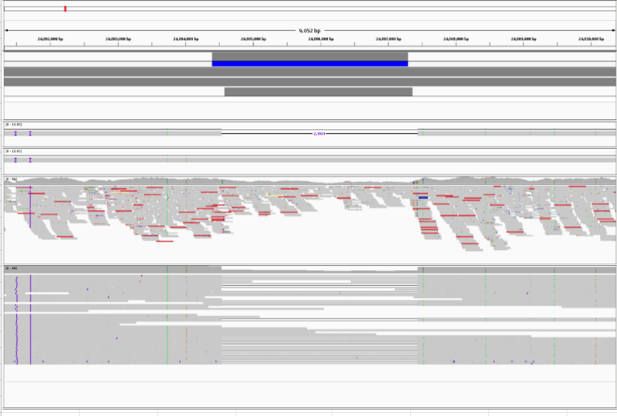
The question
Long accurate reads (PacBio HiFi) reads are phenomenal at sequence resolving structural variants. Can we use long-read SV calls as a prior to boost the power of detection in short reads?
Credit: professor Chaisson

Slide 3
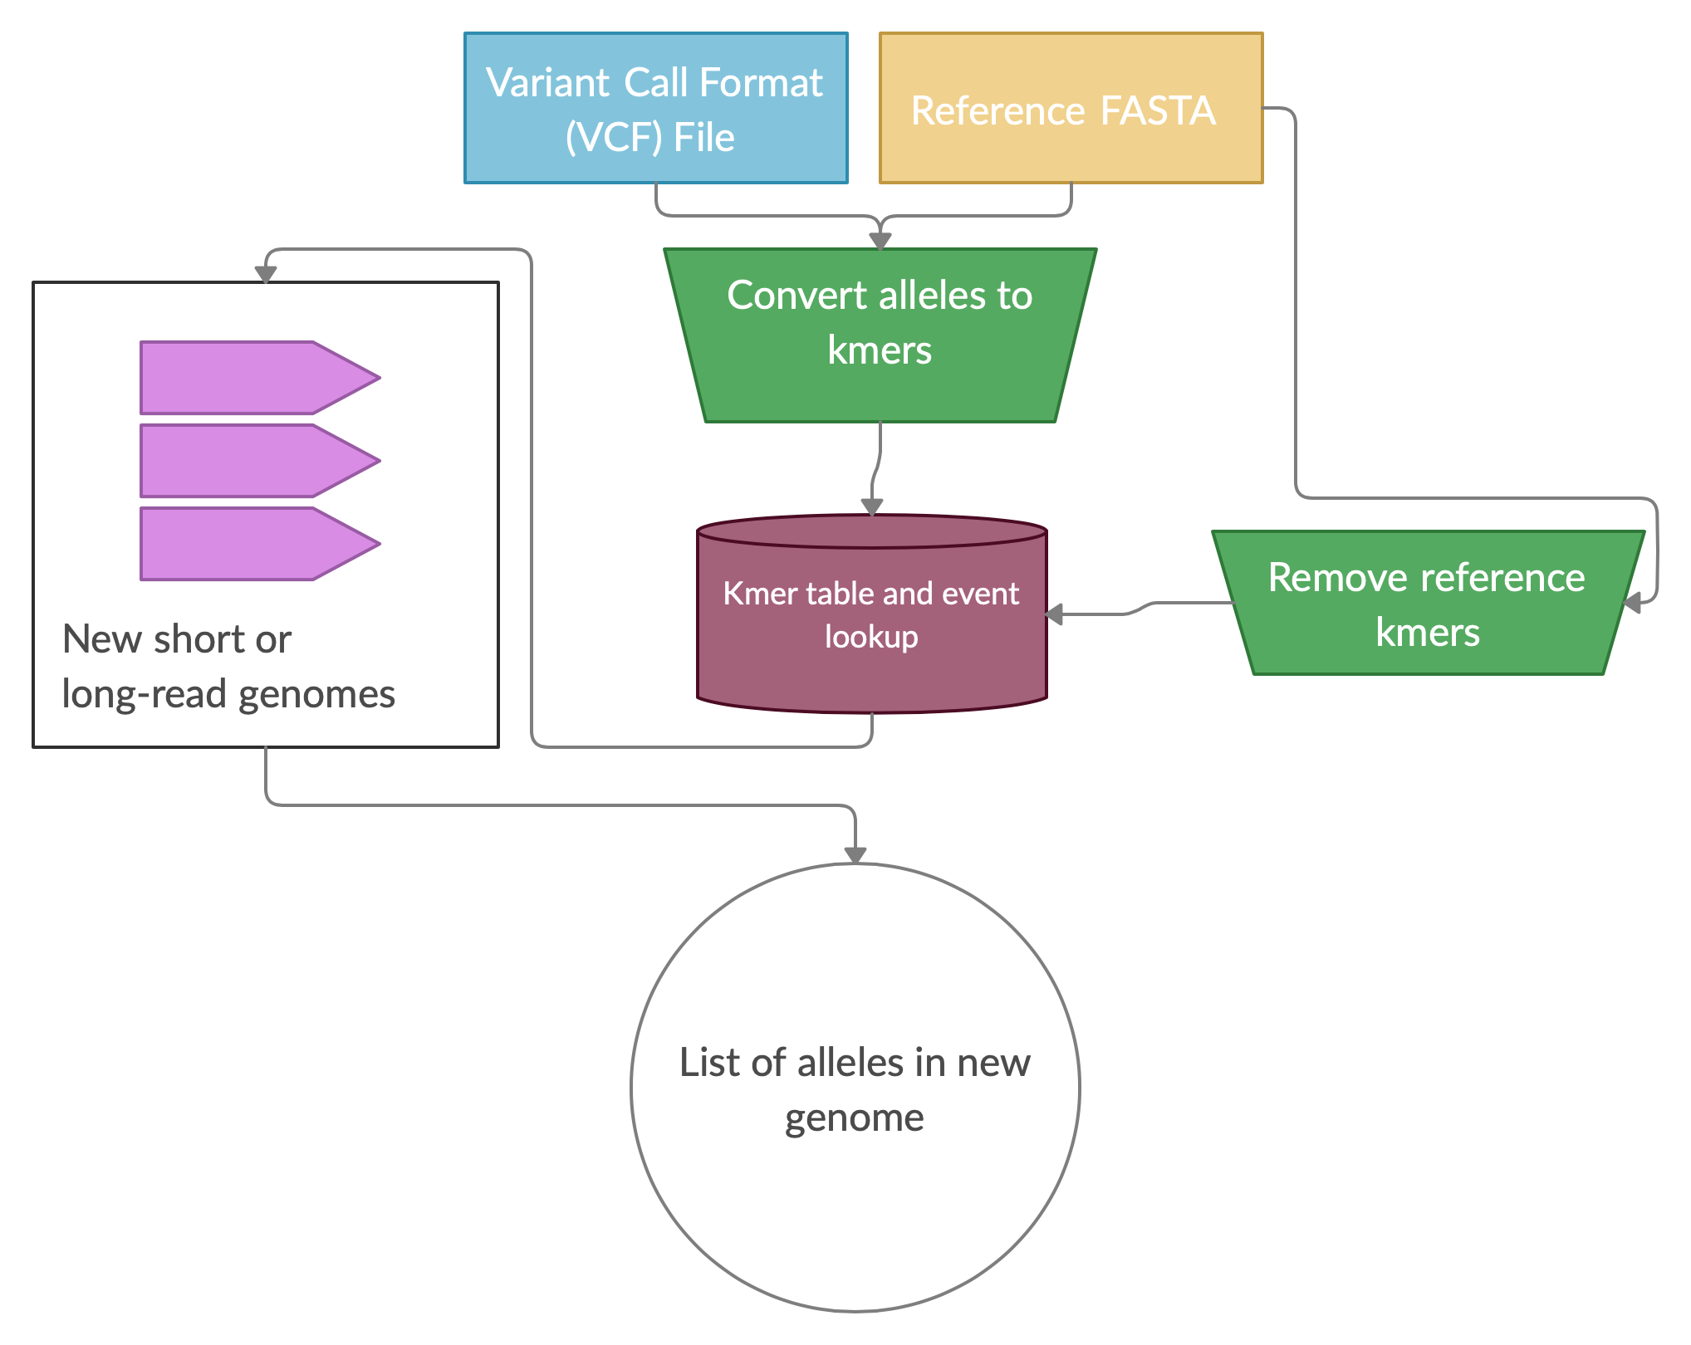
The approach
Digest long-read sv alleles into kmers
Remove reference kmers
Read new sequencing file
Type SV specific alleles

