Slide 1
MGMT 345 Nonlinear
Brent Reeves

Slide 2


Slide 3
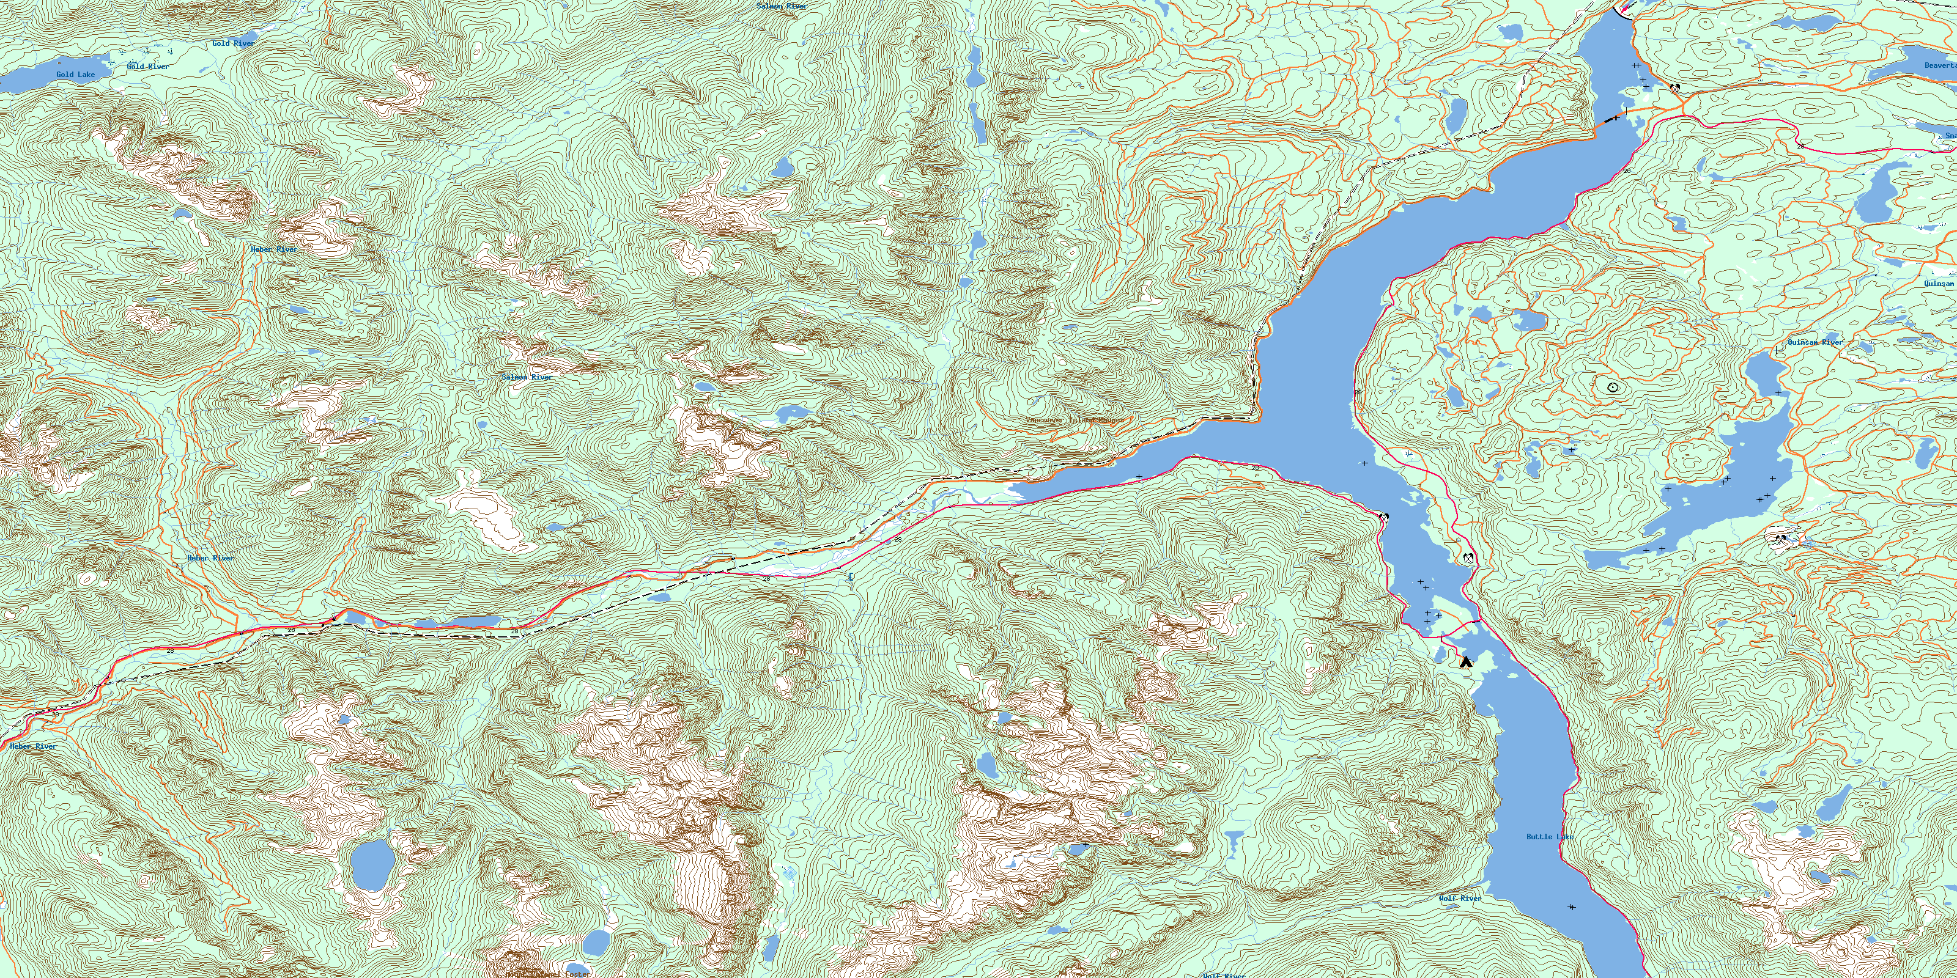

Slide 4
YOU ARE IN A MAZE OF TWISTY LITTLE PASSAGES, ALL ALIKE.

Slide 8
Examples of Linear and Nonlinear Formulas
Linear Formulas | Nonlinear Formulas
SUMPRODUCT(D1:D2, C1:C2) (D1 / D3) * C4 IF(D2 >= 2, 2*C3, 3*C4) SUMIF(D1:D2, 3, C1:C2) SUM(D4:D6) 2*C1 + 3*C2 + 3 C1 + C2 + C3 | SUMPRODUCT(C1:C2, C3:C4) (C1 / C3) * D4 IF(C2 >= 2, 2*C3, 3*C4) SUMIF(C1:C2, 3, D1:D2) ROUND(C1) MAX(C1, 0) MIN(C1, C2) ABS(C1) SQRT(C1) C1 * C2… / …^2
Data cells are located in D1:D6 and changing cells are in C1:C6.
8-8

Slide 9
The Challenges of Nonlinear Programming
Relationships are no longer proportional
It is more difficult to find appropriate Nonlinear formulas.
The Maths people inform us that nonlinear problems can be much more difficult to solve.
8-9

Slide 10
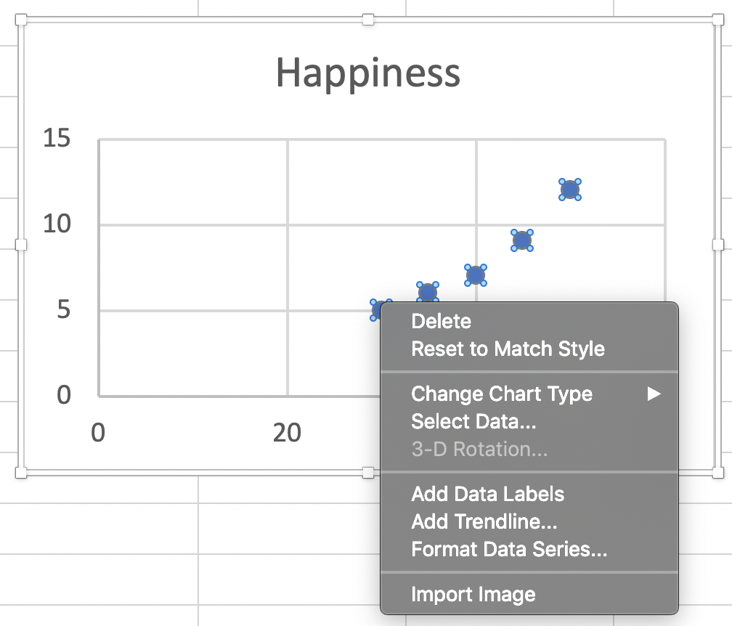
Formulas and Trendlines

Slide 11
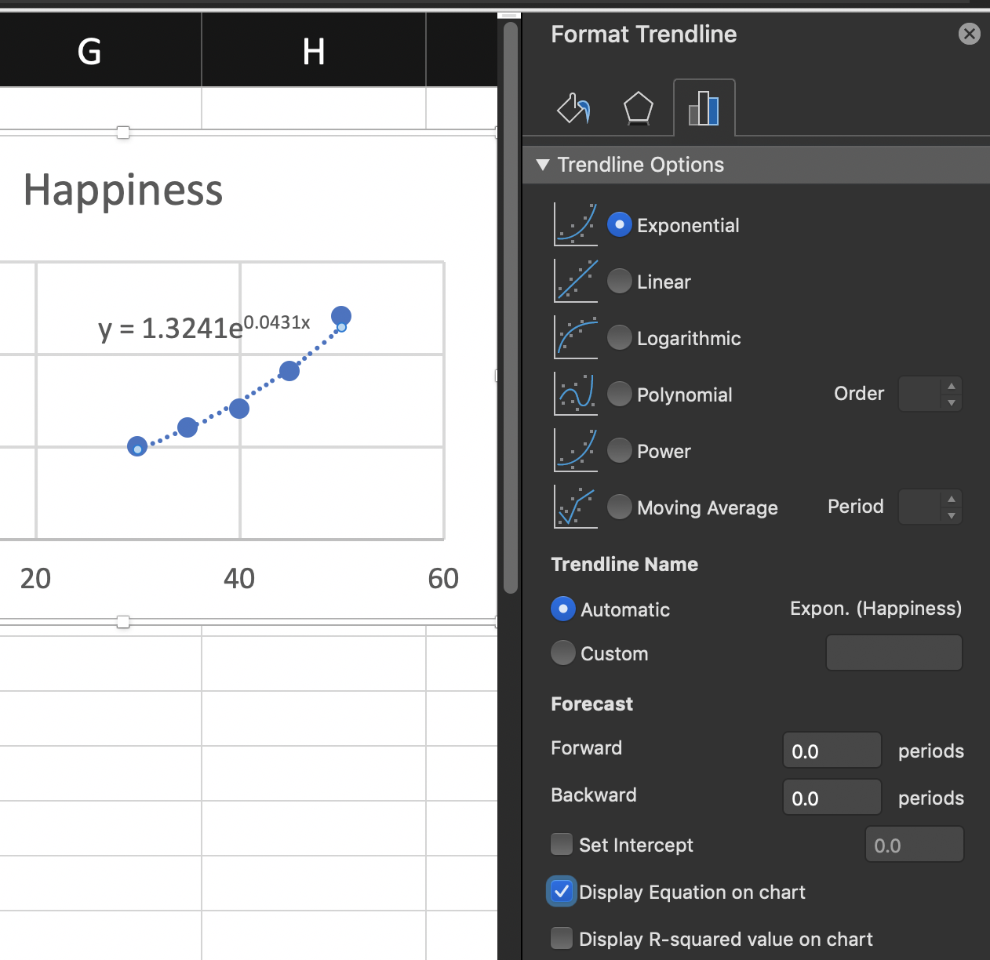
Formulas and Trendlines

Slide 12
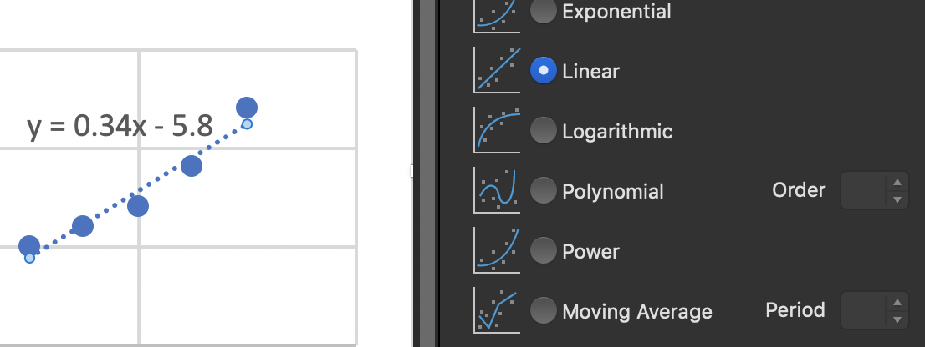
Formulas and Trendlines

Slide 13
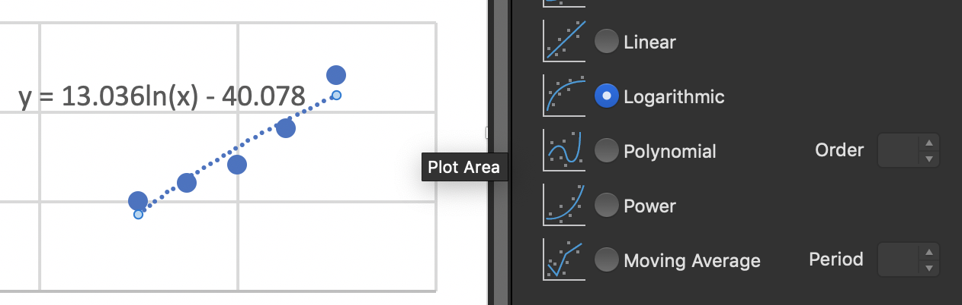
Formulas and Trendlines

Slide 14
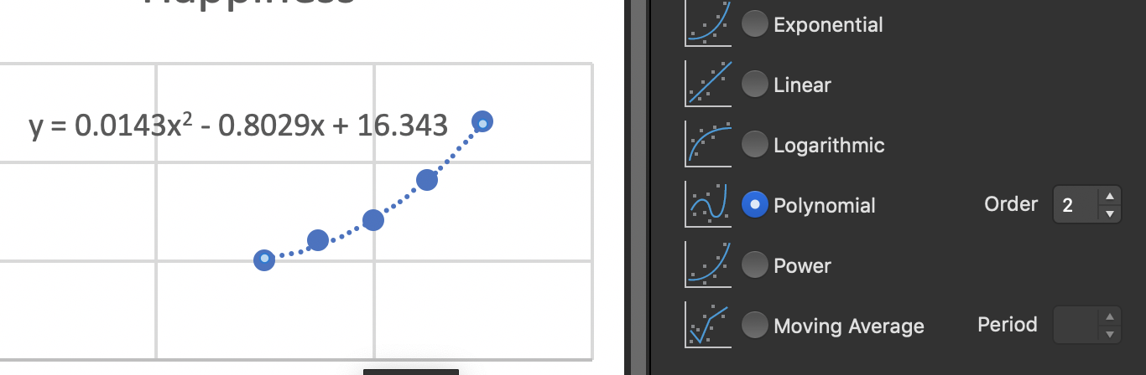
Formulas and Trendlines

Slide 15
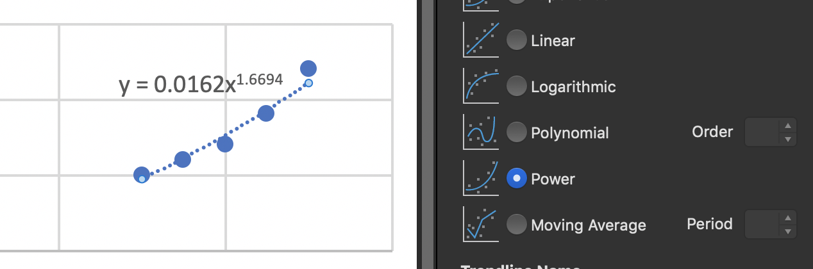
Formulas and Trendlines

Slide 16
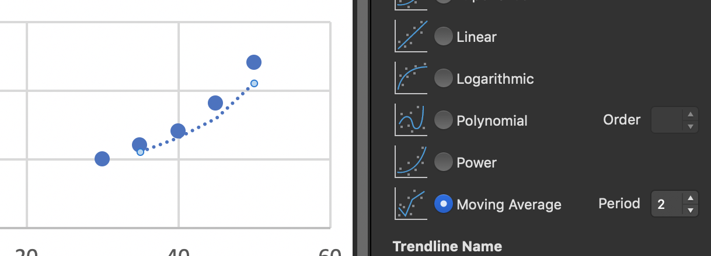
Formulas and Trendlines

