Slide 1
Barbells
ACM ICPC SER 2016 Division II

Slide 2
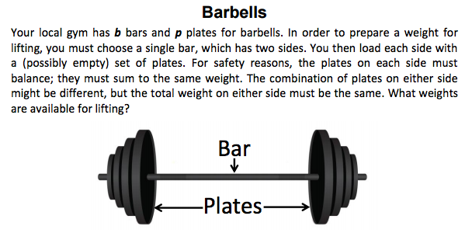

Slide 3
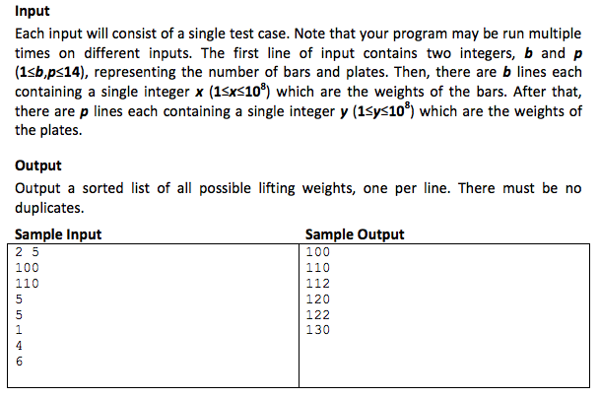
Note the small input size; p <=14

Slide 4
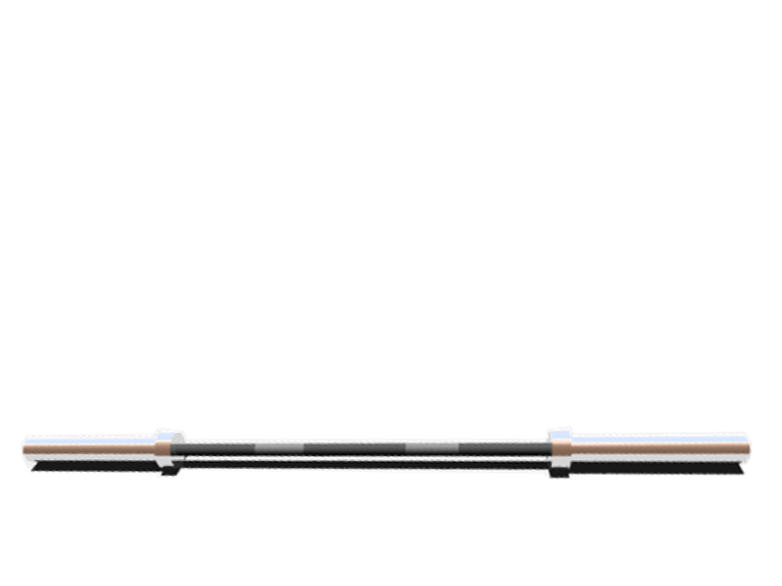
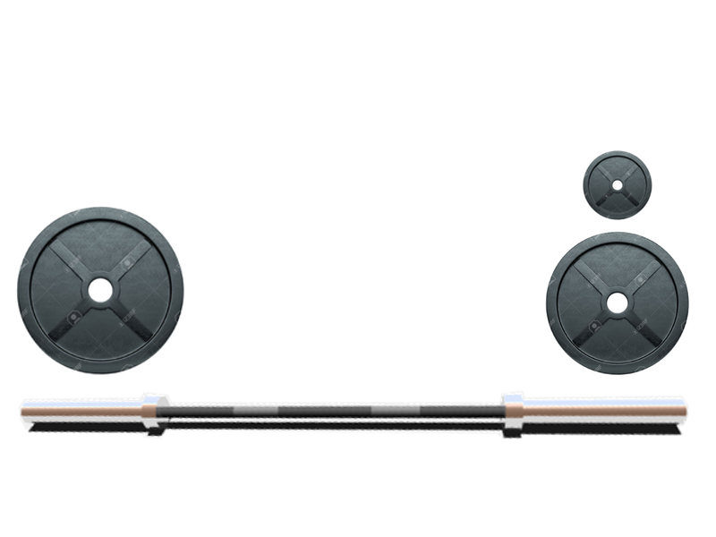
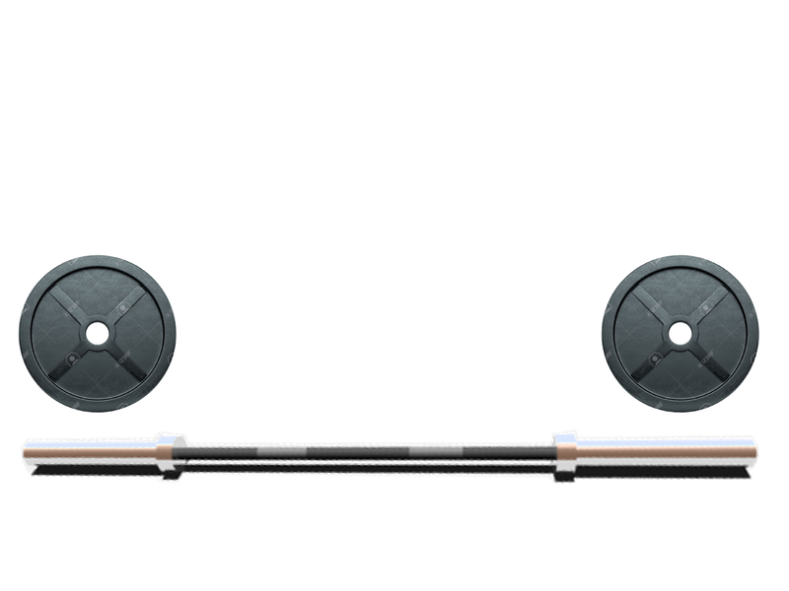
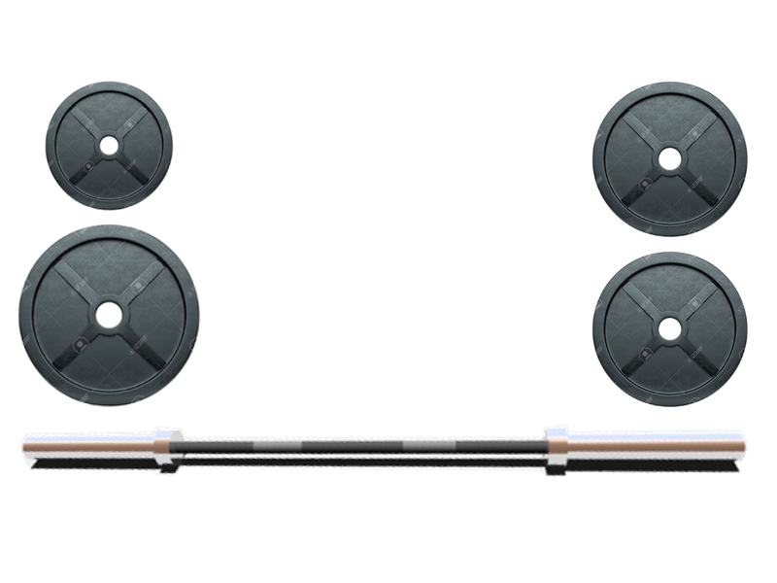
Four Distinct Weight Combinations
B + 12
(6,5,1)
B
B + 10
(5,5)
B + 20
(6,4,5,5)

Slide 5
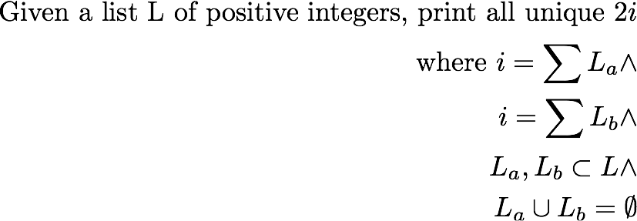
New, Mathy Problem Statement
This is just a subproblem of barbells (the weight plate part),
but also the only computationally significant one

Slide 6
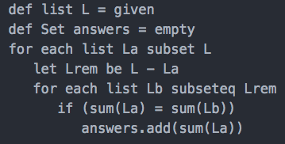
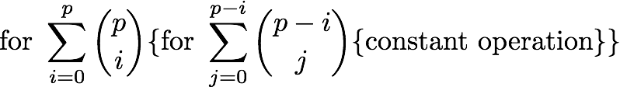
Brute Force

Slide 7
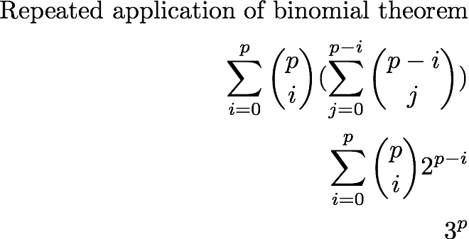

Good thing p <= 14

Slide 8
Improvements - Questions
Generation: How can we efficiently produce all subsets?
Looping: Is there any way to reduce the number of subsets we have to consider? Do we have to compare each subset to every other?
Computing: How can we efficiently perform set operations? Set summation?

Slide 9
Improvements - Observations
No subset whose weight is > half the total weight will be a part of our answer
While generating subsets, we can do some preprocessing
Eliminate invalid ones
Group subsets by total weight
Representing subsets in binary leads to constant time generation, intersection tests

Slide 10
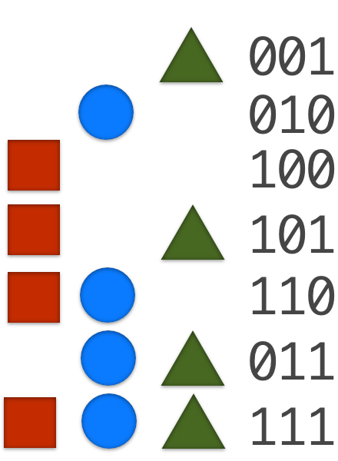
Subsets in binary
All standard set operations can be implemented in constant time through bit operations - no hashing necessary
Union: Bitwise or
Intersect: Bitwise and
Add / Remove: Flip a bit

Slide 11
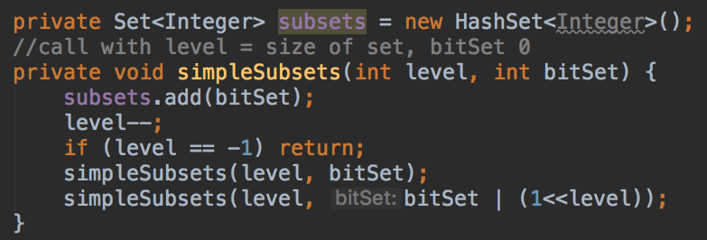
Code for Generation - General
This code contains redundancy - why?

Slide 12
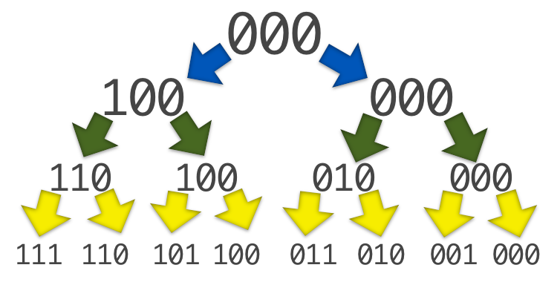
Call Sequence

Slide 13
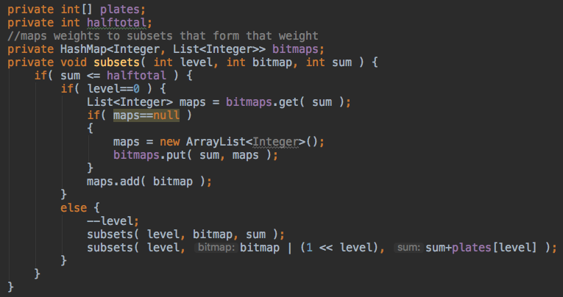
Code for Generation - With Preprocessing

Slide 14
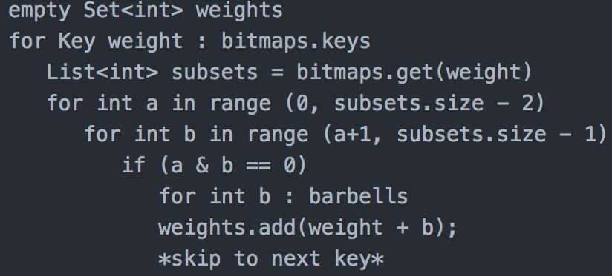
Given the ‘bitmaps’ hash map, our inner loops become way less scary
Only loop through other subsets which
sum to the same value!

Slide 15
Any Questions, Comments?

