Slide 1
Buggy Robot
SER 2016
(Problem also available on Kattis)
For spoilers, see:
https://github.fit.edu/ballard2014/BuggyRobot

Slide 2
Problem Statement
You Control a robot on a grid
Goal: reach the goal coordinate
Some squares are blocked off by obstacles
You are given a sequence of commands (U,D,L,R) which are not guaranteed to bring your robot to the goal
What’s the minimum number of changes to this sequence which brings the robot to the goal?

Slide 3
Input:
A rectangular map containing obstacles
A start coordinate
A goal coordinate
A string of commands
Constraints:
Map is <= 50x50
Command length <= 50

Slide 4
Rules
A single change consists of:
Inserting a command (U,D,L,R)
Deleting a command
The robot will not obey commands asking it to:
Run into an obstacle
Run off the map’s boundary

Slide 5
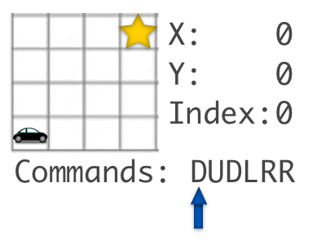
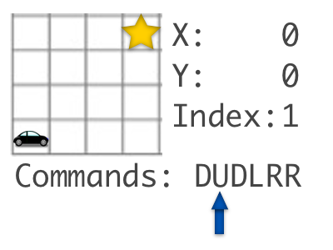
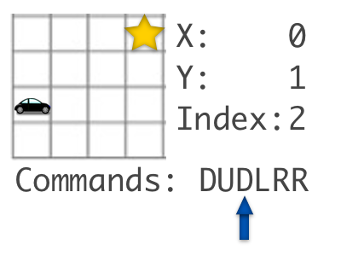
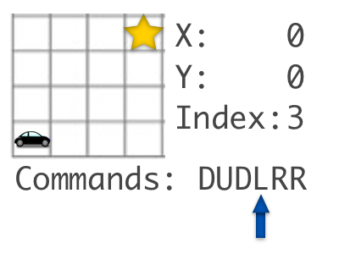
Executing Commands

Slide 6
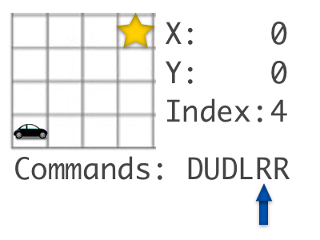
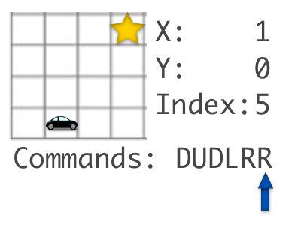
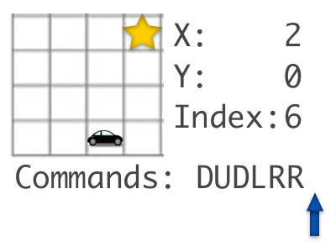
Executing Commands
Done!

Slide 7
Observations
The previous example has a special property:
There’s no benefit to appending commands anywhere but the end of the string
Does this always hold?

Slide 8
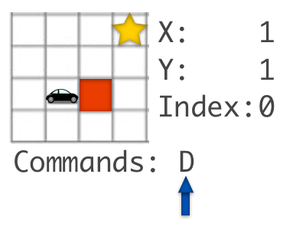
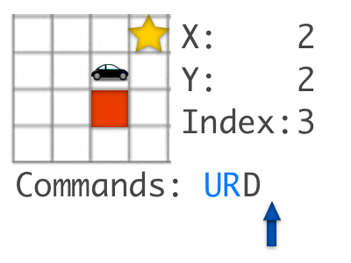
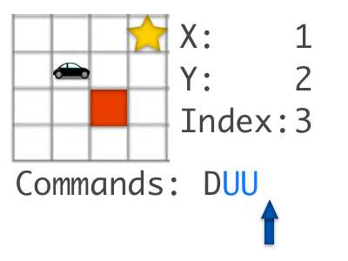
Counter Example
Starting Point —>

Slide 9
More Thoughts
For each command we can add, we have to consider what would happen if we add it anywhere in the current string
Large search space
This isn’t a textbook pathfinding problem, but we can borrow some ideas from A*, Dijkstra, etc.

Slide 10
More Thoughts
Cost Function: The fewer changes we make to the command sequence, the better
Secondary Cost Function: Manhattan Distance
Greedy Strategy: Consider ‘Universes’ in the order of increasing changes (priority queue?)
Terminate upon reaching the goal

Slide 11
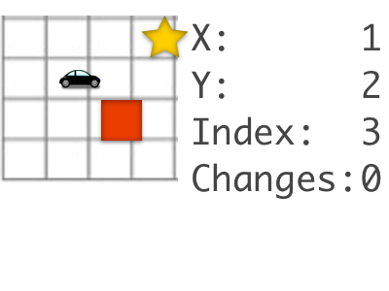
A Universe
It will be useful to define ‘Universe’ objects, which store the robot’s state as we follow different possible sequences of altering the command string
Example:

Slide 12
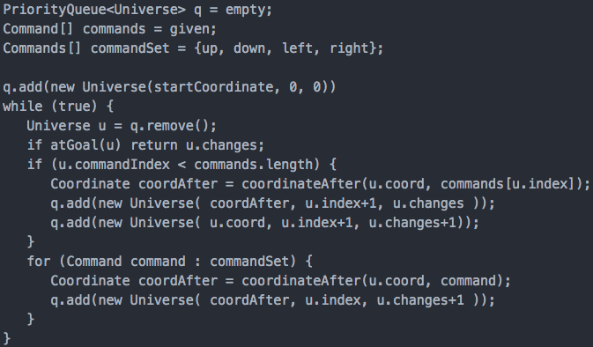
Brute Force
Note: priority = # of changes

Slide 13
Analysis
Complexity: L * 5^n
L: length of command string
n: Solution (min # of changes to reach goal)
This solution introduces a lot of redundancy, doubling the remaining problem size with every redundant Universe creation

Slide 14
Eliminating Redundancy
LPA*: Lifelong Planning Algorithm
behavior like A*
records the cost of the best method for reaching any given point in map
We can avoid redundancy by tracking the lowest cost of any (x position, y position, command index) tuple

Slide 15
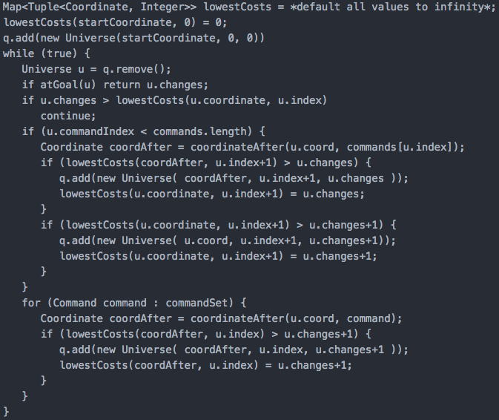

Slide 16
Analysis
Complexity (time and space): L * W * H
L: length of command string
W: Width of map
H: Height of map

Slide 17
Questions, Comments?

