Slide 1
Frequent Values
http://www.spoj.com/problems/FREQUENT/

Slide 2
Problem Statement
You are given a sequence of n integers a_1 , a_2 , ... , a_n in non-decreasing order. In addition to that, you are given several queries consisting of indices i and j (1 ≤ i ≤ j ≤ n). For each query, determine the most frequent value among the integers ai , ... , aj.
That’s what it says, at least. The example question shows that what they really want is the number of occurrences of the most frequent value in the query range

Slide 3
Input
The input consists of several test cases
Each test case starts with a line containing two integers n and q (1 ≤ n, q ≤ 100000)
The next line contains n integers a1 , ... , an (-100000 ≤ ai ≤ 100000, for each i ∈ {1, ..., n}) separated by spaces
You can assume that for each i ∈ {1, ..., n-1}: ai ≤ ai+1
The following q lines contain one query each, consisting of two integers i and j (1 ≤ i ≤ j ≤ n), which indicate the boundary indices for the query.
The final test case is followed by a zero
Upper limit for n, q is about 100,000. Rules out solutions of n^2 or worse

Slide 4



Example Problem
10 3
-1 -1 1 1 1 1 3 10 10 10
2 3
1 10
5 10
0
1
4
3
Index 1 2 3 4 5 6 7 8 9 10
Value -1 -1 1 1 1 1 3 10 10 10

Slide 5
Analysis
There is an obvious n² solution, but doesn’t work well on large input sizes
As seen in the previous graphic, queries can be intuitively modeled as intervals over a number line
So can repeated values!
Solutions are the maximum length of an intersection between a query interval and the repeated value intervals
-1 -1 1 1 1 1 3 10 10 10
[1,2] [3,6] [7,7] [8,10]

Slide 6
Interval Tree
Interval trees are optimized to answer the question “Which intervals, from a set, intersect a given interval?”
Balanced binary tree
In addition to children, each node contains:
A point on the number line
A List of Intervals in the set which intersect with that point
If a node has point ‘p’, its left child must have a point less than p, and its right child must have a point greater than p

Slide 7
Interval Tree - Construction
Interval trees act like quick sort, partitioning space by repeatedly picking a point, and sorting all intervals into three categories:
Completely left of the point
Completely right of the point
Intersecting that point
Eventually, all intervals intersect one of the points in the tree
Selecting these points effectively is important
one strategy: average of all endpoints

Slide 8
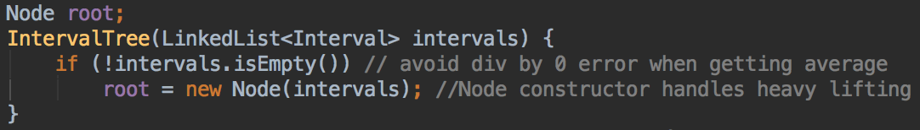
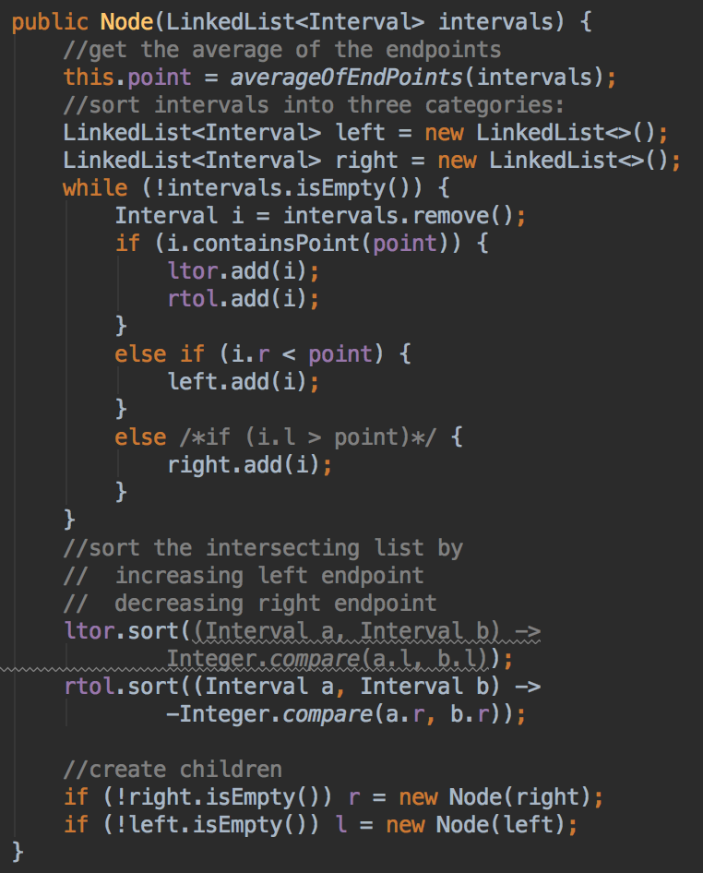
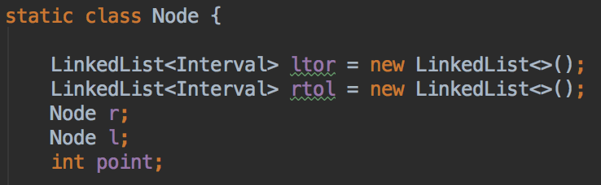
CODE

Slide 9
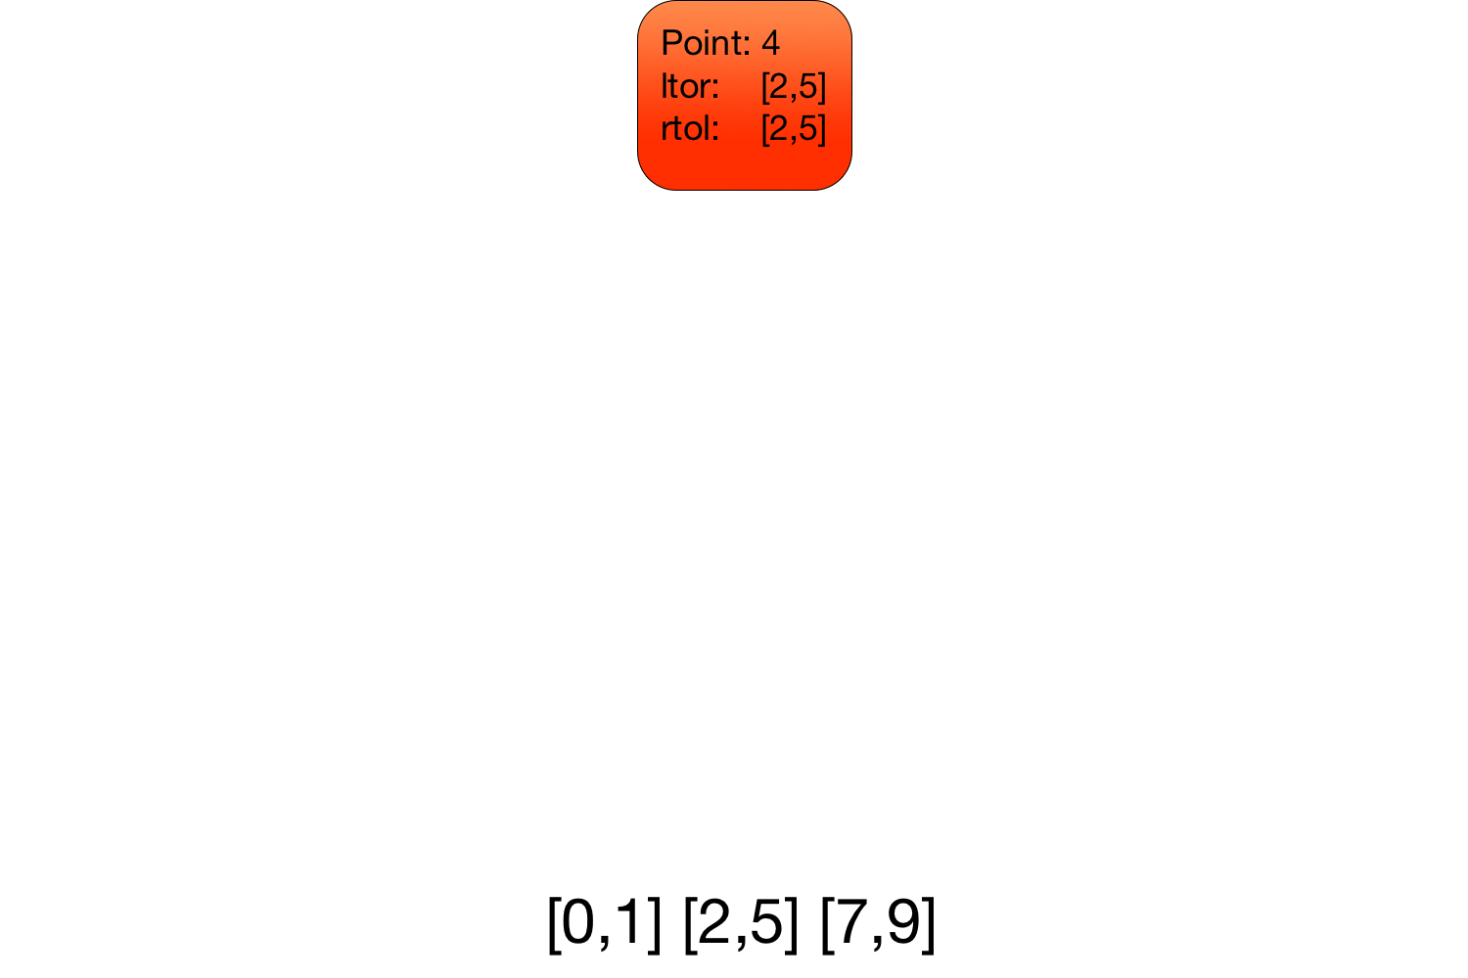
Interval Tree - Construction

Slide 10
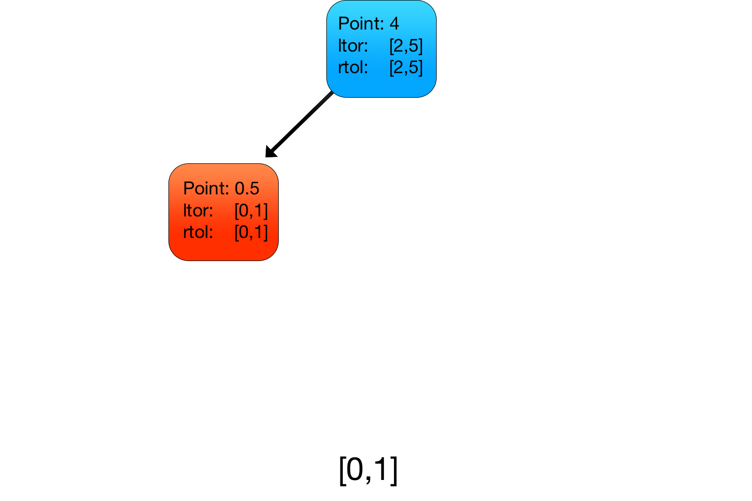
Interval Tree - Construction

Slide 11
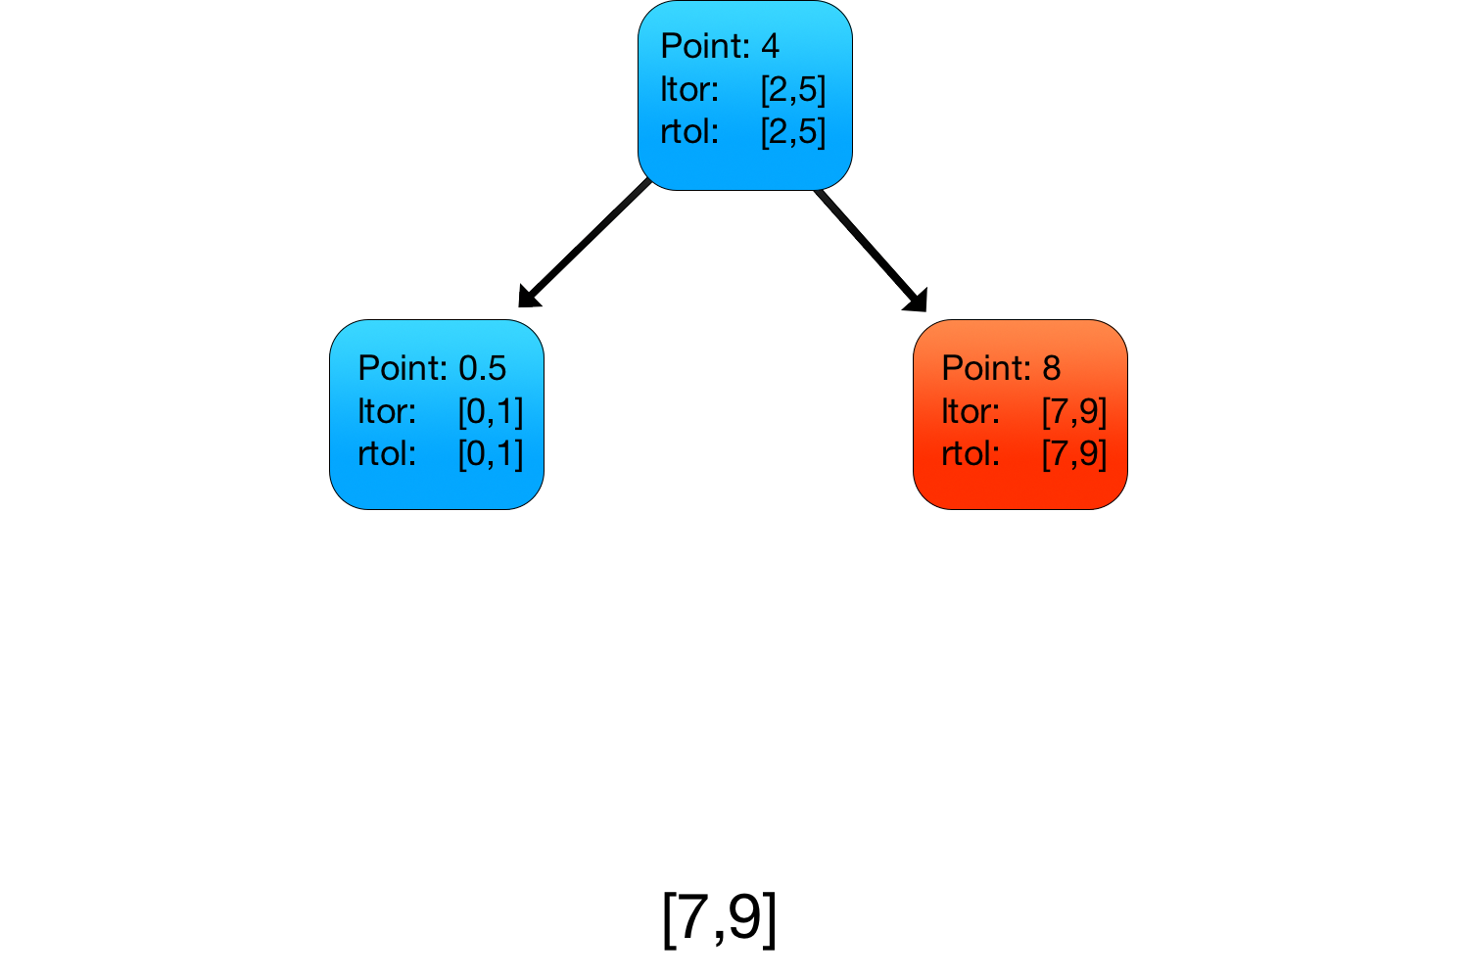
Interval Tree - Construction

Slide 12
Interval Tree - Construction
Why is it necessary to have ltor and rtol?
The following example and the querying code will make it clear

Slide 13
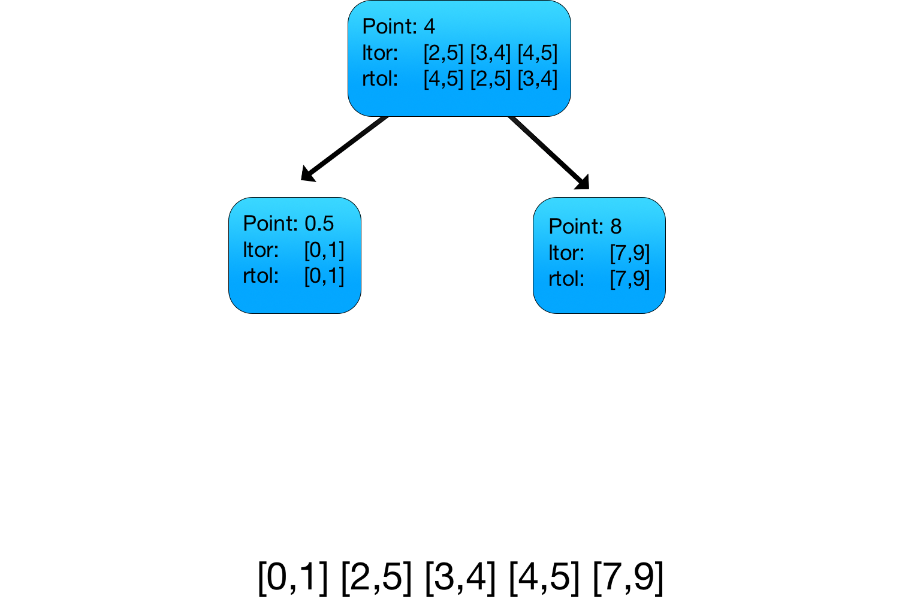
Interval Tree - Construction 2

Slide 14
Interval Tree - Querying
Given an interval, find all interval in the tree which intersect it
Get intervals at a node
If you intersect a node’s point, you can add all its intervals to your set
If not, peel away from ltor or rtol, depending on which side of the point the interval is on
Recurse through child..
R if the interval extends to the right of point
L if the interval extends to the left of point
Efficiency is O(log(n) + m)
n: intervals in tree
m: intervals in tree that intersect your query

Slide 15
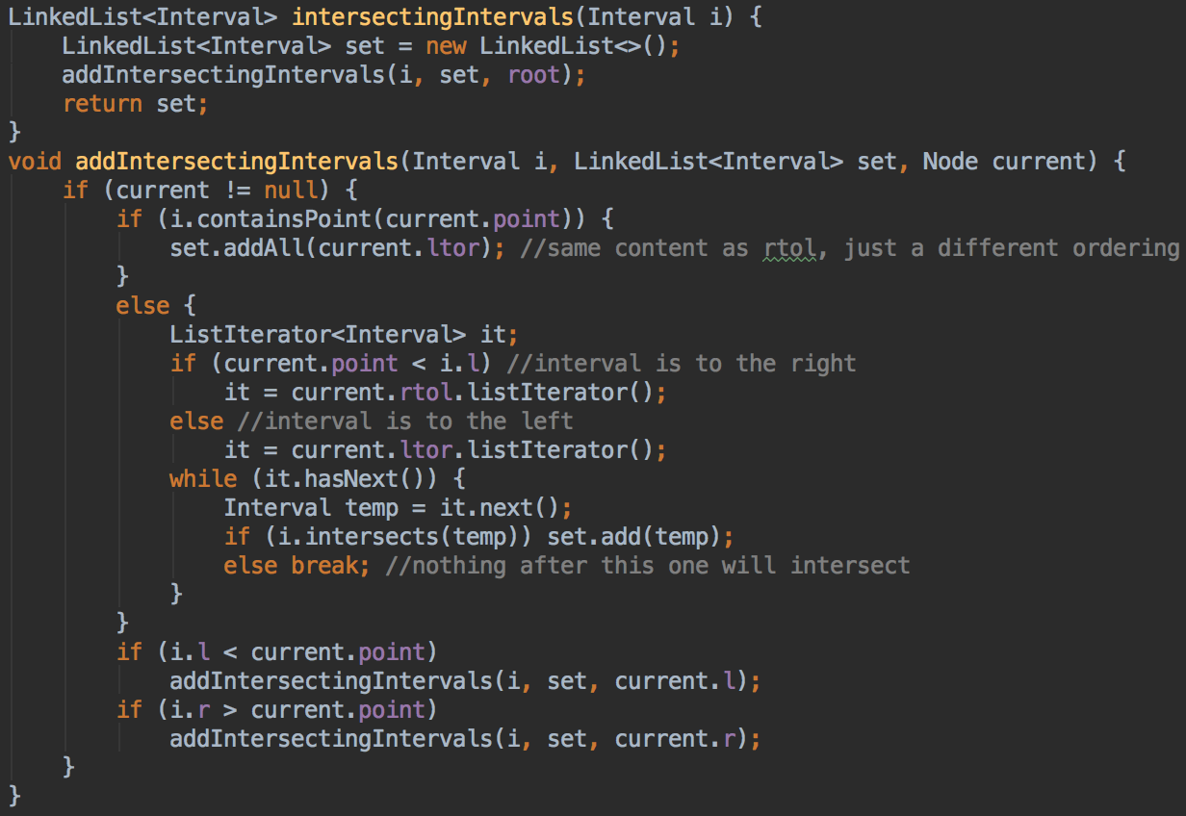
CODE

Slide 16
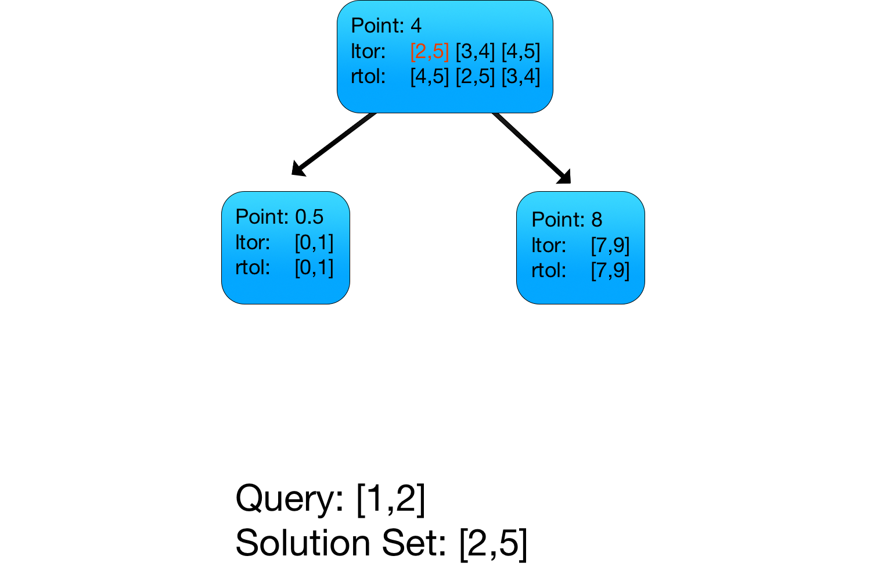
Interval Tree - Querying

Slide 17

Interval Tree - Querying
Because [1,2]and
[3,4] don’t intersect,
we don’t need
to check [4,5]!

Slide 18
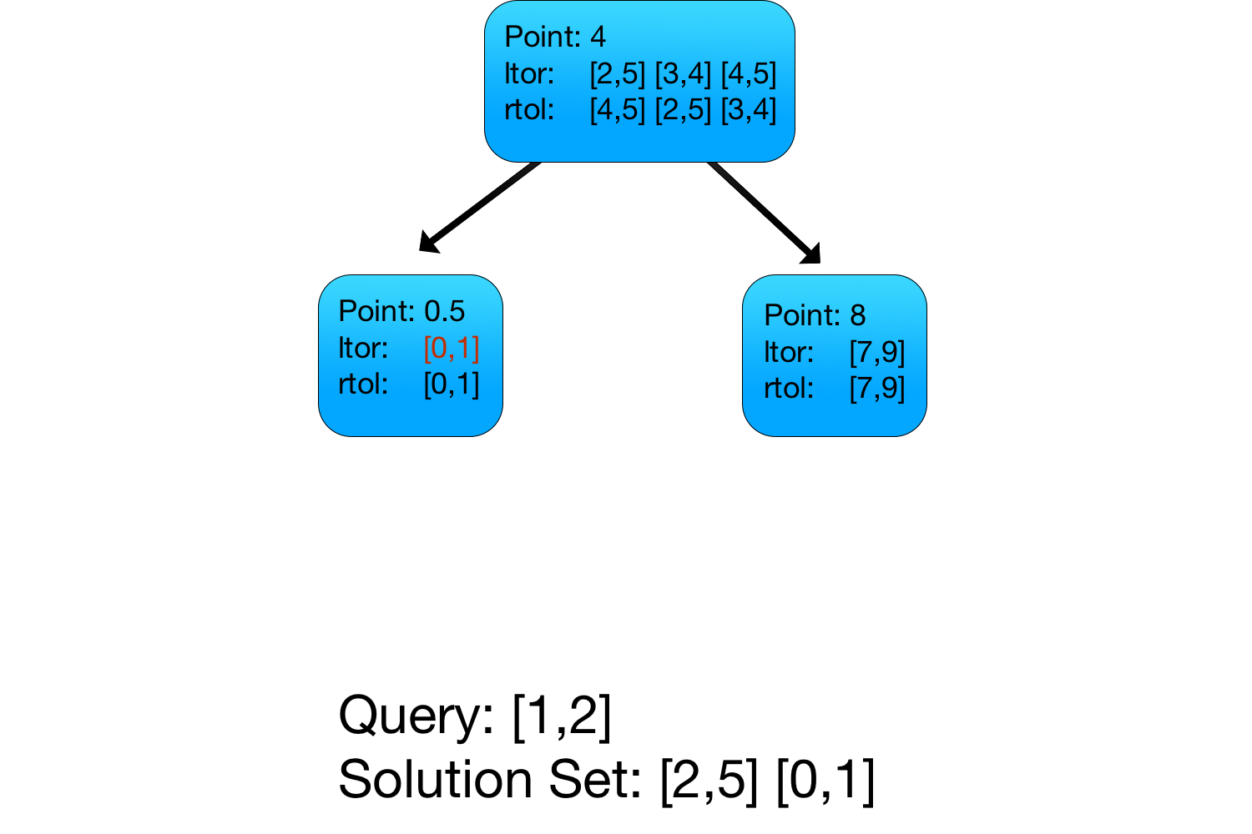
Interval Tree - Querying

Slide 19
Problem-Specific Notes
No two intervals that go in the tree overlap
makes rtol and ltor unnecessary
Once you get the set of intervals that overlap your query, you need to find the size of their intersection
example: ‘5’ repeats through interval [4,9], but my query only considers [3,7]. The correct answer is 4, not 6
You know that all solutions are >=1. You can halve the time of building the tree by only constructing it after throwing out all intervals of length one

Slide 20
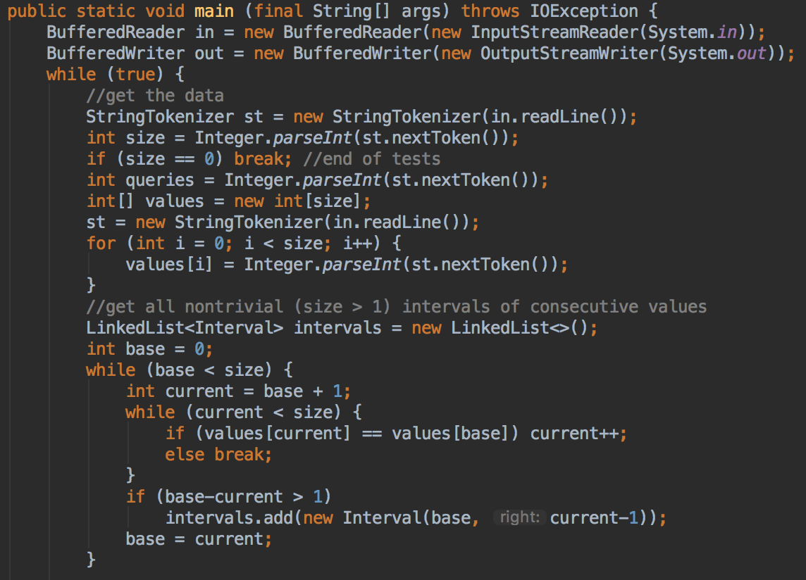
Main() Code

Slide 21
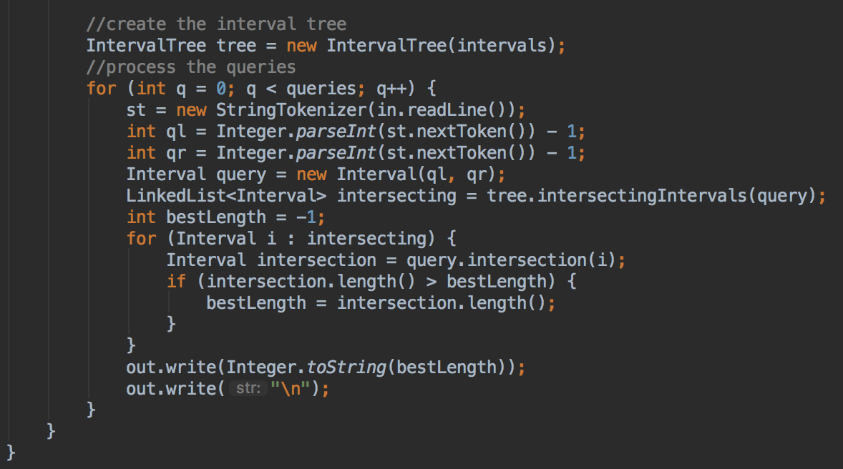
More Main() Code

