Slide 1
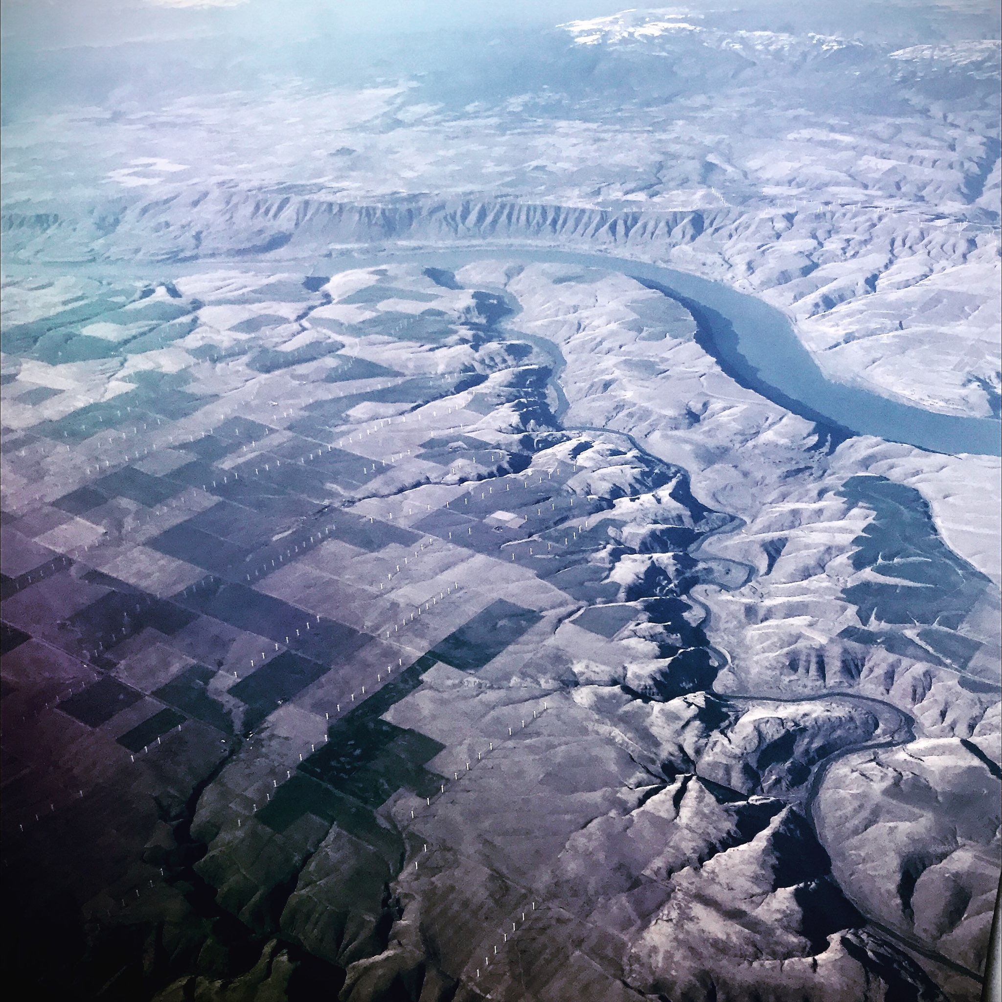
John Day River Steelhead Overshoot Logan Breshears
Picture: Jonny Armstrong

Slide 2
Raw/meta PIT Data
Raw/meta PIT Data (backup)
Online github repository
Data trimming/filtering
Sort into sub-basins
Set data time constraints (years)
Sort by salmonid species
Visualize
Raw/meta Acoustic Data (backup)
Goal!!
Run survival analysis
Reproducibility check
Raw/meta Acoustic Data
Run comparative analysis
Reproducibility check
Visualize
Automate process
Replicate PIT analysis with acoustic data
Review steps
Publish
Reproducibility check

Slide 3
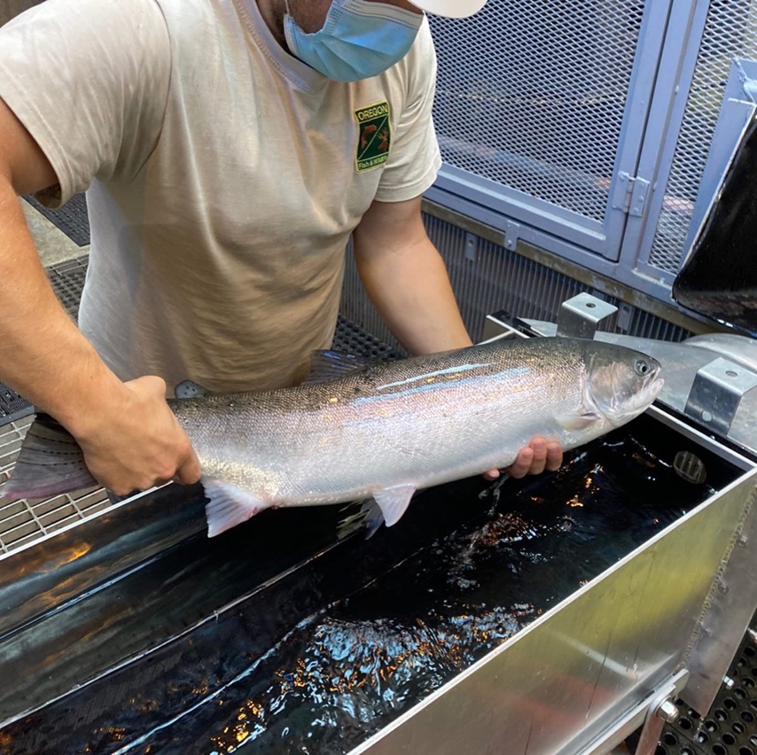
Quarter Goals
Run survival and comparative analyses for Adult steelhead migration (2005-2020).
I’ve begun writing code for the survival analyses.
Comparative analysis should just be a repeat of survival.
Familiarize myself with GitHub, and Sourcetree
Typesetting with Latex and Markdown
Clean my code structure
Not reverting back to old habits
Excel

Slide 4
Successes
Setting up an FTP server for accessing data
Coding structure is clean, legible, and repeatable
File structure has improved significantly
Comfortable using GitHub and Sourcetree
Use Markdown and Latex more frequently
Not reverting back to old habits as often

Slide 5
Setbacks
Downloading and trimming metadata from online database
Initial data downloads were incomplete
Set up an FTP server for ease of data transfer and integration with R
Wrapping up research and ODFW commitments
End of year reporting (multiple permits)
Project updates/presentations for grant funders
Coordinating data retrieval
Thinking ahead to ‘21 & ’22 for future acoustic research
Time allocation

Slide 6
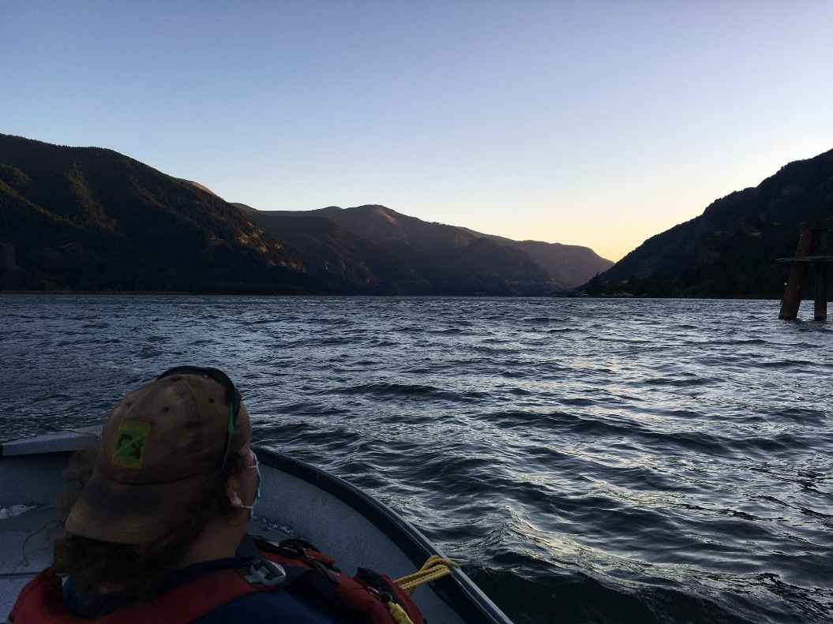
Future Goals
Finish up PIT tag analyses by the end of Dec.
Retrieve and download acoustic data from sites downstream of John Day Dam (Dec – Jan)
Upstream locations spring term
Run analyses for acoustic detections
Completely transition over to Latex

