Slide 1
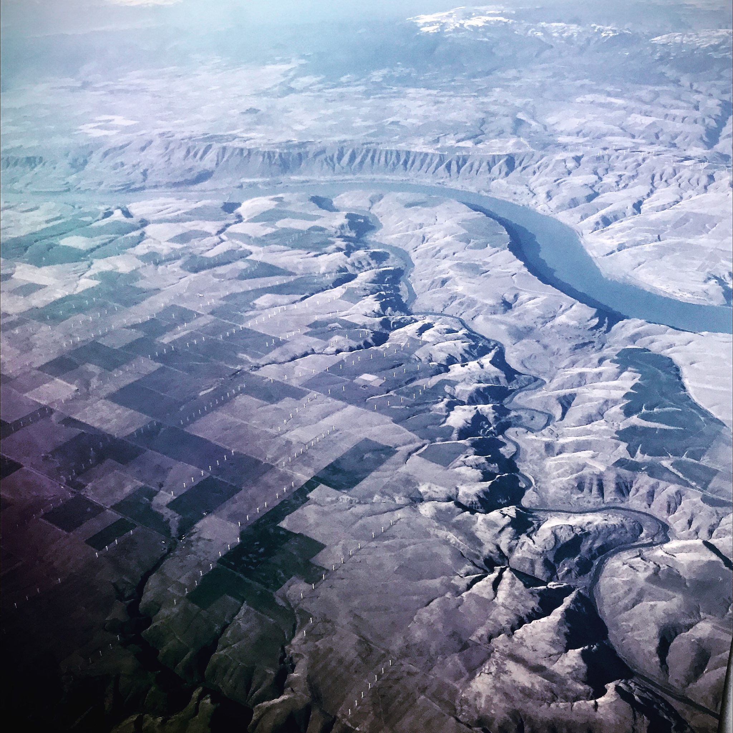
John Day River Steelhead Overshoot Logan Breshears
Picture: Jonny Armstrong

Slide 2
Raw/meta PIT Data
Raw/meta PIT Data (backup)
Online github repository
Data trimming/filtering
Sort into sub-basins
Set data time constraints (years)
Sort by salmonid species
Visualize
Raw/meta Acoustic Data (backup)
Run survival analysis
Reproducibility check
Raw/meta Acoustic Data
Run comparative analysis
Reproducibility check
Visualize
Automate process
Replicate PIT analysis with acoustic data
Review steps
Publish
Reproducibility check

Slide 3
Raw/meta PIT Data
Raw/meta PIT Data (backup)
Online github repository
Data trimming/filtering
Sort into sub-basins
Set data time constraints (years)
Sort by salmonid species
Visualize
Raw/meta Acoustic Data (backup)
Goal!!
Run survival analysis
Reproducibility check
Raw/meta Acoustic Data
Run comparative analysis
Reproducibility check
Visualize
Automate process
Replicate PIT analysis with acoustic data
Review steps
Publish
Reproducibility check

Slide 4
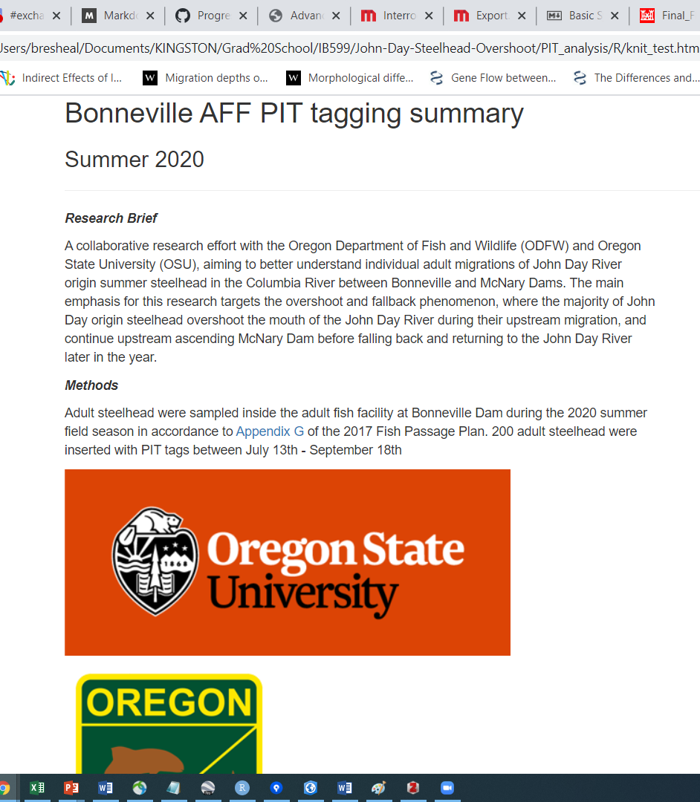
Raw/meta PIT Data
Raw/meta PIT Data (backup)
Online github repository
Data trimming/filtering
Sort into sub-basins
Set data time constraints (years)
Sort by salmonid species
Visualize
Raw/meta Acoustic Data (backup)
Goal!!
Run survival analysis
Reproducibility check
Raw/meta Acoustic Data
Run comparative analysis
Reproducibility check
Visualize
Automate process
Replicate PIT analysis with acoustic data
Review steps
Publish
Reproducibility check

Slide 5
Setbacks
Learning how to use Sourcetree with Rstudio
Created my repository three times
Time allocation
Downloading and trimming metadata from online database
Data set is large (time consuming)
Additional side projects popping up, and not working in a linear progression.
Updating software

