Slide 1
Capstone Project
Smart Agriculture Farm Management System
CSA0211 – C Programming
Presented by
Digvijay A 192320045
Reshini Priya B 192320035
Vishal J 192412433
Saveetha School of Engineering
Guided by
Dr. K. Saravanan
Department of CSE,
Saveetha School of Engineering

Slide 2
Problem Statement
Traditional farm record management is mostly manual, making it difficult for farmers to organize crop information, monitor resources, track expenses, and maintain harvest records.
Paper-based documentation often results in data loss, calculation errors, and inefficient decision-making.
There is a need for a simple software system that digitally stores farm information using C programming concepts and file handling, enabling efficient record management and improved agricultural productivity.

Slide 3
ABSTRACT
The Smart Agriculture Farm Management System is a console-based application developed in C to simplify agricultural record management.
The system enables farmers to:
Register crop details
Manage cultivation activities
Track farm resources and expenses
Record harvest information
Store data permanently using files
The application uses arrays, strings, functions, and file handling to organize agricultural records. It minimizes paperwork, improves accuracy, and provides an efficient method for maintaining farm information.

Slide 4
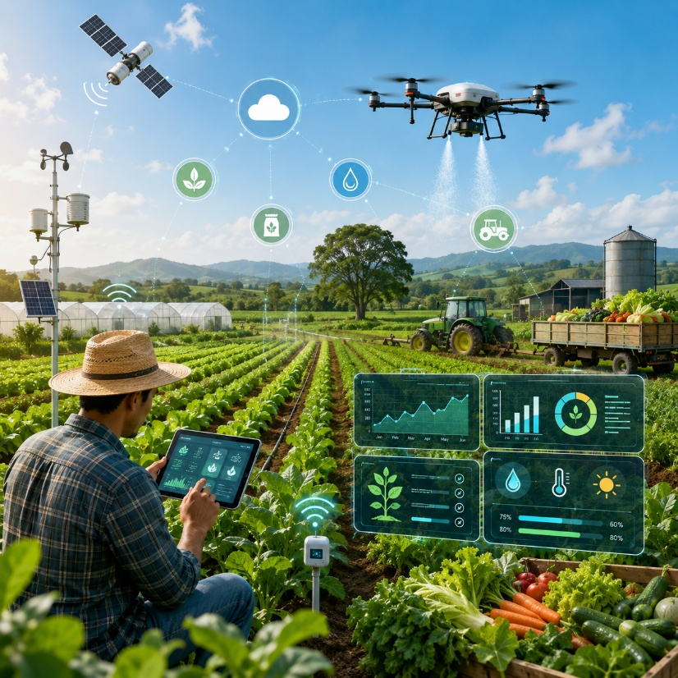
INTRODUCTION
Agriculture requires efficient management of crop cultivation, farm resources, expenses, and harvest records.
Traditional paper-based record keeping is time-consuming, prone to errors, and difficult to maintain.
The Smart Agriculture Farm Management System is a console-based application developed using the C programming language.
It enables farmers to digitally manage crop records, resource usage, expenses, and harvest information.
The system uses Arrays, Strings, Functions, Structures, and File Handling to store and process farm data efficiently. It provides a simple, low-cost, and reliable solution for improving farm management and productivity.

Slide 5
Existing System
Paper-based record maintenance
Manual crop registration
Separate notebooks for expenses
Difficult to calculate total production
High chance of data loss
Time-consuming record searching
No centralized farm management
Limitations
Human errors
Duplicate records
Poor data security
Difficult reporting
No automated calculations

Slide 6
Proposed System
The proposed Farm Management System provides a digital platform for maintaining agricultural records.
Features
Crop Registration
Cultivation Record Management
Resource Tracking
Expense Management
Harvest Recording
Production Summary
File-based permanent storage
Search, Update and Delete records
Benefits
Easy record management
Reduced paperwork
Accurate calculations
Fast information retrieval
Better decision making
Low-cost software

Slide 7
Literature Survey
Author & Year | Study / Focus | Key Findings | Relevance to Our Project
Tummers et al. (2021) | Farm Management Information Systems | Identified crop, field and financial management as key functions. | Supports centralized farm record management.
Iaksch et al. (2021) | Digitalization & Big Data in Smart Farming | Digital data improves farm management and decision-making. | Supports digital storage and processing of farm data.
El Idrissi et al. (2022) | ICT in Intelligent Farming | Discussed digital technologies for improving agricultural management. | Provides background for smart agriculture systems.
Garg & Alam (2023) | Smart Agriculture Technologies | Highlighted IoT, cloud, AI and data analytics in modern farming. | Shows future scope for extending our system.
Basir et al. (2024) | Digital Farm Recordkeeping | Discussed migration from paper-based to digital farm records. | Directly supports replacing manual farm records.
Indian Digital Agriculture Study (2023) | Farm Management Applications | Reviewed digital agricultural applications and adoption challenges. | Highlights the need for simple and accessible solutions.
Research Gap
Existing research largely focuses on advanced technologies such as IoT, AI, cloud computing and big-data analytics. Our project focuses on a simple, low-cost farm management system using core C programming concepts and file-based data storage.

Slide 8
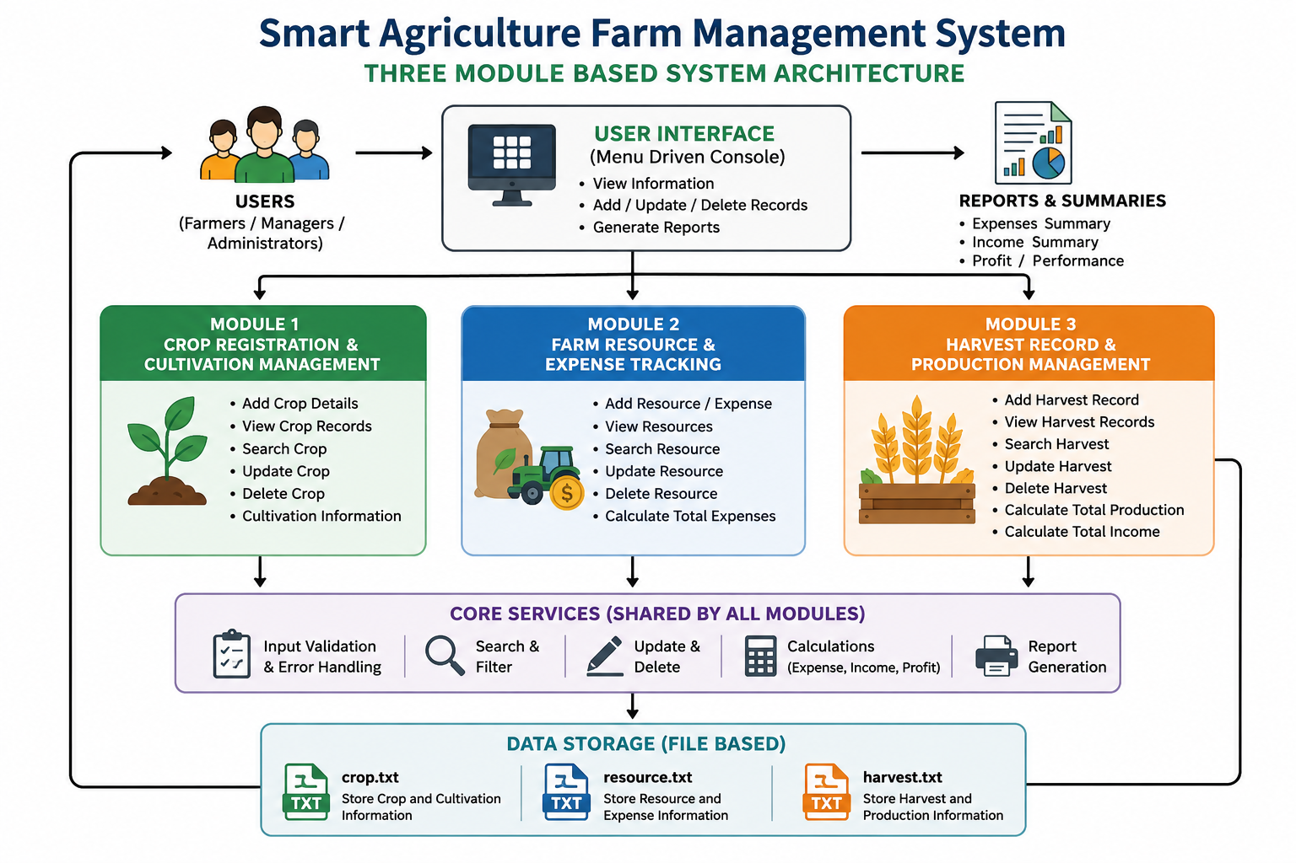

Slide 9
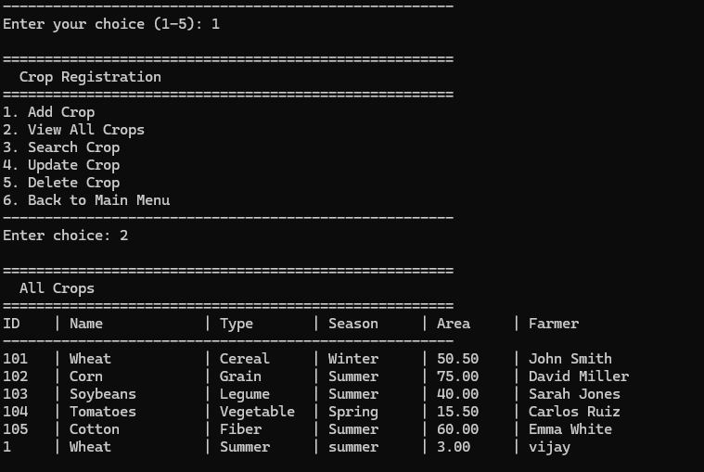
Module 1 – Crop Registration & Cultivation Management
Objective
To maintain complete records of crops cultivated on the farm and monitor their cultivation details.
Features
Register new crop information
Record planting and expected harvest dates
Store crop type, season, and cultivated area
Search, update, and delete crop records
View all registered crops
Save data permanently using file handling
Output
Organized crop database
Easy access to cultivation records
Improved crop planning and monitoring
Crop Registration & Cultivation Management in Terminal

Slide 10
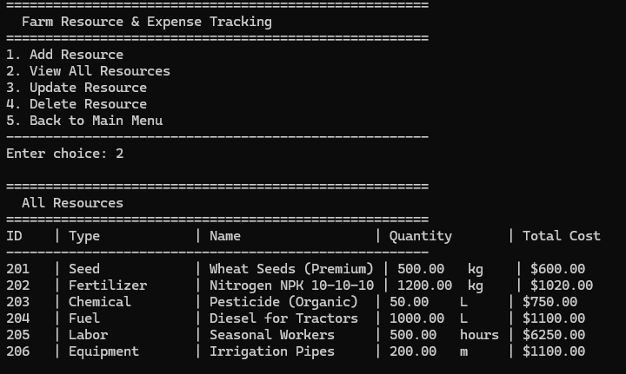
Module 2 – Farm Resource & Expense Tracking
Objective
To monitor farm resources and manage operational expenses efficiently.
Features
Record seed, fertilizer, pesticide, and irrigation usage
Track labor and machinery expenses
Update and delete resource records
Calculate total farming expenses automatically
Generate expense summary reports
Store all records in files
Output
Accurate expense management
Better resource utilization
Reduced financial tracking errors
Farm Resource & Expense Tracking in Terminal

Slide 11
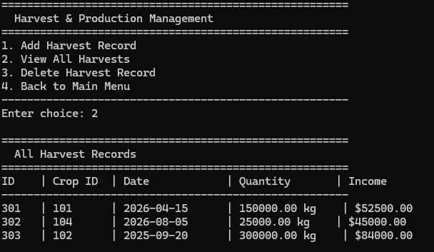
Module 3 – Harvest Record & Production Management
Objective
To maintain harvest details and analyze farm production.
Features
Record harvest information for each crop
Store harvest date and quantity produced
Record selling price and calculate total income
Search, update, and delete harvest records
Generate production and income reports
Maintain permanent harvest records using file handling
Output
Accurate production records
Automated income calculation
Better analysis of farm productivity and profitability
Harvest Record & Production Management in Terminal

Slide 12
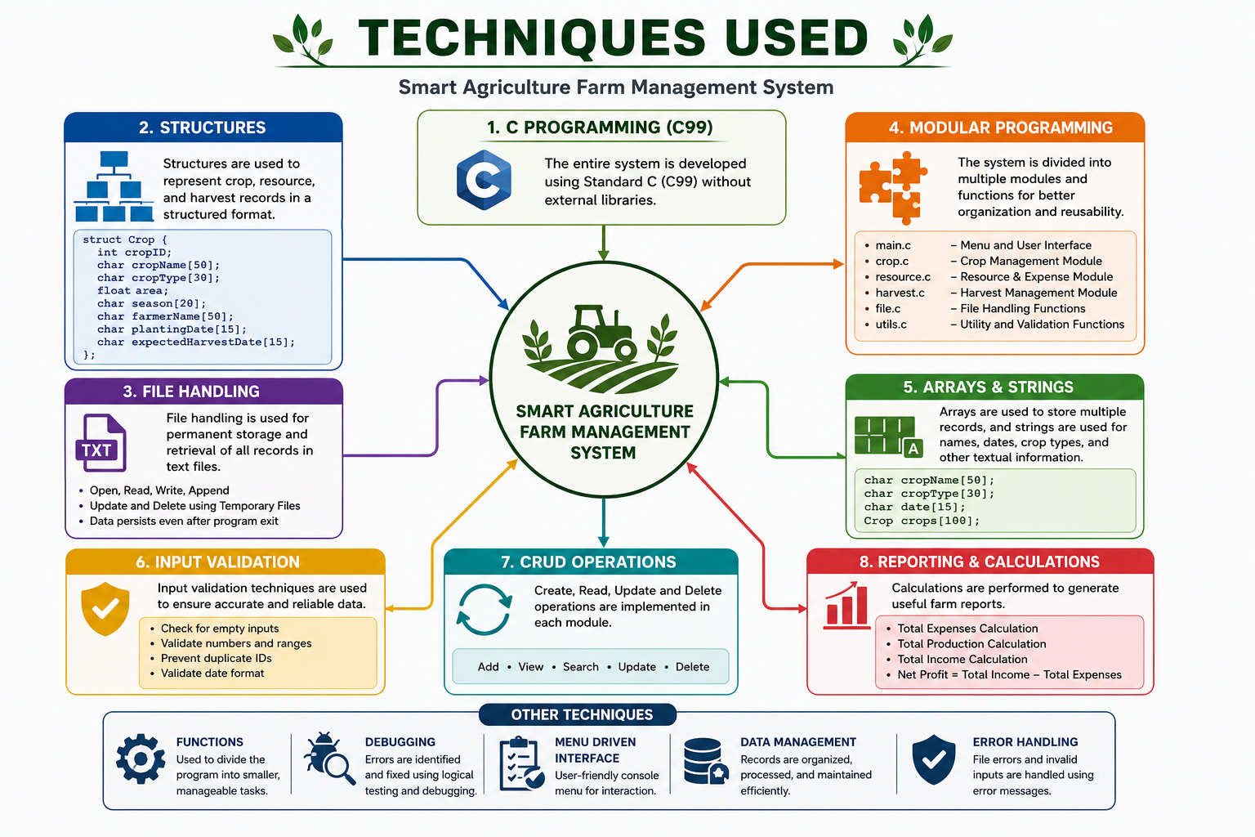

Slide 13
RESULTS AND DISCUSSION
Results
Successfully developed a menu-driven farm management system.
Crop, resource, and harvest records are stored using file handling.
Supports Add, Search, Update, Delete, and View operations.
Automatic calculation of expenses and harvest income.
Discussion
Reduces manual record-keeping errors.
Improves data organization and retrieval.

Slide 14
CONCLUSION
The Smart Agriculture Farm Management System provides a simple and efficient solution for managing farm records digitally. It enables users to maintain crop, resource, and harvest information with greater accuracy while reducing manual effort. By implementing arrays, strings, functions, and file handling, the project demonstrates the practical application of core C programming concepts. The system can be further enhanced by integrating databases, IoT devices, or mobile applications for advanced farm management.

Slide 15
REFERENCES
Mgendi, G. (2024). Unlocking the Potential of Precision Agriculture for Sustainable Farming. Springer.
Getahun, S. et al. (2024). Application of Precision Agriculture Technologies for Sustainable Crop Production. Wiley.
Islam, M. et al. (2024). AI Models in Precision Agriculture: A Review. Springer.
Tummers, J. et al. (2021). Reference Architecture Design for Farm Management Information Systems. Precision Agriculture.
Kushwaha, M. et al. (2024). Precision Farming: Methods, Technologies and Future Prospects.

Slide 16


