Slide 1
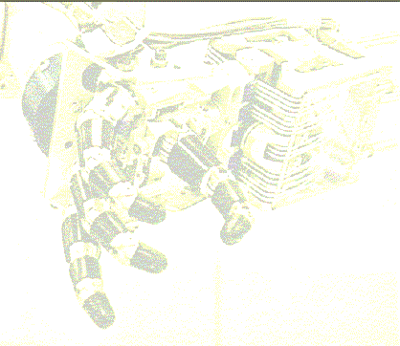
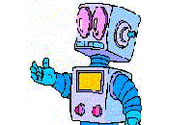
Inverse Kinematics
By Hector Rotstein
How do I put my
hand here?
IK: Choose these angles!

Slide 2
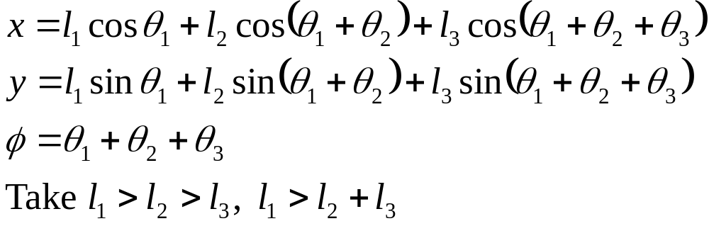



Example: Planar 3-link robot
What is the reachable space? Take l₁, l₂ fixed and vary θ₃
l₃
l₂
l₁
Now vary θ₁
Finally, vary θ₂

Slide 3
The Workspace
Workspace
Workspace: volume of space which can be reached by the end effector
Dextrous workspace: volume of space where the end effector can be arbitrarily oriented
Reachable workspace: volume of space which the robot can reach in at least one orientation

Slide 4
Example (continued)
What is the dextrous workspace in the example?

Slide 5
The IK Problem
Kinematic Problem: given joint angles and/or displacement, compute location and orientation of End Effector.
Inverse Kinematic Problem: given location and orientation of EE, find joint variables.
Why is IK hard?
May have more than one solution or none at all
Amounts to solving nonlinear trascendental equations (can be hard)

Slide 6
Existence of Solutions
A solution to the IKP exists if the target belongs to the workspace
Workspace computation may be hard. In practice is made easy by special design of the robot
The IKP may have more than one solution. How to choose the appropriate one?
2 solutions!

Slide 7
Methods of Solutions
A manipulator is solvable if the joint variables can be determined by an algorithm. The algorithm should find all possible solutions.
closed form solutions
numerical solutions
Solutions
We are interested in closed-form solutions
1. Algebraic Methods
2. Geometric Methods

Slide 8
Method of Solution (cont.)
Major result: all systems with revolute and prismatic joints having a total of six degrees of freedom in a single series chain are solvable
In general, solution is numerical
Robots with analytic solution: several intersecting joint axes and/or many α_{i} = 0, 90º.
One major application (and driving force) of IK: animation.

Slide 9
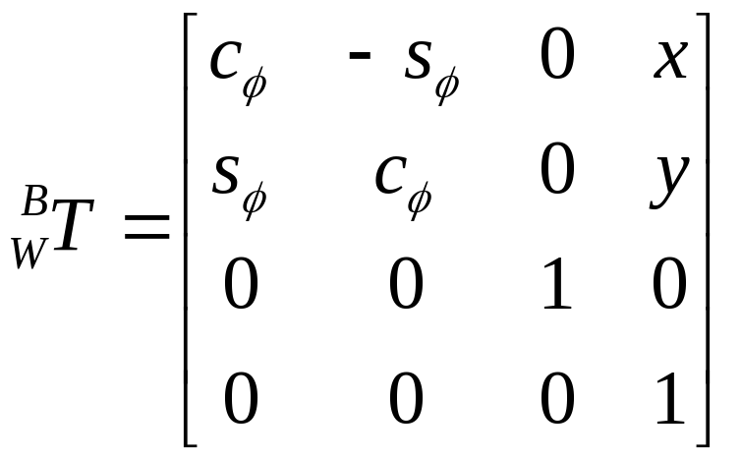
Manipulator Subspace when n<6
If n<6, then the workspace will be a portion of an n dimensional subspace
To describe the WS: compute direct kinematics, and then vary joint variables
On the previous example, the WS has the form:

Slide 10
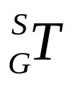
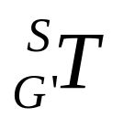
Manipulator SS when n<6 (cont)
Usual goal for manipulator with n DoF: use n parameters to specify the goal
If 6 DoF are used, n<6 will in general not suffice
Possible compromise: reach the goal as “near” as possible to original goal:
  1) Given the goal frame compute modified goal in manipulator SS as near as possible to
  2) Compute IK. A solution may still not be possible if goal is not in the manipulator workspace
For example, place tool frame origin at desired location, then select a feasible orientation

Slide 11
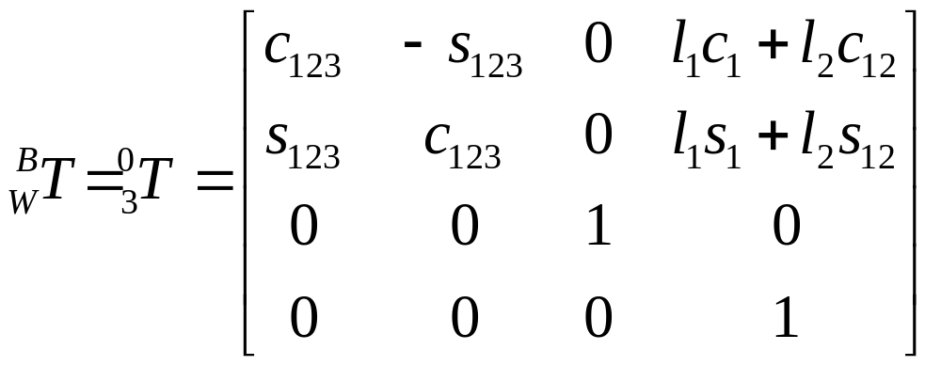
Algebraic Solution
The kinematics of the example seen before are:
Assume goal point is specified by 3 numbers:

Slide 12
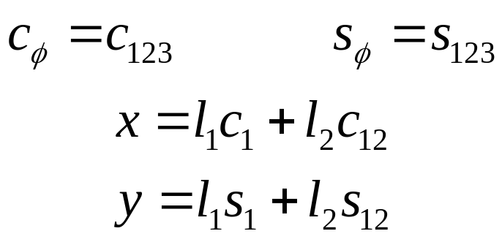
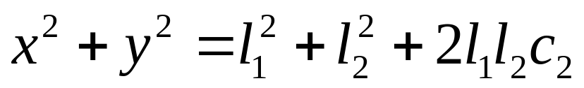
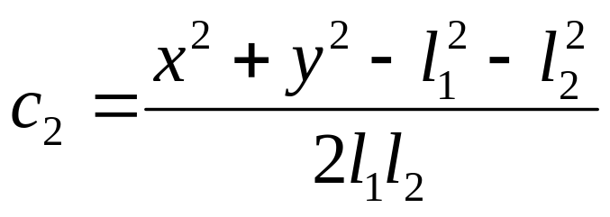
Algebraic Solution (cont.)
By comparison, we get the four equations:
Summing the square of the last 2 equations:
From here we get an expression for c₂

Slide 13
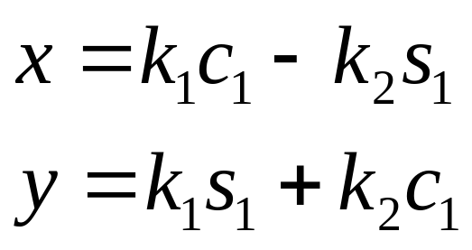
Algebraic Solution (III)
When does a solution exist?
What is the physical meaning if no solution exists?
Two solutions for θ₂ are possible. Why?
Using c₁₂=c₁c₂-s₁s₂ and s₁₂= c₁s₂-c₂s₁:
where k₁=l₁+l₂c₂ and k₂=l₂s₂. To solve these eq^{s}, set
r=+√ k₁²+k₂² and γ=Atan2(k₂,k₁).

Slide 14
Algebraic Solution (IV)
k₁
l₂
k₂
γ
θ₂
l₁
Then: k₁=r cos γ , k₁=r sin γ , and we can write:
x/r= cos γ cos θ₁ - sin γ sin θ₁
y/r= cos γ sin θ₁ + sin γ cos θ₁
or: cos(γ+θ₁) = x/r, sin(γ+θ₁) =y/r

Slide 15
Algebraic Solution (IV)
Therefore:
γ+θ₁ = Atan2(y/r,x/r) = Atan2(y,x)
and so:
θ₁ = Atan2(y,x) - Atan2(k₂,k₁)
Finally, θ₃ can be solved from:
θ₁+ θ₂+ θ₃ = φ

Slide 16
Geometric Solution
IDEA: Decompose spatial geometry into several plane geometry problems
y
θ₂
L₂
L₁
x
Applying the “law of cosines”:
x²+y²=l₁²+l₂² − 2l₁l₂cos(180−θ₂)

Slide 17
Geometric Solution (II)
Then:
y
ψ
β
The LoC gives:
l₂² = x²+y²+l₁² - 2l₁√ (x²+y²) cos ψ
So that cos ψ = (x²+y²+l₁² - l₂² )/2l₁√ (x²+y²)
We can solve for 0≤ ψ ≤ 180, and then θ₁=β±ψ
x

Slide 18
Reduction to Polynomial
Trascendental equations difficult to solve since one variable θ usually appears as cos θ and sinθ.
Can reduce to polynomial in variable
u = tan θ/2
by using:
cos θ = (1-u²)/(1+u²)
sin θ =2u /(1+u²)
How? Use the fact that sin θ =2[sin(θ/2)cos (θ/2)] and cos θ =[cos(θ/2)²- sin(θ/2)²]

Slide 19
Denavit-Hartenberg Parameters
Axis i
Axis i-1
θ_{i}
Xi
Link i
d_{i}
a_{i-1}
Xi-1
α_{i-1}

Slide 20
End of part 1

Slide 21
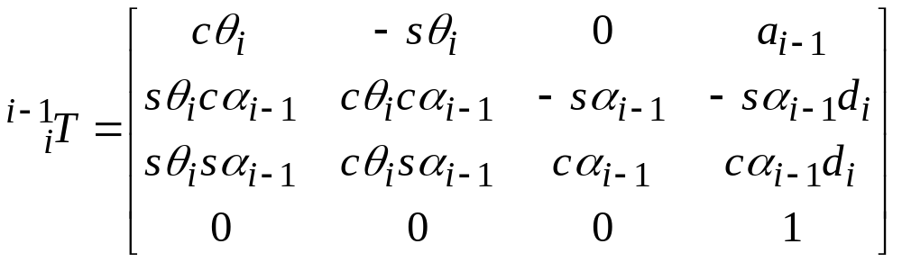
Piper’s Solution – 3 axis intersect
Solution for manipulators with 6DOF’s when three consecutive axis intersect
We will consider the case of revolute joints and last three axis intersect
Recall the transformation:

Slide 22
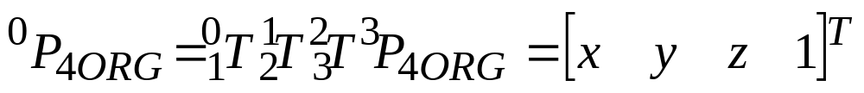
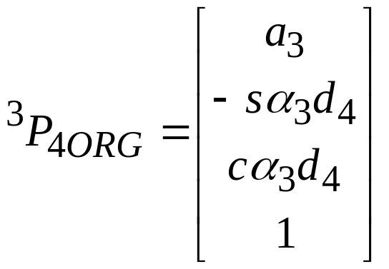
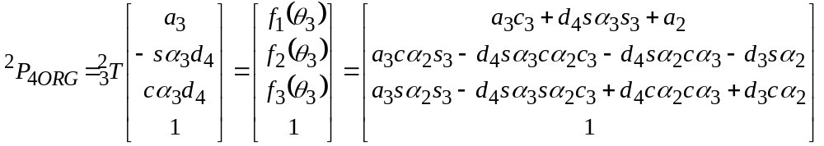
Piper’s Solution
The vector P_{4ORG} in the 3-frame has the form:
And in the 3-frame:

Slide 23
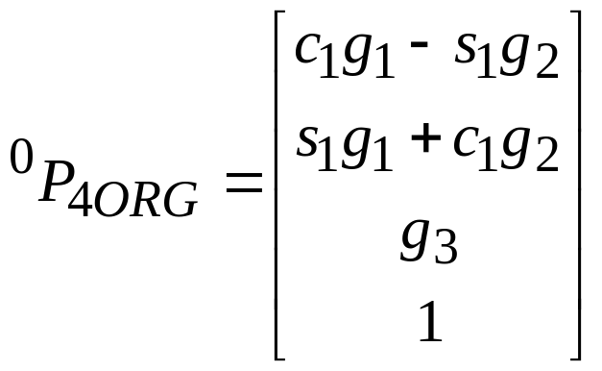
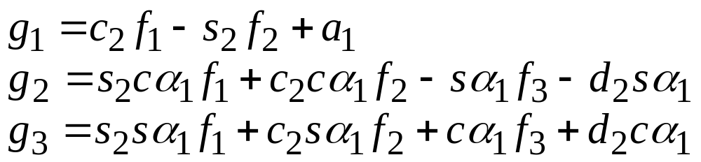
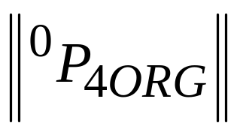
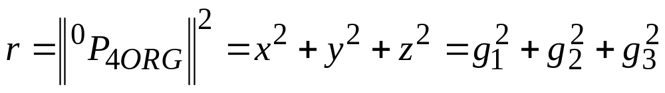
Piper’s Solution (II)
Repeating patiently
As mentioned before, for rotational joint
does not depend on θ₁:

Slide 24
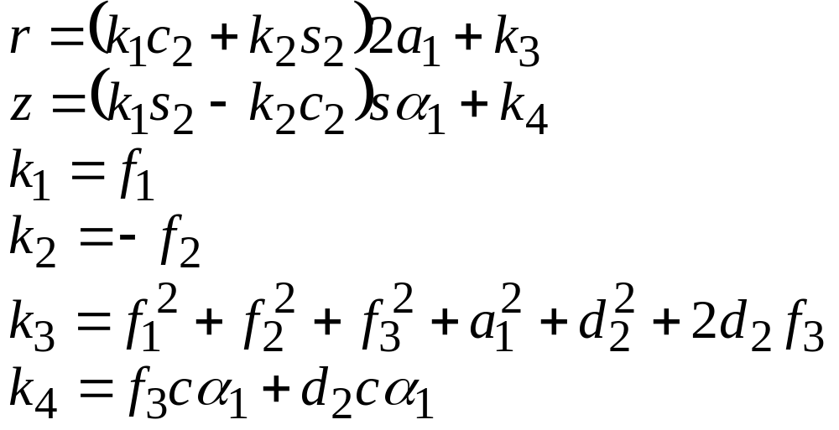
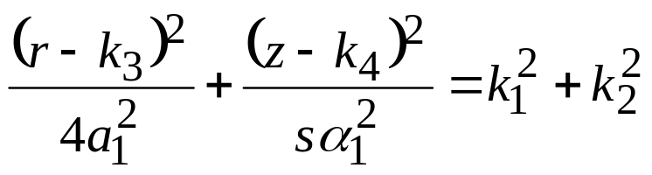
Replace the g_{i}’s, using z = g₃ and work patiently:
If a₁=0, r = k₃(θ₃). Solve for θ₃
If sin(α₁)=0, z = k₄(θ₃). Solve for θ₃
Otherwise, eliminate s₂ and c₂ above to get

Slide 25
Piper’s Solution (IV)
1 and 2 above give a quadratic equation in tan(θ₃/2)
3 gives an equation of degree four
Having solve θ₃, can solve above for θ₂ and θ₁
The remaining angles can be computed to give the desired orientation.

Slide 26
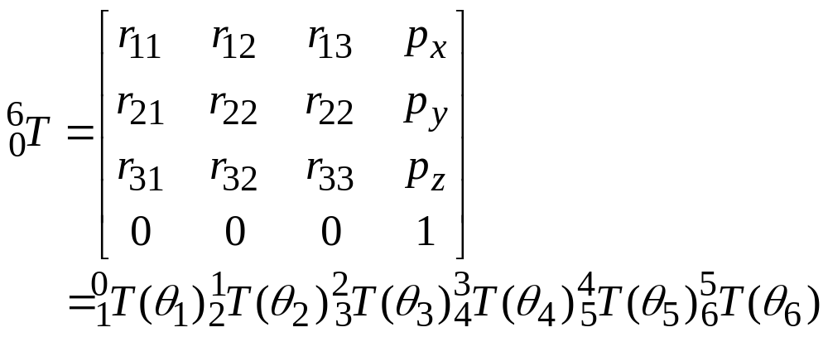
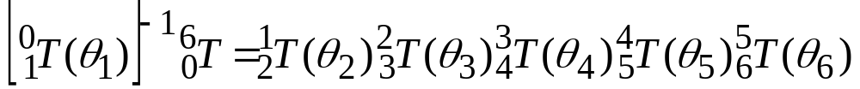
Example: PUMA560
Want to solve:
TRICK: Invert transformations to separate vbles:

Slide 27
PUMA560: DK Solution

Slide 28
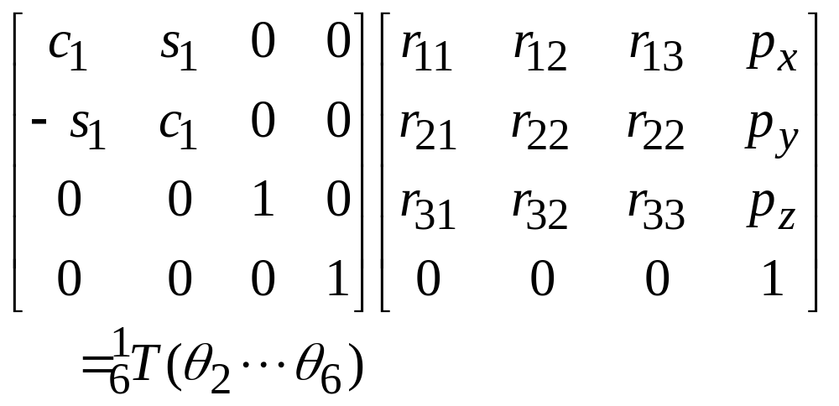
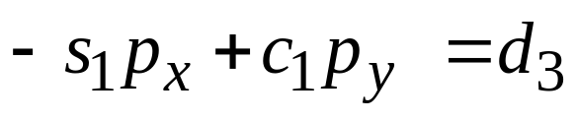
Then:
Equating (2,4) element from two sides:
Equation can also be obtained from “geometrical” arguments
Two possible solutions

Slide 29
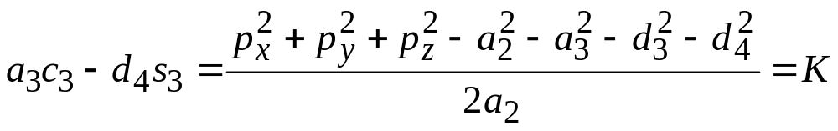
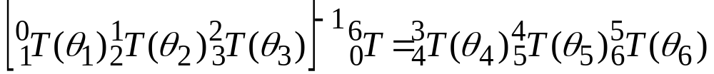
The size of the translation in {1} is independent of θ₁:
Geometrical meaning?
Two possible solutions
Write:
Repeat now a similar procedure

