Slide 1








Using SPFx with Local AI
Solution for IT & Management Concerns

Slide 2


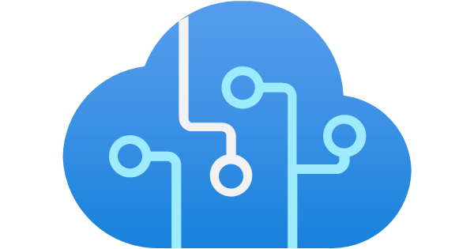
Solving Azure AI Challenges
Using SPFx with Local AI
Solution for IT & Management Concerns

Slide 3







Problems with Azure AI
Why IT & Management are Hesitant
Complex Azure settings and provisions create deployment barriers
Azure AI services cost double compared to standard counterparts
Unclear user permissions via AI may expose restricted data
AI toolbox actions not clear - potential for data sabotage
Vendor services raise legal concerns for restricted data access
Vendor services prevent IT from guaranteeing security

Slide 4
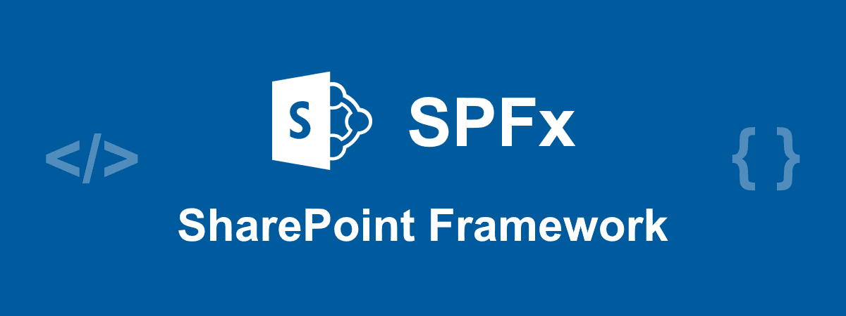




The Solution
SPFx with Local AI
SPFx inherits current user's permissions to SharePoint and Office 365
SPFx uses locally-controlled code developed by company employees
Local AI provides full control, zero external costs, and complete logging
Company server hosting ensures full control and access restrictions

Slide 5








Problems Solved
Full IT Control & Security
NO complex Azure settings and provisions required
NO ongoing costs other than server/GPU infrastructure
NO separate AI permissions - inherits current user's access rights
NO unknown AI tools - AI cannot take independent actions
NO vendor services - legal has already approved user access to data
NO vendor dependency - IT has full control over security environment

