Slide 1
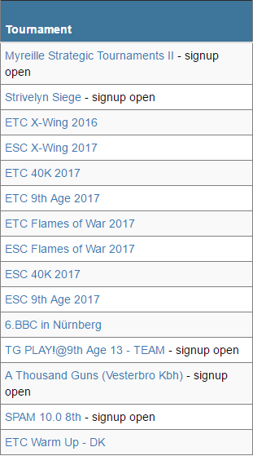
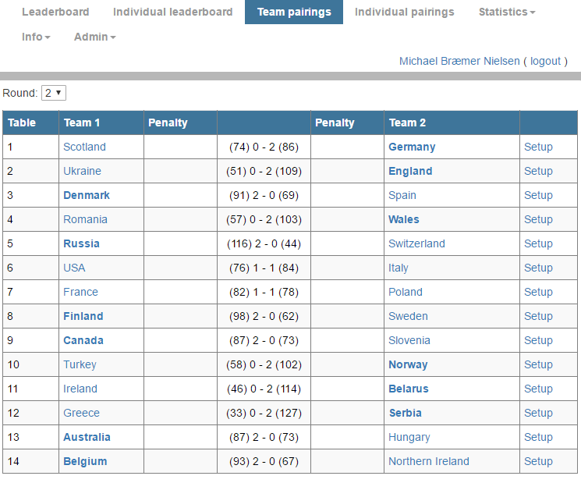
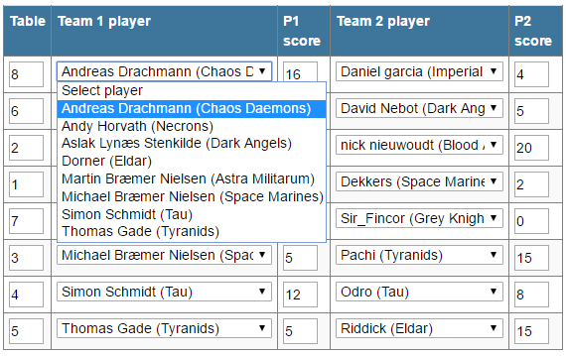
Setting up pairings in TourneyKeeper
1. Visit TourneyKeeper.net using a browser and log on by using the username/password you signed up for the tournament with.
2. Find your tournament and click the link.
3. Click Team Pairings and then Setup for your match.
4. Decide who enters pairings and fill out pairings, one game at a time, starting from the top, by selecting in the drop downs. Remember to enter table number!

