Slide 1
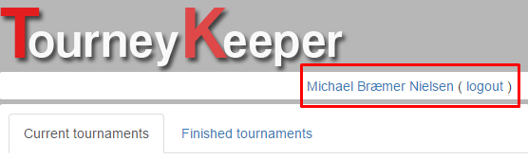
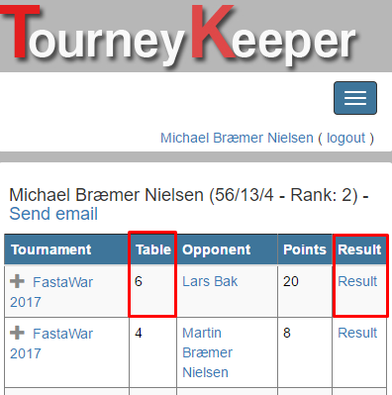
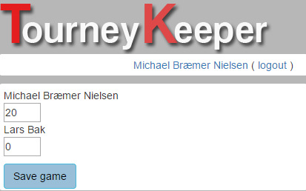
Entering scores in TourneyKeeper
1. Visit TourneyKeeper.net using a browser and log on by using the username/password you signed up for the tournament with. For team games - make sure your captain has created the pairings.
2. Click your name in the top-right corner.
3. The top game will list which table you are to play on. Click Result to enter results for the game.
4. Enter results and click Save game.

