Slide 1
It’s a TRaP: Table Randomization and Protection Against Function-Reuse Attacks
Written By: Crane et al.
Presented By: Bret Finley

Slide 2
Memory Corruption Attacks
Sometimes referred to as stack-smashing
These attacks exploit data stored in RAM
Execute data as machine instructions
Buffer-Overflow corrupts and overwrites legitimate data
Overwriting return address can lead to the Program Counter (PC) being hijacked
Especially prevalent in languages which utilize manual memory allocation/deallocation
Most notably C and C++

Slide 3
Code Injection Attack
Code Injection seeks to supplant legitimate code with that of malicious code
Overflow a buffer with malicious, carefully crafted code
The hijacked program counter will return into the attacker’s code
Malicious code is freshly introduced into the system from an outside source

Slide 4
Code Reuse Attack
Focuses on using pre-existing system or library code, rather than injected code
As before, the attacker must overflow a buffer in order to hijack the program counter
Return-to-Libc is a famous example of a Code Reuse Attack
Contains many system utility functions
A veritable playground for attackers

Slide 5
ROP Attack
A variety of Code Reuse Attack
ROP stands for Return Oriented Programming
Once the control flow is hijacked, the attacker employs a sequence of machine instructions called “gadgets”
Each gadget terminates with a return instruction (ret)
Transfers control to the next gadget
Gadgets may be chained together in order to execute a sequence of subroutines

Slide 6
JIT-ROP
JIT-ROP stands for Just-In-Time Return-Oriented-Programming
Developed to overcome address randomization
Abuse memory disclosure in order to map memory on the fly
Tricks the machine into disclosing the new randomized layout
Construct and compile malicious application on the fly

Slide 7
COOP Attack
COOP stands for Counterfeit Object-Oriented Programming
Focuses on exploiting a vulnerability in C++ inheritance
External library calls are stored and looked up in a table at runtime (dynamically-bound functions)
Allows for method selection at runtime
Semantically similar to Return-to-Libc, but exploits virtual (inherited) functions

Slide 8
The Fall of Code Injection
Data Execution Prevention (DEP) has resulted in the downfall Code Injection
noexecstack in linux
Prevents data from being interpreted as machine instructions
Very problematic for code injection
Address randomization has further complicated Code Injection
These advancements led to the increased popularity of Code Reuse Attacks

Slide 9
Defending Against Reuse Attacks
Address Randomization
Can’t assume address layout as base address is random between executions
Not a silver bullet
Just-In-Time Compilation allows for attacker to learn address layout on the fly
Readactor Security Framework
Aimed at defending against JIT-ROP attacks
Hides code pointers and late-binding code from attackers
Cannot stop COOP attacks

Slide 10
Motivation
Want to bolster randomization defenses for Code Reuse Attacks
RILC
COOP
Provide existing techniques with three contributions
Obfuscate object tables containing code pointers
Lay traps to discourage and diminish probing attacks
Modify virtual tables from read-access to execute-access, preventing layout disclosure

Slide 11
Inheritance in C++
Unlike Java, C++ supports multiple inheritance
Inherited methods must be explicitly defined with the virtual keyword
If a method is not specified to be virtual then subclasses may not override it
Virtual methods have bodies, pure virtual (abstract) methods do not
Non-virtual methods are compiled statically and called directly
Virtual method calls depend on the calling context

Slide 12
Virtual Methods
Virtual method calls contain a pointer to a table
The VTable (virtual table) contains all of the overridden versions of a method
The pointer will select the correct entry in the virtual table when the function is called

Slide 13
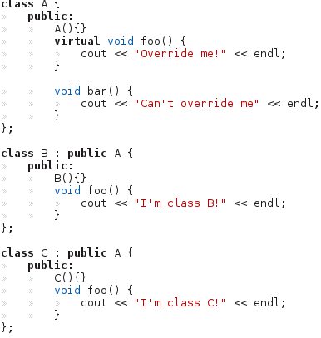
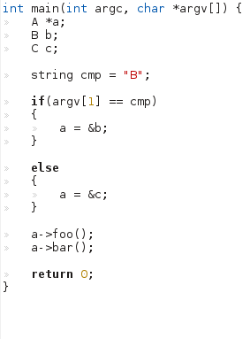

Slide 14
Function Linking at Runtime
Dynamic linking allows for late binding between symbols and their routines
This allows for varied program behavior given a single function call
Symbols-to-function addresses are kept in tables which can be looked up (and even modified) at runtime

Slide 15
Exploiting VTables
The COOP attack works by replacing the legitimate vtable with a malicious vtable
Virtual table contains function pointers which are stored in read-only memory
However, The pointer to the table itself, is stored in writable memory
To execute the attack, the attacker must
Craft their very own virtual table
Overwrite the existing vtable pointer to their own virtual table

Slide 16
Exploiting VTables Cont.
Once this is done, the next virtual table lookup will point to the malicious table
Essentially, the attacker interposes their own virtual table
Virtual method lookups will be directed here
Once corrupted, the attacker may inject their own methods in place of legitimate methods

Slide 17
Main Loop Gadget
Analogue to gadgets from ROP
Otherwise know as ML-G
Defined as: “The first virtual function that is executed in a COOP attack and its role is to dispatch the other virtual functions, called vfgadgets that make up the COOP attack”
One might think that the COOP threat may be nullified by removing potential ML-Gs
To disprove this, the authors devised two ML-Gs of their own
Recursive COOP
Unrolled COOP

Slide 18
Recursive COOP
Any virtual method which invokes further virtual methods is a candidate for attack
Destructors which call further destructors are the most popular target

Slide 19
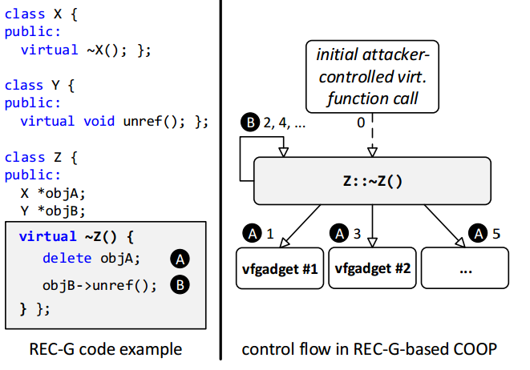

Slide 20

Unrolled COOP
Possible to devise an attack without recursion or iteration
A series of two or more virtual method calls provide an opportunity for an ML-G
Remember that the destructors called here need to be virtual

Slide 21
Security Requirements
Writable OR Executable, not both
Table-splitting and randomization
Execute Only Instructions
CPU may fetch and execute instructions, but reading and writing instructions is not allowed
Store functions in execute-only memory
JIT Protection
Protect against real-time memory disclosure
Trampolines
Defense Against Brute Force and Probing
Brute-Force attacks could incrementally reveal the randomized address space
Booby-traps

Slide 22
Countering Attacks
“Show that probabilistic defenses can thwart function reuse attacks”
Their solution: Readactor++
Readactor is a security framework aimed at combatting ROP attacks
Wanted to extend Readactor so it could defend against COOP attacks as well

Slide 23
Countering Attacks Cont.
Readactor++ protects compiled binaries in four ways
Virtual Table splitting
Booby Trapping Execute-Only table entries
Collect Translation and Protection metadata
Randomize Virtual Table layout to make injection more difficult
Readactor++ took the form of a modified C++ compiler

Slide 24
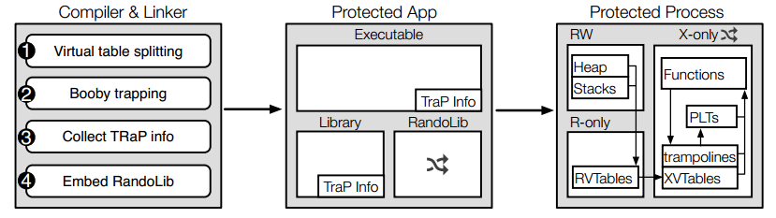
Overview of Readactor++
Notes:
A specialized compiler creates Readactor++ apps that randomize their in memory representation. A small runtime component, RandoLib uses TRaP metadata embedded in binaries to safely permute the layout of vtables and procedure linkage tables without disassemble the entire application. We prevent the disclosure of randomized code using execute-only memory.

Slide 25
Memory Disclosure
Attackers can use tricks to force the system to disclose its memory layout
Read the code segment of the program stack
Read code pointers from vtables, stack, or heap
Readactor++ combats this by hiding all code pointers and replacing them with “trampolines”

Slide 26
Memory Disclosure Cont.
A trampoline is simply a jump instruction to the pointer
Trampolines provide an extra layer of indirection which hides the code segment
Because trampolines may not be dereferenced (unlike pointers), attackers cannot force them to give away their memory layout

Slide 27
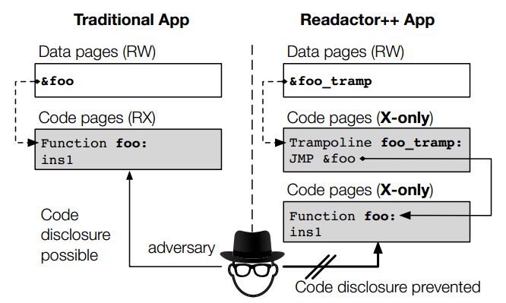
Trampolines
Notes:
In traditional apps, adversaries can locate and read functions by following code pointers. We only store pointers to trampolines in readable memory. Trampolines prevent indirect disclosure of the function layout because trampolines are non-readable and their layout is randomized independently of other code.

Slide 28
Virtual Table Randomization
Every C++ object contains necessary metadata for pointing to its virtual table
Known as the vptr
Simply randomizing the object’s metadata layout is not enough
Can be attacked much the same as address randomization

Slide 29
Virtual Table Randomization Cont.
The virtual table’s themselves are better candidates for randomization
Once these tables are randomized, we need to prevent code pointers from being read
Solution: split the virtual tables into read-only and execute-only

Slide 30
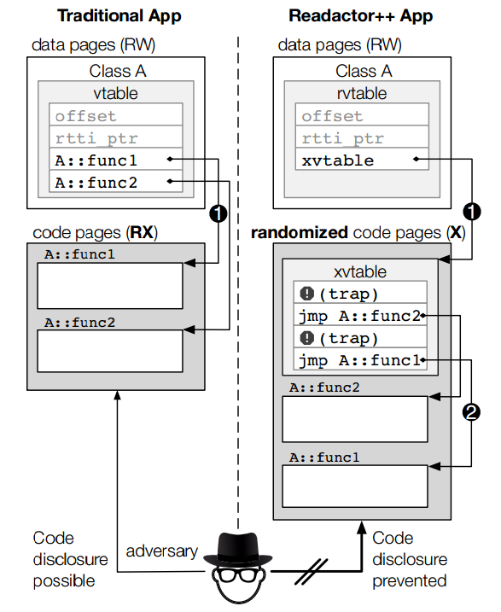
Notes:
Without protection, an adversary that can read arbitrary memory can read the vtable contents and disclose the function layout. In Readactor++ apps, the readable part of the vtables (rvtable) contain no code pointers and the executable randomized part (xvtable) is not readable
rtti- runtime type information

Slide 31
Guessing Attacks
Brute force attacks on the virtual tables are a big concern
Attacker could probe the randomized vtable until they are familiar with the layout
Placing booby-traps in the execute-only portion of the vtable will discourage probing
Triggering a booby trap
Program will immediately terminate
Virtual Table layout will freshly randomize
Application reports the activity to a system administrator

Slide 32
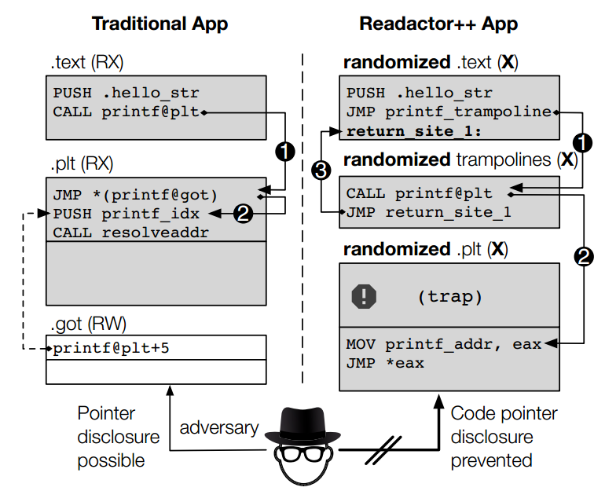
Notes:
In traditional apps, functions call PLT entries. In Readactor++ apps, functions first jump to a trampoline which performs the actual call, so that the actual return addresses are not leaked. Moreover, we resolve the targets of PLT entries, remove the global offset table (GOT), and add booby traps to deter probing.

Slide 33
Procedure Linkage Table Randomization
Acts as a map for dynamically linked library functions
Exploiting this structure is vital to a RILC attack’s success
Entries are usually organized in series, with the base addresses randomized
Readactor++ randomizes entries, as well as sets booby traps to protect against exploitation
Trampolines are added to ensure the function locations cannot be dereferenced
Lastly, TRaP data is collected in order to update call instructions with the new, random function address

Slide 34
Overview of Readactor++
Notes:
A specialized compiler creates Readactor++ apps that randomize their in memory representation. A small runtime component, RandoLib uses TRaP metadata embedded in binaries to safely permute the layout of vtables and procedure linkage tables without disassemble the entire application. We prevent the disclosure of randomized code using execute-only memory.

Slide 35
TRaP Metadata
Stands for “Table Randomization and Protection”
TRaP info represents the newly randomized locations of dynamically loaded functions and vtables
TRaP is specialized metadata that is compiled into the binary directly
Every dynamic function call and virtual call must be updated with the new address

Slide 36
RandoLib
Randomization engine for assigning new function addresses
Alter table layouts and locations
Update call sites and references to change functions using the TRaP data

Slide 37
Security Performance
Trampoline addresses are still readable
Possible security extension, could cause problems
Brute-Force Attacks
Probe the stack until the layout is known
Booby-traps stopped almost all brute-force attacks
Success rate was found to be about 0.0003%
Practical Attacks – Chromium Web Browser
JavaScript was used to create read/write locations for both COOP and RILC attacks
Both attacks were successful on vanilla Chromium and failed on Chromium compiled with Readactor++

Slide 38
Runtime Efficiency Concerns
Built the Chromium web browser using Readactor++
Can only measure performance of C++ components in the Chromium system
Measured the performance of scrolling over a large web page
Google
Gmail
CNN
Facebook
Table randomization alone resulted in about 1.0% overhead increase
The addition of x-only memory and trampolines incurred a performance overhead of 7.9%

Slide 39
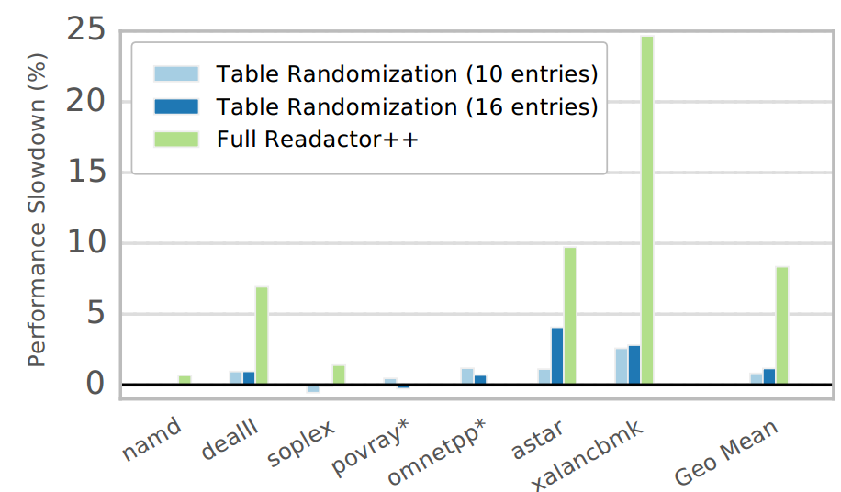

Slide 40
Future Work
Other table based attacks
C Programming Language utilizes tables of function pointers
Randomization of data structure layouts
Further protect stack objects by randomizing their layout
Dynamically linked libraries
These could be a potential attack vector for the clever hacker
Libraries loaded at runtime could be vulnerable to COOP attack
Want to provide protection at runtime for these libraries

Slide 41
Limitations
Readactor++ covers only those programs which adhere to the C++ language specification
Programs which rely on compiler-introduced changes to the vtable are not protected
Vtables can have different implementations between platforms and compilers

Slide 42
Limitations Cont.
Programs which include external libraries must be compiled with the same version as the external library
External libraries may be rebuilt with Readactor++ to follow this rule

Slide 43
Related Work
There have been many studies concerning memory corruption and its defense
Code Layout Randomization
Defense schemes for obfuscating and combatting memory layout disclosure
Control-Flow Integrity
Defend against illegal program states
Code Pointer Integrity
Defend against code pointer exploitation

Slide 44
Code Layout Randomization
Oxymoron—scheme for hiding direct code references
Oxymoron – Making Fine-Grained Memory Randomization Practical by Allowing Code Sharing by M. Backes and S. Nurnberger
Defends against memory disclosure by disallowing direct code references
Very similar to trampolines
Vulnerable to clever use of JIT-ROP as code pages are still readable

Slide 45
Control-Flow Integrity
COOP Safe Compiler
Secure C++ Virtual Calls From Memory Corruption Attacks by D. Jang, Z. Tatlock, and S. Lerner
Protect vtable pointer from modification
Attacker is unable to point it to their malicious code
Unfortunately, their method is vulnerable to RILC attacks as they do not protect return instructions

Slide 46
Code-Pointer Integrity
Separate code pointers and pointers to code pointers
Eternal War in Memory by L. Szekeres, M. Payer, T. Wei, and D. Song
These pointers are put in a safe memory area
Only functions determined “trustworthy” may be given access to these pointers
Trustworthiness is determined at compile-time, not runtime
While this scheme runs efficiently in C, programs in C++ incur a stiff overhead (>40%)

Slide 47
Conclusions
Code Reuse attacks, namely ROP and COOP attacks have become increasingly troublesome
Readactor++ is an interesting and novel defense against COOP attacks
Readactor++ has been shown to
Resist information disclosure
Identify attacks and notify the host system
When using clever configuration options, Readactor++ has been shown to have negligible affect on system performance

Slide 48
Questions?

