Slide 1
Criminal Activity in Chicago, Illinois
Bret Finley

Slide 2
Problem
Crime is an ever-present issue
Crimes committed everyday are just added on top of a growing “pile” of data
Much of this data is textual in nature
Location values
Date/Time data
Need a way to visualize this data
Notes:
No matter how you look at it crime is a very prevalent issue
Lots of crimes coming in and adding to the pile, the dataset I pulled from is constantly being updated
This data is pretty much what you’d expect, location, date, maybe an offense code of some kind, what type of crime was committed
Wanted a way to visualize this data, in this case primarily geographic

Slide 3
Audience
Wanted views to be plain and easy to understand
Also wanted users to be able to dive into and explore the data
Can be appreciated by the general public
Power users should be able to ask and answer more interesting questions
Notes:
Wanted the application to be simple enough to be appreciated by everyone
But powerful enough to allow more experienced users to ask interesting questions
Skip if taking too long

Slide 4
Dataset
Consists of reported criminal activity within the city limits of Chicago, Illinois
Each data element represents a single reported crime
Except homicides which are divided in to crime/victim
Each row value consists of several column values
Crime type
Latitude/Longitude where crime occurred
Chicago community area
Date/Time when crime occurred
Notes:
Dataset consists of individual crime reportings within Chicago, Illinois
Each point of data represents a single crime, except homicides

Slide 5
The Application
Notes:
Do the demo here
4 minutes

Slide 6
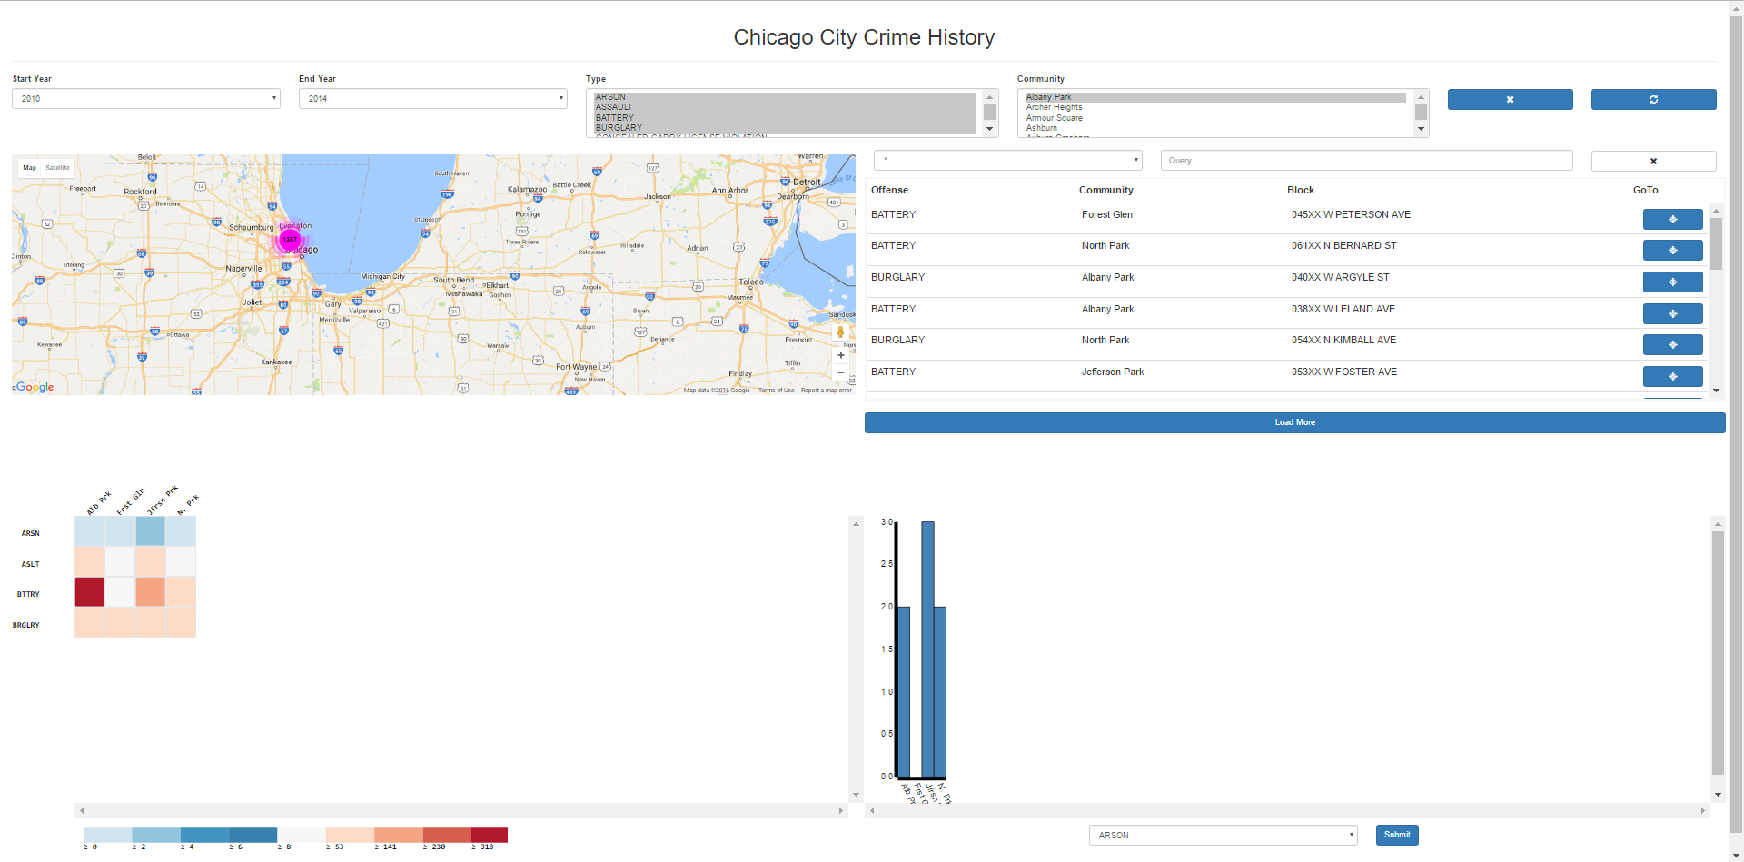

Slide 7
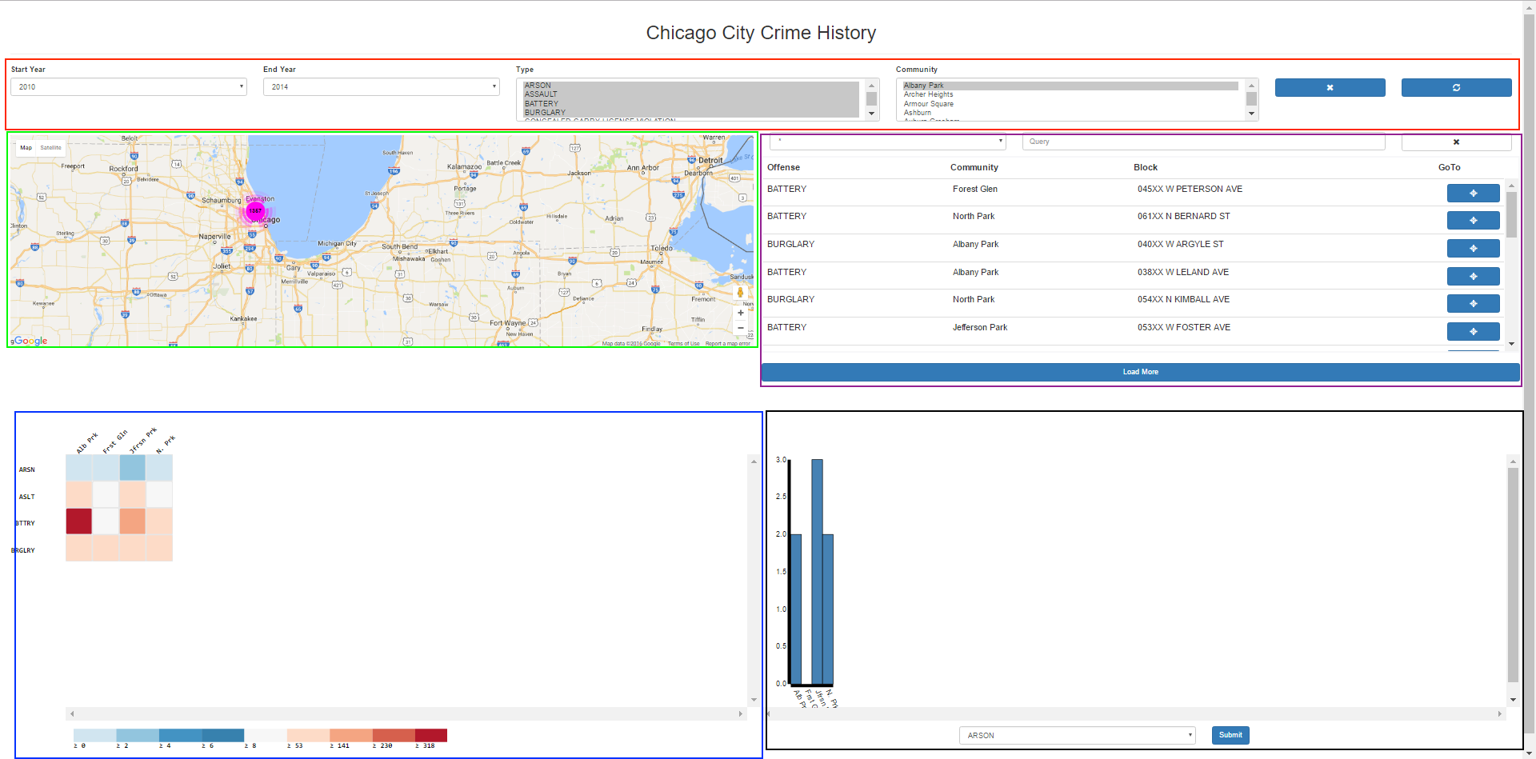

Slide 8
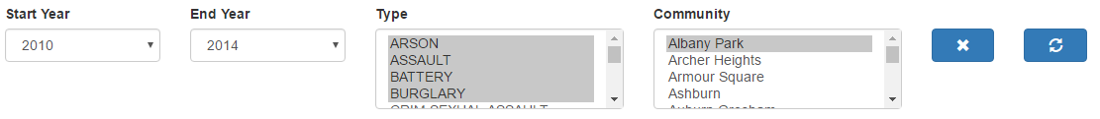
Filter Bar

Slide 9
View 1: Map

Slide 10
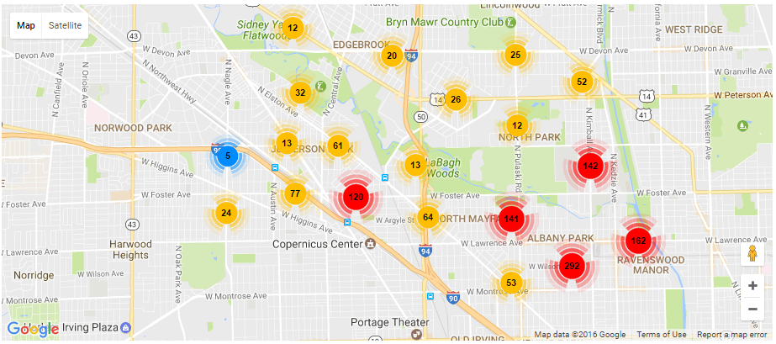

Slide 11
View 2: Table

Slide 12
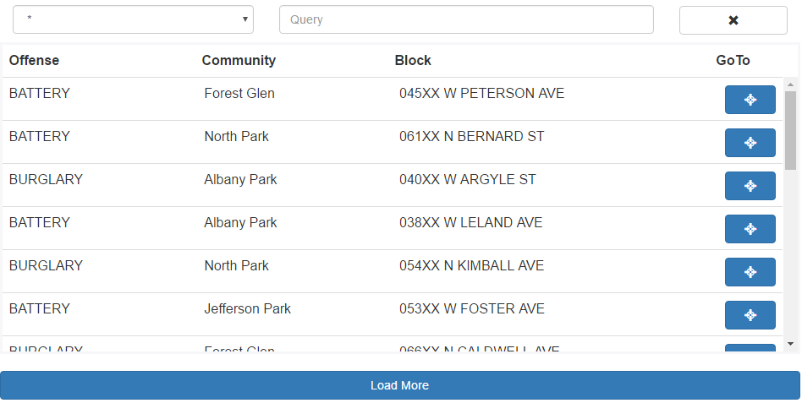

Slide 13
View 3: Heatmap

Slide 14
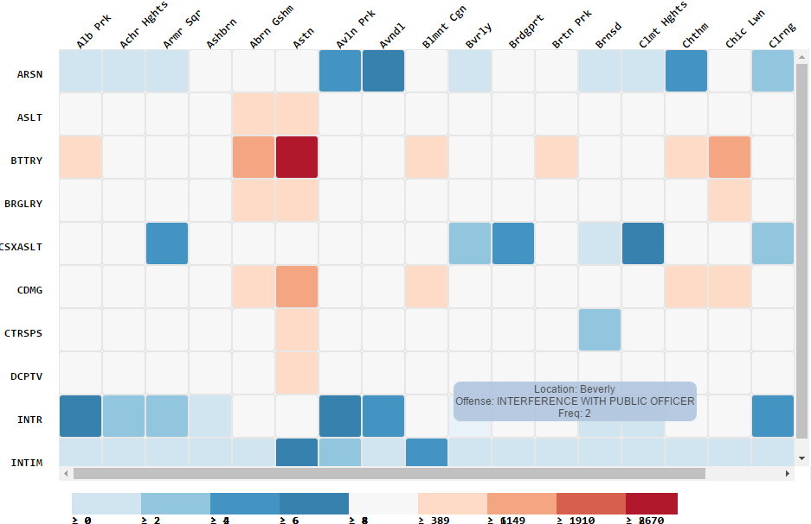

Slide 15
View 4: Bargraph

Slide 16
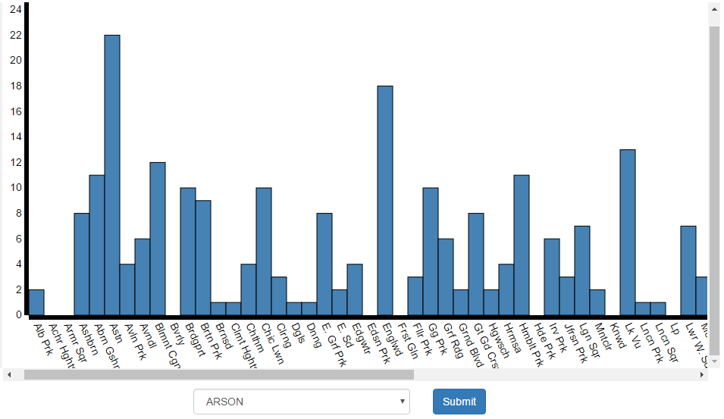

Slide 17
Project Stack
Frontend: AngularJS with JavaScript and HTML
Controller acts as a layer between view and data
Directives provide frontend templating and modularization
Services allow for reusable library modules
HTML with Angular templating allow for two-way data binding between view and controller
Notes:
9 minutes

Slide 18
Project Stack Cont.
Other Software
Google Maps for showing geographical data
D3 allows for rendering graphical representations
Backend: Node JavaScript server
ExpressJS provides routing facilities
Node file system library along with CSV library deserializes data on startup

Slide 19
Misc. Software
Lodash – JavaScript data structure utility library
dateFormat() – Library for JavaScript date formatting
MarkerClusterer – Utility for grouping Google Map markers
SortTable – Tool for making sortable HTML table headers
Notes:
Skip if taking too long (around 10 minutes)

Slide 20
Project Architecture

Slide 21
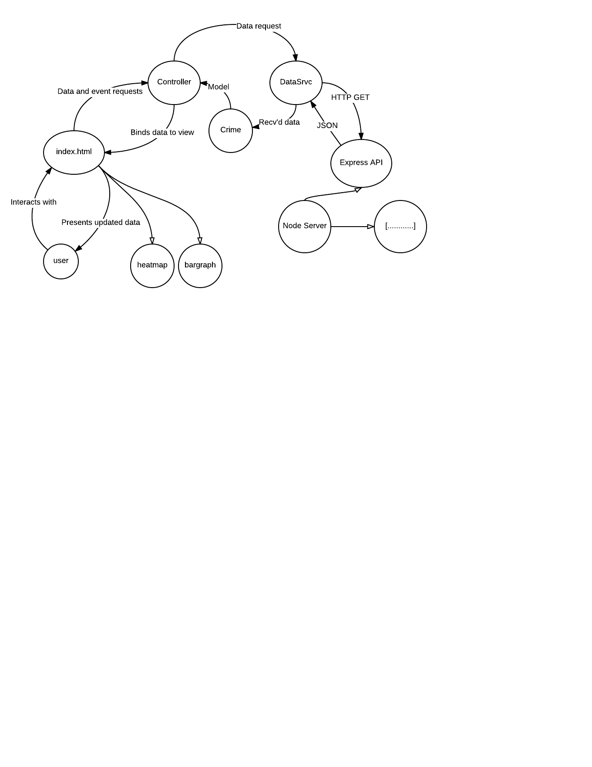
/
Notes:
10 minutes

Slide 22
Challenges
Deciding the purpose and scope of the project
Many different dimensions of data allows for almost limitless inquiry
Dataset was very large, performance was always a concern
Memory consumption
Computational performance
Diverse software stack complicated communication between modules

Slide 23
Future Work
Warn user when requesting a large number of API results
Differentiate clustered markers with same location
Add a view which organizes crimes according to when they occurred
Qualitative user study

Slide 24
Conclusions
Many different pieces went into building this application
Server is key to performance when working with lots of data
Must be judicious with what pieces of the data you want to visualize
Different views are useful for focusing what you want to show
Notes:
In order to achieve such a varied application, I had to make use of a good number of software packages
Had to use a server to offload some of the work from the client, just loading from disk was very slow
I had to be choosy of what I wanted to show, the user has to be choosy about what they want to see
With so many different aspects of the data, different views allow for separating and focusing user attention

Slide 25
Questions?

