Slide 1
Information and Communications Technology Fundamentals
ITEF113
Chapter 1

Slide 2
Introduction to Computers
Objectives:
Recognize the importance of computer literacy
Define the term, computer
Identify the components of a computer
Discuss the advantages and disadvantages of using computers
Recognize the purpose of a network

Slide 3
Introduction to Computers
Objectives:
Discuss the uses of the Internet and World Wide Web
Distinguish between system software and application software
Describe the categories of computers
Identify the elements of an information system
Discuss various computer applications in society

Slide 4
A World of Computers
What is computer literacy?
  Knowledge and understanding of computers and their uses
  Computers are everywhere

Slide 5
What is a Computer?
How is a computer defined?
    Electronic device operating under the control of instructions stored in its own memory
    Accepts data
    Raw facts, figures, and symbols processes data into information
    Data that is organized, meaningful, and useful produces and stores results

Slide 6
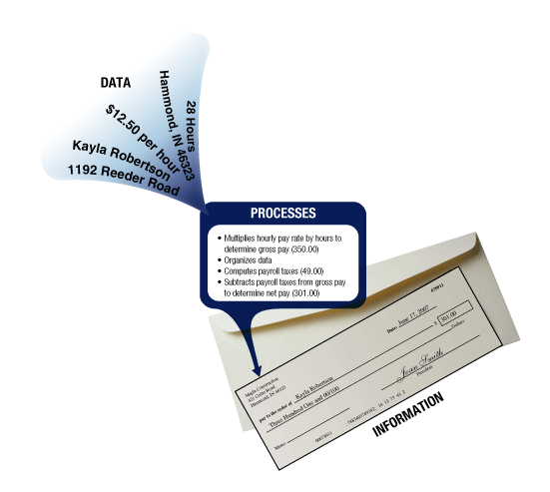
What is a Computer?
What is the information processing cycle?
  Input
  Process
  Output
  Storage
  Communication

Slide 7
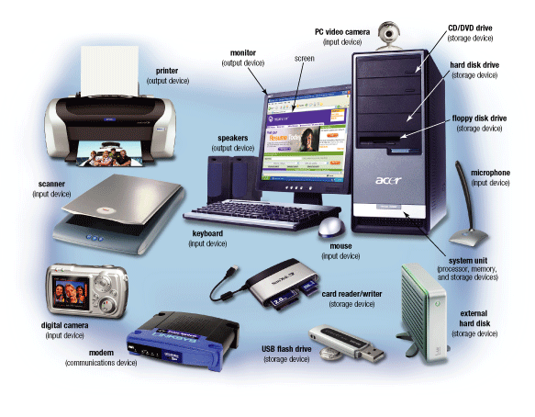
The Components of a Computer
What is an input device?
Hardware used to enter data and instructions

Slide 8
The Components of a Computer
What is an output device?
Hardware that conveys information to one or more people

Slide 9
The Components of a Computer
What is the system unit?
Case containing electronic components used to process data

Slide 10
The Components of a Computer
What are two main components on the motherboard?
  Processor
    Also called a Central Processing Unit (CPU)
    The electronic component that interprets and carries
    out the basic instructions that operate the computer
  Memory
    Consists of electronic components that store
    instructions waiting to be executed and data needed by
    those instructions

Slide 11
The Components of a Computer
What is storage?
  Holds data, instructions, and information
  for future use
  Storage media
      Physical material on which data, instructions,
      and information are stored
  Storage device
      Records and retrieves items to and from
      storage media

Slide 12
The Components of a Computer
What is a floppy disk and USB flash drive?
Floppy Disk
Thin, circular, flexible
disk enclosed in a
square-shaped plastic
shell
Stores up to about 1.4
million characters
USB Flash Drive
Provides much greater storage
capacity than a floppy disk or
Zip® disk
Small and lightweight
enough to be transported
on a keychain or in a
pocket

Slide 13
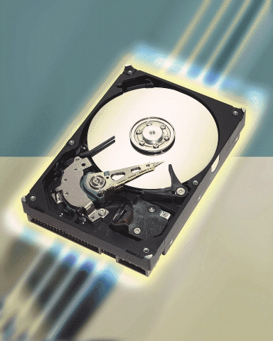
The Components of a Computer
What is a hard disk?
  Provides greater storage
  capacity than a
  floppy disk, Zip disk, or
  USB flash drive
  Most are housed inside
  of the system unit

Slide 14
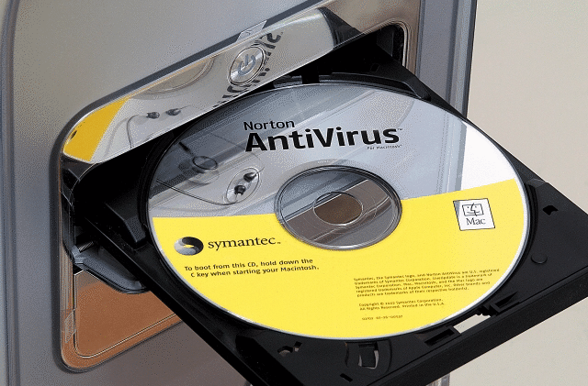
The Components of a Computer
What is a compact disc?
  Flat, round, portable metal disc

Slide 15
The Components of a Computer
What is a communications device?
Hardware component that
enables a computer to
send and receive data, instructions,
and information
Occurs over cables, telephone
lines, cellular radio networks,
satellites, and other
transmission media
Click to view Web Link,
click Chapter 1, Click Web Link
from left navigation,
then click Communications Devices below Chapter 1

Slide 16
Advantages and Disadvantages of Using Computers
What are the advantages of using computers?
Reliability
Speed
Consistency
Storage
Communications

Slide 17
Advantages and Disadvantages of Using Computers
What are the disadvantages of using computers?
Violation of
Privacy
Impact on
Labor Force
Health Risks
Impact on
Environment

Slide 18
Networks and the Internet
What is a network?
  Collection of computers and devices connected together
Used to share
Resources
Hardware
devices
Saves
time
and
money
Software
programs
Data
Information

Slide 19
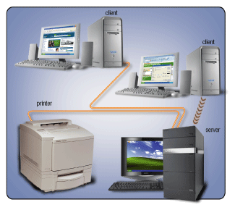
Networks and the Internet
What is a server?
  A server manages the resources on a network
  Clients access
  the resources
  on the server

Slide 20
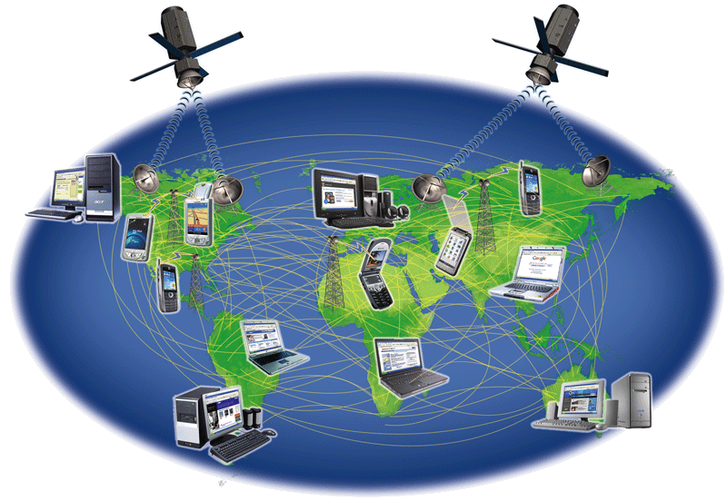
Networks and the Internet
What is the Internet?
  Worldwide collection of networks that connects
  millions of businesses, government agencies, educational institutions, and individuals
Click to view Web Link,
click Chapter 1, Click Web Link
from left navigation,
then click Internet
below Chapter 1

Slide 21
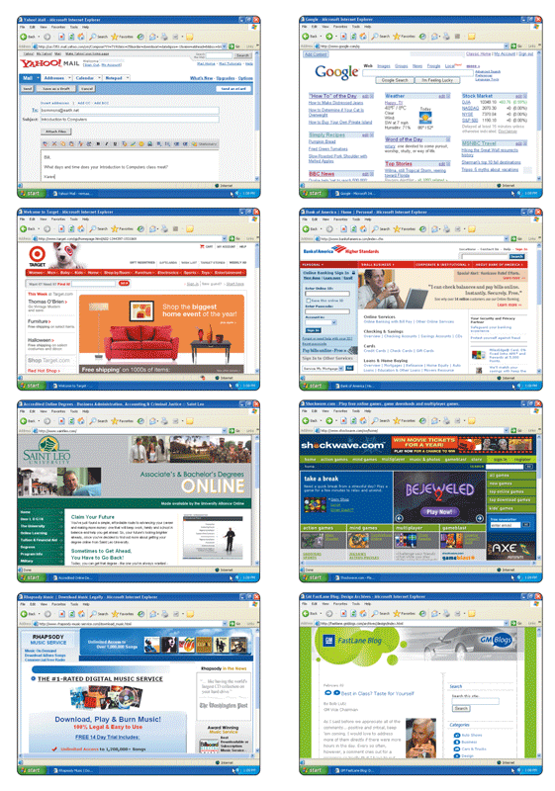
Networks and the Internet
Why do users access the Internet?
  Communication
  Information
  Shopping
  Banking and Investing
  Classes
  Entertainment
  Download Music
  Share Information

