Slide 1
Chapter 10: DHCP
Routing & Switching
Notes:
Cisco Networking Academy program
Routing & Switching
Chapter 10: DHCP

Slide 2
Chapter 10
10.0 Introduction
10.1 Dynamic Host Configuration Protocol v4
10.2 Dynamic Host Configuration Protocol v6
10.3 Summary
Notes:
Chapter 10

Slide 3
Chapter 10: Objectives
Describe the operation of DHCPv4 in a small-to-medium-sized business network.
Configure a router as a DHCPv4 server.
Configure a router as a DHCPv4 client.
Troubleshoot a DHCP configuration for IPv4 in a switched network.
Explain the operation of DHCPv6.
Configure a stateless DHCPv6 for a small-to-medium-sized business.
Configure a stateful DHCPv6 for a small-to-medium-sized business.
Troubleshoot a DHCP configuration for IPv6 in a switched network.
Notes:
Chapter 10 Objectives

Slide 4
10.1 Dynamic Host Configuration Protocol v4
Notes:
10.1 Dynamic Host Configuration Protocol v4

Slide 5
DHCPv4 Operation Introducing DHCPv4
DHCPv4 uses three different address allocation methods:
Manual Allocation – The administrator assigns a pre-allocated IPv4 address to the client, and DHCPv4 communicates only the IPv4 address to the device.
Automatic Allocation – DHCPv4 automatically assigns a static IPv4 address permanently to a device, selecting it from a pool of available addresses.
Dynamic Allocation – DHCPv4 dynamically assigns, or leases, an IPv4 address from a pool of addresses for a limited period of time chosen by the server, or until the client no longer needs the address. This method is the most commonly used.
Notes:
10.1.1.1 Introducing DHCPv4

Slide 6
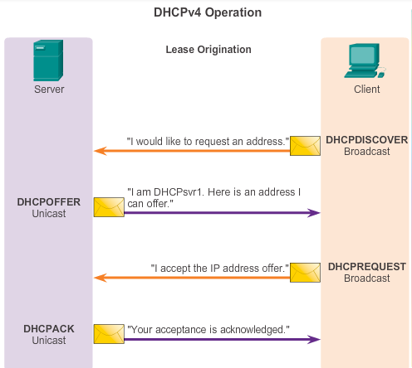
DHCPv4 Operation DHCPv4 Operation
Notes:
10.1.1.2 DHCPv4 Operation

Slide 7
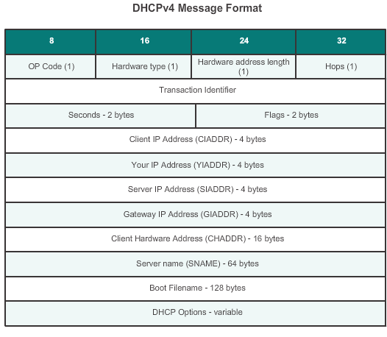
DHCPv4 Operation DHCPv4 Message Format
Notes:
10.1.1.3 DHCPv4 Message Format

Slide 8
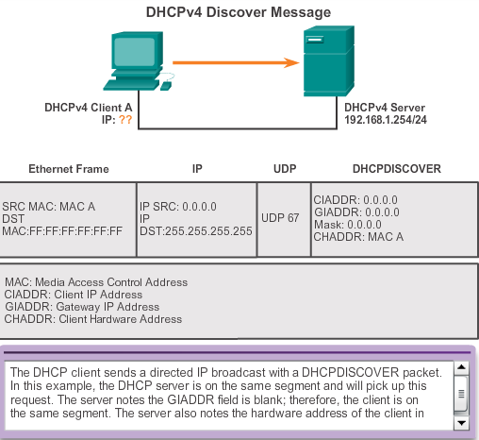
DHCPv4 Operation Format DHCPv4 Discover and Offer Messages
Notes:
10.1.1.4 DHCPv4 Discover and Offer Messages

Slide 9
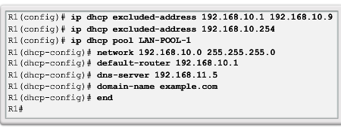
DHCPv4 Operation Configuring a DHCPv4 Server
A Cisco router running the Cisco IOS software can be configured to act as a DHCPv4 server. To set up DHCP:
Exclude addresses from the pool.
Set up the DHCP pool name.
Define the range of addresses and subnet mask. Use the default-router command for the default gateway. Optional parameters that can be included in the pool – dns server, domain-name.
To disable DHCP, use the no service dhcp command.
Notes:
10.1.2.1 Configuring a DHCPv4 Server

Slide 10
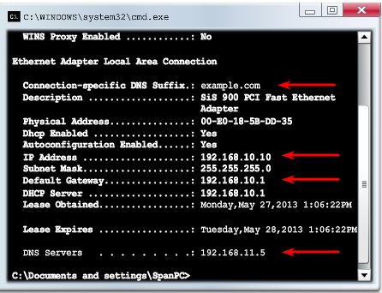
DHCPv4 Operation Verifying a DHCPv4 Server
Commands to verify DHCP:
show running-config | section dhcp
show ip dhcp binding
show ip dhcp server statistics
On the PC, issue the ipconfig /all command.
Notes:
10.1.2.2 Verifying a DHCPv4 Server

Slide 11
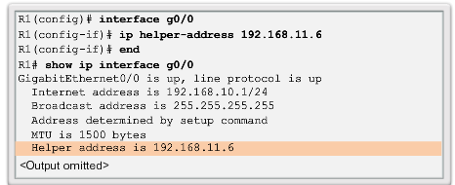
DHCPv4 Operation DHCPv4 Relay
Using an IP helper address enables a router to forward DHCPv4 broadcasts to the DHCPv4 server. Acting as a relay.
Notes:
10.1.2.3 DHCPv4 Relay

Slide 12
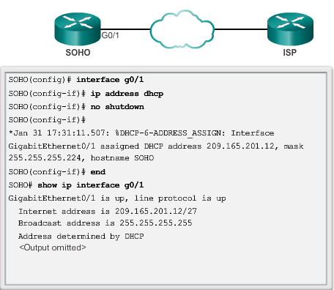
Configuring a DHCPv4 Client Configuring a Router as a DHCPv4 Client
Notes:
10.1.3.1 Configuring a Router as DHCPv4 Client

Slide 13
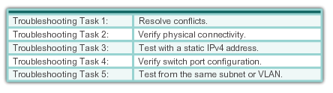
Troubleshoot DHCPv4 Troubleshooting Tasks
Notes:
10.1.4.1 Troubleshooting Tasks

Slide 14
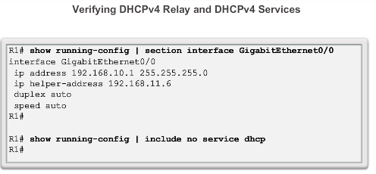
Troubleshoot DHCPv4 Verifying the Router DHCPv4 Configuration
Notes:
10.1.4.2 Verify Router DHCPv4 Configuration

Slide 15
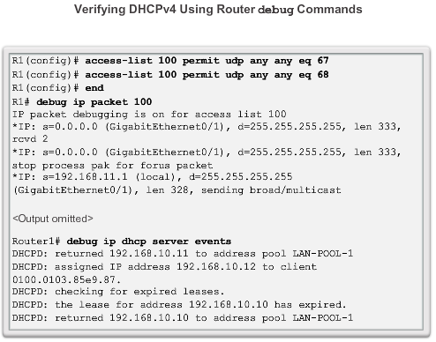
Troubleshoot DHCPv4 Debugging DHCPv4
Notes:
10.1.4.3 Debugging DHCPv4

Slide 16
10.2 Dynamic Host Configuration Protocol v6
Notes:
10.2 Dynamic Host Configuration Protocol v6

Slide 17
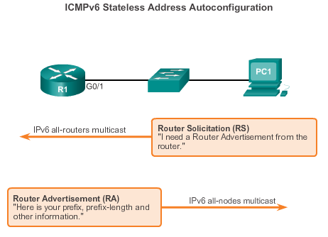
SLAAC and DHCPv6 Stateless Address Autoconfiguration
Stateless Address Autoconfiguration (SLAAC) is a method in which a device can obtain an IPv6 global unicast address without the services of a DHCPv6 server.
Notes:
10.2.1.1 Stateless Address Autoconfiguration (SLAAC)

Slide 18
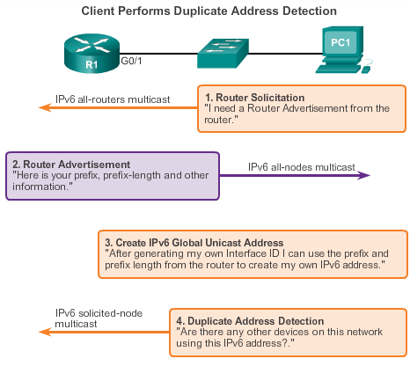
SLAAC and DHCPv6 SLAAC Operation
Notes:
10.2.1.2 SLAAC Operation

Slide 19
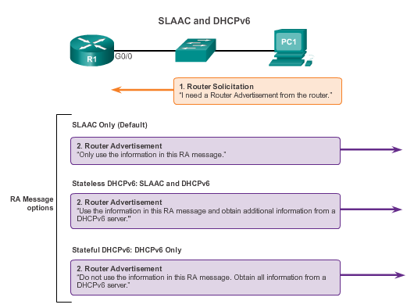
SLAAC and DHCPv6 SLAAC and DHCPv6
Notes:
10.2.1.3 SLAAC and DHCPv6

Slide 20
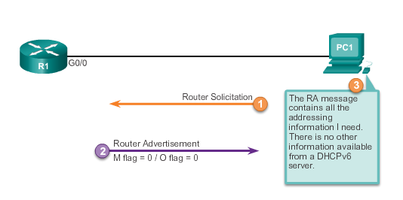
SLAAC and DHCPv6 SLAAC Option
Notes:
10.2.1.4 SLAAC Option

Slide 21
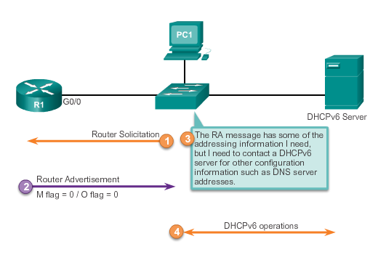
SLAAC and DHCPv6 Stateless DHCP Option
Notes:
10.2.1.5 Stateless DHCP Option

Slide 22
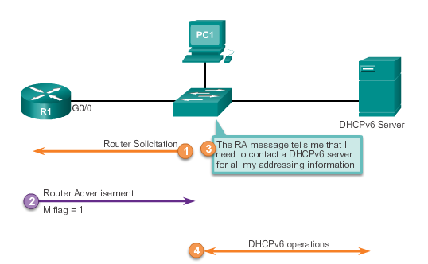
SLAAC and DHCPv6 Stateful DHCP Option
Notes:
10.2.1.6 Stateful DHCP Option

Slide 23
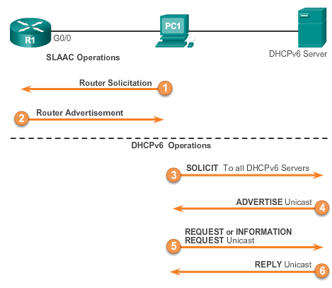
SLAAC and DHCPv6 DHCPv6 Operations
Notes:
10.2.1.7 DHCPv6 Operations

Slide 24
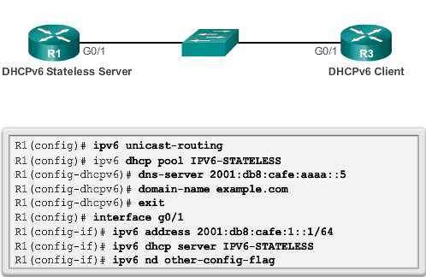
Stateless DHCPv6 Configuring a Router as a Stateless DHCPv6 Server
Notes:
10.2.2.1 Configuring a Router as a Stateless DHCPv6 Server

Slide 25
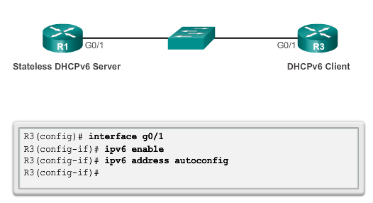
Stateless DHCPv6 Configuring a Router as a Stateless DHCPv6 Client
Notes:
10.2.2.2 Configuring a Router as a Stateless DHCPv6 Client

Slide 26
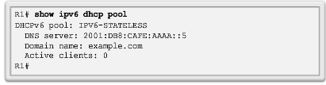
Stateless DHCPv6 Verifying Stateless DHCPv6
Verify the stateless DHCP client using the following commands:
show IPv6 interface
debug ipv6 dhcp detail
Notes:
10.2.2.3 Verifying Stateless DHCPv6 Server and Client

Slide 27
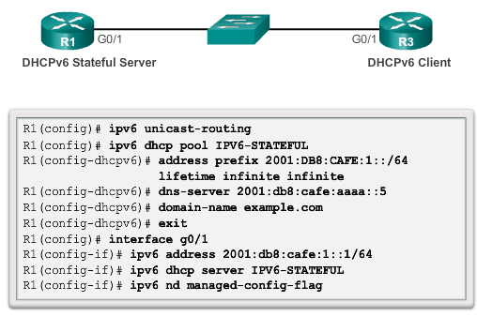
Stateful DHCPv6 Configuring a Router as a Stateful DHCPv6 Server
Notes:
10.2.3.1 Configuring a Router as a Stateful DHCPv6 Server

Slide 28
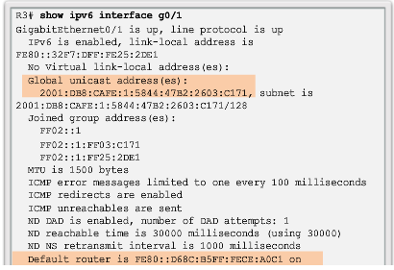
Stateful DHCPv6 Verifying Stateful DHCPv6
Verify the stateful DHCPv6 server using the following commands:
show ipv6 dhcp pool
show ipv6 dhcp binding
Verify the stateful DHCPv6 client using the show ipv6 interface command.
Notes:
10.2.3.3. Verifying Stateful DHCPv6

Slide 29
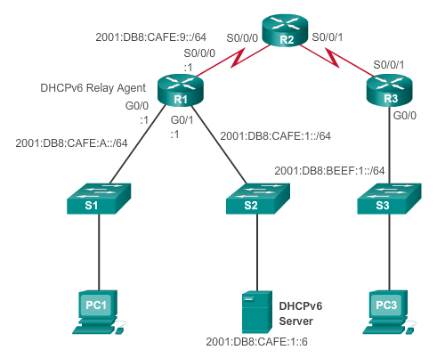
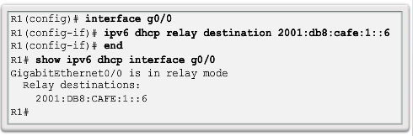
Stateful DHCPv6 Configuring a Router as a Stateful DHCPv6 Relay Agent
Notes:
10.2.3.4 Configuring a Router as a DHCPv6 Relay Agent

Slide 30
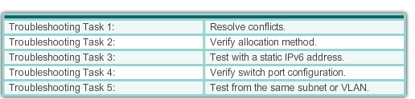
Troubleshooting DHCPv6 Troubleshooting Tasks
Notes:
10.2.4.1 Troubleshooting Tasks

Slide 31
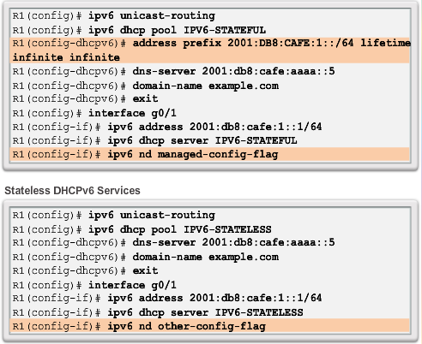
Troubleshooting DHCPv6 Verifying the Router DHCPv6 Configuration
Notes:
10.2.4.2 Verify Router DHCPv6 Configuration

Slide 32
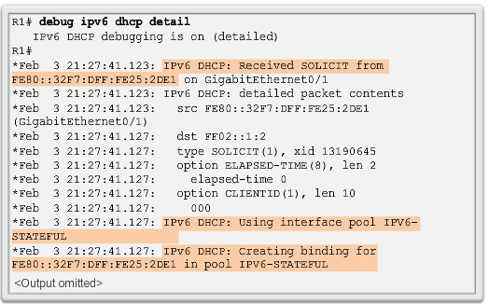
Troubleshooting DHCPv6 Debugging DHCPv6
Notes:
10.2.4.3 Debugging DHCPv6

Slide 33
10.3 Summary
Notes:
10.3 Summary

Slide 34
Chapter 10: Summary
All nodes on a network require a unique IP address to communicate with other devices.
DHCPv4 includes three different address allocation methods:
Manual Allocation
Automatic Allocation
Dynamic Allocation
There are two methods available for the dynamic configuration of IPv6 global unicast addresses:
Stateless Address Autoconfiguration (SLAAC)
Dynamic Host Configuration Protocol for IPv6 (Stateful DHCPv6)
Notes:
Chapter 10 Summary

Slide 35
Chapter 10: Summary (cont.)
The same tasks are involved when troubleshooting DHCPv4 and DHCPv6:
Resolve address conflicts.
Verify physical connectivity.
Test connectivity using a static IP address.
Verify the switch port configuration.
Test the operation on the same subnet or VLAN.
Notes:
Chapter 10 Summary

Slide 36


