Slide 1
Chapter 3: VLANs
Routing & Switching
Notes:
Cisco Networking Academy program
Routing & Switching
Chapter 3: VLANs

Slide 2
Chapter 3
3.1 VLAN Segmentation
3.2 VLAN Implementation
3.3 VLAN Security and Design
3.4 Summary
Notes:
Chapter 3

Slide 3
Chapter 3: Objectives
Explain the purpose of VLANs in a switched network.
Analyze how a switch forwards frames based on VLAN configuration in a multi-switched environment.
Configure a switch port to be assigned to a VLAN based on requirements.
Configure a trunk port on a LAN switch.
Configure Dynamic Trunk Protocol (DTP).
Troubleshoot VLAN and trunk configurations in a switched network.
Configure security features to mitigate attacks in a VLAN-segmented environment.
Explain security best practices for a VLAN-segmented environment.
Notes:
Chapter 3 Objectives

Slide 4
3.1 VLAN Segmentation
Notes:
Cisco Networking Academy program
Routing & Switching
Chapter 3: VLANs

Slide 5
Overview of VLANs VLAN Definitions
A VLAN is a logical partition of a Layer 2 network.
Multiple partitions can be created, allowing for multiple VLANs to co-exist.
Each VLAN is a broadcast domain, usually with its own IP network.
VLANs are mutually isolated and packets can only pass between them via a router.
The partitioning of the Layer 2 network takes place inside a Layer 2 device, usually via a switch.
The hosts grouped within a VLAN are unaware of the VLAN’s existence.
Notes:
3.1.1.1 VLAN Definitions

Slide 6
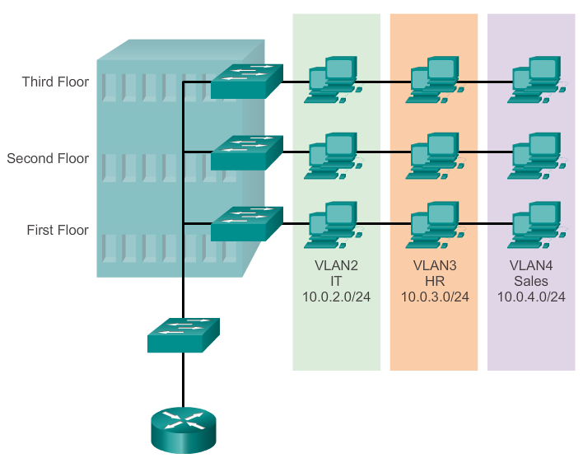
Overview of VLANs VLAN Definitions (cont.)
Notes:
3.1.1.1 VLAN Definitions

Slide 7
Overview of VLANs Benefits of VLANs
Security
Cost reduction
Better performance
Shrink broadcast domains
Improved IT staff efficiency
Simpler project and application management
Notes:
3.1.1.2 Benefits of VLANs

Slide 8
Overview of VLANs Types of VLANs
Data VLAN
Default VLAN
Native VLAN
Management VLAN
Voice VLAN
Notes:
3.1.1.3 Types of VLANs

Slide 9
Types of VLANs
Data VLAN
A data VLAN is a VLAN that is configured to carry only user-generated traffic.
A VLAN could carry voice-based traffic or traffic used to manage the switch, but this traffic would not be part of a data VLAN. It is common practice to separate voice and management traffic from data traffic.
The importance of separating user data from switch management control data and voice traffic is highlighted by the use of a special term used to identify VLANs that only carry user data - a "data VLAN".
A data VLAN is sometimes referred to as a user VLAN.

Slide 10
Types of VLANs
Default VLAN
All switch ports become a member of the default VLAN after the initial boot up of the switch.
Having all the switch ports participate in the default VLAN makes them all part of the same broadcast domain.
This allows any device connected to any switch port to communicate with other devices on other switch ports.
The default VLAN for Cisco switches is VLAN 1. VLAN 1 has all the features of any VLAN, except that you cannot rename it and you can not delete it. Layer 2 control traffic, such as CDP and spanning tree protocol traffic, will always be associated with VLAN 1 - this cannot be changed.
VLAN trunks support the transmission of traffic from more than one VLAN. Although VLAN trunks are mentioned throughout this section, they are explained in the next section on VLAN trunking.

Slide 11
Types of VLANs
Native VLAN
A native VLAN is assigned to an 802.1Q trunk port.
An 802.1Q trunk port supports traffic coming from many VLANs (tagged traffic) as well as traffic that does not come from a VLAN (untagged traffic).
The 802.1Q trunk port places untagged traffic on the native VLAN. (see figure 3.1.2 – 1 ). Untagged traffic is generated by a computer attached to a switch port that is configured with the native VLAN.
Native VLANs are set out in the IEEE 802.1Q specification to maintain backward compatibility with untagged traffic common to legacy LAN scenarios. For our purposes, a native VLAN serves as a common identifier on opposing ends of a trunk link. It is a best practice to use a VLAN other than VLAN 1 as the native VLAN.

Slide 12
Types of VLANs
Management VLAN
A management VLAN is any VLAN you configure to access the management capabilities of a switch.
VLAN 1 would serve as the management VLAN if you did not proactively define a unique VLAN to serve as the management VLAN.
You assign the management VLAN an IP address and subnet mask. A switch can be managed via HTTP, Telnet, SSH, or SNMP.
Since the out-of-the-box configuration of a Cisco switch has VLAN 1 as the default VLAN, you see that VLAN 1 would be a bad choice as the management VLAN; you wouldn't want an arbitrary user connecting to a switch to default to the management VLAN.

Slide 13
Types of VLANs
Voice VLANs
It is easy to appreciate why a separate VLAN is needed to support Voice over IP (VoIP). Imagine you are receiving an emergency call and suddenly the quality of the transmission degrades so much you cannot understand what the caller is saying. VoIP traffic requires:
Assured bandwidth to ensure voice quality
Transmission priority over other types of network traffic
Ability to be routed around congested areas on the network
Delay of less than 150 milliseconds (ms) across the network

Slide 14
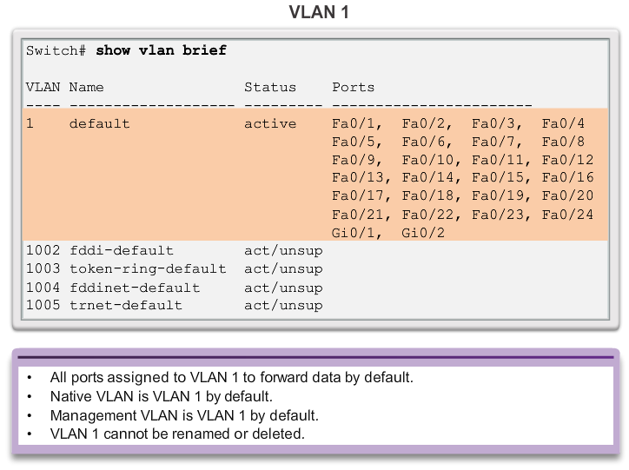
Overview of VLANs Types of VLANs (cont.)
Notes:
3.1.1.3 Types of VLANs

Slide 15
Overview of VLANs Voice VLANs
VoIP traffic is time-sensitive and requires:
Assured bandwidth to ensure voice quality.
Transmission priority over other types of network traffic.
Ability to be routed around congested areas on the network.
Delay of less than 150 ms across the network.
The voice VLAN feature enables access ports to carry IP voice traffic from an IP phone.
The switch can connect to a Cisco 7960 IP phone and carry IP voice traffic.
The sound quality of an IP phone call can deteriorate if the data is unevenly sent; the switch supports quality of service (QoS).
Notes:
3.1.1.4 Voice VLANs

Slide 16
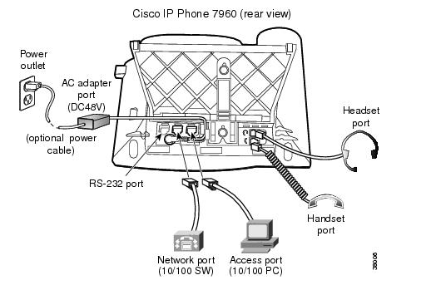
Overview of VLANs Voice VLANs (cont.)
The Cisco 7960 IP phone has two RJ-45 ports that each support connections to external devices.
Network Port (10/100 SW) - Use this port to connect the phone to the network. The phone can also obtain inline power from the Cisco Catalyst switch over this connection.
Access Port (10/100 PC) - Use this port to connect a network device, such as a computer, to the phone.
Notes:
3.1.1.4 Voice VLANs

Slide 17
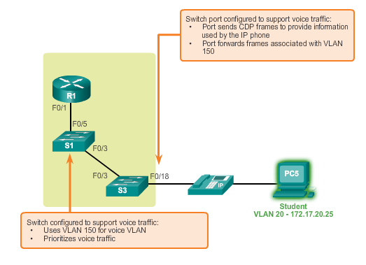
Overview of VLANs Voice VLANs (cont.)
Notes:
3.1.1.4 Voice VLANs

Slide 18
VLANs in a Multi-Switched Environment VLAN Trunks
A VLAN trunk carries more than one VLAN.
A VLAN trunk is usually established between switches so same-VLAN devices can communicate, even if physically connected to different switches.
A VLAN trunk is not associated to any VLANs; neither is the trunk ports used to establish the trunk link.
Cisco IOS supports IEEE802.1q, a popular VLAN trunk protocol.
Notes:
3.1.2.1 VLAN Trunks

Slide 19
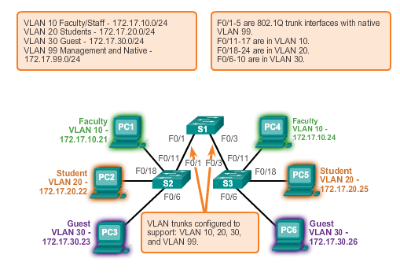
VLANs in a Multi-Switched Environment VLAN Trunks (cont.)
Notes:
3.1.2.1 VLAN Trunks

Slide 20
VLANs in a Multi-Switched Environment Controlling Broadcast Domains with VLANs
VLANs can be used to limit the reach of broadcast frames.
A VLAN is a broadcast domain of its own.
A broadcast frame sent by a device in a specific VLAN is forwarded within that VLAN only.
VLANs help control the reach of broadcast frames and their impact in the network.
Unicast and multicast frames are forwarded within the originating VLAN.
Notes:
3.1.2.2 Controlling Broadcast Domains with VLANs

Slide 21
VLANs in a Multi-Switched Environment Tagging Ethernet Frames for VLAN Identification
Frame tagging is the process of adding a VLAN identification header to the frame.
It is used to properly transmit multiple VLAN frames through a trunk link.
Switches tag frames to identify the VLAN to that they belong. Different tagging protocols exist; IEEE 802.1Q is a vey popular example.
The protocol defines the structure of the tagging header added to the frame.
Switches add VLAN tags to the frames before placing them into trunk links and remove the tags before forwarding frames through nontrunk ports.
When properly tagged, the frames can transverse any number of switches via trunk links and still be forwarded within the correct VLAN at the destination.
Notes:
3.1.2.3 Tagging Ethernet Frames for VLAN Identification

Slide 22
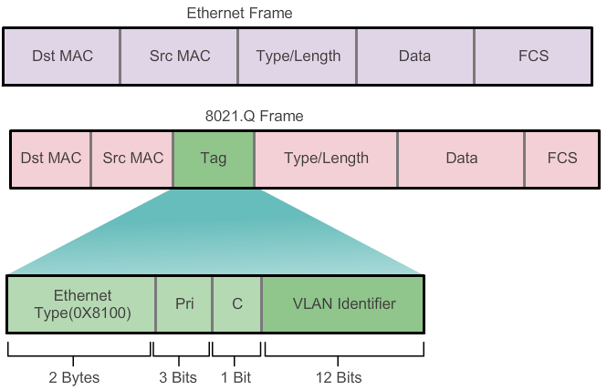
VLANs in a Multi-Switched Environment Tagging Ethernet Frames for VLAN Identification
Notes:
3.1.2.3 Tagging Ethernet Frames for VLAN Identification

Slide 23
VLANs in a Multi-Switched Environment Native VLANs and 802.1Q Tagging
Frames that belong to the native VLAN are not tagged.
Frames received untagged remain untagged and are placed in the native VLAN when forwarded.
If there are no ports associated to the native VLAN and no other trunk links, an untagged frame is dropped.
In Cisco switches, the native VLAN is VLAN 1, by default.
Notes:
3.1.2.4 Native VLANs and 802.1Q Tagging

Slide 24
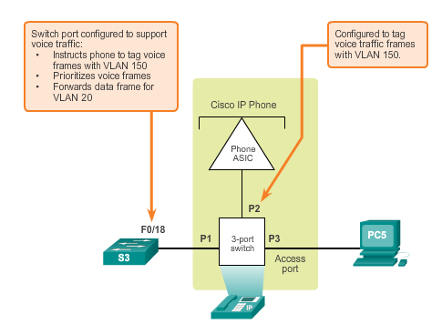
VLANs in a Multi-Switched Environment Voice VLAN Tagging
Notes:
3.1.2.5 Voice VLAN Tagging

Slide 25
3.2 VLAN Implementations
Notes:
Cisco Networking Academy program
Routing & Switching
Chapter 3: VLANs

Slide 26
VLAN Assignment VLAN Ranges on Catalyst Switches
Cisco Catalyst 2960 and 3560 Series switches support over 4,000 VLANs.
VLANs are split into two categories:
Normal range VLANs
VLAN numbers from 1 to 1,005
Configurations stored in the vlan.dat (in the flash memory)
VTP can only learn and store normal range VLANs
Extended Range VLANs
VLAN numbers from 1,006 to 4,096
Configurations stored in the running configuration (NVRAM)
VTP does not learn extended range VLANs
Notes:
3.2.1.1 VLAN Ranges On Catalyst Switches

Slide 27
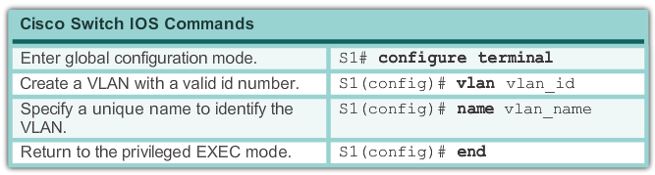
VLAN Assignment Creating a VLAN
Notes:
3.2.1.2 Creating a VLAN

Slide 28
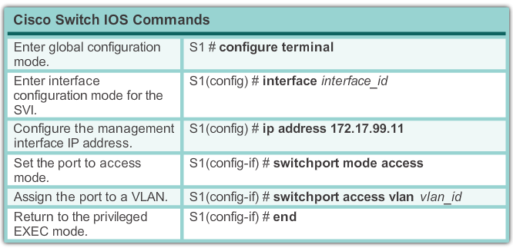
VLAN Assignment Assigning Ports to VLANs
Notes:
3.2.1.3 Assigning Ports To VLANs

Slide 29
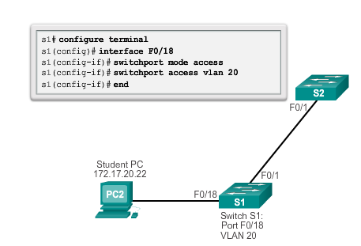
VLAN Assignment Assigning Ports to VLANs (cont.)
Notes:
3.2.1.3 Assigning Ports To VLANs

Slide 30
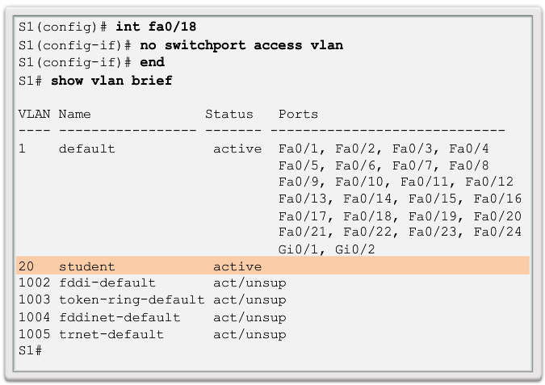
VLAN Assignment Changing VLAN Port Membership
Notes:
3.2.1.4 Changing VLAN Port Membership

Slide 31
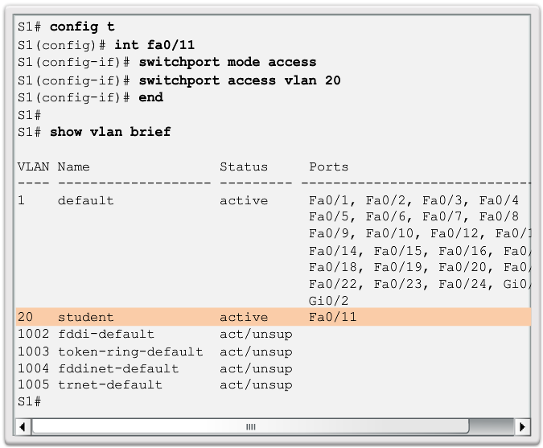
VLAN Assignment Changing VLAN Port Membership (cont.)
Notes:
3.2.1.4 Changing VLAN Port Membership

Slide 32
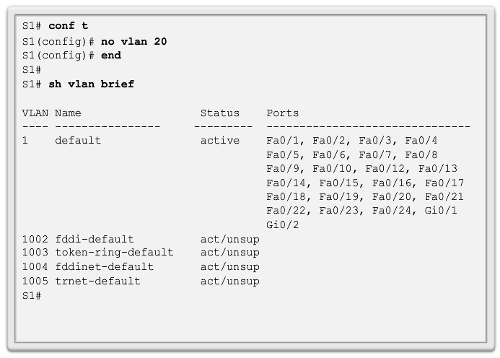
VLAN Assignment Deleting VLANs
Notes:
3.2.1.5 Deleting VLANs

Slide 33
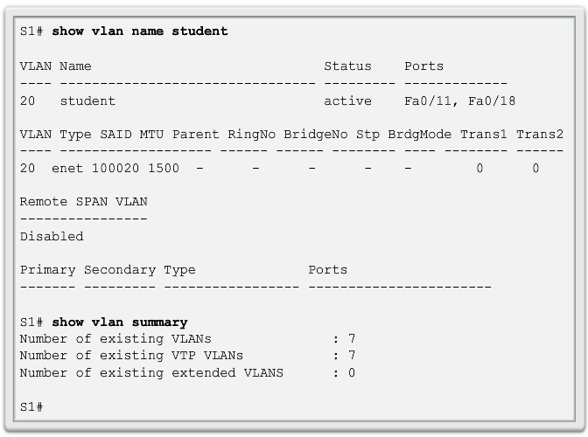
VLAN Assignment Verifying VLAN Information
Notes:
3.2.1.6 Verifying VLAN Information

Slide 34
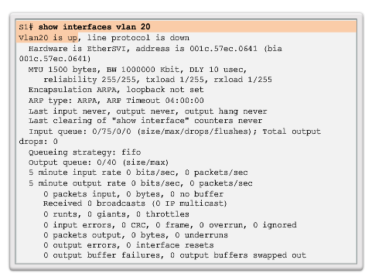
VLAN Assignment Verifying VLAN Information (cont.)
Notes:
3.2.1.6 Verifying VLAN Information

Slide 35
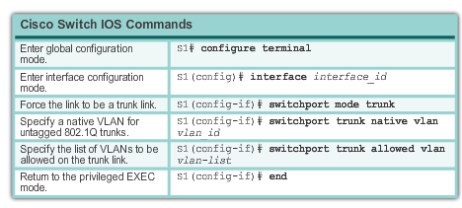
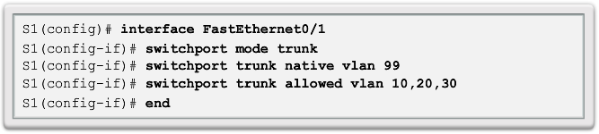
VLAN Assignment Configuring IEEE 802.1q Trunk Links
Notes:
3.2.2.1 Configuring IEEE 802.1q Trunk Links

Slide 36
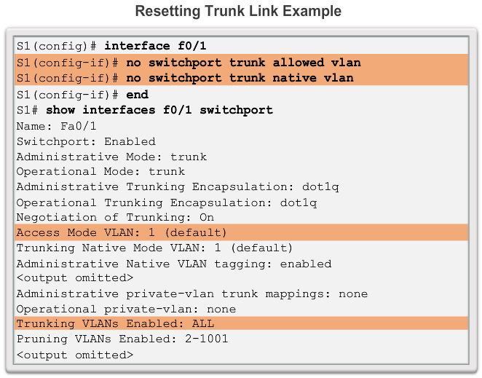
VLAN Assignment Resetting the Trunk To Default State
Notes:
3.2.2.2 Resetting the Trunk To Default State

Slide 37
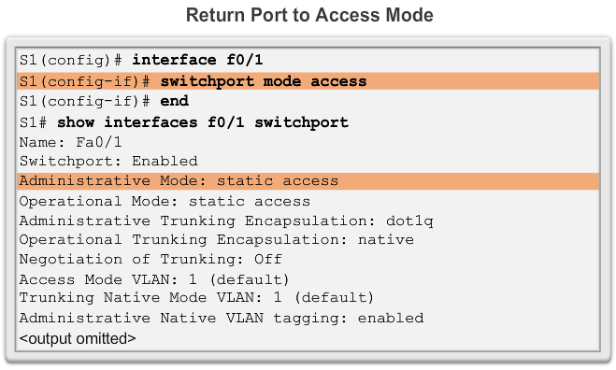
VLAN Assignment Resetting the Trunk To Default State (cont.)
Notes:
3.2.2.2 Resetting the Trunk To Default State

Slide 38
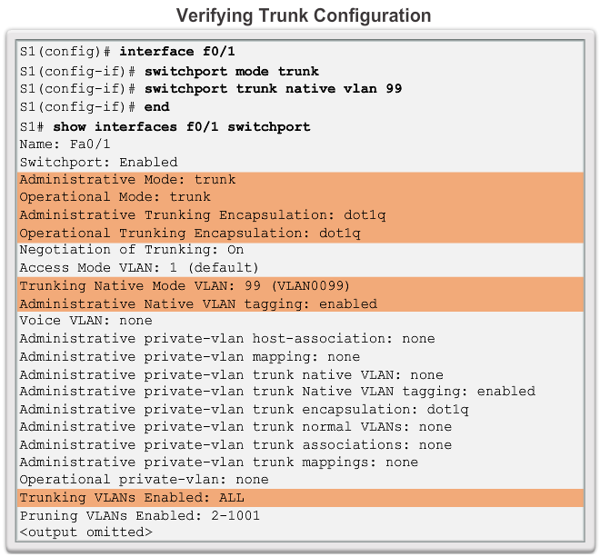
VLAN Assignment Verifying Trunk Configuration
Notes:
3.2.2.3 Verifying Trunk Configuration

Slide 39
Dynamic Trunking Protocol Introduction to DTP
Switch ports can be manually configured to form trunks.
Switch ports can also be configured to negotiate and establish a trunk link with a connected peer.
The Dynamic Trunking Protocol (DTP) manages trunk negotiation.
DTP is a Cisco proprietary protocol and is enabled, by default, in Cisco Catalyst 2960 and 3560 switches.
If the port on the neighbor switch is configured in a trunk mode that supports DTP, it manages the negotiation.
The default DTP configuration for Cisco Catalyst 2960 and 3560 switches is dynamic auto.
Notes:
3.2.3.1 Introduction to DTP

Slide 40
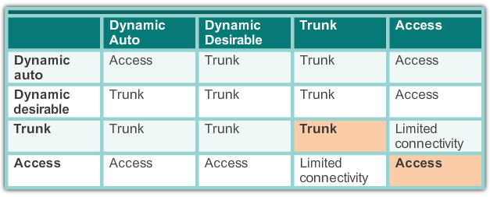
Dynamic Trunking Protocol Negotiated Interface Modes
Cisco Catalyst 2960 and 3560 support the following trunk modes:
Switchport mode dynamic auto
Switchport mode dynamic desirable
Switchport mode trunk
Switchport nonegotiate
Notes:
3.2.3.2 Introduction to DTP

Slide 41
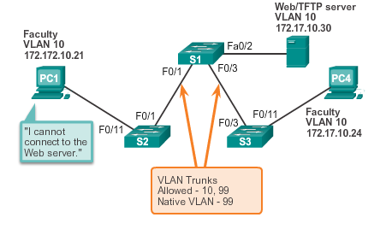
Troubleshooting VLANs and Trunks IP Addressing Issues with VLAN
It is a common practice to associate a VLAN with an IP network.
Because different IP networks only communicate through a router, all devices within a VLAN must be part of the same IP network to communicate.
The figure displays that PC1 cannot communicate to the server because it has a wrong IP address configured.
Notes:
3.2.4.1 IP Addressing Issues with VLAN

Slide 42
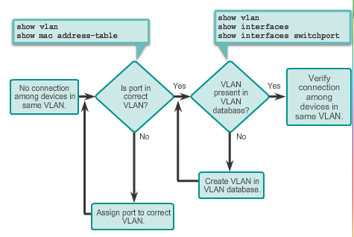
Troubleshooting VLANs and Trunks Missing VLANs
If all the IP addresses mismatches have been solved, but the device still cannot connect, check if the VLAN exists in the switch.
Notes:
3.2.4.2 Missing VLANs

Slide 43
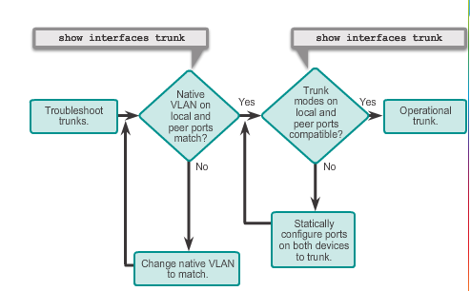
Troubleshooting VLANs and Trunks Introduction to Troubleshooting Trunks
Notes:
3.2.4.3 Introduction to Troubleshooting Trunks

Slide 44
Troubleshooting VLANs and Trunks Common Problems with Trunks
Trunking issues are usually associated with incorrect configurations.
The most common type of trunk configuration errors are:
Native VLAN mismatches
Trunk mode mismatches
Allowed VLANs on trunks
If a trunk problem is detected, the best practice guidelines recommend to troubleshoot in the order shown above.
Notes:
3.2.4.4 Common Problems With Trunks

Slide 45
Troubleshooting VLANs and Trunks Trunk Mode Mismatches
If a port on a trunk link is configured with a trunk mode that is incompatible with the neighboring trunk port, a trunk link fails to form between the two switches.
Use the show interfaces trunk command to check the status of the trunk ports on the switches.
To fix the problem, configure the interfaces with proper trunk modes.
Notes:
3.2.4.5 Trunk Mode Mismatches

Slide 46
Troubleshooting VLANs and Trunks Incorrect VLAN List
VLANs must be allowed in the trunk before their frames can be transmitted across the link.
Use the switchport trunk allowed vlan command to specify which VLANs are allowed in a trunk link.
Use the show interfaces trunk command to ensure the correct VLANs are permitted in a trunk.
Notes:
3.2.4.6 Incorrect VLAN List

Slide 47
3.3 VLAN Security and Design
Notes:
Cisco Networking Academy program
Routing & Switching
Chapter 3: VLANs

Slide 48
Attacks on VLANs Switch Spoofing Attack
There are a number of different types of VLAN attacks in modern switched networks; VLAN hopping is one example.
The default configuration of the switch port is dynamic auto.
By configuring a host to act as a switch and form a trunk, an attacker could gain access to any VLAN in the network.
Because the attacker is now able to access other VLANs, this is called a VLAN hopping attack.
To prevent a basic switch spoofing attack, turn off trunking on all ports, except the ones that specifically require trunking.
Notes:
3.3.1.1 Switch Spoofing Attack

Slide 49
Attacks on VLANs Double-Tagging Attack
Double-tagging attack takes advantage of the way that hardware on most switches de-encapsulate 802.1Q tags.
Most switches perform only one level of 802.1Q de-encapsulation, allowing an attacker to embed a second, unauthorized attack header in the frame.
After removing the first and legit 802.1Q header, the switch forwards the frame to the VLAN specified in the unauthorized 802.1Q header.
The best approach to mitigating double-tagging attacks is to ensure that the native VLAN of the trunk ports is different from the VLAN of any user ports.
Notes:
3.3.1.2 Double-Tagging Attack

Slide 50
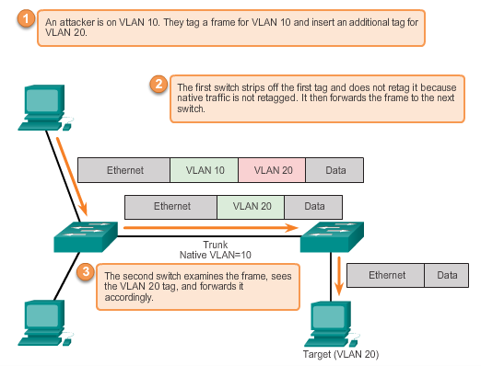
Attacks on VLANs Double-Tagging Attack (cont.)
Notes:
3.3.1.2 Double-Tagging Attack

Slide 51
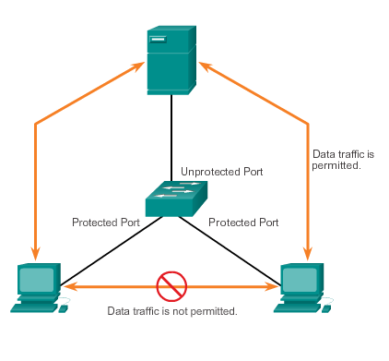
Attacks on VLANs PVLAN Edge
The Private VLAN (PVLAN) Edge feature, also known as protected ports, ensures that there is no exchange of unicast, broadcast, or multicast traffic between protected ports on the switch.
Local relevancy only.
A protected port only exchanges traffic with unprotected ports.
A protected port does not exchange traffic with another protected port.
Notes:
3.3.1.3 PVLAN Edge

Slide 52
Design Best Practices for VLANs VLAN Design Guidelines
Move all ports from VLAN 1 and assign them to a not-in-use VLAN
Shut down all unused switch ports.
Separate management and user data traffic.
Change the management VLAN to a VLAN other than VLAN 1. (The same goes to the native VLAN.)
Ensure that only devices in the management VLAN can connect to the switches.
The switch should only accept SSH connections.
Disable autonegotiation on trunk ports.
Do not use the auto or desirable switch port modes.
Notes:
3.3.2.1 VLAN Design Guidelines

Slide 53
Chapter 3: Summary
This chapter:
Introduced VLANs and their types
Described the connection between VLANs and broadcast domains
Discussed IEEE 802.1Q frame tagging and how it enables differentiation between Ethernet frames associated with distinct VLANs as they traverse common trunk links.
Examined the configuration, verification, and troubleshooting of VLANs and trunks using the Cisco IOS CLI and explored basic security and design considerations.
Notes:
Chapter 3 Summary

Slide 54


