Slide 1
DATA TYPES
ITEU233
TRANSLATION OF PROGRAMMING LANGUAGES

Slide 2
DATA TYPES
We all have developed an intuitive notion of what types are; what's behind the intuition?
  collection of values from a "domain" (the denotational approach)
  internal structure of a bunch of data, described down to the level of a small set of fundamental types (the structural approach)
  equivalence class of objects (the implementor's approach)
  collection of well-defined operations that can be applied to objects of that type (the abstraction approach)

Slide 3
Data Types
What are types good for?
  implicit context
  checking - make sure that certain meaningless operations do not occur
    type checking cannot prevent all meaningless operations
    It catches enough of them to be useful
Polymorphism results when the compiler finds that it doesn't need to know certain things

Slide 4
Data Types
STRONG TYPING has become a popular buzz-word
  like structured programming
  informally, it means that the language prevents you from applying an operation to data on which it is not appropriate
STATIC TYPING means that the compiler can do all the checking at compile time

Slide 5
Type Systems
Examples
  Common Lisp is strongly typed, but not statically typed
  Ada is statically typed
  Pascal is almost statically typed
  Java is strongly typed, with a non-trivial
  mix of things that can be checked statically and things that have to be
  checked dynamically

Slide 6
Type Systems
Common terms:
  discrete types – countable
    integer
    boolean
    char
    enumeration
    subrange
  Scalar types - one-dimensional
    discrete
    real

Slide 7
Type Systems
Composite types:
  records (unions)
  arrays
    strings
  sets
  pointers
  lists
  files

Slide 8
Type Systems
ORTHOGONALITY is a useful goal in the design of a language, particularly its type system
  A collection of features is orthogonal if there are no restrictions on the ways in which the features can be combined (analogy
  to vectors)

Slide 9
Type Systems
For example
  Pascal is more orthogonal than Fortran, (because it allows arrays of anything, for instance), but it does not permit variant records as arbitrary fields of other records (for instance)
Orthogonality is nice primarily because it makes a language easy to understand, easy to use, and easy to reason about

Slide 10
Type Checking
A TYPE SYSTEM has rules for
  type equivalence (when are the types of two values the same?)
  type compatibility (when can a value of type A be used in a context that expects type B?)
  type inference (what is the type of an expression, given the types of the operands?)

Slide 11
Type Checking
Type compatibility / type equivalence
  Compatibility is the more useful concept, because it tells you what you can DO
  The terms are often (incorrectly, but we do it too) used interchangeably.

Slide 12
Type Checking
Certainly format does not matter:
struct { int a, b; }
is the same as
struct {
int a, b;
}
We certainly want them to be the same as
    struct {
    int a;
    int b;
    }

Slide 13
Type Checking
Two major approaches: structural equivalence and name equivalence
  Name equivalence is based on declarations
  Structural equivalence is based on some notion of meaning behind those declarations
  Name equivalence is more fashionable these days

Slide 14
Type Checking
There are at least two common variants on name equivalence
  The differences between all these approaches boils down to where you draw the line between important and unimportant differences between type descriptions
  In all three schemes described in the book, we begin by putting every type description in a standard form that takes care of "obviously unimportant" distinctions like those above

Slide 15
Type Checking
Structural equivalence depends on simple comparison of type descriptions substitute out all names
  expand all the way to built-in types
Original types are equivalent if the expanded type descriptions are the same

Slide 16
Type Checking
Coercion
  When an expression of one type is used in a context where a different type is expected, one normally gets a type error
  But what about
  var a : integer; b, c : real;
  ...
  c := a + b;

Slide 17
Type Checking
Coercion
  Many languages allow things like this, and COERCE an expression to be of the proper type
  Coercion can be based just on types of operands, or can take into account expected type from surrounding context as well
  Fortran has lots of coercion, all based on operand type

Slide 18
Type Checking
C has lots of coercion, too, but with simpler rules:
  all floats in expressions become doubles
  short int and char become int in expressions
  if necessary, precision is removed when assigning into LHS

Slide 19
Type Checking
In effect, coercion rules are a relaxation of type checking
  Recent thought is that this is probably a bad idea
  Languages such as Modula-2 and Ada do not permit coercions
  C++, however, goes hog-wild with them
  They're one of the hardest parts of the language to understand

Slide 20
Type Checking
Make sure you understand the difference between
  type conversions (explicit)
  type coercions (implicit)
  sometimes the word 'cast' is used for conversions (C is guilty here)

Slide 21
Records (Structures) and
Variants (Unions)
Records
  usually laid out contiguously
  possible holes for alignment reasons
  smart compilers may re-arrange fields to minimize holes (C compilers promise not to)
  implementation problems are caused by records containing dynamic arrays
    we won't be going into that in any detail

Slide 22
Records (Structures) and
Variants (Unions)
Unions (variant records)
  overlay space
  cause problems for type checking
Lack of tag means you don't know what is there
Ability to change tag and then access fields hardly better
  can make fields "uninitialized" when tag is changed (requires extensive run-time support)
  can require assignment of entire variant, as in Ada

Slide 23
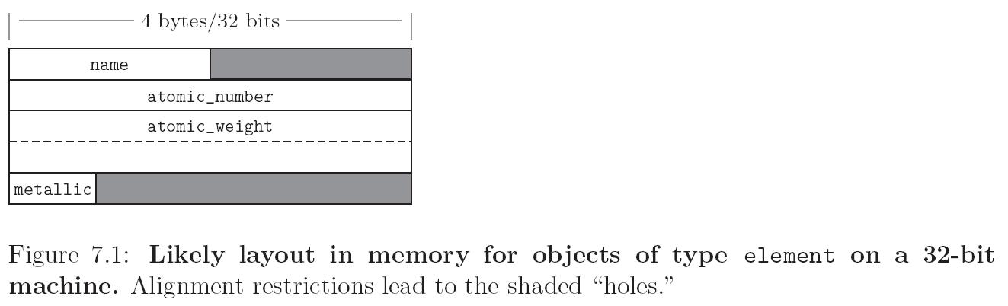
Records (Structures) and
Variants (Unions)
Memory layout and its impact (structures)

Slide 24
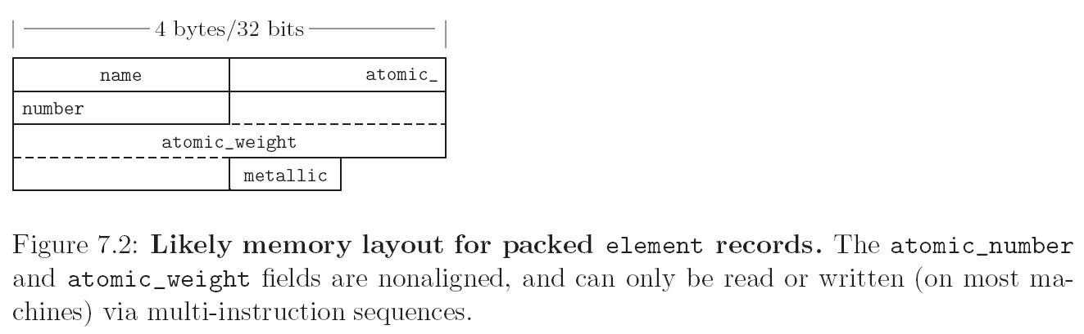
Records (Structures) and
Variants (Unions)
Memory layout and its impact (structures)

Slide 25
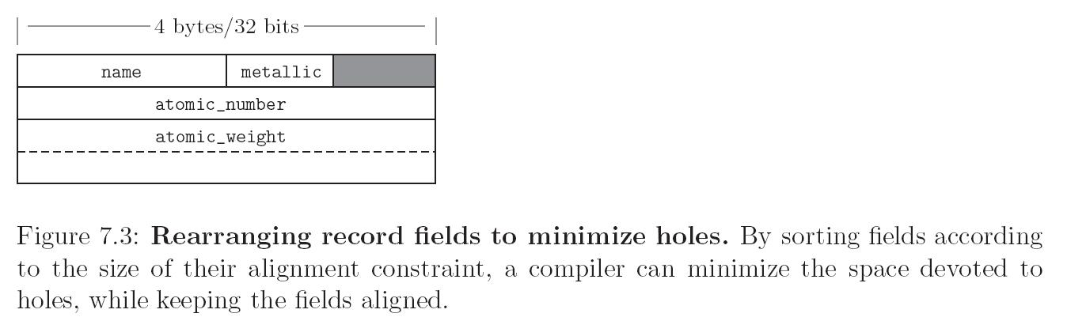
Records (Structures) and
Variants (Unions)
Memory layout and its impact (structures)

Slide 26
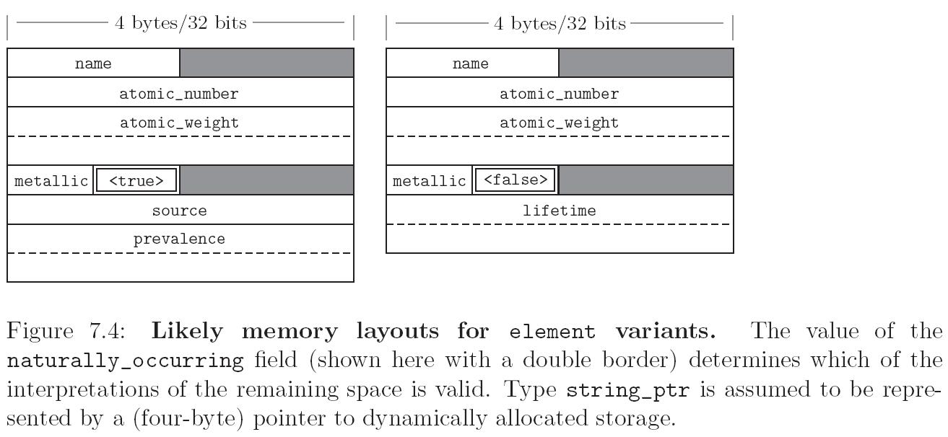
Records (Structures) and
Variants (Unions)
Memory layout and its impact (unions)

Slide 27
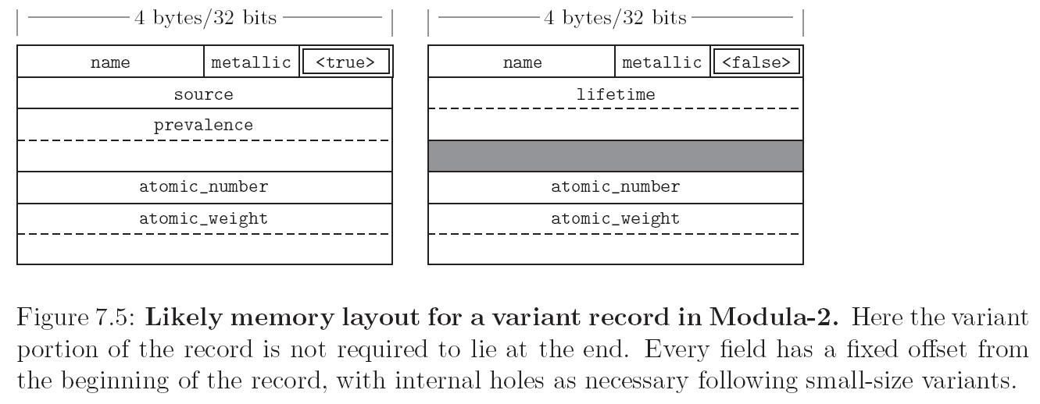
Records (Structures) and
Variants (Unions)
Memory layout and its impact (unions)

Slide 28
Arrays
Arrays are the most common and important composite data types
Unlike records, which group related fields of disparate types, arrays are usually homogeneous
Semantically, they can be thought of as a mapping from an index type to a component or element type
A slice or section is a rectangular portion of an array (See figure 7.6)

Slide 29
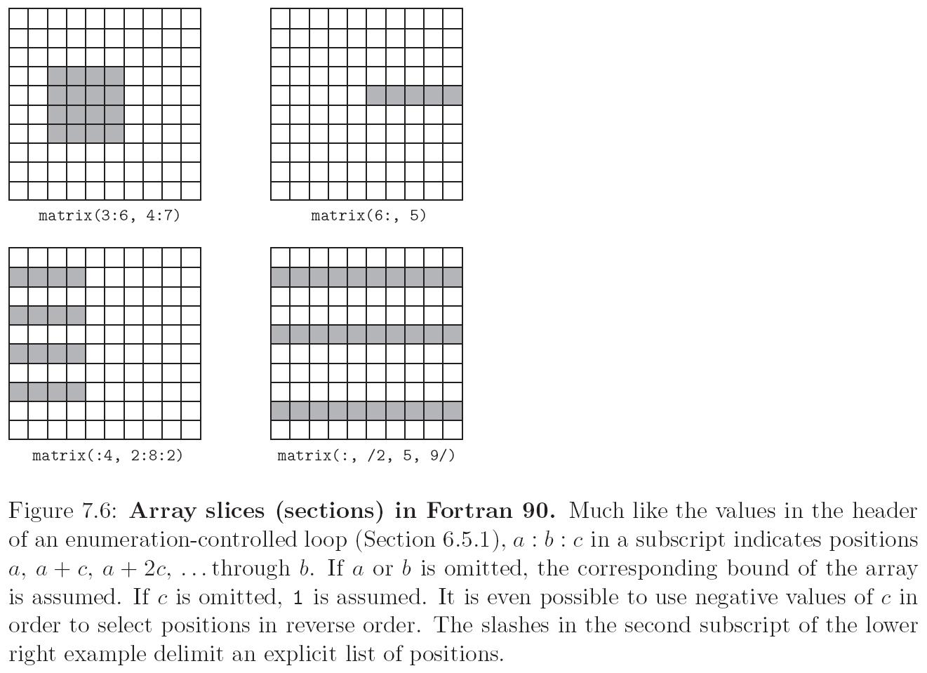
Arrays

Slide 30
Arrays
Dimensions, Bounds, and Allocation
  global lifetime, static shape — If the shape of an array is known at compile time, and if the array can exist throughout the execution of the program, then the compiler can allocate space for the array in static global memory
  local lifetime, static shape — If the shape of the array is known at compile time, but the array should not exist throughout the execution of the program, then space can be allocated in the subroutine’s stack frame at run time.
  local lifetime, shape bound at elaboration time

Slide 31
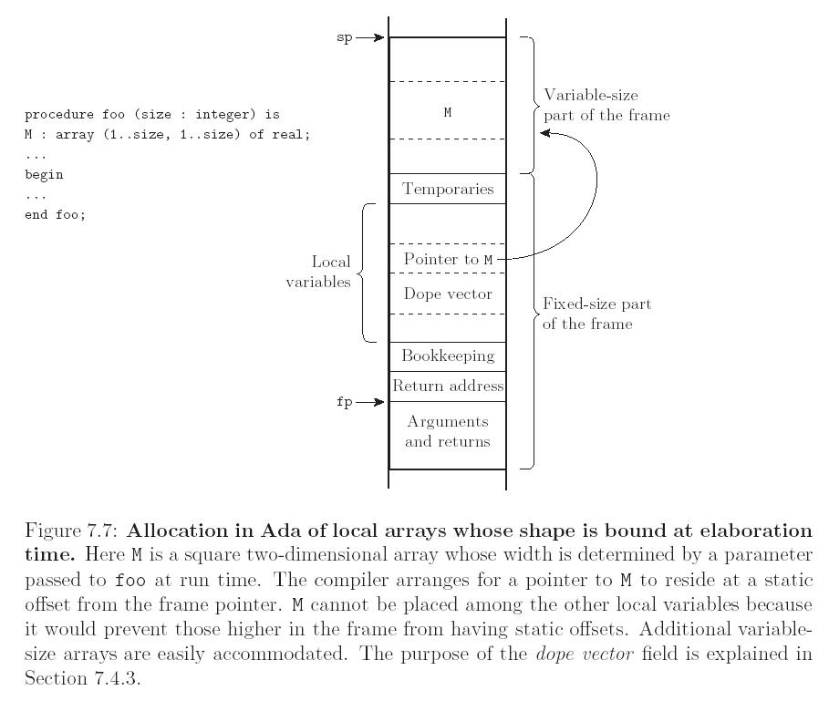
Arrays

Slide 32
Arrays
Contiguous elements (see Figure 7.9)
  column major - only in Fortran
  row major
    used by everybody else
    makes array [a..b, c..d] the same as array [a..b] of array [c..d]

Slide 33
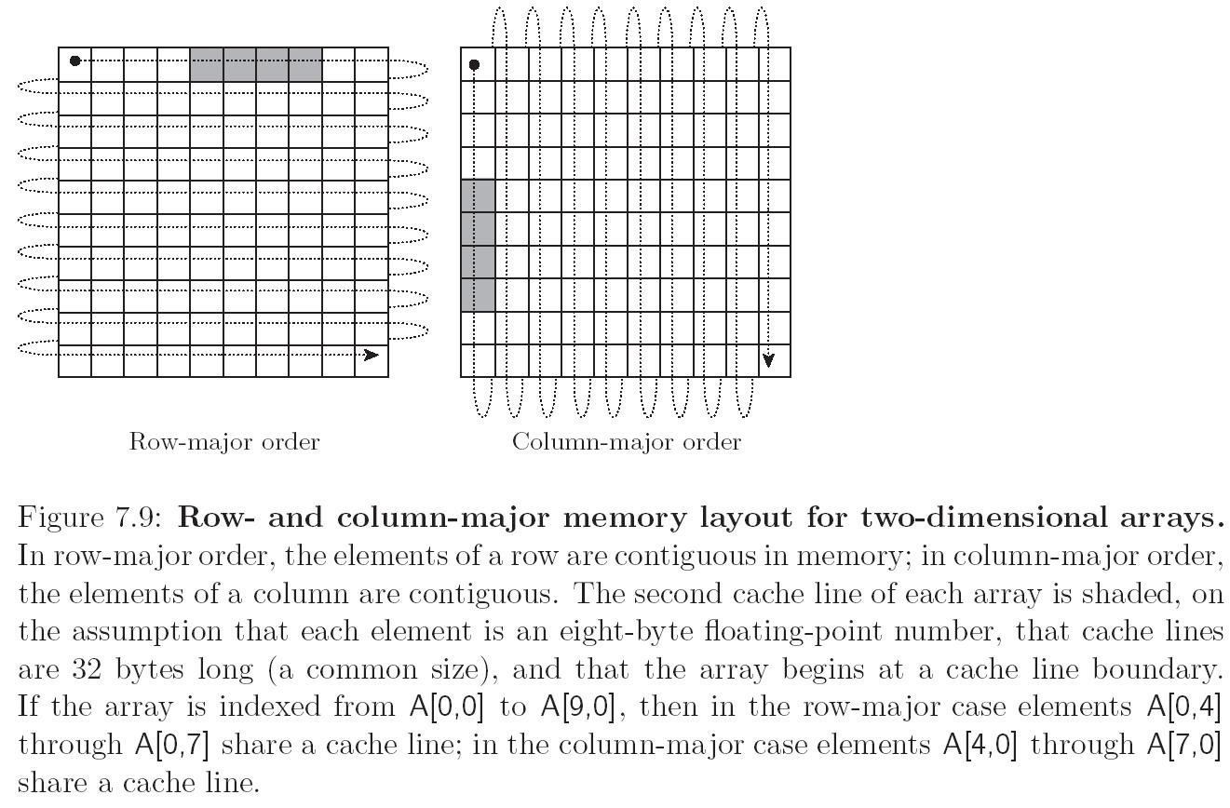
Arrays

Slide 34
Arrays
Two layout strategies for arrays (Figure 7.10):
  Contiguous elements
  Row pointers
Row pointers
  an option in C
  allows rows to be put anywhere - nice for big arrays on machines with segmentation problems
  avoids multiplication
  nice for matrices whose rows are of different lengths
    e.g. an array of strings
  requires extra space for the pointers

Slide 35
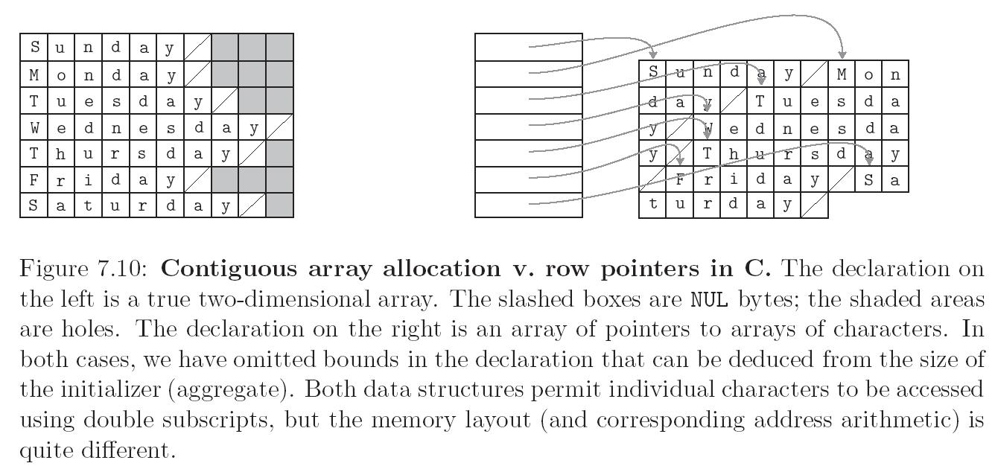
Arrays

Slide 36
Arrays
Example: Suppose
A : array [L1..U1] of array [L2..U2] of array [L3..U3] of elem;
D1 = U1-L1+1
D2 = U2-L2+1
D3 = U3-L3+1
Let
S3 = size of elem
S2 = D3 * S3
S1 = D2 * S2

Slide 37
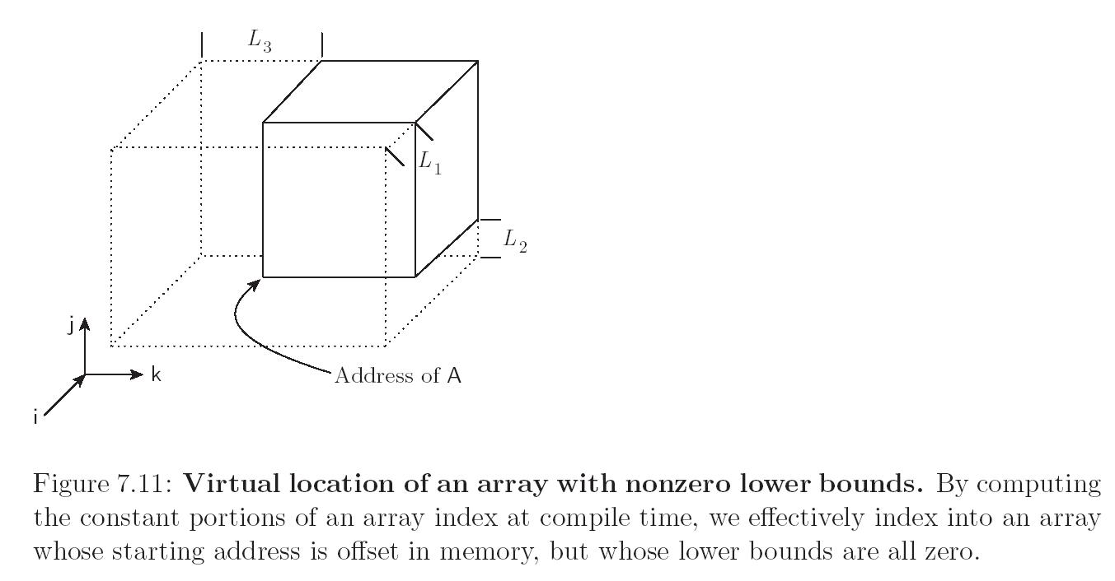
Arrays

Slide 38
Arrays
Example (continued)
We could compute all that at run time, but we can make do with fewer subtractions:
== (i * S1) + (j * S2) + (k * S3)
+ address of A
- [(L1 * S1) + (L2 * S2) + (L3 * S3)]
The stuff in square brackets is compile-time constant that depends only on the type of A

Slide 39
Strings
Strings are really just arrays of characters
They are often special-cased, to give them flexibility (like polymorphism
or dynamic sizing) that is not available for arrays in general
  It's easier to provide these things for strings than for arrays in general because strings are one-dimensional and (more important) non-circular

Slide 40
Sets
We learned about a lot of possible implementations
  Bitsets are what usually get built into programming languages
  Things like intersection, union, membership, etc. can be implemented efficiently with bitwise logical instructions
  Some languages place limits on the sizes of sets to make it easier for the implementor
    There is really no excuse for this

Slide 41
Pointers And Recursive Types
Pointers serve two purposes:
  efficient (and sometimes intuitive) access to elaborated objects (as in C)
  dynamic creation of linked data structures, in conjunction with a heap storage manager
Several languages (e.g. Pascal) restrict pointers to accessing things in the heap
Pointers are used with a value model of variables
  They aren't needed with a reference model

Slide 42
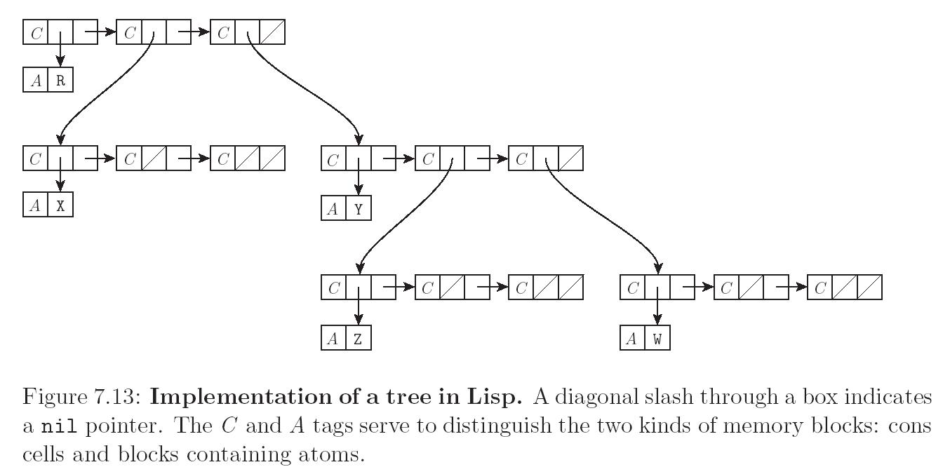
Pointers And Recursive Types

Slide 43
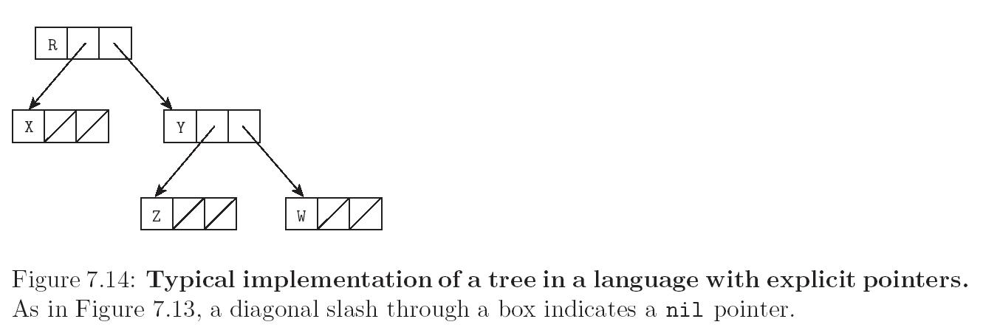
Pointers And Recursive Types

Slide 44
Pointers And Recursive Types
C pointers and arrays
int *a == int a[]
int **a == int *a[]
BUT equivalences don't always hold
  Specifically, a declaration allocates an array if it specifies a size for the first dimension
  otherwise it allocates a pointer
  int **a, int *a[] pointer to pointer to int
  int *a[n], n-element array of row pointers
  int a[n][m], 2-d array

Slide 45
Pointers And Recursive Types
Compiler has to be able to tell the size of the things to which you point
  So the following aren't valid:
  int a[][] bad
  int (*a)[] bad
  C declaration rule: read right as far as you can (subject to parentheses), then left, then out a level and repeat
  int *a[n], n-element array of pointers to integer
  int (*a)[n], pointer to n-element array of integers

Slide 46
Pointers And Recursive Types
Problems with dangling pointers are due to
  explicit deallocation of heap objects
    only in languages that have explicit deallocation
  implicit deallocation of elaborated objects
Two implementation mechanisms to catch dangling pointers
  Tombstones
  Locks and Keys

Slide 47
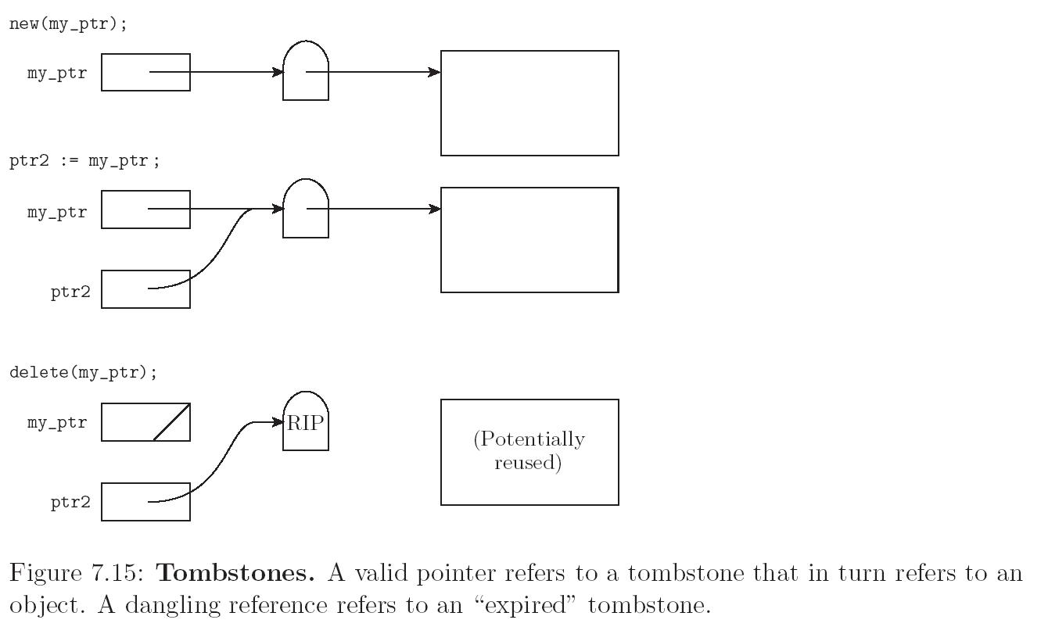
Pointers And Recursive Types

Slide 48
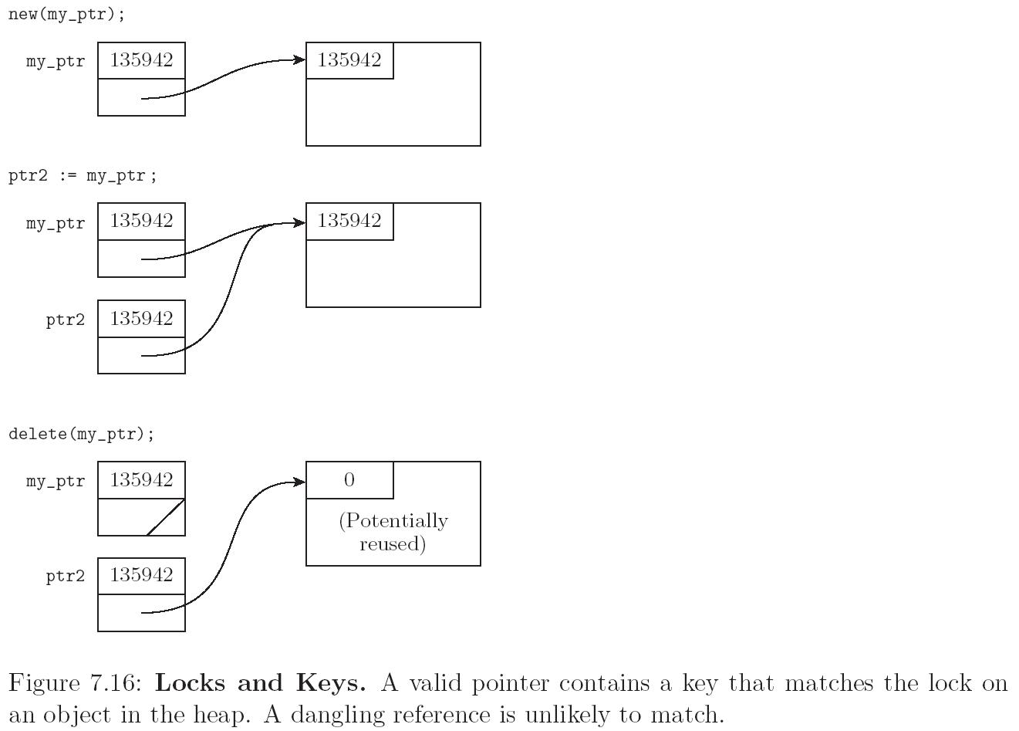
Pointers And Recursive Types

Slide 49
Pointers And Recursive Types
Problems with garbage collection
  many languages leave it up to the programmer to design without garbage creation - this is VERY hard
  others arrange for automatic garbage collection
  reference counting
    does not work for circular structures
    works great for strings
    should also work to collect unneeded tombstones

Slide 50
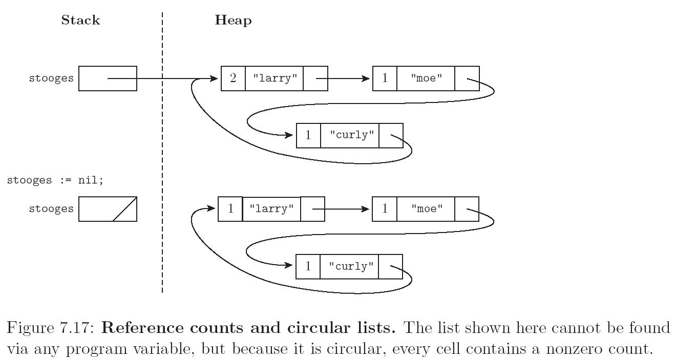
Pointers And Recursive Types
Garbage collection with reference counts

Slide 51
Pointers And Recursive Types
Mark-and-sweep
  commonplace in Lisp dialects
  complicated in languages with rich type structure, but possible if language is strongly typed
  achieved successfully in Cedar, Ada, Java, Modula-3, ML
  complete solution impossible in languages that are not strongly typed
  conservative approximation possible in almost any language (Xerox Portable Common Runtime approach)

Slide 52
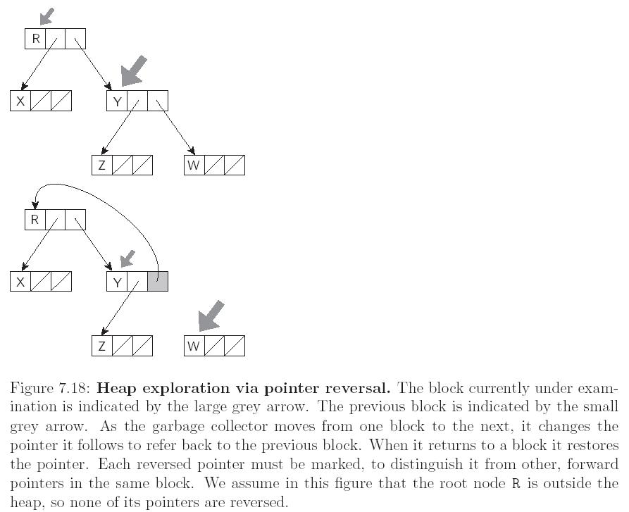
Pointers And Recursive Types
Garbage collection with pointer reversal

Slide 53
Lists
A list is defined recursively as either the empty list or a pair consisting of an object (which may be either a list or an atom) and another (shorter) list
  Lists are ideally suited to programming in functional and logic languages
    In Lisp, in fact, a program is a list, and can extend itself at run time by constructing a list and executing it
  Lists can also be used in imperative programs

Slide 54
Files and Input/Output
Input/output (I/O) facilities allow a program to communicate with the outside world
  interactive I/O and I/O with files
Interactive I/O generally implies communication with human users or physical devices
Files generally refer to off-line storage implemented by the operating system
Files may be further categorized into
  temporary
  persistent

