Slide 1
Just enough spark
Robert Breton

Slide 2
Overview
The aim of short course is provide you with the basics. The basics comprise of two key elements: 1. The use the python API 2. Intuitive understanding of what spark is doing under the surface (and why it is important)

Slide 3


1. Intro
Why use spark?
……….
Notes:
The key functionality of spark is that it operates in distributed memory. This allows multiple passes of over data.. Needed for machine learning and analysis.

Slide 4
How many languages do you need to know to communicate with spark?
Notes:
In theory one. We are using python as it is commonly used and well developed. There are other languages, such as scala, R, SQL. Under the surface they should all do the same thing as they have to be translated to spark jobs.

Slide 5
Just one! Python…pyspark
(With a little help from SQL)

Slide 6
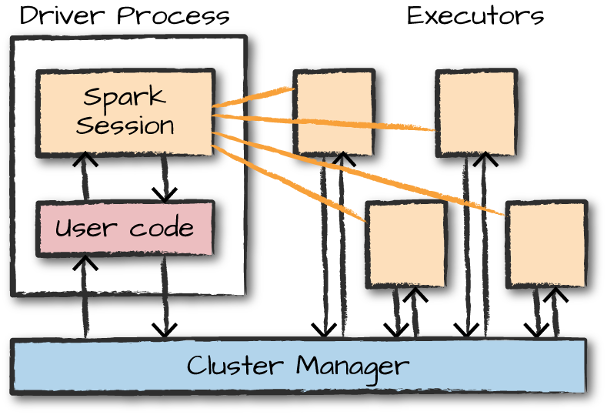
Session one: Lets introduce a few key methods and step a bit beyond just working the API.
Notes:
In this session we are going to be covering:
Sparksession what is it? Driver process. The executors take orders from the driver.. Return process status. Under the surface it is all translated to scala.
Pyspark dataframe as opposed to R/Python
Immutability – to change a dataframe we need to inform spark how to transform it.
Lazy – spark puts together logical plans until an action occurs.. Doesn’t do the work.. Just figures out a path to do the work. Predicate push down
Transformations – lists of things to do.. Optimised but not actioned
Actions.. Three types. Show, collect & output
Multiple language equivalence.. We can show this with the physical plan (explain)

Slide 7
Session one
1. Sparksession (object)
2. Pyspark dataframe (as opposed to python or R dataframe)
3. Immutable objects
4. Lazy execution
5. Transformations
6. Actions
7. Equivalence of multiple languages
8. Physical plan

Slide 8
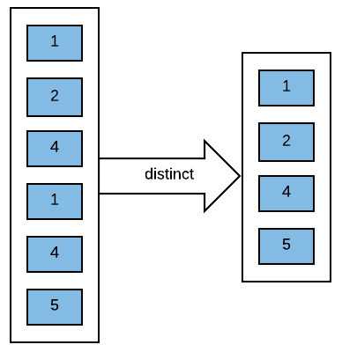
Session two: Will revise a few concepts from the first session. It will also introduce api documentation and multiple methods doing the same thing!
Notes:
In this session we are going to be covering:
Reading in files (reminder)
Lazy (reminder)
Again transformations and actions .. How does this relate laziness? … remember spark is just setting up a plan.. How can we get to the plan?
Cache()

Slide 9
Session two
1. File reading and the creation of dataframes
2. Lazy (reminder)
3. Transformations / actions (reminder)
4. Cache()
5. Distinct vs dropduplicates (this is an interesting pattern)
6. Location of the official documentation (how to use it)

Slide 10
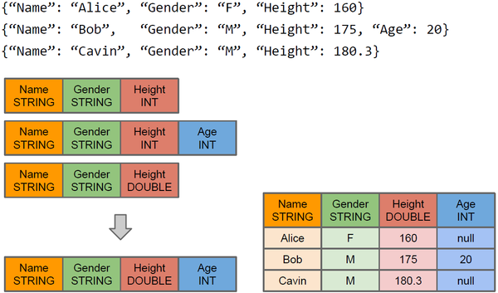
Session three: The aim of this notebook is to introduce more advanced dataframe manipulation. It will give you an indication of how to identify patterns of solution.
Notes:
This session will cover:
Infer/create schema (when to do each?)
Order/sort data (same pattern)
Column class and associated methods to create new columns, change column names/types and much more
Filter/where (same pattern)
Conditional statements using when/otherwise

Slide 11
Session three
1. Infer/create schema
2. Order/sort data
3. Column Class and associated methods
4. Filter/where
5. Conditional statements using when/otherwise )
Notes:
1. Infer/create schema
2. Order/sort data
3. Column Class and associated methods
4. Filter/where
5. Conditional statements using when/otherwise

Slide 12
Do question 1 (15 mins)

Slide 13
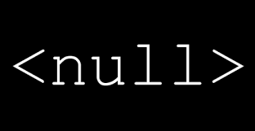
Session four: The aim of this notebook is to cover nulls. What they are, when they are used and what we can do with them
Notes:
This session will cover:
When nulls occur.. Missing or unexpected value
What can you do with nulls … drop/fill/abort

Slide 14
Do question 2 (15 mins)

Slide 15
Session four
Why are there nulls on read?
What can we do about them?
Imposing a schema with unexpected values
Removing unwanted characters using regex_replace
Counting/showing nulls
Dropping /filling and replacing nulls (na methods)
Notes:
General good practice rules:
Use nulls to represent missing or empty values
Being explicit is always better than being implicit with nulls
Be aware that specifying that a column does not have a null type is not enforced
What can you do with null values?
drop
fill
abort

Slide 16

Session five: The aim of this notebook is to cover joining, broadcasting and appending
Notes:
This session will cover:
Join expressions and types
Broadcasting
Appending (location matters)

Slide 17
Session five
Joining expression
Joining type
Shuffle join/broadcast join
Appending (location matters)
Notes:
General good practice rules:
Use nulls to represent missing or empty values
Being explicit is always better than being implicit with nulls
Be aware that specifying that a column does not have a null type is not enforced
What can you do with null values?
drop
fill
abort

Slide 18
Do question 3 (15 mins)

Slide 19
Closing
The use the python API:
1. basic dataframe manipulation
2. logical plan
3. create new columns/filters/conditionals
4. equivalence of different languages
5. nulls
6. joining
Intuition

Slide 20
Good luck!
This was a pilot… the training team is being formed at the moment:
Was this the right level?
What do you want to see more of?
Less of?
This will help us build a more formal training course
F

