Slide 1
Need for the PD
Materials
Trash bags
Paper clips
String
Scissors
Tape?
Printed
Exit Ticket
Lesson Sketch sheet

Slide 2
What is STEM? Presenters: Dr. Joshua Rosenberg and Michael Lawson February 20th, 2019 Northview Primary School

Slide 3
What is STEM?
Task: Describe STEM using pictures, sentences, key words, etc.
The Challenge: To develop a model of STEM teaching and learning using lines, circles, and text.
Materials
Chart paper
markers
Time: 10 minutes
Notes:
M&J ask what do you think about the model when they talk about it. Hold our judgements.

Slide 4
What is STEM?
Thinking about STEM as a set of practices (doing and thinking):
CCSS Math Practice Standards
NGSS Practice Standards
Thinking about STEM as a tool to understand and identify
things that are changing in a situation
things that are important
Cain’s Arcade
Notes:
Lynn – the term variables may be intimidating to the elementary teachers. According to Hans, many of the teachers do not have any sense of what STEM is.
Things that are changing in a situation; Things that are important – perhaps use a graphing story to offer a concrete way to think about variables.

Slide 5
STEM Related Practice Standards
NGSS Practice Standards
Asking questions and defining problems
Developing and using models
Planning and carrying out investigations
Analyzing and interpreting data
Using mathematics and computational thinking
Constructing explanations (for science) and designing solutions (for engineering)
Engaging in argument from evidence
Obtaining, evaluating, and communicating information
CC Math Practice Standards
Make sense of problems and persevere in solving them.
Reason abstractly and quantitatively.
Construct viable arguments and critique the reasoning of others.
Model with mathematics.
Use appropriate tools strategically.
Attend to precision.
Look for and make use of structure.
Look for and express regularity in repeated reasoning.

Slide 6
First Steps to Developing Students’ Thinking about STEM
Draw/Write what you think is going on?
Why do I smell things from a distance?
How does a tractor move?
Why does the mirror fog up when you take a hot shower?
You try:
Can you think of one that your students would be interested in? What content does it tie to in your curriculum?
Notes:
Brainstorm, model, and investigate in small ways. Draw what you think is going on…

Slide 7
Making decisions about important information in situations
Graphing Stories
http://www.graphingstories.com/
Think about…
What is happening?
What information is important?
What is changing?
How do we describe what is going on?
Estimation 180
http://www.estimation180.com/

Slide 8
STEM and Literacy How do STEM and Literacy connect? Why use literacy to talk about STEM subjects?

Slide 9
STEM Related Practice Standards
TN Literacy Skills for Math and Science Proficiency
Use multiple reading strategies.
Understand and use correct mathematical vocabulary.
Discuss and articulate mathematical ideas.
Write mathematical arguments.

Slide 10
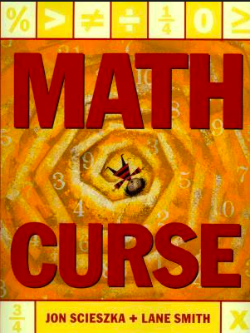

Literacy and STEM
Ada Twist Scientist

Slide 11
STEM and Literacy
What did Ada teach us about STEM?

Slide 12
STEM Modeling Activtiy

Slide 13
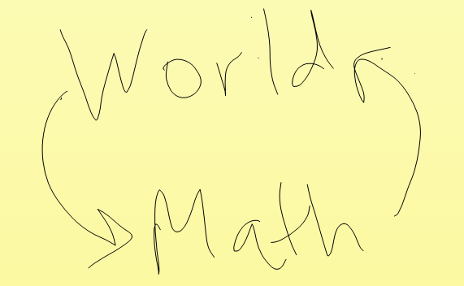
Real-world STEM Modeling
1. Identifying essential information in a situation
2. Designing ways to figure out that information
3. Testing our way of thinking
4. Interpreting the results of those operations
5. Validating the conclusions of those results

Slide 14
Chutes-R-Us

Slide 15
Chutes-R-Us
You are employees of a new company that designs and makes parachutes. Your job in your design team is to design a parachute that has the lowest terminal velocity when it hits the ground, but is not too expensive to make.
You will be provided with the materials (silk, cord, tape, and scissors). The cost of each parachute is determined by the amount of silk you use. The cost of silk is $1.00 per square centimeter.
This activity is adapted from one created by Paul Hodge and colleagues at Vanderbilt University
Notes:
Stays in the air as long as possible, but is not too expensive to make

Slide 16

Your design group will work during this class to design and build a parachute. Each design group will present their design and test their parachute. We will take this data as a company to determine “the best” parachute.
Good Luck!

Slide 17
How do we define “the best” parachute?

Slide 18
Example of Data Collected
How did we collect the data? What did we take into consideration? What do we need to add to this data set to make it complete and usable to determine “the best”?
Group | Size (cm²) | Time in seconds (avg of 3 timers) | Step (*0=floor)
Beast | 666 | 4.36 | 2
#VolSTEMed | 1008 | 4.59 | 2
#VolSTEMeme | 240 | 4.62 | 0
Gucci | 1829 | 5.29 | 0
I Guess Us | 283 | 2.91 | 2
Team Without A Name | 522 | 4.31 | 1
Prototype | 711 | 4.56 | 0

Slide 19
How could this lesson play out in the elementary classroom? What are the challenges?
Notes:
Lynn – would change this given the audience…

Slide 20
STEM Resources
Lists of children’s literature
http://letsreadmath.com/math-and-childrens-literature/middle-school-mathematics-literature/
https://www.mathsolutions.com/documents/lessons_chart-2.pdf
http://static.nsta.org/pdfs/2018BestSTEMBooks.pdf
Three-Act-Math: https://gfletchy.com/3-act-lessons/ (among many others)
101 Questions: http://www.101qs.com/
Open Middle: http://www.openmiddle.com/
NGSS: https://nextgenscience.org/resources/examples-quality-ngss-design
Concord Consortium: https://learn.concord.org
STEM Teaching Tools: http://stemteachingtools.org Teaching Channel: https://www.teachingchannel.org/home
NASA: https://www.jpl.nasa.gov/edu/teach/activity/stem-activities-for-families/
TN Geography: http://data-tga.opendata.arcgis.com/
Oak Ridge STEM Resource: https://orise.orau.gov/stem/k-12/curriculum-for-the-classroom.html#lesson-plans
Graphing Stories and Estimation 180
Who in your school or school system could be a STEM Resource?

Slide 21
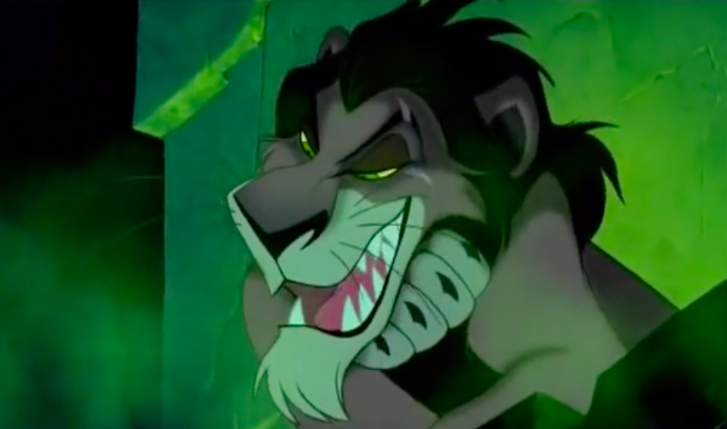
STEM Lesson Sketch Challenge to you! As you think about STEM in your school and classroom, use the STEM Lesson Sketch to outline what one lesson might involve. Consider trying 1 or 2 by the end of the year!
But, as Scar would say, “Be prepared!”—for the challenges of doing an integrated STEM lesson and keep at it!

Slide 22
Exit Ticket
On a piece of paper, please respond to the following prompts:
1) Rate the relevance on the PD to your classroom.
2) Write two takeaways from today’s PD.
3) What do you still want to know about STEM?

