Slide 1
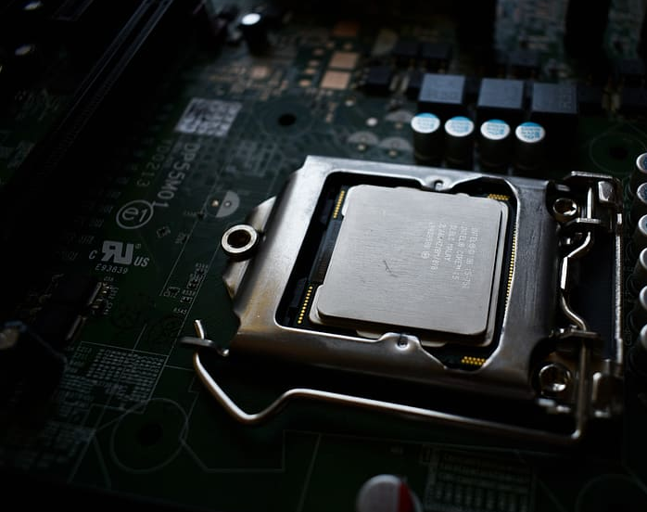

EECS 388: Embedded Systems Lecture 8
Instructor: Tamzidul Hoque, Assistant Professor, Dept. of EECS, University of Kansas (hoque@ku.edu), office: Eaton 2038
Credits: Some slides are adopted from Henk Corporaal’s Computer Architecture and Organization course
and also from CS232: Computer Architecture II. University of Illinois at Urbana-Champaign.

Slide 2
Context
Chapter 4:Introduction to Computing Systems: From Bits & Gates to C & Beyond, Yale Patt
Application Program
Operating
System
Compiler
Machine Language (ISA)
Digital Logic
Electronic Circuits
Transistors

Slide 3
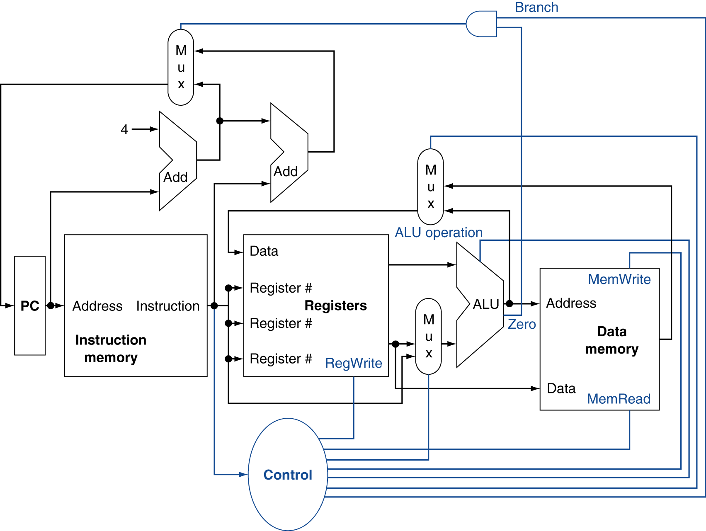
Illustration of CPU Datapath for MIPS
How this architecture operates for:
Fetch
Decode
Execute
Memory
Write Back

Slide 4
Initial State
$t0 | 0
$t1 | 40
$t2 | 60
$s0 | 200
$s1
$s2
Register
Address
Data
0
4
8
add $t0, $t1, $t2
Inst. Memory
sw $s0, 4($t1)
beq $s1, $s2, 24
Address
Data
40 | 0
44 | 0
48 | 0
Data Memory

Slide 5
Fetch
F
D
EXE
Mem
$t0 | 0
$t1 | 40
$t2 | 60
$s0 | 200
$s1
$s2
WB
Register
Address
Data
0
4
8
add $t0, $t1, $t2
Inst. Memory
sw $s0, 4($t1)
0
beq $s1, $s2, 24
Address
Data
40 | 0
44 | 0
48 | 0
Data Memory

Slide 6
Fetch:
F
D
EXE
Mem
$t0 | 0
$t1 | 40
$t2 | 60
$s0 | 200
$s1
$s2
WB
Register
Address
Data
0
0
4
8
add $t0, $t1, $t2
Inst. Memory
sw $s0, 4($t1)
beq $s1, $s2, 24
Address
Data
40 | 0
44 | 0
48 | 0
Data Memory
Program counter starts from 0

Slide 7
Fetch
F
D
EXE
Mem
$t0 | 0
$t1 | 40
$t2 | 60
$s0 | 200
$s1
$s2
WB
Register
Address
Data
0
add $t0,
$t1, $t2
0
4
8
add $t0, $t1, $t2
Inst. Memory
sw $s0, 4($t1)
beq $s1, $s2, 24
Address
Data
40 | 0
44 | 0
48 | 0
Data Memory
Inst mem gets 0 as input, outputs the content at address 0

Slide 8
Fetch
F
D
EXE
Mem
$t0 | 0
$t1 | 40
$t2 | 60
$s0 | 200
$s1
$s2
WB
Register
Address
Data
0
add $t0,
$t1, $t2
0
4
8
add $t0, $t1, $t2
add $t0, $t1, $t2
Inst. Memory
sw $s0, 4($t1)
beq $s1, $s2, 24
Address
Data
40 | 0
44 | 0
48 | 0
Data Memory
Content at address 0 is the first instruction

Slide 9
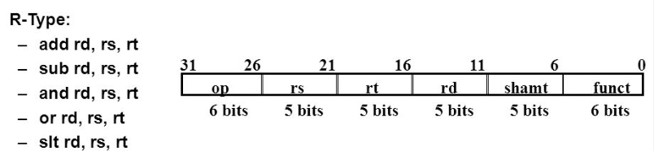
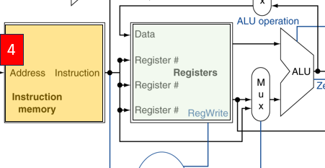
Decode for Add
add $t0, $t1, $t2
Inst 25-21, rs
Inst 20-16, rt
Inst 15-11, rd
Inst 15-0, imm
9

Slide 10
Decode
F
D
EXE
Mem
$t0 | 0
$t1 | 40
$t2 | 60
$s0 | 200
$s1
$s2
WB
Register
Address
Data
0
add $t0,
$t1, $t2
0
4
8
$t1
add $t0, $t1, $t2
$t2
Inst. Memory
sw $s0, 4($t1)
$t0
beq $s1, $s2, 24
Address
Data
40 | 0
44 | 0
48 | 0
add
Data Memory
Instruction gets broken down into segments and goes to register and control units

Slide 11
Decode
F
D
EXE
Mem
$t0 | 0
$t1 | 40
$t2 | 60
$s0 | 200
$s1
$s2
WB
Register
Address
Data
0
add $t0,
$t1, $t2
0
4
8
$t1
add $t0, $t1, $t2
$t2
Inst. Memory
sw $s0, 4($t1)
$t0
beq $s1, $s2, 24
Address
Data
Select Rt
40 | 0
44 | 0
48 | 0
add
Data Memory
Control signals are asserted

Slide 12
Decode
F
D
EXE
Mem
$t0 | 0
$t1 | 40
$t2 | 60
$s0 | 200
$s1
$s2
WB
Register
Address
Data
0
add $t0,
$t1, $t2
40
0
4
8
$t1
add $t0, $t1, $t2
$t2
60
Inst. Memory
sw $s0, 4($t1)
$t0
beq $s1, $s2, 24
Address
Data
40 | 0
44 | 0
48 | 0
add
Data Memory
Register data Rs and Rt comes out

Slide 13
Decode
F
D
EXE
Mem
$t0 | 0
$t1 | 40
$t2 | 60
$s0 | 200
$s1
$s2
WB
Register
Address
Data
0
add $t0,
$t1, $t2
40
0
4
8
$t1
100
add $t0, $t1, $t2
$t2
60
60
Inst. Memory
sw $s0, 4($t1)
$t0
beq $s1, $s2, 24
Address
Data
40 | 0
44 | 0
48 | 0
add
Do Add
Data Memory
ALU Performs Add

Slide 14
Mem
F
D
EXE
Mem
$t0 | 0
$t1 | 40
$t2 | 60
$s0 | 200
$s1
$s2
WB
Register
Address
Data
0
add $t0,
$t1, $t2
40
0
4
8
$t1
100
add $t0, $t1, $t2
$t2
60
60
Inst. Memory
sw $s0, 4($t1)
$t0
beq $s1, $s2, 24
Address
Data
40 | 0
44 | 0
48 | 0
add
No read/Write
Data Memory
Mem stage only needed for Load Store

Slide 15
Write Back
F
D
EXE
Mem
$t0 | 100
$t1 | 40
$t2 | 60
$s0 | 200
$s1
$s2
Select ALU out
WB
Register
100
100
Address
Data
0
add $t0,
$t1, $t2
0
4
8
add $t0, $t1, $t2
Inst. Memory
sw $s0, 4($t1)
$t0
beq $s1, $s2, 24
Address
Data
add
Data Memory
Write Back the result to $t0

Slide 16
Anytime
F
D
EXE
Mem
$t0 | 100
$t1 | 40
$t2 | 60
$s0 | 200
$s1
$s2
Not a branch
PC+4
WB
Register
Address
Data
4
0
4
8
add $t0, $t1, $t2
Inst. Memory
sw $s0, 4($t1)
beq $s1, $s2, 24
Address
Data
add
Data Memory
Update PC to PC+4 before next fetch

Slide 17
Fetch Next Inst
F
D
EXE
Mem
$t0 | 100
$t1 | 40
$t2 | 60
$s0 | 200
$s1
$s2
WB
Register
Address
Data
0
4
8
add $t0, $t1, $t2
Inst. Memory
sw $s0, 4($t1)
4
beq $s1, $s2, 24
Address
Data
Data Memory

Slide 18
Fetch:
F
D
EXE
Mem
$t0 | 100
$t1 | 40
$t2 | 60
$s0 | 200
$s1
$s2
WB
Register
Address
Data
4
0
4
8
add $t0, $t1, $t2
Inst. Memory
sw $s0, 4($t1)
beq $s1, $s2, 24
Address
Data
40 | 0
44 | 0
48 | 0
Data Memory
Program counter starts from 0

Slide 19
Execution process of Second Instruction

Slide 20
Fetch
F
D
EXE
Mem
$t0 | 100
$t1 | 40
$t2 | 60
$s0 | 200
$s1
$s2
WB
Register
Address
Data
4
sw $s0, 4($t1)
0
4
8
add $t0, $t1, $t2
Inst. Memory
sw $s0, 4($t1)
beq $s1, $s2, 24
Address
Data
40 | 0
44 | 0
48 | 0
Data Memory
Inst mem gets 4 as input, outputs the content at address 4

Slide 21
Fetch
F
D
EXE
Mem
$t0 | 100
$t1 | 40
$t2 | 60
$s0 | 200
$s1
$s2
WB
Register
Address
Data
4
sw $s0, 4($t1)
0
4
8
add $t0, $t1, $t2
sw $s0, 4($t1)
Inst. Memory
sw $s0, 4($t1)
beq $s1, $s2, 24
Address
Data
40 | 0
44 | 0
48 | 0
Data Memory
Content at address 4 is the first instruction

Slide 22


Decode for SW/LW
Base
Offset
sw $s0, 4($t1)
Inst 25-21, rs
Inst 20-16, rt
Inst 15-11, rd
Inst 15-0, imm

Slide 23
Decode
F
D
EXE
Mem
$t0 | 100
$t1 | 40
$t2 | 60
$s0 | 200
$s1
$s2
WB
Register
Address
Data
4
sw $s0, 4($t1)
0
4
8
$t1
add $t0, $t1, $t2
$s0
Inst. Memory
sw $s0, 4($t1)
beq $s1, $s2, 24
4
Address
Data
40 | 0
44 | 0
48 | 0
sw
Data Memory
Instruction gets broken down into segments and goes to register and control units

Slide 24
Decode
F
D
EXE
Mem
$t0 | 100
$t1 | 40
$t2 | 60
$s0 | 200
$s1
$s2
WB
Register
Address
Data
4
sw $s0, 4($t1)
0
4
8
$t1
add $t0, $t1, $t2
$s0
Inst. Memory
sw $s0, 4($t1)
beq $s1, $s2, 24
4
Address
Data
Select Imm
40 | 0
44 | 0
48 | 0
sw
Data Memory
Control signals are asserted

Slide 25
Decode
F
D
EXE
Mem
$t0 | 100
$t1 | 40
$t2 | 60
$s0 | 200
$s1
$s2
WB
Register
Address
Data
4
sw $s0, 4($t1)
40
0
4
8
$t1
add $t0, $t1, $t2
$s0
Inst. Memory
sw $s0, 4($t1)
4
beq $s1, $s2, 24
200
Address
4
Data
40 | 0
44 | 0
48 | 0
sw
Data Memory
Register data comes out

Slide 26
Decode
F
D
EXE
Mem
$t0 | 100
$t1 | 40
$t2 | 60
$s0 | 200
$s1
$s2
WB
Register
Address
Data
4
sw $s0, 4($t1)
40
0
4
8
$t1
44
add $t0, $t1, $t2
$s0
Inst. Memory
sw $s0, 4($t1)
4
beq $s1, $s2, 24
200
Address
4
Data
40 | 0
44 | 0
48 | 0
add
sw
Do Add
Data Memory
ALU Performs Add

Slide 27
Decode
F
D
EXE
Mem
$t0 | 100
$t1 | 40
$t2 | 60
$s0 | 200
$s1
$s2
WB
Register
Address
Data
4
sw $s0, 4($t1)
40
0
4
8
$t1
44
add $t0, $t1, $t2
$s0
Inst. Memory
sw $s0, 4($t1)
4
beq $s1, $s2, 24
200
Address
4
Data
40 | 0
44 | 0
48 | 0
add
sw
Do Add
Data Memory
200
Store data to address 44

Slide 28
Example Question
Calculate the values in the box after all stages of instruction sw $s0, 4($t1) are done?
$t0 | 100
$t1 | 40
$t2 | 60
$s0 | 200
$s1
$s2
Register
?
?
Address
Data
40 | 0
44 | 0
48 | 0
Data Memory
?

Slide 29
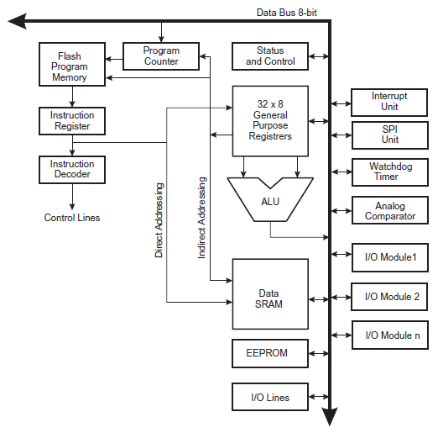
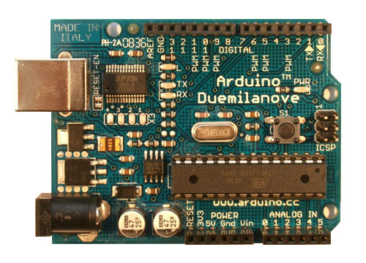
Case Study: Atmel ATmega168
8 bit data bus
Atmel ATmega168 datasheet

Slide 30
Case Study: Atmel ATmega168
8 bit data bus
Instruction Memory
PC
Register File
IR
Control Unit
ALU
IO
Data Memory
Atmel ATmega168 datasheet

Slide 31
Recap
Von Neumann computer model

