Slide 1
Hack KU 2023 Open Source Contribution OpenAI - Whisper
By: Brett Balquist, Kaden Huber, and James Tormohlen

Slide 2
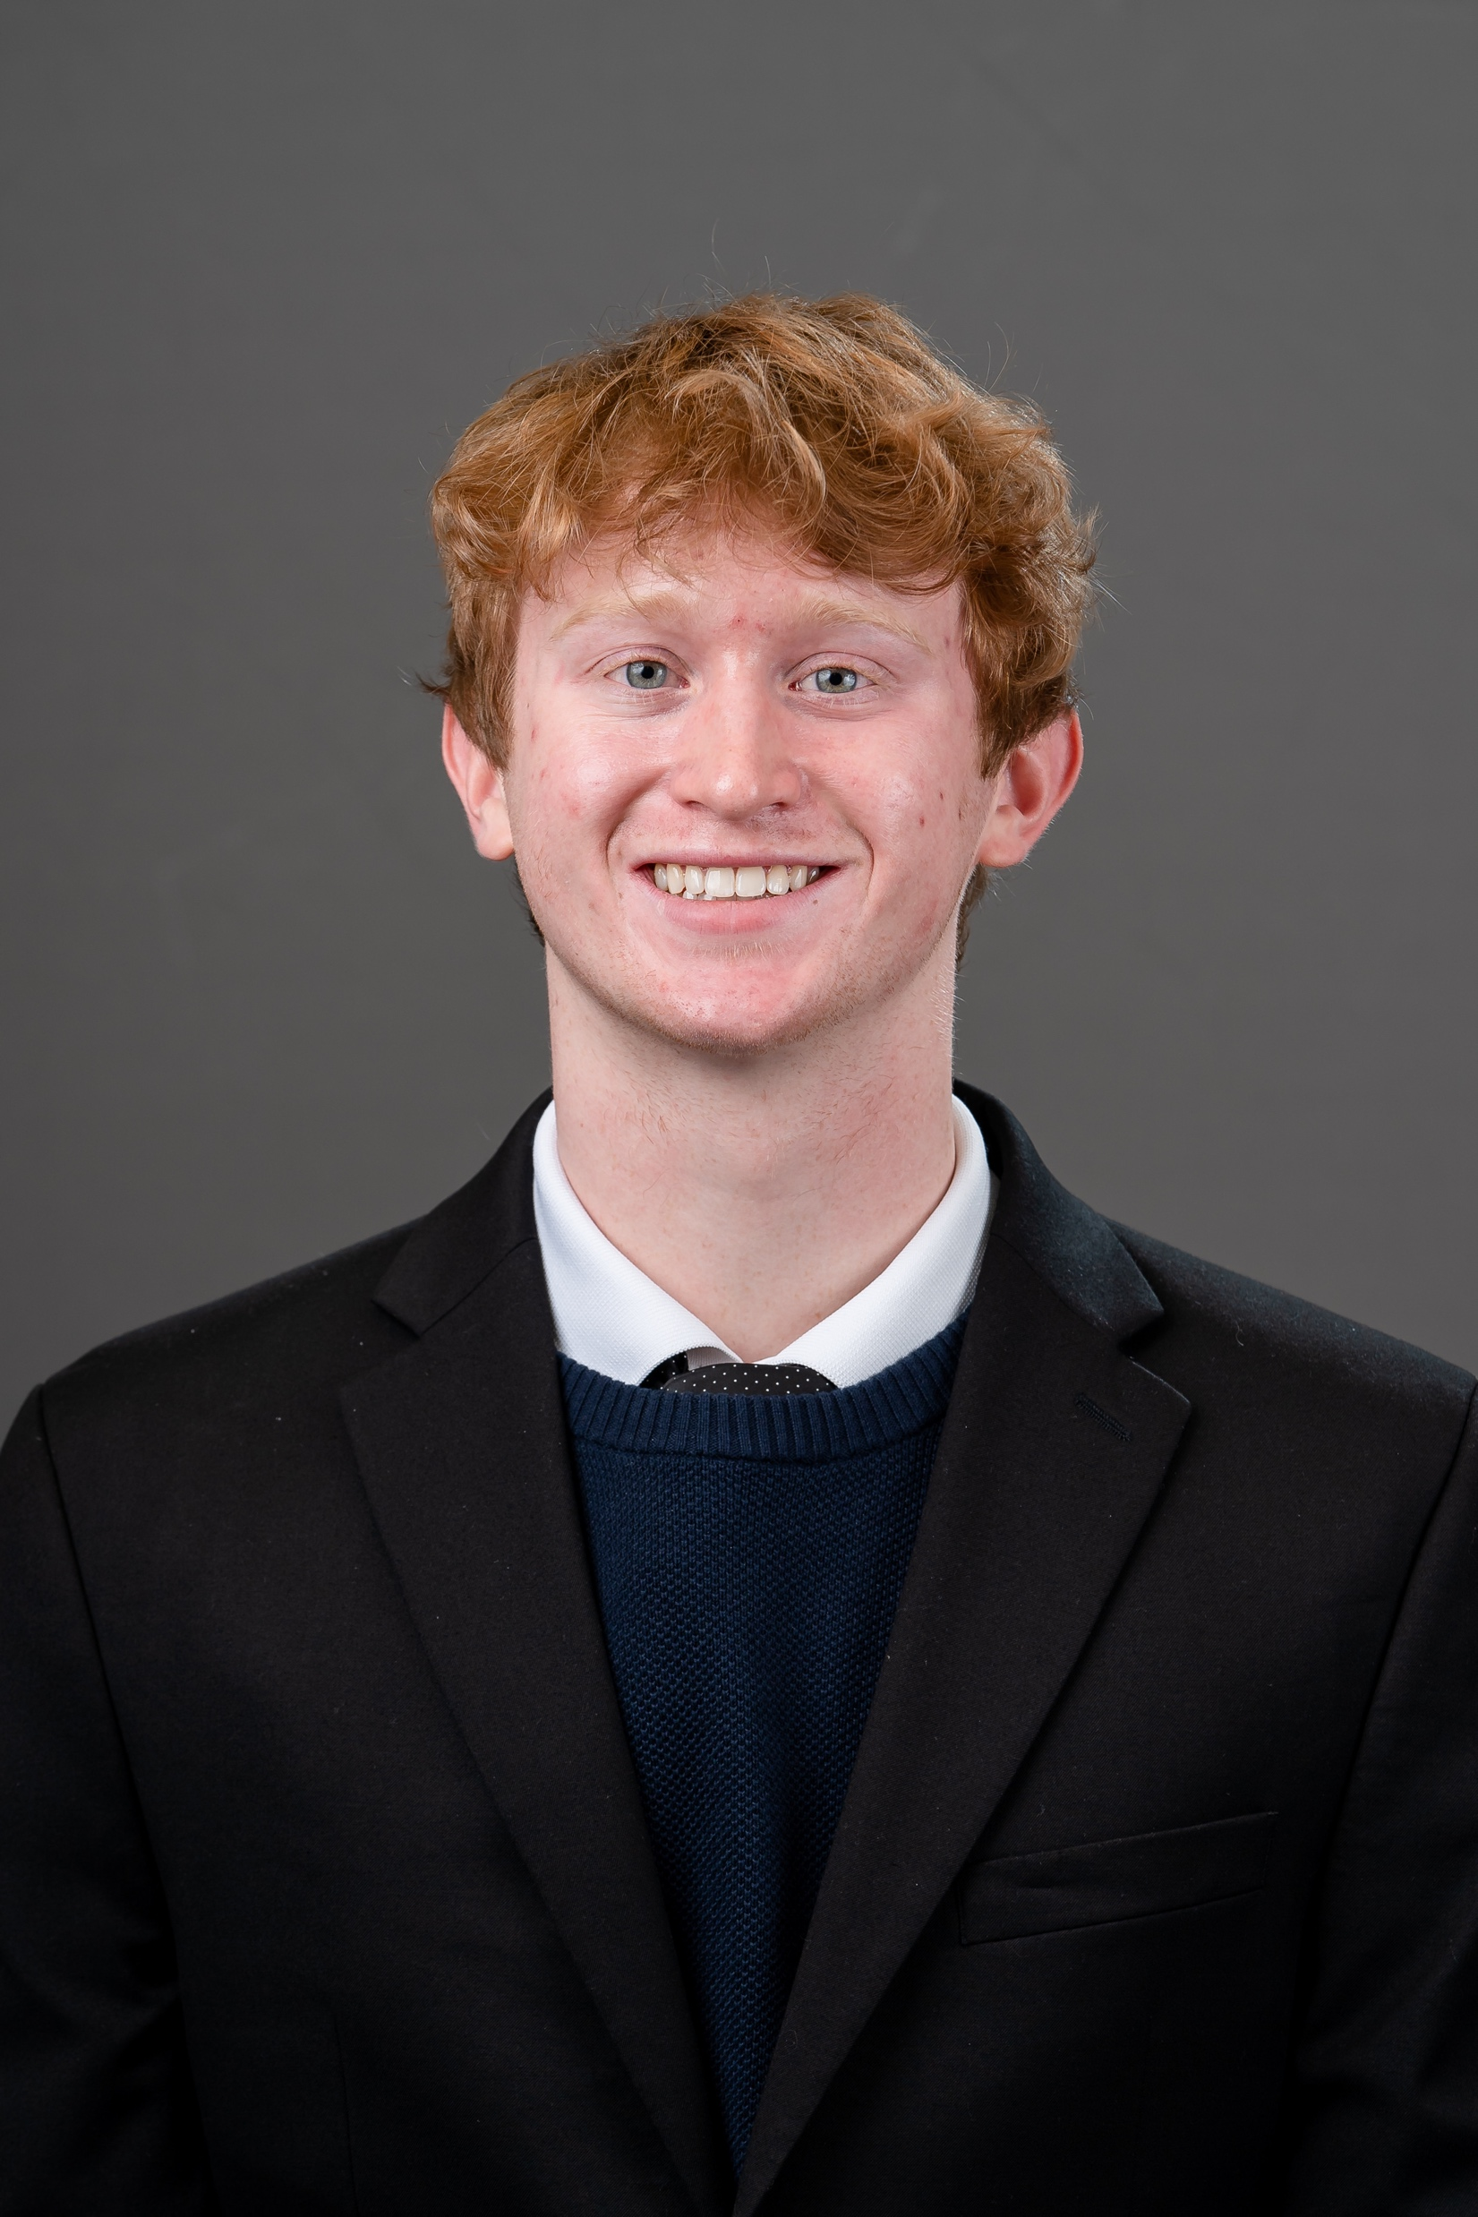
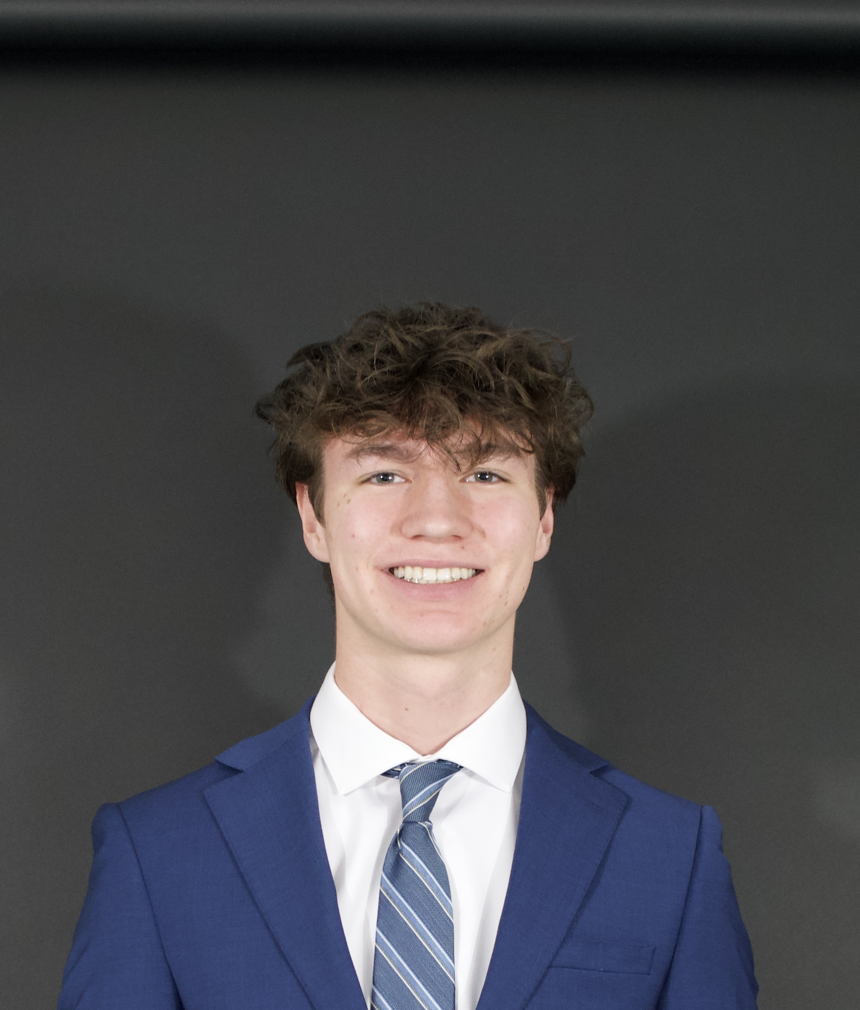
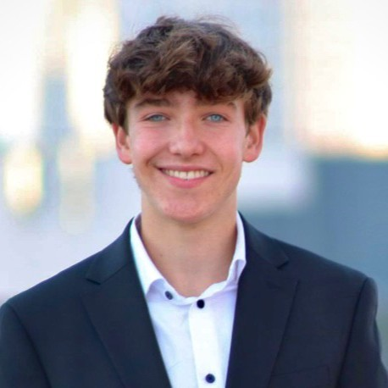
Meet The Team
Brett Balquist
Computer Science + Math
Class of 2026
First Hackathon
James Tormohlen
Computer Science
Class of 2026
First Hackathon
Kaden Huber
Computer Science
Class of 2026
First Hackathon

Slide 3

Why did we choose our Project?
We have worked with whisper previously and encountered a lot of problems. So, we decided to learn more about open source and contribute to this Project.
Our Goals:
Improve documentation
Improve code
Contribute to the community

Slide 4



Contributions
Code PR
README PR
Discussion Post
Improved warnings output format
Improved readability and specificity
Posted about M1 Mac Installation Troubleshooting

Slide 5
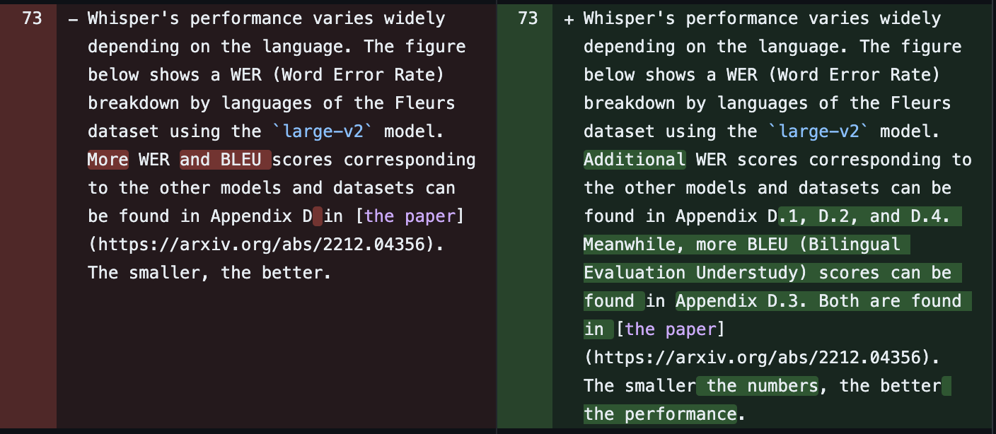
README PR
The change we implemented to the README offered more precise locations of information in a research paper and enhanced overall readability.
SEE PR HERE

Slide 6
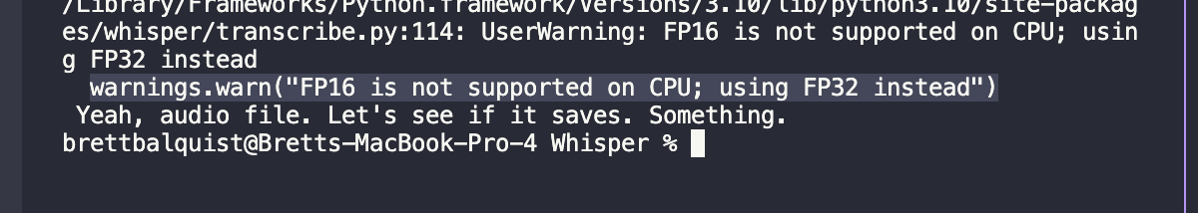
Code PR
The code that we changed improved the format of the warnings output. Warning self printed and the improved code removed this while mainting proper pathing to describe the warning.
See PR Here

Slide 7
M1 Mac Installation Troubleshooting
Posted to Whisper discussion board with tips on how to trouble shoot installation of Whisper, Ffmpeg, and Brew. Provided tips for common errors faced and condensed simple instructions that are helpful for beginners.
SEE POST HERE

Slide 8
What We learned
Github
How to contribute to open source projects and make profesional pull requests.
Markdown
How to better use the markdown text language to give instructions and documentation.

Slide 9

For the future
Going forward we would go more in depth in code contributions and answer existing questions and make a project that uses the given library. Oftentimes making a project can be the best way to contribute to open-source software by providing tools and inspiration for others.

Slide 10
Thank you!

