Slide 1
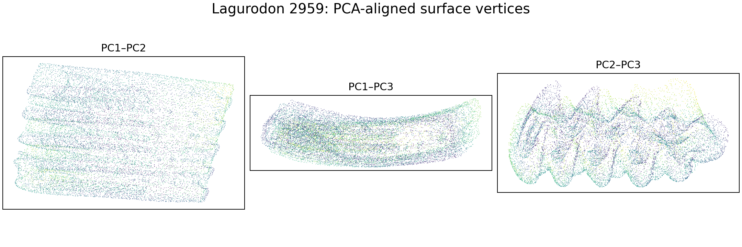
Can AI Identify a Tooth?
Machine learning, 3-D anthropology, and interpretation
Brett McKinney
https://github.com/brett-mckinney/anthroAI
Notes:
What evidence would need before accepting an AI-generated species identification.

Slide 2
PLAN
Workshop Outline
AI, machine learning, and the role of data
Iris UMAP and supervised classification in R
PLY meshes, tooth visualization, and feature creation
Interpretation, risks, and classroom transfer
2
Notes:
workshop alternates between short explanations and live R demonstrations.

Slide 3
FOUNDATIONS
Artificial intelligence and machine learning
Artificial intelligence
Machine learning
A broad field concerned with computer systems that perform tasks associated with intelligent behavior.
A subset of AI in which algorithms learn patterns from examples instead of relying only on hand-written rules.
Generative AI creates new text, images, code, audio, or other content. It can help write an analysis, but it does not make the resulting science valid.
3
Notes:
AI is the umbrella term. Machine learning is one approach. Generative AI and predictive ML overlap but serve different purposes.

Slide 4
FOUNDATIONS
How a machine-learning investigation works
Model Fitting
Question
›
Examples
›
Numeric features
›
Pattern or model
›
Unseen test data
›
Human interpretation
Every step introduces scientific choices. A model can only use the information represented in its data and features.
4
Notes:
model fitting occupies only one stage. Data collection, representation, testing, and interpretation often matter more.

Slide 5
FOUNDATIONS
Supervised and unsupervised learning
Unsupervised learning
Supervised learning
No outcome labels guide fitting
Known labels or outcomes guide fitting
Finds variation, neighborhoods, or unusual observations
Predicts a category or numeric value
Examples: PCA, clustering, UMAP
Examples: kNN, regression, decision trees, random forest, deep learning
The current tooth project is primarily unsupervised: one known specimen cannot define or validate a species boundary.
5
Notes:
Ask participants to classify familiar tasks as supervised or unsupervised. Then connect the distinction to the single known Lagurodon specimen.

Slide 6
R DEMONSTRATION
Iris data as a first R example
150 flowers
iris_features <- as.matrix(iris[, 1:4])
iris_labels <- iris$Species
iris_scaled <- scale(iris_features)
Four numeric features
Three known species
Rows are observations. Columns are features. Labels stay separate until we decide whether the task is supervised.
6
Notes:
Live demo: open the script, inspect head(iris), table(iris$Species), and the dimensions. Explain assignment, data frames, and selecting columns.

Slide 7
Unsupervised Learning Methods
Reduce high dimensional space to lower dimensional (embedding)
Visualize patterns
Identify clusters or groupings
Example Methods
  Principal Component Analysis (PCA)
  Uniform Manifold Approximation and Projection (UMAP)
Notes:
Major and Minor axes

Slide 8
Idea behind Principal Component Analysis
The mathematics originated in the 1700s for analytic geometry
Canonical form of Ellipse:
Notes:
Major and Minor axes

Slide 9
What if your ellipse looked like this?

Slide 10
Use Eigenvector Matrix Transformation to Rotate
Eigenvectors u₁ and u₂
Eigenvalues 3 and 1
u₂ (PC2)
u₁ (PC1)
Highest variation

Slide 11
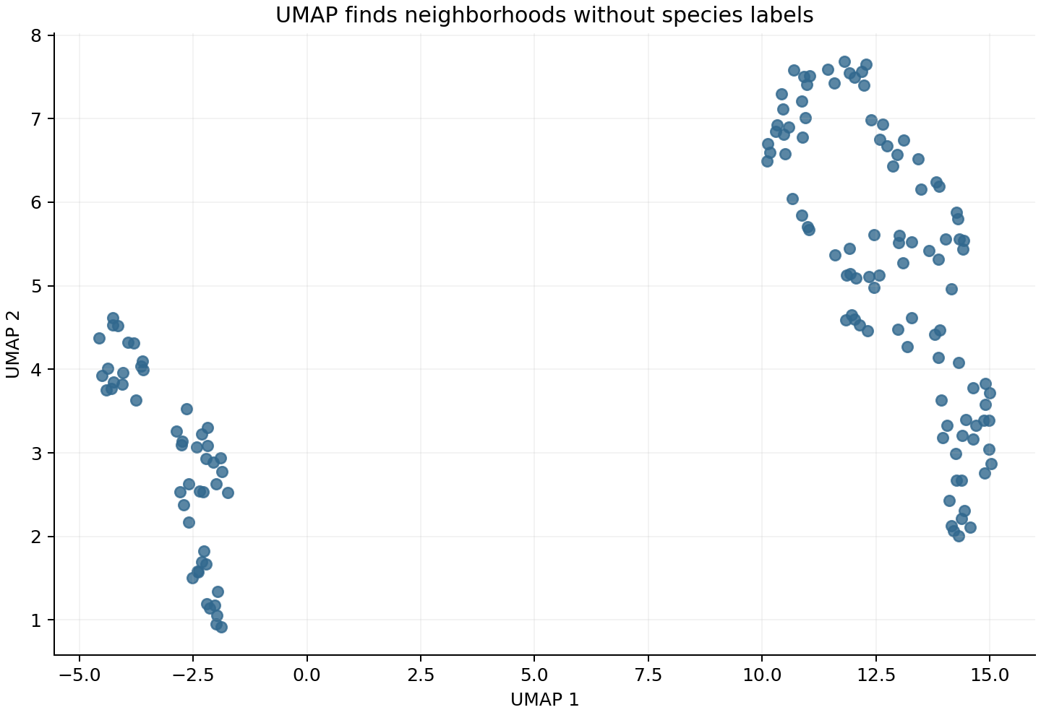
R DEMONSTRATION
UMAP without labels
set.seed(2026)
iris_umap <- uwot::umap(
iris_scaled,
n_neighbors = 15,
min_dist = 0.15
)
What structure do you see?
7
Notes:
Before revealing species, invite teachers to identify groups. Explain that UMAP used the four measurements but not the labels. The axes have no direct biological units.

Slide 12
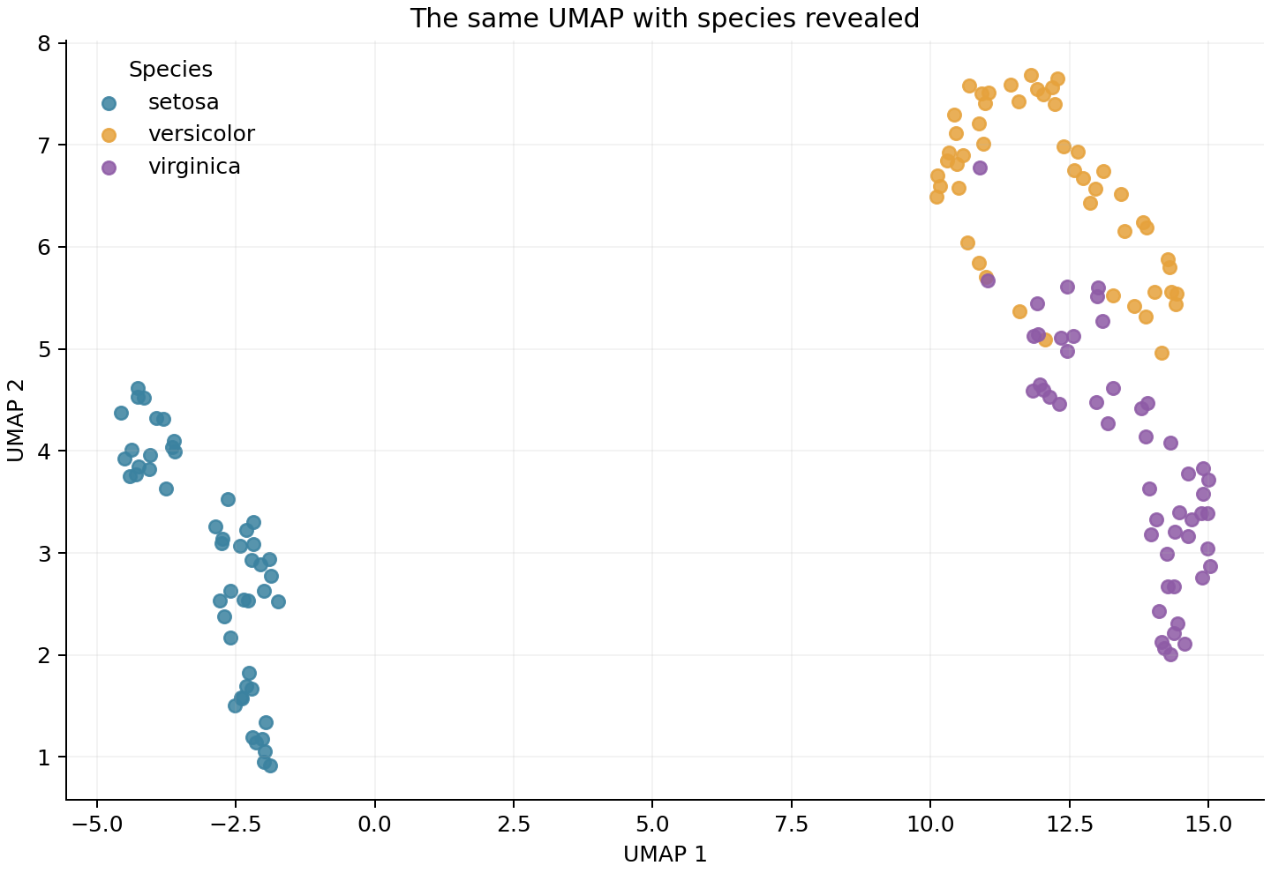
R DEMONSTRATION
Known labels help interpret UMAP
Color is added after UMAP
Setosa separates clearly
Versicolor and virginica overlap
A cluster does not automatically equal a species
8
Notes:
Reveal the labels. Distinguish visual separation from validated prediction. UMAP can change with settings and random seed.

Slide 13
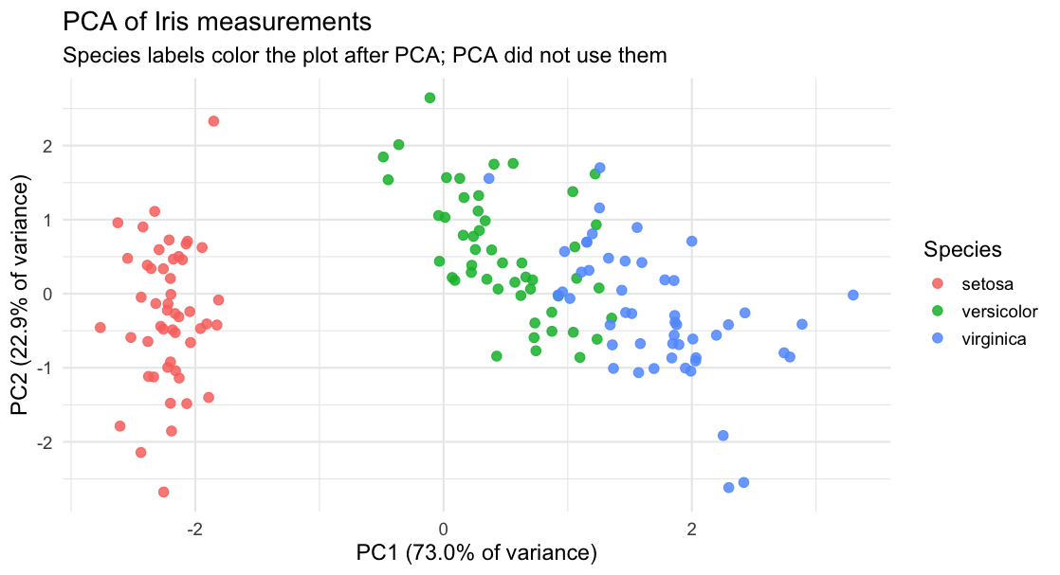
R DEMONSTRATION
Principal Component Analysis
Unlike UMAP
PCA has no tuning parameters
Can be good or bad
8
Notes:
Reveal the labels. Distinguish visual separation from validated prediction. UMAP can change with settings and random seed.

Slide 14
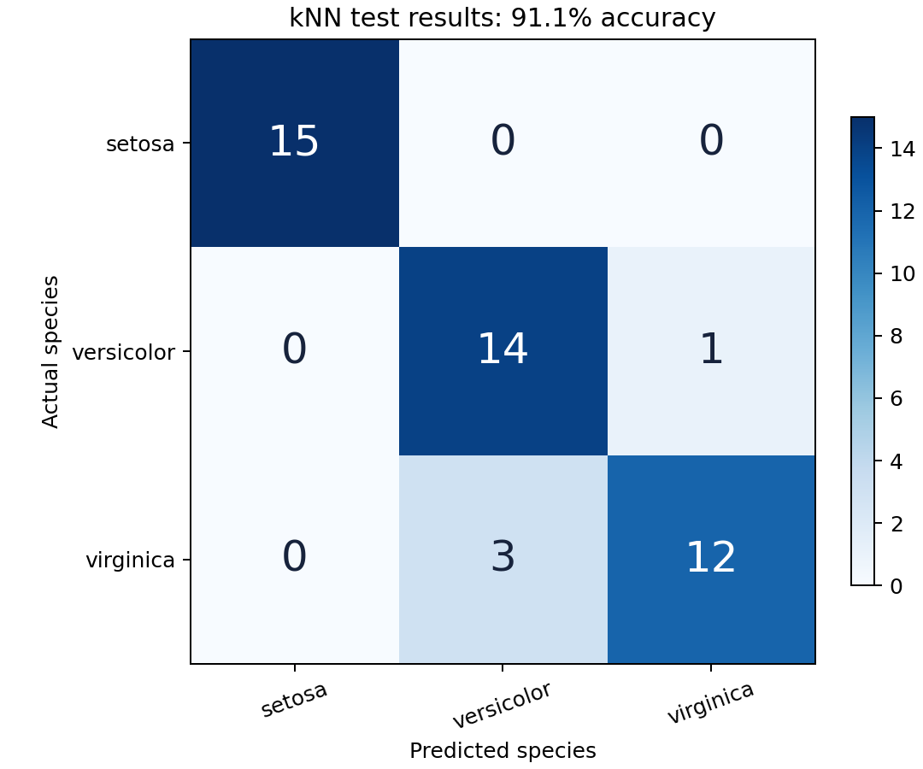
R DEMONSTRATION
Supervised learning requires a test
train: labeled examples used to fit
test: held-out examples used to evaluate
predicted_species <- predict_knn(
train_x, train_y, test_x, k = 5
)
A high accuracy on one small split demonstrates the method. Repeated cross-validation provides a more reliable performance estimate.
9
Notes:
Explain nearest neighbors and the confusion matrix. Do not dwell on the exact accuracy from this one split.

Slide 15
TOOTH PROJECT
Now let’s look at Anthropology Tooth Data
Given ten 3-D tooth images and one known Lagurodon specimen, which unknown teeth are morphologically similar?
Unsupervised Learning
No Supervised Learning
Can’t classify species from one labeled tooth
Similarity ranking, visualization, outlier detection, and hypotheses for follow-up
11
Notes:
State the research question carefully. Ask participants to identify which words make it scientifically modest: morphologically similar rather than same species.

Slide 16
TOOTH PROJECT
PLY (PoLYgon) File Format
ply
format ascii 1.0
element vertex 105827
property float32 x
property float32 y
property float32 z
element face 211368
property list ... vertex_indices
end_header
20.6435 12.374 40.6787
20.6435 12.3687 40.6833
20.6142 12.374 40.6833
20.6727 12.374 40.6833
20.5529 12.4042 40.6775
Vertices
Points with x, y, and z coordinates that sample the tooth surface.
Faces
Triangles that connect vertices into a surface mesh. Connectivity lets us estimate area and enclosed volume.
12
Notes:
Open the PLY file in a text editor if practical. Explain the header, vertex rows, face rows, and zero-based indexing. Emphasize that this is 3-D shape analysis rather than ordinary 2-D image classification.

Slide 17
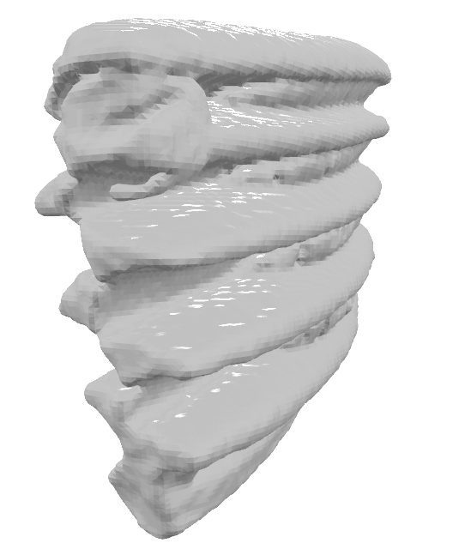
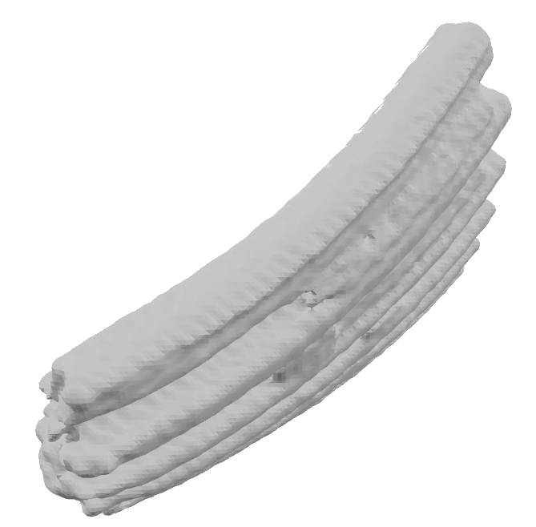
TOOTH PROJECT
Orientation across ply files is not standardized
Lagurodon_2959
2750
13
Notes:
When comparing teeth, distances could be confounded by orientation.

Slide 18
TOOTH PROJECT
Principal Component Analysis standardizes views
PCA alignment centers the vertices and rotates the tooth along its major axes. Color shows depth relative to each viewing plane.
13
Notes:
Live demo: run the PLY-reading and visualization section. PCA alignment improves comparability but does not guarantee anatomical orientation.

Slide 19
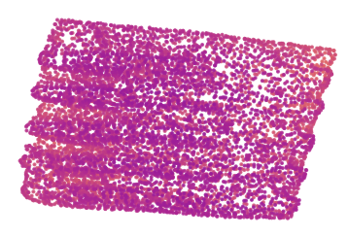
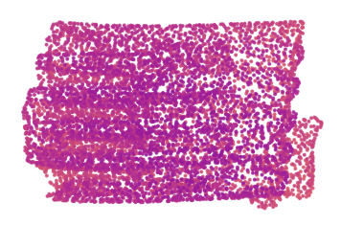
TOOTH PROJECT
After PCA Rotation
Lagurodon_2959
2750
13
Notes:
When comparing teeth, distances could be confounded by orientation.

Slide 20
Feature Engineering
Interpretable features from mesh geometry
Length, width, height
Overall dimensions after PCA alignment
Elongation, flatness
Proportions
Surface area, volume
Size and amount of surface
Sphericity
Compactness relative to a sphere
SA of sphere of same volume as object/actual SA of object
Radial quantiles
Distribution of surface distance from the center
PC variance ratios
Dominant directions of geometric variation
These measurements are explainable, but they may reflect wear, tooth position, breakage, or preprocessing as well as taxonomy.
14
Notes:
Run the feature section and inspect one_tooth_features.csv. Which features an anthropologist would trust and what additional measurements they would add.

Slide 21
TOOTH PROJECT
Example features for the known Lagurodon mesh
Vertices
105,827
Elongation
1.578
Triangular faces
211,368
Flatness
2.032
Length
5.001
Surface area
64.965
Width
3.169
Enclosed volume
8.446
Height
1.560
Sphericity
0.309
Units follow the coordinate units in the source mesh from scanner calibration
15
Notes:
Interpret ratios before raw dimensions. Mention that vertex and face counts describe digital resolution and should not serve as biological species features.

Slide 22
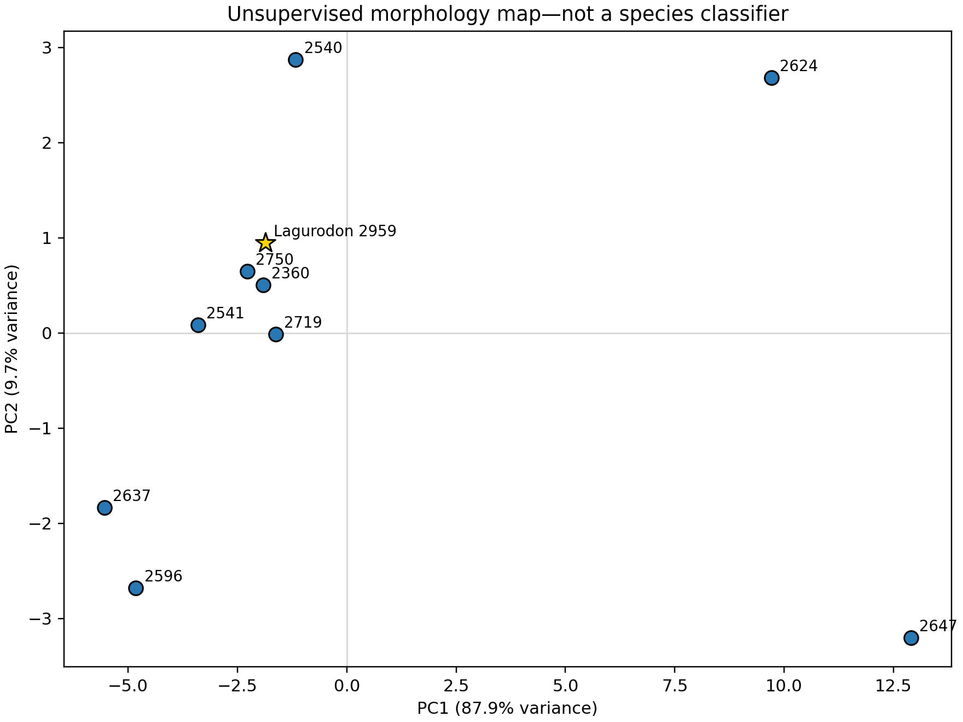
TOOTH PROJECT
PCA in Morphology Feature Space
Closest to the known specimen
1 2750
2 2360
Similarity may reflect taxonomy, but it may also reflect tooth position, wear, damage, orientation, or mesh processing.
16
Notes:
Explain the PCA axes and the known reference marker

Slide 23
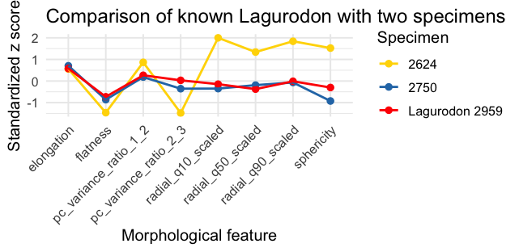
TOOTH PROJECT
Which morphology features drive similarity
Farthest
Closest
Target
16
Notes:
Explain the PCA axes and the known reference marker

Slide 24
RESPONSIBLE AI
What could go wrong?
Overfitting
The model memorizes a small dataset
Data leakage
Related scans appear in both training and testing
Shortcut learning
Scanner, resolution, or background predicts the label
Confounding
Wear or tooth position appears to be species
False clusters
UMAP settings create persuasive visual separation
Hallucination
Generative AI invents methods, facts, or citations
Automation bias
People accept a polished answer too quickly
Sensitive data
Cultural, provenance, or human-subject information is exposed
Data augmentation creates more training views, not more independent biological specimens.
17

Slide 25
A practical AI checklist
01
What is the scientific question?
02
What evidence does the model receive?
03
Are the examples representative?
04
How will we test on unseen cases?
05
Could the model be using a shortcut?
06
What can a domain expert verify?
18
Notes:
Use the checklist to revisit the tooth project. End with a short discussion of how teachers could adapt the workflow to ecology, archaeology, biology, or environmental science.

Slide 26
PRACTICE
Summary of Commonly Used AI/ML Tools
Tool
Useful capability
Main caution
ChatGPT and other generative tools
Explanations, drafts, code, debugging
Can produce convincing errors
R and RStudio
Reproducible analysis and publication-quality graphics
Requires data and coding literacy
Teachable Machine
Fast browser-based image, sound, and pose classification
Easy to confuse demonstration with validation
Orange (Python)
Visual workflows for data exploration and ML
Still requires sound experimental design
MeshLab and 3-D viewers
Inspect and clean surface meshes
Visualization alone does not identify species
10

