Slide 1
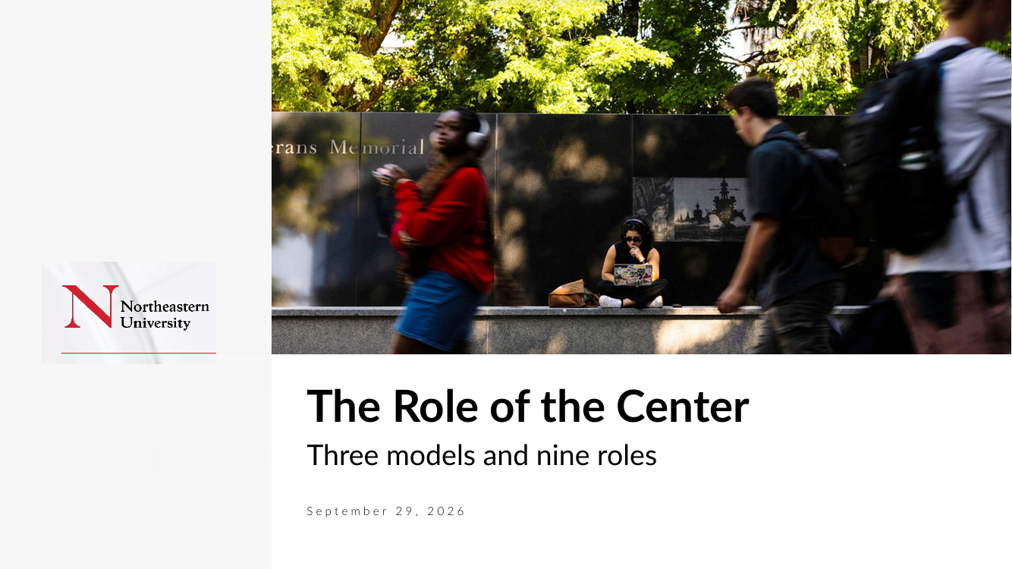
The Role of the Center
Three models and nine roles
September 29, 2026

Slide 2
ROLE OF THE CENTER
Three Models for “Role of the Center”
The most successful is least prevalent
Minimalist
Imperialist
Activist
Academic institution examples:
Most!
Basic “governance” functions
Financial reporting
Legal
Budgeting
Little coordination and sharing of best-practice
Almost no systemic process improvement
Academic institution examples:
None that shall be named
Significant resources “owned” by the center or checking-up (to reduce risk)
Believe the center can substitute for deficiencies in business units
Controls and processes
Large staffs
Academic institution examples:
TBD … few if any
Finds the value-added “sweet spot” between over- and under-intervention
Builds capabilities inside and across business units
Raises issues, enforces standards, but by working through the business unit leaders
Has significant input to, but does not own, budgets and business plans
Manages the long-term shape of the agenda
Requires fewer, but more talented people
Source: 2026-09-29 Role of the Center deck
Northeastern University
2

Slide 3
ROLE OF THE CENTER
Example: “How to Implement Important Process Improvements?”
Minimalist
Imperialist
Activist
Would not engage other than to encourage “do it”
Business units independently decide whether and how to implement any improvements
Methods, mechanisms and results not coordinated
Creates process improvement programs
Gain control of the individuals who will implement
Mandate and measure compliance
Creates programs using a university standard
Trains and coaches departments
May need influence of SVPs/Deans or President, and therefore their “buy-in”
Results will speak; creates “pull” for more help by other departments
Measures communicated broadly to reinforce the “pull”
President intervenes if required
Challenges
Low levels of accountability ensure little action
Lasting change never happens
Challenges
Generally unpalatable where BU’s have had large measures of autonomy
Challenges
Will not work with a leadership team that doesn’t agree about the relevance of the program/initiative
Source: 2026-09-29 Role of the Center deck
Northeastern University
3

Slide 4
ROLE OF THE CENTER
Nine “Roles of the Center” (1 of 2)
 | Role | Description | Activist approach
1 | Define institution direction | Formulate vision and mission Set and reassess/renew strategy Define university identity/image Guide university culture (e.g., set of shared values) Crisis management | Strong central leadership Deep departmental involvement Highly skilled leadership (technical, political, social)
2 | Manage the “portfolio” | Execute acquisitions, divestitures, and joint ventures Approve partnerships and alliances Help raise capital (e.g., philanthropy, debt) | Strong leadership from the center
3 | Leverage the departmental network | Identify and exploit synergies Share ideas/best practices Identify/create platforms to be shared across departments Exploit cross-business unit market opportunities | The center acts as a “coach” Few, but very capable employees who set and understand direction “Trains” department staff to execute. May provide surge capacity
4 | Establish policies and processes for the organization | Control and incentive systems Budgeting Reporting and strategic planning | Ownership for processes Work through and with SVPs and President to communicate SVPs and President deeply involve activist center to assure strategic objectives are met
Source: 2026-09-29 Role of the Center deck
Northeastern University
4

Slide 5
ROLE OF THE CENTER
Nine “Roles of the Center” (2 of 2)
 | Role | Description | Activist approach
5 | Allocate resources across the enterprise | Capital measurement and allocation People/talent measurement and allocation Opportunities | Resources owned by departments, efficiencies tracked at center. Center uses “forces” to manage (e.g., reporting, allocations, etc.)
6 | Enhance academic unit ‘business’ performance | Challenge BU leadership’s assumptions Stretch targets / approve goals Review performance against goals Coach and motivate | Where required, Center offers assistance about performance improvement (track record makes the offer relevant) For “intensive care” departments, SVP or President insist on involvement
7 | Develop leadership talent | Team leadership abilities Functional expertise Executive selection, development, and removal | Center should have significant input to the profile and skills of DA’s Departments have final hiring decisions Center has input on performance and compensation decisions
8 | Maintain essential institution functions | Human resources Regulatory compliance Public, donor, investor, and government relations | Managed from the center
9 | Maintain service/support functions | IT Procurement Insurance/risk management Financial processing/accounting/disbursements, etc. Real estate/auxiliaries, etc. Transportation / security / parking, etc. | Managed from the center
Source: 2026-09-29 Role of the Center deck
Northeastern University
5

Slide 6
ROLE OF THE CENTER
Centralization Depends on Pace of Change and Uncertainty
Pace of change
High
Centralized
Activist
Controlled
Decentralized
RCM
ETOB
Low
Low
Degree of change / level of uncertainty
High
Source: 2026-09-29 Role of the Center deck
Northeastern University
6

Slide 7
Appendix
Parkinson’s Law
Northeastern University
7

Slide 8
APPENDIX | PARKINSON’S LAW
Parkinson’s Law
“We can pay more people, or we can pay people more”
5–7%
Parkinson explains the growth of bureaucracy by two forces:
The Law of Multiplication of Subordinates
“An official wants to multiply subordinates, not rivals”
The total of those employed inside a bureaucracy grew by 5%–7% per year, “irrespective of variation in the amount of work (if any) to be done.”
The Law of Multiplication of Work
“Officials make work for each other”
Source: The Economist, November 19, 1955
Northeastern University
8

Slide 9
APPENDIX | PARKINSON’S LAW
The Law of Multiplication of Subordinates
How seven people do the work formerly done by one
Consider Manager “A”
“A” feels overworked (real/imaginary?)
“A” sees three possible remedies
REMEDY
REACTION
1
Resign
When has this happened?
2
Ask to halve the work with a colleague (Manager “B”)
Appointing/promoting “B” brings a rival for W’s vacancy (thank God W is finally retiring…)
3
Demand the assistance of two subordinates (“C” and “D”)
“A” would much rather have “C” and “D” ‘below’ him
Let’s talk about the inevitability of “E,” “F,” “G,” and “H” when “C” feels overworked
Source: Parkinson’s Law deck
Northeastern University
9

Slide 10
APPENDIX | PARKINSON’S LAW
The Law of Multiplication of Work
Officials make work for each other
Seven make so much work that “A” is working harder than ever
Consider the following
Incoming memo request submitted to “E”
“E” decides this falls within the expertise of “F”
“F” drafts a reply and sends it to “C”
“C” edits and sends on to “D” for consultation and advice
“D” asks “G” to deal with it
“G” goes on vacation and hands it off to “H”
“H” edits the draft further and sends on to “D”, who returns it to “C,” who revises further and sends to “A”
“A” edits to his preference, producing the same reply he would have written if “C” and “D” never existed
A
C
D
E
F
G
H
Were any of these workers lazy or unproductive?
Source: Parkinson’s Law deck
Northeastern University
10

Slide 11
APPENDIX | PARKINSON’S LAW
What is the growth rate predicted by Parkinson’s law?
Variable | Definition
k | number of staff seeking promotion through the appointment of subordinates
m | person-hours devoted to work in the department doing a particular task
p | difference between ages of appointment and retirement
n | number of units being administered
y | total original staff
100(2k^{m} + p)
%
yn
5.2% – 6.6%
Left unchecked, nearly all bureaucracies exhibit annual growth rates of 5.2% p.a. – 6.6% p.a.
Source: Parkinson’s Law deck
Northeastern University
11

Slide 12
APPENDIX | PARKINSON’S LAW
Symptoms of Complexity
Culture and capability
Structure
“Customers complain about how hard it is to do business with us”
“Takes us too long to make decisions”
“My ideas never make it up the chain”
“The staff feels demotivated”
“The staff feels micromanaged”
“I spend too much time on low-value work and managing bureaucracy”
“The staff is not accountable”
“We have a shallow talent bench”
Too many managers
People cost out of line
Low and inconsistent spans of control for managers
Too many layers between the first-line worker and the President
Too many layers between the decision maker and the customer
A lot of redundancy across the organization
Source: Parkinson’s Law deck
Northeastern University
12

Slide 13
Appendix
A New Yorker’s View of the World
Northeastern University
13

Slide 14
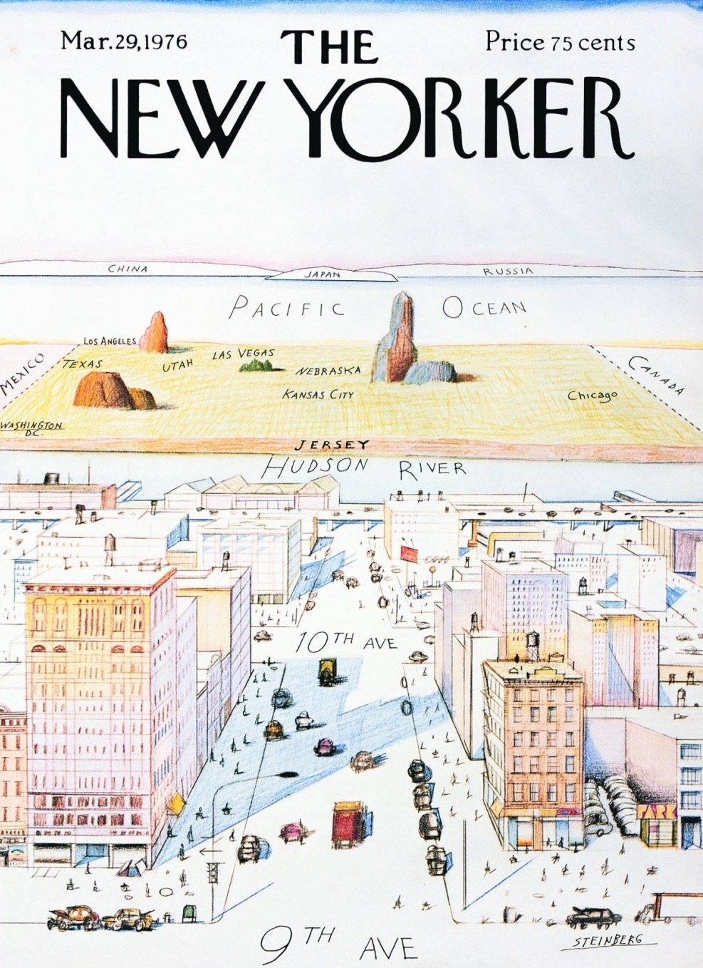
APPENDIX
A New Yorker’s View of the World
DISCLAIMER
The following pages represent gross generalizations that are applicable only to individuals at other institutions
Recognize that each of our own divisions/schools is perfect and that none of the behaviors described apply to us individually
Image: The New Yorker, March 29, 1976
Northeastern University
14

Slide 15
APPENDIX
A Narcissistic View of the World
Part 1 of 2
Administrators view
Deans as
Administrators view
Chairs as
Administrators view
the Center as
Trying to have and keep political capital and not being able to say “no”
Too inclined to say yes regardless of financial complications or long-term or unintended consequences
Protecting their turf and dynasty, subordinating university interests and agenda to the interests and agenda of the division/school
Too inclined to make expedient exceptions that result in damaging precedents
Striving to build a legacy of academic excellence regardless of resources available or cost
Leaders who uses resources as a scorecard
Captains of a luxury liner with a six-volt trolling motor
Inattentive to regulatory and compliance obligations in order to protect faculty life
Great academic leaders, but unprepared and less skilled at managing the financial, operational, human resources, and legal issues related to their huge enterprises
Favoring decentralized control –even at the expense of efficiency, effectiveness and expertise
Wanting a strong Dean and Dean’s Office for dealing with the university, legislature, and public, but a weak Dean and Dean’s Office when dealing with the department and faculty
A large group of independent contractors pursuing own careers and agendas with little loyalty or concern for university issues
Exhibiting huge sense of entitlement and lack of reality
Condescending to Dean and faculty relative to business expertise, productivity and culture.
Underpaying/undervaluing the academic mission of a University
The enemy within
Behaving as though faculty work for them as opposed to their working for faculty
Having all the dollars and all the fun
A close relative that has just won the Powerball
Gross generalizations that apply only to other institutions; see disclaimer on slide 13
Northeastern University
15

Slide 16
APPENDIX
A Narcissistic View of the World
Part 2 of 2
Chairs see
The faculty see
Center staff see
The Center as a cash cow for their research missions
Deans as cash cows for their research and education missions
Development as a source of revenue for their own faculty and programs
Department administrators as their own with no responsibility to the institution at large
The Chair as not supportive of their role and careers
The Dean as demanding their time for education without adequate reimbursement
The Dean as being too focused on other priorities of the department and not understanding of their individual national reputations
Development as never being able to raise enough support
Finance and administrative leaders as bureaucrats, regulators and moles for the dean and “administration”
Administration as unnecessary overhead
Department Chairs as being uninterested in university initiatives
The Deans and finance/admin leaders as not understanding the pressures that the university is under and only wanting more money for academic programs
The Dean as being uninvolved in university initiatives and/or only interested in getting more resources from the Center
Deans as the owner of the ballpark who insists that all games (home and away) be played at his/her stadium
Gross generalizations that apply only to other institutions; see disclaimer on slide 13
Northeastern University
16

