Slide 1
FY26 Endowment Returns — Top 50 National Universities
1-Year Return
As officially reported (updated 2026-09-28) — 6 of 51 institutions had released this figure. Gold portion of a bar is the estimated share of the return attributable to legacy SpaceX venture stakes crystallized by SpaceX's 2026 IPO.
Base return
Est. SpaceX-attributable gain
Northeastern
Source: institution financial reports, board/trustee disclosures, and financial press coverage. US News rank in parentheses (2027 Best National Universities (released Sept 22, 2026); ties included). Dollar figure under each return is the reported FY26 endowment value; NA = not yet published. Northeastern's return is a management estimate pending audited figures. SpaceX-attributable shares reflect each institution's own disclosure; not an audited breakdown. Remaining 45 of 51 institutions had not yet released this figure as of 2026-09-28.
Northeastern University

Slide 2
FY26 Endowment Returns — Top 50 National Universities
5-Year Annualized Return
As officially reported (updated 2026-09-28) — 2 of 51 institutions had released this metric.
Base return
Northeastern
Source: institution financial reports, board/trustee disclosures, and financial press coverage. US News rank in parentheses (2027 Best National Universities (released Sept 22, 2026); ties included). Remaining 49 of 51 institutions had not yet released this figure as of 2026-09-28.
Northeastern University

Slide 3
FY26 Endowment Returns — Top 50 National Universities
10-Year Annualized Return
As officially reported (updated 2026-09-28) — 3 of 51 institutions had released this metric.
Base return
Northeastern
Source: institution financial reports, board/trustee disclosures, and financial press coverage. US News rank in parentheses (2027 Best National Universities (released Sept 22, 2026); ties included). Remaining 48 of 51 institutions had not yet released this figure as of 2026-09-28.
Northeastern University

Slide 4
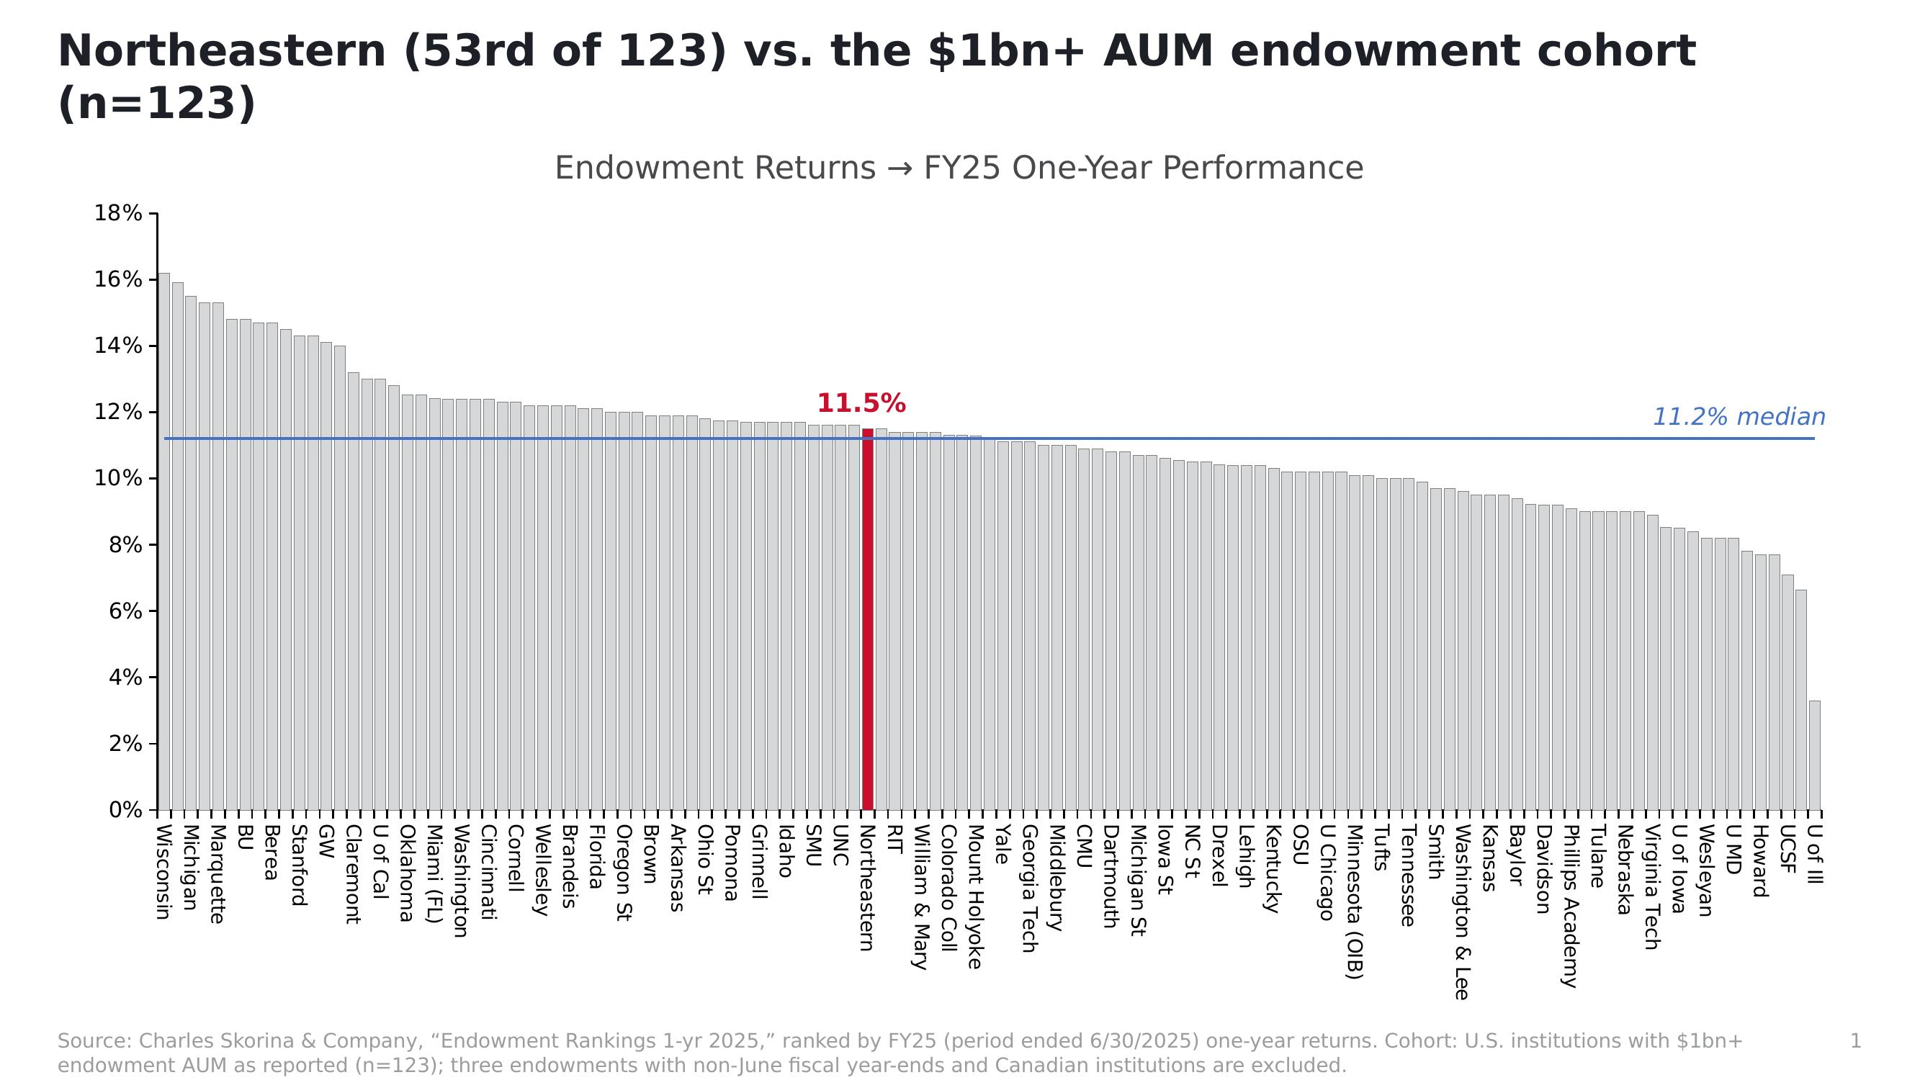
BACKUP (for reference) — FY25 peer-cohort view, 1-Year Performance, n=123 (Charles Skorina & Co.)

Slide 5
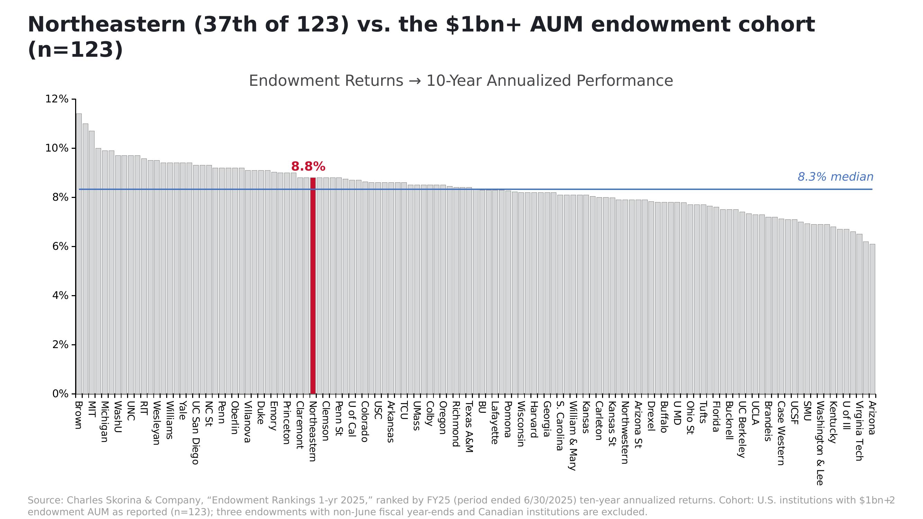
BACKUP (for reference) — FY25 peer-cohort view, 10-Year Annualized Performance, n=123 (Charles Skorina & Co.)

