Slide 1

Financial Overview
The environment, where we stand, and the challenges ahead
Briefing for the Office of the General Counsel
September 30, 2026

Slide 2
Executive summary: pressure is rising, Northeastern is performing, and margin is the constraint
THE ENVIRONMENT
WHERE WE STAND
WHERE WE STAND
CHALLENGES AHEAD
20%
#33
4.0%
−7.2%
Fewer new foreign undergraduates
Private-university R&D rank
FY26 operating margin
Degree-seeking enrollment
New foreign undergraduate enrollment at U.S. colleges fell about 20% in spring 2026; graduate fell about 24%.
Northeastern ranks #33 among private institutions by FY24 R&D ($347M), up from #42 in FY14, growing 13.5% a year.
Recovered from 1.1% in FY25, but still 320 basis points below FY18.
FY25 to FY27 in the low scenario; professional graduate falls 22.8% while net tuition holds at +0.4%.
Where the General Counsel’s office is likely to be engaged
Immigration and visa compliance, sponsored-research and grant compliance, workforce actions, and debt covenants and donor terms.
Source: Boston Globe (May 12, 2026); NSF HERD Survey FY24; Northeastern Financial Affairs (FY26 unaudited)

Slide 3
The storyline: three parts
1
The environment
Pressures converging on higher education, what the headlines say, and the structural forces behind them
2
Where Northeastern stands
Research momentum, enrollment, staffing, operating results and the balance sheet
3
Challenges ahead
Where the data points to risk, and where the General Counsel’s office is likely to be engaged

Slide 4
1
The environment
Pressures on higher education, and the forces behind them

Slide 5
Six pressures are converging on higher education, and on Northeastern
1
Students and demand
2
Cost and return
3
International students
Ivies dipping into waitlists; enrollment- and need-aware admissions
Students opting out of college; middle class moving to public institutions
Small colleges challenged; consolidation
ROI on a college degree
Cost and economic disparity
Time to degree
Colleges lowering or not increasing tuition
Visas and duration of stay
Geopolitics
Global competition (China, Canada)
Price elasticity in graduate programs
4
Federal role and research
5
AI and new competitors
6
Public trust and compliance
Role of government and funding challenges
Shifting national priorities
Security research
Time to the PhD
Disruption from AI
Bite-sized learning
For-profits; companies and consultancies training on their own
Tech elite
Political and public opinion on higher education
Regulatory and compliance requirements
Federal actions, executive orders and endowment taxation
Source: Board of Trustees Retreat, September 24, 2026 (Landscape and Disruptors); peer actions from federal-response tracking

Slide 6
The headlines: international enrollment is falling and campuses are cutting
Recent coverage, June–August 2026
The Boston Globe
The Boston Globe
San Francisco Chronicle
INSIDE HIGHER ED
MAY 12, 2026
JULY 31, 2026
JULY 2026
AUGUST 24, 2026
US colleges report 20 percent drop in foreign students over visa clampdown
New visa changes will upend international studies. Graduate programs are bracing for impact.
New student visa limits could ripple through Bay Area labs and campuses
International Student Rule Already Spurring Disenrollments
INSIDE HIGHER ED
The Washington Post
CNBC
The Christian Science Monitor
AUGUST 6, 2026
JUNE 29, 2026
AUGUST 21, 2026
AUGUST 13, 2026
Campus Cuts Hit Even Wealthy Institutions
U.S. colleges cut programs, report budget gaps after losing foreign students
International student enrollment falls amid tighter U.S. visa policies, reports show
As financial outlook darkens, colleges cut staff, programs ahead of new school year
NAFSA projects roughly 111,000 fewer international students on U.S. campuses this fall (about −9.5%).
Source: headlines as published by each outlet; NAFSA/JB International analysis as reported by Inside Higher Ed, August 2026

Slide 7






The headlines: international enrollment is falling and campuses are cutting
Recent coverage, June–August 2026, as clipped
MAY 12, 2026
JULY 31, 2026
JULY 2026
AUGUST 24, 2026
US colleges report 20 percent drop in foreign students over visa clampdown
New visa changes will upend international studies. Graduate programs are bracing for impact.
New student visa limits could ripple through Bay Area labs and campuses
International Student Rule Already Spurring Disenrollments
AUGUST 6, 2026
JUNE 29, 2026
AUGUST 21, 2026
AUGUST 13, 2026
Campus Cuts Hit Even Wealthy Institutions
U.S. colleges cut programs, report budget gaps after losing foreign students
International student enrollment falls amid tighter U.S. visa policies, reports show
As financial outlook darkens, colleges cut staff, programs ahead of new school year
NAFSA projects roughly 111,000 fewer international students on U.S. campuses this fall (about −9.5%).
Source: headlines as published by each outlet; logos are the publications’ trademarks; NAFSA/JB International analysis via Inside Higher Ed, August 2026

Slide 8
Research, education and healthcare each face structural change
Updated through 2025–2026 where sources publish; regulatory and compliance burden compounds each
Research
Education
Healthcare
Federal R&D funding was 0.63% of GDP in 2024, versus 1.86% at its 1964 peak. The federal share of U.S. R&D funding fell from 45% in 2010 to 34% in 2022.
Congress held NIH at $47.5 billion for FY2026 (+1.0%), $19.6 billion above the President’s request. NSF received $8.75 billion, down 3%.
U.S. R&D totaled $937 billion in 2023, with an estimated $993 billion in 2024, driven by business funding.
Federal student loan debt reached a record $1.696 trillion in December 2025, more than triple its 2007 level of $516 billion.
College closures averaged ten a year from 2014 to 2025, versus three a year from 1996 to 2013. More than 80 private nonprofit colleges closed or merged from 2020 to 2025.
Recent-graduate unemployment was about 5.6% with 42% underemployment in Q2 2026 as AI automates entry-level work. 61.1% of the fall 2019 cohort finished a credential within six years.
Health spending reached 18.0% of GDP in 2024, up 8.2% on the year, and is projected to reach 20.3% by 2033.
CMS projects private health insurance enrollment to fall 2.2% in 2026 when enhanced subsidies expire under current law.
All reform proposals aim to contain health’s share of GDP, driving structural transformation and a shift from volume to value.
Sources: NCSES; CRS (P.L. 119-75); Federal Student Aid; SHEEO; NY Fed; National Student Clearinghouse; CMS Office of the Actuary

Slide 9
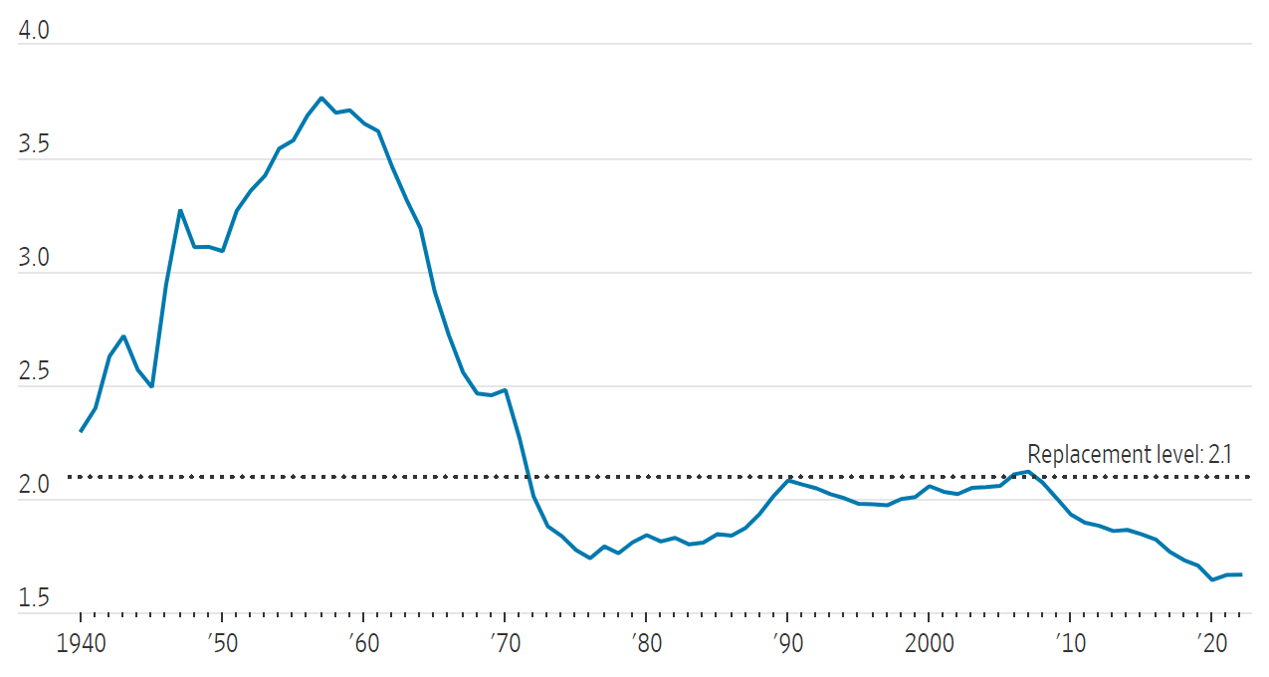
The demographic cliff: four-year enrollment is forecast to fall about 15% from its 2025 peak
Many colleges and universities will face declining or stagnant enrollment; the 2008 dip in births reaches college in 2025
Overall enrollment forecast, four-year institutions (index, 2025 peak = 100)
U.S. total fertility rate trend
Fertility falls with economic cycles
Trends by institution type
Universities anticipate up to a ~15% drop in freshman prospects beginning in 2025, driven by the fall in births during the 2008 recession.
The dip in births in 2008 corresponds to students entering college 17 years later, in 2025.
Demand for elite institutions is projected to drop by much less during 2025 to 2029.
Regional four-year institutions are expected to lose more than 11 percent of their students, from 1.43 million in 2012 to 1.27 million in 2029.
Sources: CUPA-HR, “The Looming Enrollment Cliff” (2019); Wall Street Journal, “A Visual Breakdown of America’s Stagnating Number of Births” (2023)

Slide 10
The sector grew eightfold from 1870 to 2010, peaked at 4,726 in 2012–13, and has shrunk 18% since
U.S. degree-granting institutions, including branch campuses: start of each decade, the 2012–13 peak, and 2018 and 2022–23
2023–24 update
All Title IV institutions fell 2%, from 5,918 to 5,819: 161 closed, merged or lost eligibility and 62 were added.
Source: NCES Digest of Education Statistics 2023, Table 317.10; NCES press release, August 21, 2024 (Title IV institutions)

Slide 11
The United States has far more colleges/universities than other countries
Four-year colleges/universities by country
(for countries with ≥ 50 colleges/universities) n=36
Source: World Bank; HIPI university list

Slide 12
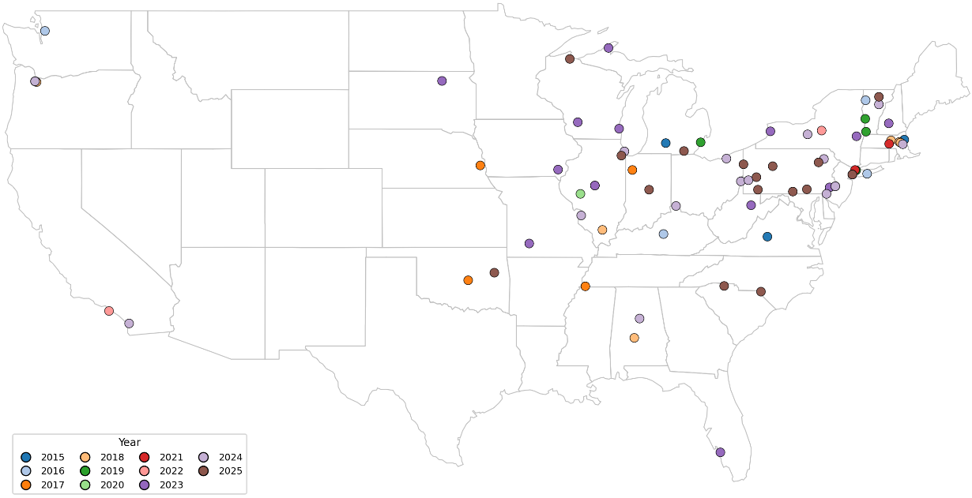
76 college closures since 2015 – and the pace is ramping up
Closures by year

Slide 13
Federal R&D support has fallen from 1.9% of GDP to 0.6%, while other sources now fund 2.8%
U.S. R&D funding by source as a percent of GDP, 1953–2024
2024
Total U.S. R&D was 3.39% of GDP: business funded 2.54%, the federal government 0.63% and other nonfederal sources 0.22%. Total R&D reached $937 billion in 2023, with an estimated $993 billion in 2024.
Source: NSF National Center for Science and Engineering Statistics, National Patterns of R&D Resources (NSF 26-314, figure 3); 2024 is an estimate

Slide 14
Federal regulation has grown from 9,745 pages in 1950 to 194,395 in 2024, twentyfold
Total pages in the Code of Federal Regulations, 1950–2024. At one page a day, the full Code would take 533 years to read.
Source: George Washington University Regulatory Studies Center, Reg-Stats (Federal Register statistics; GovInfo for 2024)

Slide 15
Regulatory complexity is a growing burden: 35 areas, about 200 statutes, about 20 agencies
> 35
~200
~20
different regulatory areas
different statutes
different agencies to report to
e.g., Accreditation, Campus Safety, Financial Aid, Grants and Contracts
e.g., ADA, FERPA, Higher Education Act, Title IX
e.g., Dept. of Education, NSF, NIH
Accounting
Accreditation
Affirmative Action
Americans with Disabilities Act and Section 504
Athletics
Campus Safety / Clery Act
Conflict of Interest Policies
Copyright and Fair Use
Donors and Gifts
Environmental Health and Safety
GAAP
Higher Education Opportunity Act 2008
Americans with Disabilities Act and Section 504
Title IX
Clery Act
C.F.R. and public health
Copyright Law
Uniform Prudent Management of Funds Act
Department of Education
Department of Justice
Financial Accounting Standards Board
National Science Foundation
National Institutes of Health
Public Health Agency
FDA
“HEA totals nearly 1,000 pages; there are over 1,000 pages in the official Code of Federal Regulations devoted to higher education… on average every workday ED issues one new sub-regulatory guidance directive or clarification… No one has taken the time to ‘weed the garden.’” — Senator Lamar Alexander
Source: Northeastern Financial Affairs; Senator Lamar Alexander

Slide 16
The college earnings premium has grown from 28% in 1965 to 80% in 2014, and still holds today
Median family income of adults ages 30–39, with and without a four-year college degree ($000)
28%
27%
33%
46%
62%
80%
2024–2025 UPDATE
College premium above
2.3×
Median household income in 2024: $132,700 when the householder has a bachelor’s degree or higher, versus $58,410 with a high school degree only (Census).
+63%
Bachelor’s degree holders’ median weekly earnings versus high school graduates in 2025; the premium was 66% in 2024 (BLS).
Source: Brookings tabulations of Census CPS ASEC (1965–2014); Census (Sept. 2025) and BLS Education Pays (2024, 2025) use different measures

Slide 17
2
Where Northeastern stands
Research momentum, enrollment, staffing and financial performance

Slide 18

Northeastern ranked #99 of 925 institutions in FY 2024 R&D expenditures
Top 150 institutions by FY 2024 total R&D; Northeastern was #107 in FY 2023 and #134 in FY 2014
Has a medical school
No medical school
Northeastern
37 institutions ≥ $1B
72 institutions ≥ $500M
127 institutions ≥ $250M
#1
#25
#50
#75
#100
#125
#150
Note: Johns Hopkins includes the Applied Physics Laboratory ($2.55B of $4.13B). Total higher-ed R&D in FY 2024 was $117.7B across 925 institutions.
Source: NSF NCSES, Higher Education Research and Development (HERD) Survey, FY 2024 (NSF 26-304)
Notes:
All 925 institutions in HERD FY 2024 Table 4 (standard and short form). Chart shows the top 150. Johns Hopkins ($4.13B) includes the Applied Physics Laboratory ($2.55B). Medical school = institution reported medical-school R&D in Table 19. Total HERD R&D in FY 2024 was $117.6B (standard form; $117.7B all institutions).

Slide 19
Northeastern ranked #33 among private institutions
Top 50 private institutions by FY 2024 total R&D; Northeastern was #36 in FY 2023 and #42 in FY 2014
Has a medical school
No medical school
Northeastern
Note: Johns Hopkins includes the Applied Physics Laboratory ($2.55B of $4.13B).
Source: NSF NCSES, Higher Education Research and Development (HERD) Survey, FY 2024 (NSF 26-304)
Notes:
Top 50 private institutions by FY 2024 total R&D (HERD Tables 4 and 5). Names shortened for the axis: MIT, Caltech, Dartmouth (incl. Dartmouth Hitchcock), Vanderbilt (incl. VUMC), Icahn School of Medicine at Mount Sinai, Washington U. St. Louis. Includes standalone private research and medical institutions (Scripps, Woods Hole, Cold Spring Harbor, Rockefeller, Baylor College of Medicine). Medical school = reported medical-school R&D in Table 19.

Slide 20
Over the past five years, Northeastern's R&D grew 13.5% per year, 1.9x the rate of all institutions
Annual growth rate of R&D expenditures, FY 2019–2024, top 50 privates: Northeastern ranked #3 of 50
Has a medical school
No medical school
Northeastern
All HERD institutions: 7.1%/yr
Source: NSF NCSES, Higher Education Research and Development (HERD) Survey, FY 2024 (NSF 26-304)
Notes:
Compound annual growth rate of total R&D expenditures, FY 2019–2024, for the top 50 private institutions (HERD Table 13). All HERD institutions (standard form): 7.1% per year. Median of the top-50 privates: 7.2%.

Slide 21

Enrollment, net tuition and tuition discount by student group
Undergraduate, professional graduate and JD/PhD · FY20 – FY27 · 1 October snapshots; FY27 = low scenario
Undergraduate
Professional Graduate
JD/PhD
Degree-seeking enrollment
Net tuition revenue
Tuition discount by year
Students (thousands)
$ millions · management reporting, not GAAP
Discount rate, % of gross tuition
Total enrollment decreased 7.2% from FY25 to FY27
Undergraduate increased 7.8% from FY25 to FY27
Professional graduate decreased 22.8% from FY25 to FY27
Total net tuition increased 0.4% from FY25 to FY27
Undergraduate increased 12.6% from FY25 to FY27
Professional graduate decreased by 28.4% from FY25 to FY27
Drivers of higher discounts:
Decrease in international students
Decrease in NUin
Increase in Pell students and overall need
Increase merit appeals approved due to high discounting by competitors (e.g., Syracuse)
Source (enrollment): degree-seeking enrollment by reporting group, supplied 17 September 2026, Fall 2019 – Fall 2026; fiscal year ends June 30, so Fall 2019 = FY20 … Fall 2026 = FY27.

Slide 22
Degree-seeking
Undergraduate the dominant growth driver since FY20
Degree-seeking students by reporting group · FY20 – FY27 · 1 October snapshots; FY27 estimated
Undergraduate added 6,601 students since FY20. Professional graduate rose 6,087 to a peak of 23,247 in FY24 and has given nearly all of it back — 17,607 in FY27, +447 on FY20.
CAGR
FY20 → FY27
Change
FY20 → FY27
47,770
48,812
47,367
45,468
45,300
41,842
JD/PhD (+473)
+2.9%
+473
37,779
37,825
Professional Graduate (+447)
Down 24% since FY24
+0.4%
+447
Undergraduate (+6,601)
+4.5%
+6,601
Total degree-seeking
+2.6%
+7,521
Professional graduate is 24% below its FY24 peak of 23,247.
Undergraduate leads it by 7,496 in FY27.
Source: Northeastern degree-seeking enrollment by reporting group, supplied September 2026 (FY27 is an estimate); full notes in speaker notes
Notes:
Original slide footnote: Source: degree-seeking enrolment by reporting group (Undergraduate, Professional Graduate, JD/PhD) supplied 8 September 2026, Fall 2019 – Fall 2026. FISCAL-YEAR LABELS: the fiscal year ends June 30, so each fall term falls in the following fiscal year — Fall 2019 = FY20 … Fall 2026 = FY27. FY27 IS AN ESTIMATE, not a reported count; non-degree students are excluded. The undergraduate/graduate split on the enrolment page in the appendix comes from an earlier table that classifies about 2,000 students differently; the yearly totals are identical on both.

Slide 23
Professional New Student Scenarios
Graduate
-3%
-9%
-9%
-3%
-1%
-1%
-10%
-1%
-1%
Actual
Actual
Actual
Forecast
Budget Target
Scenarios
Budget Target
Scenarios
Budget Target
Scenarios

Slide 24
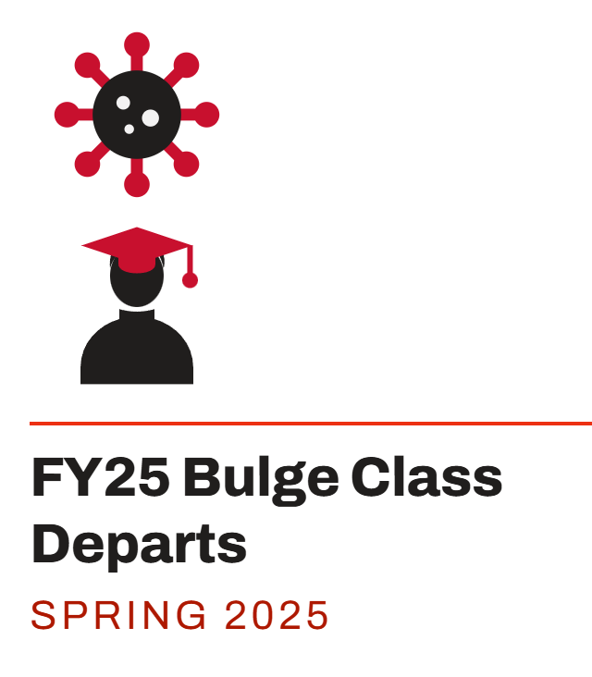
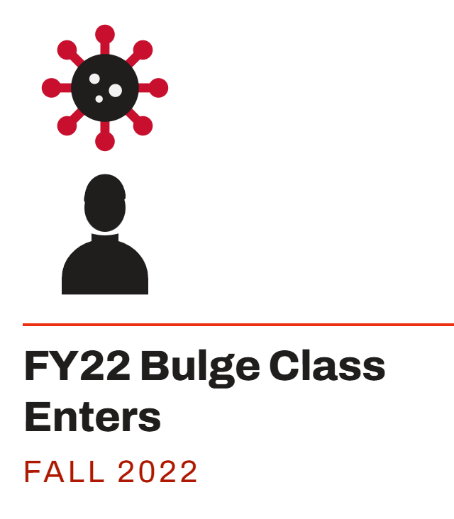
By funding source
Full-time staff grew 46% since FY20, to 4,179 — but headcount has fallen 312 in the past year
Total full-time staff by year, by funding source and campus · FY20 – FY27 · 1 Oct snapshots; FY27 at 1 Aug 2026
Of the +1,312 net adds, London supplied 182 and Oakland 218; the rest of the internally funded base added 802, and externally funded staff 110.
+1,312
+1,202
+110
–312
Total FTE added since FY20 (+46%)
Internally funded adds — 92% of growth
Externally funded adds — 8% of growth
Change from FY26 peak of 4,491
CAGR FY20 → FY27
4,274
4,447
4,491
4,179
+9.9%
Externally funded (+110)
3,653
2,867
3,055
3,088
Oakland campus (+218)
n/a
London (+182)
n/a
Internally funded, all other (+802)
+3.7%
44% growth since FY20
Total University
+5.5%
externally
funded
117 (4.1%)
124 (4.1%)
124 (4.0%)
145 (4.0%)
176 (4.1%)
227 (5.1%)
217 (4.8%)
227 (5.4%)
Externally funded = sponsored sources (Restricted and Research funds); internally funded = all other university sources.
Oakland and London are internally funded carve-outs; neither has a CAGR (zero FY20 base).
Source: Northeastern staff headcount files, September 2026; full methodology in speaker notes
Notes:
Original slide footnote: Sources: totals, Oakland and FY20 – FY22 from "2026-09-03 2019 - Current Staff Headcounts - Credits - UG class sizes.xlsx," Detail tab; FY23 – FY27 funding split from "2026-09-04 2019-2026 Staff headcount by funding source.xlsx," Division Detail by FT tab, with FY20 – FY22 derived by applying each division's own FY23 internal share to its published headcount — the same basis as the executive-level pages, so the two foot to each other. LONDON: first reported Fall 2025 — 216 in FY26 and 182 in FY27, all Operating funds (Division Detail by FT, DIV54). Full-time filled positions, excluding postdocs. INTERNALLY FUNDED = Operating, Auxiliary, Designated and Plant funds; EXTERNALLY FUNDED = Restricted and Research funds. FISCAL-YEAR LABELS: Fall 2019 = FY20 ... Fall 2025 = FY26; FY27 is the 1 August 2026 snapshot, ten months after FY26.

Slide 25

CONSOLIDATED OVERVIEW
$ in millions
Financial Dashboard
OPERATING RESULTS · FY23–FY25 ACTUALS, FY26 BUDGET AND UNAUDITED
METRIC
FY23–26 TREND
FY23
FY24
FY25
FY26 BUDGET
FY26 UNAUDITED
Δ VS. FY26 BUDGET
COMMENT
Net Tuition & Fees
1,474
1,638
1,772
1,858
1,782
▼ −76 (−4.1%)
FY26 includes ~1,450 MMC students
Total Operating Revenues
2,063
2,297
2,442
2,582
2,473
▼ −109 (−4.2%)
Total Operating Expenses
1,908
2,162
2,321
2,469
2,353
▼ −116 (−4.7%)
Operating Margin ($)
156
135
121
112
120
▲ +8 (+7.1%)
Operating Margin (%)
7.5%
5.9%
4.9%
4.4%
4.9%
▲ +0.5 pt
Research Awards
282
296
267
250
291
▲ +41 (+16.4%)
Gifts & Commitments
120
370
130
120
125
▲ +5 (+4.2%)
BALANCE SHEET & LIQUIDITY · AT FISCAL YEAR END
METRIC
FY23–26 TREND
FY23
FY24
FY25
FY26 BUDGET
FY26 UNAUDITED
Δ VS. FY25
COMMENT
Net Assets
3,741
4,110
4,363
—
5,050
▲ +687 (+15.7%)
FY26 includes $203M MMC
Debt Service Coverage
3.4x
3.3x
3.5x
—
3.4x
▼ −0.1x (−2.9%)
Long-Term Debt
1,292
1,257
1,432
—
1,954
▲ +522 (+36.5%)
FY26 incl. $39M MMC + $485M Series 2026 issuance
Cash & Short-Term Inv.
563
546
412
—
572
▲ +160 (+38.8%)
Endowment
1,714
1,906
2,110
—
2,361
▲ +251 (+11.9%)
Based on preliminary 16% FY26 endowment return
Sparklines show FY23–FY25 actuals and FY26 unaudited (navy point). Chips: green = favorable, red = unfavorable, amber = essentially unchanged; operating rows vs. FY26 budget (expenses below budget = favorable), balance-sheet rows vs. FY25 (higher debt = unfavorable). Percent change in parentheses.
Source: Northeastern Financial Affairs (FY26 unaudited)

Slide 26
SEPTEMBER 2026 · $ IN MILLIONS UNLESS NOTED
5-Year Financial Trend
DASHBOARD METRIC · FY22–FY26 TREND
FY26 BUDGET
FY26 UNAUDITED
DASHBOARD METRIC · FY22–FY26 TREND
FY26 BUDGET
FY26 UNAUDITED
Net Tuition & Fees
Total Operating Revenues
+9% CAGR FY22–26
1,858
1,782
+9% CAGR FY22–26
2,582
2,473
−76 vs. budget
−109 vs. budget
Total Operating Expenses
Research Awards†
+10% CAGR FY22–26
2,469
2,353
+6% CAGR FY22–26
250
291
−116 vs. budget
+41 vs. budget
Operating Margin ($)
112
120
Gifts & Commitments
+8 vs. budget
+6% CAGR FY22–26
120
125
Operating Margin (%)
+5 vs. budget
4.4%
4.9%
+0.5 pt vs. budget
FY26 reflects unaudited results. Sparklines show FY22–FY26 with FY26 unaudited as the final point; CAGR is compounded from FY22 to FY26. Tiles: green = favorable vs. FY26 budget, red = unfavorable. † Research Awards FY26 is a preliminary estimate. Same metric definitions and sources as the 20-year view.
Source: Northeastern Financial Affairs (FY26 unaudited)

Slide 27
FY21–FY25 ACTUALS WITH FY26 UNAUDITED
Actual
FY26 Unaudited
We continue to perform well operationally
Credit rating comparison
Moody's “A” rated peer median (FY25)
Moody's “Aa” rated peer median (FY25)
Operating Results
Annual Debt Service Coverage
GAAP UR EBIDA Margin
EBIDA to Debt Service
Source: Moody’s Ratings (June 24, 2026); Northeastern Financial Affairs
Notes:
Original slide footnote: Moody's “A” (single-A, blue) and “Aa” (double-A, green) rating category medians across all Moody's-rated private universities nationally (n=70), FY2025 — the broad national single-A sample, not restricted to Northeastern's own peer set or institution size. Source: Moody's Ratings, “Higher Education – US: Medians – Private colleges' margin pressure intensifies as costs rise,” 24 June 2026, Appendix D – A (single-A, n=70) and Appendix D – Aa (double-A, n=60, green).

Slide 28
PEER BENCHMARKING · GAAP UR OP EBIDA MARGIN
11.5% FY26 EBIDA margin would put Northeastern fifth among 20 academic peers
Peers at FY2025 audited actuals; Northeastern shown at its FY2026 projection
Moody's “A” rated peer median (FY25)
Moody's “Aa” rated peer median (FY25)
⚕
⚕
⚕
⚕
⚕
⚕
⚕
⚕
⚕
Moody's rating
Aa1
Aa2
Aa3
A1
A2
A3
Source: institutions’ audited FY2025 financial statements; Moody’s; methodology in speaker notes
Notes:
Original slide footnote: EBIDA margin = (Operating result + Depreciation & Amortization + Interest) ÷ Total operating revenues & other support, all four measured on each institution's Without-Donor-Restrictions (unrestricted operating) basis. ⚕ Includes a consolidated health system or clinical practice-plan revenue stream (Duke, Cornell, NYU, Emory, USC, Tulane, Miami, George Washington; Tufts incl. ~$163.7M Cummings Veterinary/Dental clinical practice revenue) — not directly comparable to a pure-academic peer. FYE varies: Aug 31 (Northwestern, NYU, Emory); May 31 (Boston College, Miami, Villanova); June 30 (all others). USC shown before its $55.5M insurance recovery (3.7% with). Source: each institution's audited FY2025 consolidated financial statements.

Slide 29

GAAP UR OP
Margin bottomed at 1.1% in FY25 and recovered to 4.0% in FY26
Still 320bp below FY18
Operating margin (operating result ÷ total operating revenues and other support), FY18–FY25 actuals, FY26 preliminary
–320 bps
Margin compression, FY18 to FY26
$79M
Annual surplus forgone vs. holding the FY18 margin on FY26 revenue
$25M
What one point of FY26 margin is worth
Source: as above. "$79M forgone" is arithmetic — FY26 revenue at the FY18 margin ($177M) less the FY26 result ($98M). It is not a claim that the FY18 margin was achievable in FY26. FY26 is preliminary and unaudited, from the 9/24/26 FAC draft. Nonoperating activity is excluded on this basis.
Source: Northeastern Financial Affairs (FY26 preliminary, unaudited)
Notes:
GAAP UR operating result: $93M in FY18, peak $157M in FY22, trough $27M in FY25, $98M on preliminary FY26. On a revenue base that nearly doubled, FY26 is still a 320bp margin decline from FY18.

Slide 30
GAAP UR OP
Above both Moody’s medians through FY20 — below the A-category median every year since FY21
Bars: Northeastern EBIDA margin — (operating result + depreciation + interest) ÷ total operating revenues and other support, unrestricted basis. Lines: Moody’s private-university medians.
9.5%
FY25 EBIDA margin — the low of the series
–567 bps
EBIDA margin compression, FY18 to FY25
204 bps
How far FY25 sits below the A-category median of 11.5% — 84 bps below the comprehensive median
Source: Northeastern Financial Affairs; Moody’s Ratings

Slide 31
On the same basis, Northeastern’s FY25 EBIDA margin ranks 13th of 22 academic peers
GAAP UR OP
Peer FY25 EBIDA Margins
Aaa
Aa1
Aa2
Aa3
A1
A2
Baa1
11.5%
Northeastern sits at 9.5% against a peer median of 9.8%, Moody’s comprehensive median of 10.3% and the broad A median of 11.5% — the A cohort being the one that matches Northeastern’s own A1 rating.
Source: institutions’ audited FY2025 financial statements; Moody’s; methodology in speaker notes
Notes:
Original slide footnote: Source: each institution’s audited FY2025 consolidated financial statements, without-donor-restrictions operating column; EBIDA = operating result + depreciation (and amortization) + interest, over total operating revenues and other support. FYE varies: Aug 31 for NYU, Emory, Northwestern; May 31 for Boston College, Miami, Villanova; June 30 for the rest. Health-system consolidators (†) blend academic and clinical margins and are not like-for-like. Syracuse discloses depreciation and interest only combined. USC is shown before its $55.5M insurance recovery; with it, 3.7%. Medians: Moody’s 24 June 2026 private-university medians, FY2025 — comprehensive n=61, broad A n=70.

Slide 32
3
Challenges ahead
What to watch, and where Legal is likely to be engaged

Slide 33
Faculty are far less likely than administrators or trustees to see the financial challenge
Share who agree that each group is realistic and aware of the financial challenges confronting the institution (4 or 5 on a five-point scale)
Source: Inside Higher Ed surveys of college and university business officers, 2013–2024; trustees not surveyed in 2013

Slide 34
Challenges ahead: margin, enrollment mix and federal exposure, and where Legal comes in
Challenge
What the data shows
Likely areas of GC engagement (for discussion)
Margin below history
Operating margin recovered to 4.0% in FY26 from 1.1% in FY25, still 320 bp below FY18. FY25 EBIDA margin of 9.5% sits below the 11.5% A-category median.
Cost-reduction actions: workforce, vendor and lease commitments; consistency of external disclosures.
Enrollment mix and discount
Degree-seeking enrollment down 7.2% FY25–FY27 (low scenario); professional graduate down 22.8%. Net tuition up only 0.4% as discounting rises.
Immigration and SEVP compliance; the new duration-of-status visa rule; student contract and program-closure terms.
Federal funding and regulation
Research awards of $291M in FY26. Peers face funding cuts, executive orders and endowment taxation. Federal regulation is 20 times its 1950 page count.
Grant compliance, government inquiries, executive-order response and research security.
Cost base
Full-time staff up 46% since FY20 to 4,179, down 312 in the past year. 92% of growth was internally funded.
Employment actions and restructuring; London and Oakland campus obligations.
Leverage and endowment
Long-term debt of $1,954M (from $1,432M in FY25, incl. $485M Series 2026). Debt service coverage 3.4x. Endowment $2,361M.
Bond covenants and disclosure; donor restrictions and endowment gift terms.
Source: Northeastern Financial Affairs (FY26 unaudited); enrollment and staffing data supplied September 2026. GC areas are proposed for discussion.

Slide 35
Backup
Sector detail, value of a degree, economic mobility, peer responses and R&D detail

Slide 36
How many colleges and universities are there in the U.S.? Not an easy question to answer
Post-secondary institutions by level and control, 2021–22; share of each group in the bar
26%
of all institutions are four-year private nonprofits, the group Northeastern belongs to; 13% are four-year public.
79%
of the 1,940 non-degree institutions are for-profit, which is why for-profits are 38% of the total but only 18% of degree-granting institutions.
3,896
degree-granting institutions in 2022–23 (2,628 four-year, 1,268 two-year), down 18% from the 2012–13 peak. All Title IV institutions fell 2% to 5,819 in 2023–24.
Source: NCES Digest of Education Statistics 2023 (Tables 317.10 and 317.20) and IPEDS; 2021–22 academic year

Slide 37
The U.S. has 6.9 colleges per million people, four times the average of large countries
Colleges and universities per 1 million population, countries with 50 million or more people (n=29); excludes India and China
Korea (4.71), Japan (4.61) and France (4.33) come closest, at 63% to 68% of the U.S. rate. The U.S. has 2,349 four-year institutions versus 572 in Japan.
Sources: World Bank; HIPI university list. Excludes India (0.33 per million; 474 colleges) and China (0.28; 398 colleges).

Slide 38
Economic mobility has fallen: 92% of the 1940 cohort out-earned their parents, versus 50% of the 1984 cohort
Share of children earning more than their parents, by birth cohort (parent and child income measured at age 30)
The 1984 birth cohort is the latest in Opportunity Insights’ published data (Chetty et al., Science 2017); the data table has not been extended.
Source: Opportunity Insights (formerly The Equality of Opportunity Project), Chetty et al.

Slide 39
Higher attainment still pays: a bachelor’s degree earns 63% more than a high school diploma
Median usual weekly earnings and unemployment rate by educational attainment, full-time wage and salary workers age 25 and over, 2025
Median usual weekly earnings ($)
Unemployment rate
A master’s degree earns 19% more than a bachelor’s. 2025 annual estimates are 11-month averages that exclude October (federal shutdown) and are not strictly comparable with earlier years.
Source: U.S. Bureau of Labor Statistics, Current Population Survey (Education Pays, 2025)

Slide 40
What are our spending and investment priorities as a nation?
U.S. spending ($ billion), latest available; items updated in this edition are labeled with their year; NIH and NSF highlighted
Sources: APPA, AGA, NASPL, BTS, NRF, CRS/Congress.gov (NIH, NSF FY2026); other items 2024 from sources in speaker notes
Notes:
Updated this edition: pet care $158B (APPA, 2025); gambling (AGA commercial gaming revenue) $78.7B (2025); lottery $109.4B (NASPL, FY2025 total including gaming machines, table games and sports betting); NIH $47.5B and NSF $8.75B (FY2026 enacted); baggage fees $7.27B (BTS, 2024 record; 2025 not yet published); Valentine's Day flowers $3.1B (NRF, 2026). All other items are 2024 figures from: Bureau of Transportation Statistics, Fortune Business Insights, IBIS World, Mordor Intelligence, Responsible Lending, Statista, Yahoo Finance, Yum! Brands, and industry sources; not updated because no same-basis 2025 figure was found (wine and spirits, beer, soft drinks, tobacco, bottled water, beauty, coffee, video games, child care, lawn care, sporting events, pizza, legal marijuana, chocolate, movies, Taco Bell, credit card late fees, concerts, overdraft fees, potato chips, cosmetic surgery, perfume, tattoos, Twinkies).

Slide 41






















Varying peer responses to federal actions
Peer institutions have taken multiple steps to mitigate funding cuts, EOs, and endowment taxation
Universities targeted by POTUS
NIH Funding (‘24)
$404 | $691 | $139 | $470 | $103 | $692 | $58 | $858 | $580 | $488 | $356 | $28 | $646 | $567 | $613 | $112 | $58 | $732 | $25 | $269 | $91 | $37 | $19 | $62 | $127
$ million
Endowment
$53 | $15 | $7 | $11 | $10 | $22 | $33 | $13 | $12 | $8 | $8 | $18 | $41 | $7 | $38 | $25 | $4 | $12 | $8 | $10 | $8 | $3 | $4 | $4 | $10
$ billion
25% of SEAS
staff laid off
October 2025
100 layoffs
Sep 2025
425 staff positions eliminated
Layoffs announced
June 2025
Layoffs announced
Dec 2025
2,000
layoffs
Mar 2025
599 staff buyouts; layoffs August 2025
1,000 layoffs November 2025
Layoff potential announced December 2025
360+ layoffs announced August 2025
316 layoffs + eliminated
~200 vacant positions
Voluntary Separation announced
Reorganization announced, layoffs
75 layoffs
Oct 2025
240 layoffs
July 2025
180
staff
Layoffs
S
F&S
S
S
Hiring Freeze
F&S
F&S
F&S
F&S
F&S
F&S
F&S
S
F&S
F&S
F&S
S
F&S
F&S
S
S
S
S
F&S
F&S
Salary Freeze
Merit reduction
Non-personnel:
10% cut
Non-personnel:
5% cut + 4% (Feb 26)
Schools: 5% cut
Support units: 10% cut
Budget cuts of $140M
5%-10%
cuts
Reduce $100M in spending
Budget cuts of $33M
Budget cuts of $30M
2.5% cut
5%-10%
2.5% cut
5% cut
3% cut
Potential
5% cut
Budget Reductions
No new campus buildings
50%
cut
CapEx Freeze
Graduate Program Impacts
20%
Hiring “frost” / staff, layoffs expected, and/or expense reductions under review
Hiring “freeze”, layoffs and/or expense reductions communicated/confirmed

Slide 42
Since FY 2014, Northeastern has climbed from #42 to #33 among private institutions, passing 9 peers
Rank among all private institutions by total R&D expenditures, FY 2014–2024
Rockefeller U. #26
Woods Hole #31
#33 Northeastern U.
U. Notre Dame #34
#34 U. Notre Dame
Wake Forest U. #35
#35 Wake Forest U.
#36 Woods Hole
Tufts U. #37
#37 Rockefeller U.
Tulane U. #38
#38 Tufts U.
Rice U. #39
#39 Rice U.
Drexel U. #40
#40 Tulane U.
Thomas Jefferson U. #41
#41 Thomas Jefferson U.
Northeastern U. #42
#44 Drexel U.
Note: Excludes Yeshiva U., whose medical school (Albert Einstein C. of Medicine, now #31) began reporting separately in FY 2019.
Source: NSF NCSES, Higher Education Research and Development (HERD) Survey, FY 2024 (NSF 26-304)
Notes:
Private institutions re-ranked each year by that year's total R&D (HERD Table 13, current institution definitions). Shown: Northeastern and every private institution that ranked above it in FY 2014 but below it in FY 2024. Yeshiva University is omitted: it ranked above Northeastern in FY 2014, but Albert Einstein College of Medicine began reporting separately in FY 2019 (Einstein now ranks #31).

Slide 43

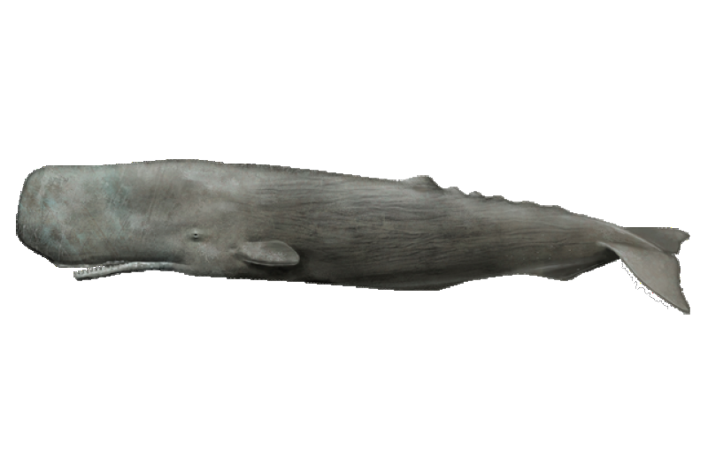


Northeastern is a “beluga”: smaller than the median top-50 private, but among the fastest growing
FY 2024 R&D expenditures vs. annual R&D growth rate (FY 2014–2024), top 50 private institutions
BYU
Beluga whales
Smaller / faster growing
Median $492M
Sperm whales
Larger / faster growing
Baylor U.
$135M · 20.6%/yr
Syracuse
U. Dayton
Northeastern
New York
Northwestern
U. Pennsylvania
Thomas Jefferson
U. Notre Dame
Icahn Mount Sinai
Georgetown
Carnegie Mellon
Boston
Emory
Wake Forest
Rice
USC
Yale
Johns Hopkins
Dartmouth
Princeton
Vanderbilt
Rush
Tulane
Tufts
U. Chicago
WashU
Cornell
Median 6.2% per year
U. Miami
Baylor C. Med.
Columbia
Stanford
Cold Spring Harbor
George Washington
Med. C. Wisconsin
Case Western
Harvard
Duke
Brandeis
Woods Hole
U. Rochester
RPI
Drexel
Scripps Research
Caltech
MIT
Brown
Humpback whales
Smaller / slower growing
Rockefeller
Blue whales
Larger / slower growing
$100M
$200M
$500M
$1B
$2B
$4B
FY 2024 total R&D expenditures (log scale)
Note: Vertical axis capped at 16% (Baylor U., 20.6%, shown by arrow); horizontal axis is logarithmic. Johns Hopkins includes APL; Albert Einstein excluded (no FY 2014 data).
Source: NSF NCSES, Higher Education Research and Development (HERD) Survey, FY 2024 (NSF 26-304)
Notes:
Each point is one of the top 50 private institutions (Albert Einstein excluded; no FY 2014 data). Vertical line = median FY 2024 R&D ($492M); horizontal line = median ten-year growth rate (6.2%). Horizontal axis is logarithmic. Johns Hopkins includes APL. Beluga quadrant (smaller / faster): Dartmouth, Georgetown U., Northeastern U., U. Notre Dame, Wake Forest U., Rice U., Thomas Jefferson U., U. Dayton, Syracuse U., Brigham Young U., Baylor U..

