Slide 1
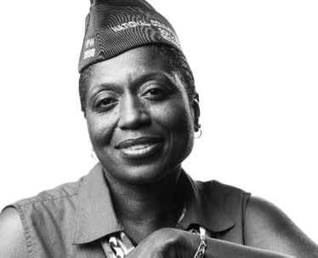
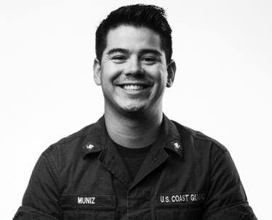
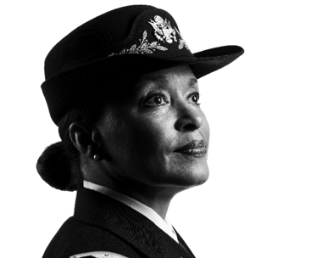
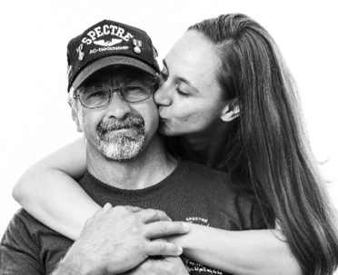

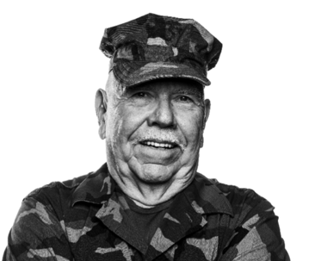
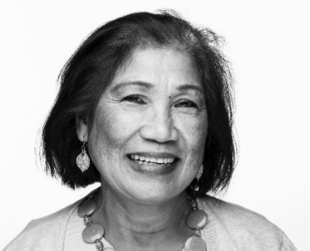
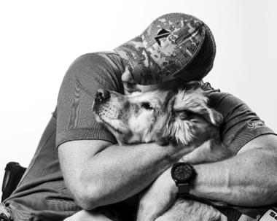


Usability and Discovery Research Readout
Notifications MVP
3.27.18

Slide 2
What We Wanted to Learn
What We Did What We Learned

Slide 3
What We Wanted to Learn
The Problem | The Product | Why This Testing | Research Objective

Slide 4
The Problem
Currently, there is no way to keep Vets.gov users updated on the status of claims and appeals, or to send them confirmations, without their logging into the site.

Slide 5
The Product
An MVP of an external notification for Vets.gov.
Specifically, we’re prototyping an email confirmation to follow the submission of a health care application.

Slide 6
Why This Testing?
We want to better understand users’ needs and expectations around notifications on Vets.gov.
We want to gain insights that will help us implement Vets.gov's first external notification, as well as future notifications.

Slide 7
Research Objective
What are Veterans’ expectations around receiving electronic communication and notifications from the VA?
What kinds of notifications do Veterans find useful, and which do they view as noise?

Slide 8
What We Did
Participants | Research Process | Prototype

Slide 9
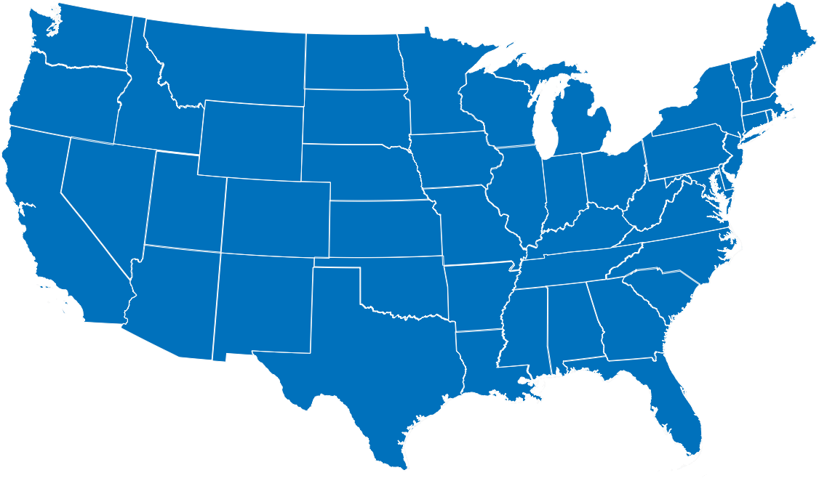
Participants
p3
p1
p2
p5
p4
3
women
2
men
36-71
years old
4
branches of service
1
former VSO

Slide 10
Research Process
Moderated Usability Tests and Interviews
Observations & Quotes
Findings & Open Questions
Themes
5 Remote

Slide 11
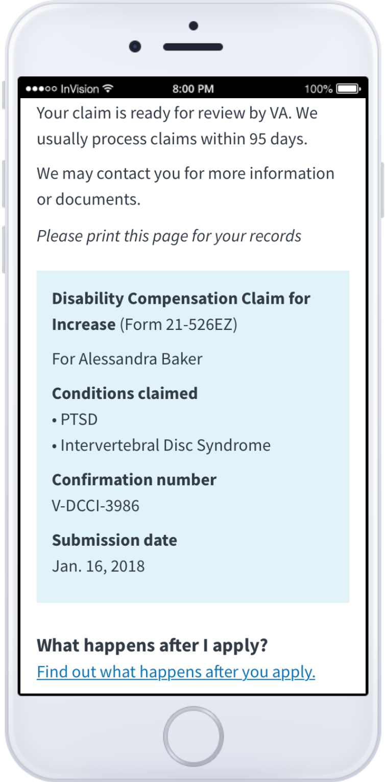
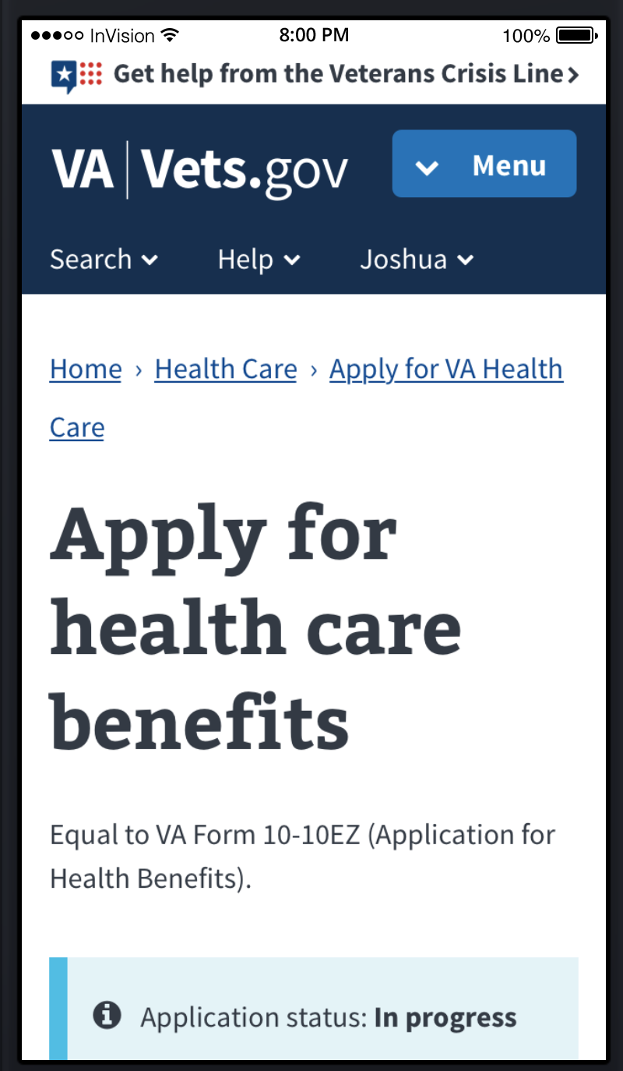
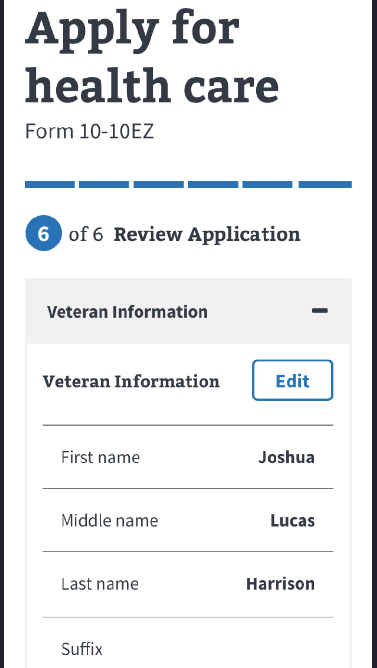
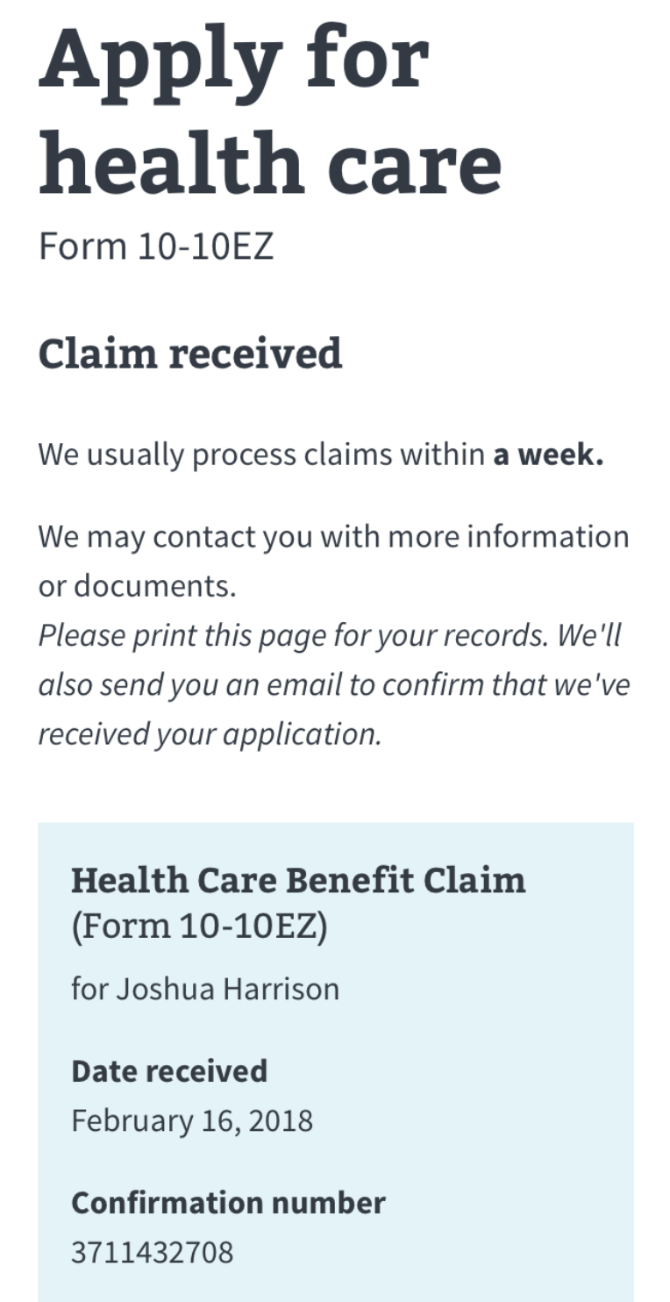
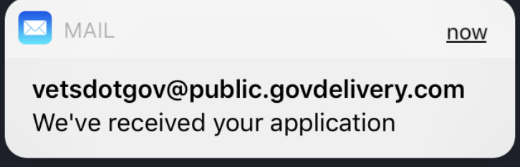
Prototype
Participants were asked to pretend they were submitting an application for health care benefits on Vets.gov. After submitting, they reviewed a confirmation page, then received a notification that they had an email from vetsdotgov@public.govdelivery.com.
Notes:
Note to Paris: I’m going to ask Samara to help me make the click-through look nicer ahead of the readout.

Slide 12
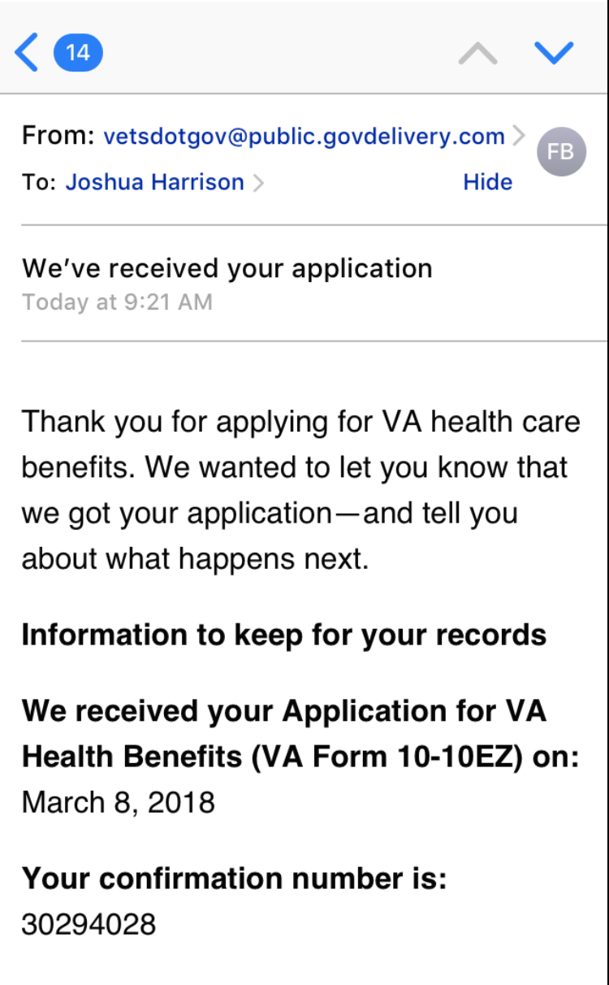
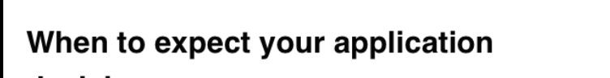
Prototype
Participants were then asked to read the email and answer questions about:
Whether they found the email useful
Whether they would expect to receive such an email
How long after submitting the application they would expect to receive the email
Whether they understood who the sender was, and whether they trusted them

Slide 13
Interviews
Finally, participants were interviewed about past experiences communicating with the VA, as well as about their notifications preferences in general.
The team listened for:
Which notifications are useful, and which are frustrating or annoying, and why
How participants would prefer to receive communication from the VA, and about which topics
Which organizations are using notification models that participants like

Slide 14
What We Learned

Slide 15
Top Findings (in order of priority)
The best notifications are succinct, personal, reassuring, and timely.
Participants would prefer VA communications that are timely, give a clear sense of what to expect and when, and provide consistent information across all channels.
It is not a universal standard for participants to receive text messages as part of a suite of notifications from organizations.
When it comes to receiving an email after submitting an application, a few minutes is preferable, a few hours is understandable, and a few days is suspicious.
Veterans trust emails about their VA benefits from a .com sender less than they would those from a .gov sender.

Slide 16
Finding 1 – Useful Notifications
There are four components that make up a useful notification:
Succinct: brief and action-oriented.
Personal: applies to me and my life.
Reassuring: the things I set up to happen on a recurring schedule are happening.
Timely: shows up when I need the information.

Slide 17
“I’m looking for information that applies specifically to me….if it doesn’t apply to me, I don’t care.”
“I'm already stressed when I open it. Keep it simple.”
- Kelly

Slide 18
“Those are the most useful: the things that you set up to keep your life on schedule and confirm the things you set up to be automated are actually occurring.”
“They tell me what I want and when I need it. Short, sweet, to the point is the best way to put it.”
- Bill

Slide 19
Finding 2 – VA Communications
Participants would prefer VA communications that are timely, give a clear sense of what to expect and when, and provide consistent information across all channels.
4
4
5
5
related past frustrations with not knowing when or how they would be updated on a VA application.
related experiences where online systems, letters, and phone calls had provided different statuses or information.

Slide 20
Finding 2 – VA Communications
Participants would prefer VA communications that are timely, give a clear sense of what to expect and when, and provide consistent information across all channels.
3
4
5
5
mentioned interest in a centralized place online where they could see their updated claims status and shipment of medical supplies
said they wanted the VA to communicate with them when there were updates about their applications or appointments

Slide 21
“Keeping people informed is a good way to lower expectations, or lower anxiety.”
- Bill

Slide 22
“Yeah, so [laughing] right now when I schedule an appointment I get a letter in the mail, and I also get a voicemail telling me that I have an appointment. The vm usually comes two days before the appointment does. The letter comes anywhere from two or three days ahead of time to [a few days afterwards]. But there is no e-mail option.”
- Kelly

Slide 23
Finding 3 – Text Messages
It is not a universal standard for participants to receive text messages as part of a suite of notifications from an organization.
😟 🤔 😍
2 Veterans said they did not want to receive text messages.
1 Veteran said they would be open to text messages under
certain circumstances.
2 Veterans were enthusiastic about receiving text messages.

Slide 24
Finding 3 – Text Messages
What are participants’ concerns about text messages?
Less secure
Texting is for personal communication, rather than formal communication with an organization
Harder to access from a computer or to search
Long responses are harder to type on a phone
Notes:
Seems less formal and legit

Slide 25
“I do text more for social communication with family. I prefer email. I know you can save a text message, but it's easier to access email from multiple venues. You can do it from a tablet. You can do it from your desktop. You can do it from your cell phone.”
- Bill

Slide 26
“I've been on the receiving end of texts that weren't meant to me. If God forbid the number is sent wrong--you know, 2 numbers are skewed or they hit fat fingered things, that's what I can easily do--if that text message got sent to somebody that it shouldn’t, now they potentially have your information.”
- Sarah

Slide 27
Finding 3 – Text Messages
When are text messages okay?
As a secondary means of communication, in addition to an email, phone call, or letter
When they are reminders that do not require a response, or only a very brief response
As a notification of a change in status of an application, and to remind them to look in another place online to find out more information

Slide 28
“Versus e-mail, the notification isn't always on or you have to click in through a certain app to even see it…text message seems to be more immediate. Prompt, boom, right there and you're getting a notification.”
- Tammy

Slide 29
“If it comes to setting up or confirming appointments or whatever, like I mentioned earlier, the text message is fine with me….It gives me the ability to respond to that yes or no, and it somehow manually reschedules my appointment from 3 weeks from now to that. That would be great.”
- Bill

Slide 30
Finding 4 – Wait Time
How long is too long to wait for an email?
A few minutes is preferable. A few hours is understandable.
A few days is suspicious.
4
said receiving an email about their application a day or two after submitting it would make them question the validity of the email.
5
1
said they would not mind the email taking a day or two to arrive, since that’s how long the mail would take. (This was the only participant who had been a VSO.)
5

Slide 31
[What if you received the email a few hours after submitting your application?]
“I don't think it would be the end of the world, but again, with people wanting instant gratification, some people would probably be a little frustrated with it, but as long as I got the notification within a couple of hours, that would be ok.”
- Bill

Slide 32
[What if you received the email a day or two after submitting your application?]
“I would have worried — why didn't I receive it earlier? I would still open it, but I would have thought or assumed I'd have received it earlier than that.”
- Tammy

Slide 33
Finding 5 – Email Sender
Veterans trust emails about their VA benefits from a .com sender less than they would those from a .gov sender.
4
mentioned being suspicious of a .com sender referencing their application.
5
said they would be more likely to trust this email address if the email arrived right after they submitted their application. Trust would decrease the longer it took to receive the email.
2
5

Slide 34
“You have to look at it closely…I think we have to be very careful from letters assuming to be the VA. If I wasn't sure, I would call the toll free number. I would ask ‘is this a bona fide address from the VA health system?’”
- Ronald

Slide 35
What’s next?
Incorporating findings into notifications for Pensions/Burials MVP and VIC
Findings relating to interest in a centralized web portal for personalized updates and information will drive discovery around Notifications Center
Performing additional research on whether and when text messages are a viable and desirable form of communication

Slide 36

Thank you

