Slide 1

Maven IIB9 Plug-in Version 9.0
Features Customized for IBM IIB9 workspaces
Improves significantly on older SBB IIB plug-in
“Mavenizes” IIB9 Workspaces easily
Manages complete IIB-BAR build lifecycle
Offers a solution for versioning and utilization of common libraries across projects
Self-documents with plug-in’s ‘morehelp’ goal

Slide 2
Maven IIB9 Plug-in Versions Features Comparison
Open Source Features vs. eMI Project Upgrade | v. 2.3 | v. 9.0
Unpacking of Dependencies into workspace | ☑ | ☑
Bar File Packaging | ☑ | ☑
‘Compiled’ Bar File Packaging (via mqsicreate) | ☐ | ☑
Multiple Bar Override Support | ☑ | ☑
Automated Bar Deployment | ☐ | ☑
Integration Test Support | ☐ | ☑
Documentation Available | ☐ | ☑
Project Mavenization | ☐ | ☑
Artifact Deployment to Maven Distribution Repository | ☐ | ☑

Slide 3
Maven IIB9 Plug-in’s BAR lifecycle
Offers a complete IIB-BAR build lifecycle analogous to Maven’s JAR, WAR, or EAR lifecycles.
Supports project setup, bar creation, packaging, bar overrides, deployment to broker(s), integration testing and release/snapshop deployment to a Maven Repository
Lifecycle Goal Descriptions follow

Slide 4
BAR lifecycle - initialize
Performs cleanup of any additional files not deleted in the maven “clean” goal
Example: 3rd Party Jars in the project’s root may require deletion

Slide 5

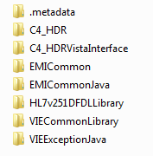
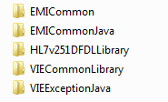
BAR lifecycle – generate-resources
Copies ‘compile’ jar dependencies into project
Brings common libraries into workspace
Small Team Project(s)
Complete IIB9 Workspace
+
=➔
Program Level Common Libraries

Slide 6

BAR lifecycle – process-resources
Validates the workspace (each project name = each directory name)
Ignores .metadata directories
Validated IIB9 Workspace

Slide 7
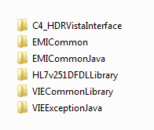

BAR lifecycle – compile
Creates a broker archive using mqsicreatebar and/or mqsipackagebar
Saves the broker file in target directory using traditional maven naming convention
C4_HDRVistaInterface-6.0-SNAPSHOT.jar
IIB9 Workspace

Slide 8
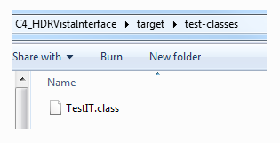
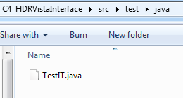
BAR lifecycle – test-compile
Compiles any Integration Tests from src/test/java directory to target/test-classes/ directory.
Project’s src/test/java directory
Project’s target/test-classes/ directory

Slide 9
BAR lifecycle – process-classes
Applies bar overrides using properties files found in resources folders.
C4_HDRVistaInterface-6.0-SNAPSHOT.jar

Slide 10

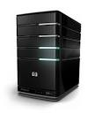
BAR lifecycle – pre-integration-test
Deploys a Bar to a Configured IIB9 Broker using the mqsideploy command.
Integration Test Environment 1 (IIB9 Broker)
IntTestEnv1.broker
mqsideploy command

Slide 11
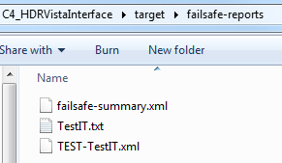
BAR lifecycle – integration-test
Executes integration tests against the just-deployed bar on targeted broker.
Executes tests with *IT.java, *ITCase.java, or IT*.java pattern
Integration Test Environment 1 (IIB9 Broker)
Compiled Integration Tests
1) Executes tests
Project’s fail-safe reports directory
2) writes results to

Slide 12
BAR lifecycle – verify
Evaluates integration test results.
fails build if failures found
Integration Tests Results

Slide 13
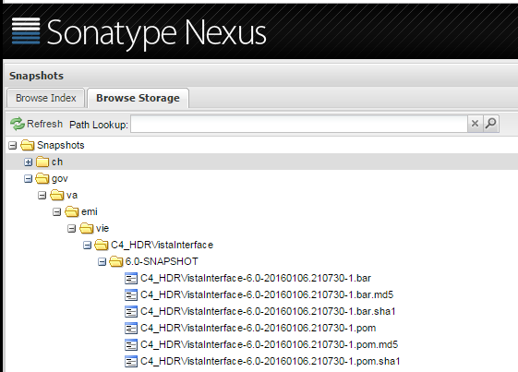
BAR lifecycle – deploy
Deploys a Bar to a Maven Repository.
Deploys without Bar Overrides
Project’s Target Directory
Maven Repository
C4_HDRVistaInterface-6.0-SNAPSHOT.jar

Slide 14
Maven IIB9 Plugin’s ZIP lifecycle
The ZIP lifecycle is a simple but powerful custom lifecycle that deploys versioned, zipped common libraries (source) to a Maven Repository
Enables the retrieval of common source libraries into multiple projects without having to pull from Source Control Management systems.
Treats dependent common library source just like compiled 3rd Party jars.

Slide 15
Normal IIB9 Workspace
SCM Server
(Subversion)
Local Workspace
Ind. Projects
Emi Common
Emi Common Java
IIB9 Projects
are normally
Checked out into a workspace directory
Vie Common
Vie Common Java
HDR
HDR Vista Interface
ESR, VTS, ….

Slide 16
‘Mavenized’ IIB9 Workspace
SCM Server
(Subversion)
Local Workspace
Parent Pom.xml
Ind. Projects
Pom.xml
Emi Common
Pom.xml
Emi Common Java
IIB9 Maven Plugin
‘Mavenize’
Goal
Pom.xml
Vie Common
The IIB9 Maven Plugin’s ‘mavenize’ goal can point at a workspace and add an appropriate pom.xml file to each project
Pom.xml
Vie Common Java
Pom.xml
HDR
Pom.xml
HDR Vista Interface
Pom.xml
ESR, VTS, ….

Slide 17
Uploading Common Libraries
Maven
Repository
SCM Server
(Subversion)
Local Workspace
Parent Pom.xml
Ind. Projects
Pom.xml
Emi Common
Pom.xml
Emi Common Java
IIB9 Maven Plugin’s
Parent Pom.xml ‘Deploy’ goal
Pom.xml
Vie Common
Pom.xml
Vie Common Java
Optional: The common libraries can be zipped up and uploaded to Maven repository for later use
Pom.xml
HDR
Pom.xml
HDR Vista Interface
Pom.xml
ESR, VTS, ….

Slide 18
Checking out Team Projects
SCM Server
(Subversion)
Local Workspace
Individual Team IIB9 Projects are Checked out into a workspace directory in a standard fashion. Note that we have not yet checked out common libraries into the workspace.
Individual Team
Projects
Pom.xml
HDR
Pom.xml
HDR Vista Interface
Pom.xml
ESR, VTS, ….

Slide 19
Integration of common libraries
SCM Server
(Subversion)
Maven
Repository
Local Workspace
Ind. Projects
Pom.xml
Emi Common
Pom.xml
Emi Common Java
Pom.xml
Vie Common
Pom.xml
Vie Common Java
Optional: We can pull and unzip versioned common libraries into workspace from a Maven repository while pulling projects directly from SCM
Pom.xml
HDR
Pom.xml
HDR Vista Interface
Pom.xml
ESR, VTS, ….

Slide 20
Checking Out All Projects
SCM Server
(Subversion)
Maven
Repository
Local Workspace
Ind. Projects
X
Pom.xml
Emi Common
X
Pom.xml
Emi Common Java
X
Pom.xml
Vie Common
X
Pom.xml
Vie Common Java
You Decide: The common libraries are not pulled from the Maven Repository when the ‘unpack Iib Dependencies Into Workspace’ configuration is set to false
Pom.xml
HDR
Pom.xml
HDR Vista Interface
Pom.xml
ESR, VTS, ….

Slide 21
That’s it for Now
Thank you for your attention!
Questions?
Contact Information: Brett Shelley, brett.shelley@vadosity.com, (717) 585-3726

