Slide 1
Using the UPF Workflow for Uncertainty Quantification
candle_tutorials/Topics/3_uncertianty_quantification

Slide 2
Comparing DL UQ Variants
Synergy for combo drugs predicted with deep learning (DL) models.
Two UQ methods:
Bootstrap: bootstrap training data resulting in N models and then doing N inference runs.
Dropout: train once with dropout enabled and do inferencing with dropout in place N times.
GDSC cell lines and Almanac compounds (no ground truth)
Not all results are available (top 50K synergy samples predicted, top 50K uncertainty samples predicted)
Files (from 01/18/2018):
GDSC-Bootstrap-N10-Almanac_synergy_UQ.xlsx
GDSC-Dropout-UQ-N100-Almanac_synergy_UQ.xlsx
Notes:
Deep learning model ? Parameters of the model are not specified (number of layers, nodes per layer, features, etc.).
Dropout parameter used ? How to compare the perturbation levels between bootstrap and dropout ?

Slide 3
Highly confident predictions (small bootstrap std) have high accuracy (with high confidence the predictions are in a small interval around the true value).

Slide 4
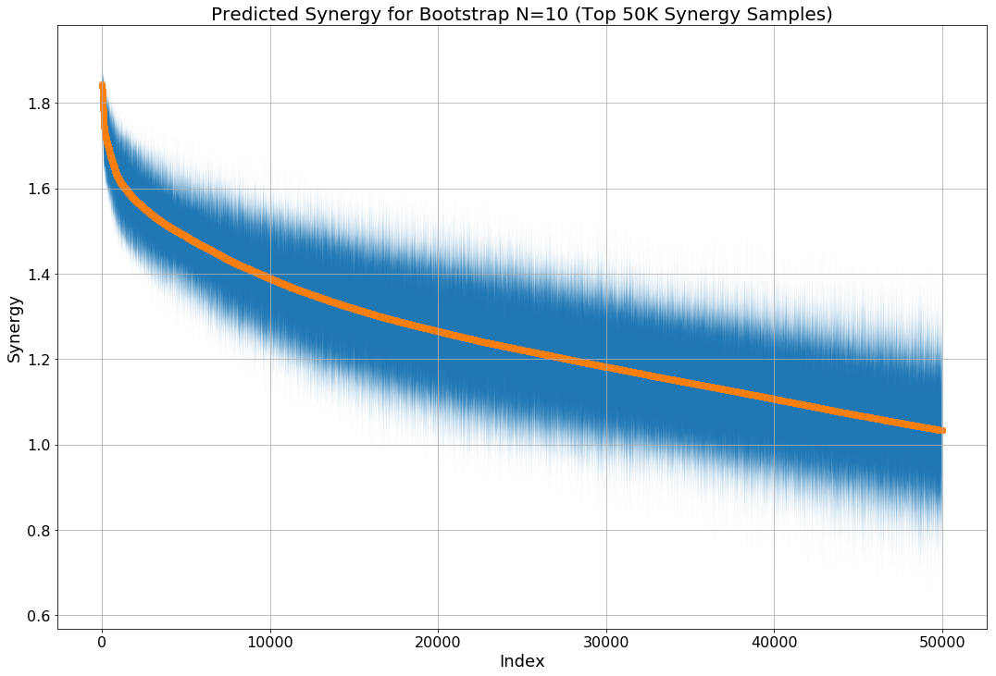
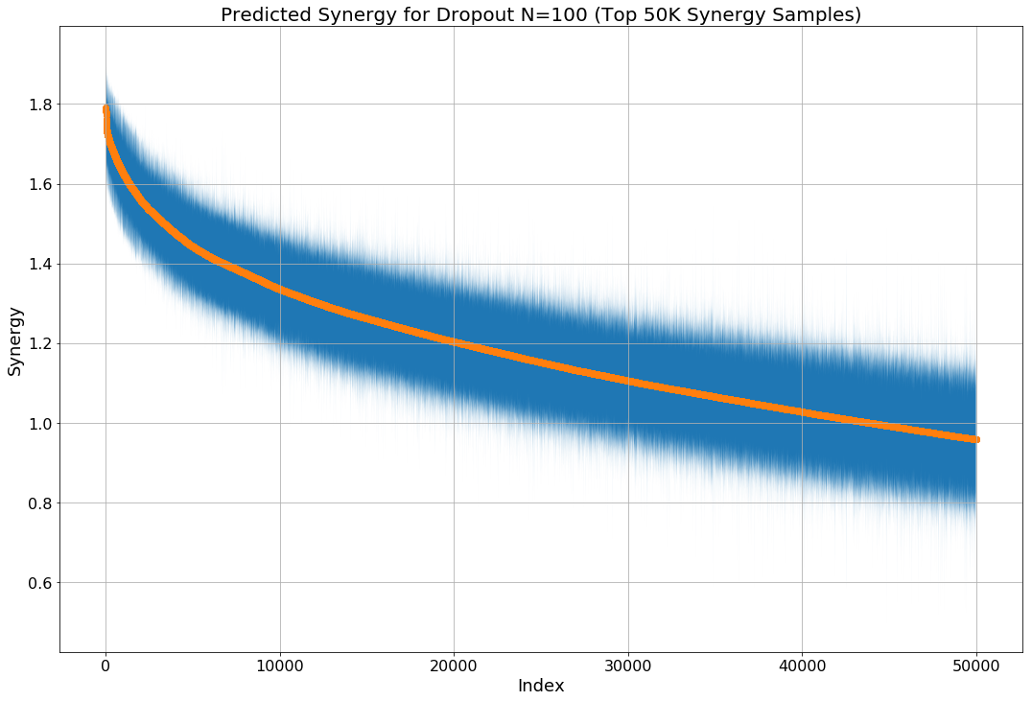
Different methods: dropout vs bootstrap
Notes:
- Good agreement in top synergy values.
Bootstrap estimates of synergy are slightly higher than dropout estimates
Bootstrap estimates have slightly more variance than dropout

Slide 5
Scaling Inferencing for UQ Measurements of Drug Synergy Predictions
680 Drugs in Combination
670 Samples
30 Replicates

Slide 6
Steps in the Tutorial
Add Permanent Dropout Layers to DNN
Add Permanent Dropout Layers to Inference Script
Modify the JSON Model Representation
Set Up the UPF Workflow
Run the Experiment

