Slide 1
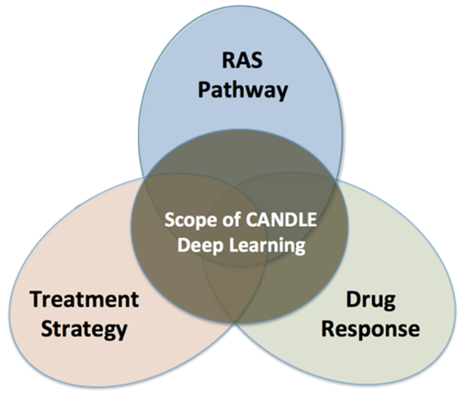
An Introduction to Scalable Deep Learning WORKflows with CANDLE
OPTIMAL DEEP LEARNING On EXASCALE computers
erhtjhtyhy
Justin M Wozniak
Computer Scientist
Mathematics & Computer Science
Argonne National Laboratory
CANDLE Deep Learning Workshop @ NIH
February 22, 2018

Slide 2
Collaborators
CANDLE Infrastructure: Tom Brettin, Jon Ozik, Nick Collier, Rajeev Jain (ANL) Jamal Mohd-Yusof, Cristina Garcia Cardona (LANL) George Zaki (NIH)
Pilot benchmarks Fangfang Xia (ANL), Brian Van Essen (LLNL), Arvind Ramanathan (ORNL)
PI Rick Stevens (ANL)

Slide 3
OUTLINE
Overview of CANDLE project
Overview of hyperparameter optimization
Introduction to hyperparameter optimization
Workflow-based solution: EMEWS
Afternoon tutorial:
Hyperparameter optimization of a CANDLE Benchmark

Slide 4
CANDLE TUTORIALS
May be found here: https://github.com/ECP-CANDLE/Tutorials
Subdirectory 2018/NIH
See the top-level README to get started with the installation

Slide 5
CANDLE OVERVIEW

Slide 6
CANDLE workflows: Goals
Develop an exascale deep learning environment for cancer
Building on open source deep learning frameworks and middleware
Optimization for CORAL and exascale platforms
Support all three pilot project needs for deep learning – common abstractions
Collaborate with DOE computing centers, HPC vendors and ECP co-design and software technology projects
Mission statement: Enable the most challenging deep learning problems in cancer research to run on the most capable supercomputers in the DOE

Slide 7
CANDLE Software Stack
Hyperparameter Sweeps,
Data Management (e.g. DIGITS, Swift, etc.)
Workflow
Network description, Execution scripting API
(e.g. Keras, Mocha)
Scripting
Tensor/Graph Execution Engine
(e.g. Theano, TensorFlow, LBANN-LL, etc.)
Engine
Architecture Specific Optimization Layer
(e.g. cuDNN, MKL-DNN, etc.)
Optimization

Slide 8
HYPERPARAMETER OPTIMIZATION

Slide 9
CANDLE
CANDLE (PI: Rick Stevens) is an Argonne led multi-DOE lab collaboration developing a suite of software to support scalable deep learning for cancer applications on DOE supercomputing resources
Funded by the DOE Exascale Computing Project
Developing implementations of deep neural networks on targeted problems related to the three core DOE-NCI Joint Design of Advanced Computing Solutions for Cancer (JDACS4C) pilot projects
GitHub: http://github.com/ECP-CANDLE

Slide 10
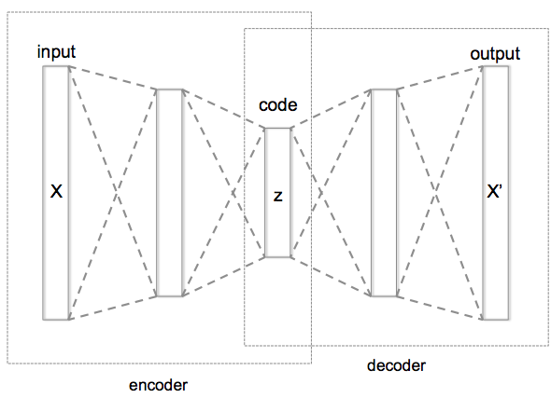
WHAT IS HYPERPARAMETER OPTIMIZATION
Hyperparameter optimization = HPO
Neural networks have a large number of possible configuration parameters, called hyperparameters
Avoids collision with NN weights, which are sometimes called parameters
Applying optimization can automate part of the design of the neural network
In the cancer Pilot 1 autoencoder shown, the system can determine
How many neurons to put in each layer
What activation function to use
What batch size to use
Etc.

Slide 11
Mathematical expression for hpo
For a given problem:
A loss function F is determined on a given NN (usually accuracy)
The hyperparameter optimization problem is to minimize F(p),
for all hyperparameter sets p in the valid parameter space P,
however, P is large and F is expensive.
P is the cross product of all valid network settings,
some of which may be categorical, some integer, some continuous.
Evaluating F involves training the network on a training data set and applying it to the validation set
We can use a generic, previously developed method to optimize F !
These methods require and can use large compute resources

Slide 12
BASIC STRATEGIES
Grid search
Random search
Generic optimization
Stochastic gradient descent
Evolutionary algorithms
Model-based optimization (mlrMBO in R)
NN hyperparameter-specific optimization
Hyperopt, NEAT, Optunity, …

Slide 13
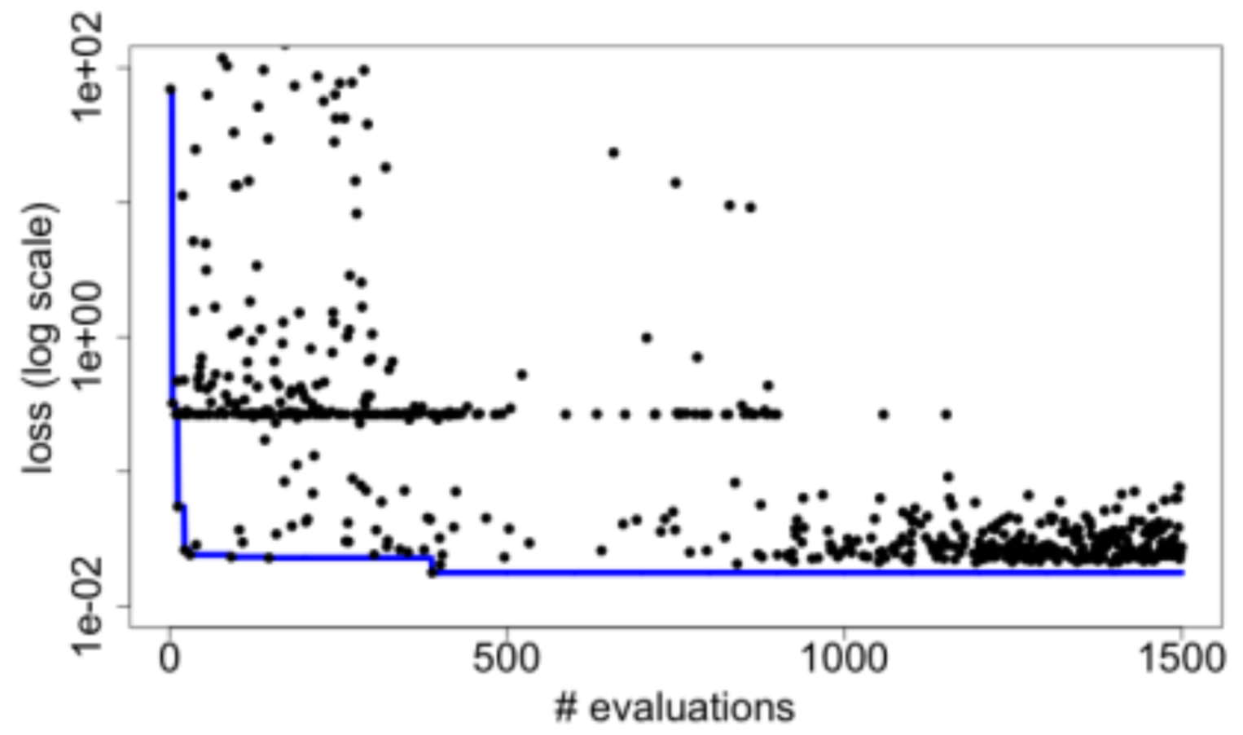
Candle Hyperparameter learning
Search trajectory of mlrMBO (R model-based optimization) algorithm
Each iteration does 300 evaluations (batch size)
Minimum and average performance on validation data set decreases as the ME algorithm learns
Predicting Tumor Cell Line Response to Drug Pairs with Deep Learning, F. Xia, M. Shukla, T. Brettin, C. Garcia-Cardona, J. Cohn, J. Allen, S. Maslov, Y. Evrard, S. Holbeck, J. Doroshow, E. Stahlberg, and R. Stevens (Computational Approaches for Cancer Workshop @ SC 2017)

Slide 14
CANDLE: Benchmarks

Slide 15
CANDLE benchmark spec
Overall goal:
To enable the hyperparameter search and UQ (and more?) workflows in a consistent, convenient way
Standardized network specification format
default_model_file
Standardized command line intercept protocol
Overwrite the default model as needed
Standardized initialize and run protocol
Use same defaults across frameworks
run(gParameters)
Standalone with ability to couple to larger workflows

Slide 16
CANDLE benchmark spec
Overview
Coded in Keras
Applicable to a variety of ML problems
Can target multiple execution frameworks including Tensorflow, Theano, CNTK, mxNet
Each framework may have different default parameters
Leverage existing packages: numpy, pandas, etc.
Provides various utility packages
Default_utils.py
File_utils.py
Data_utils.py
Keras_utils.py

Slide 17
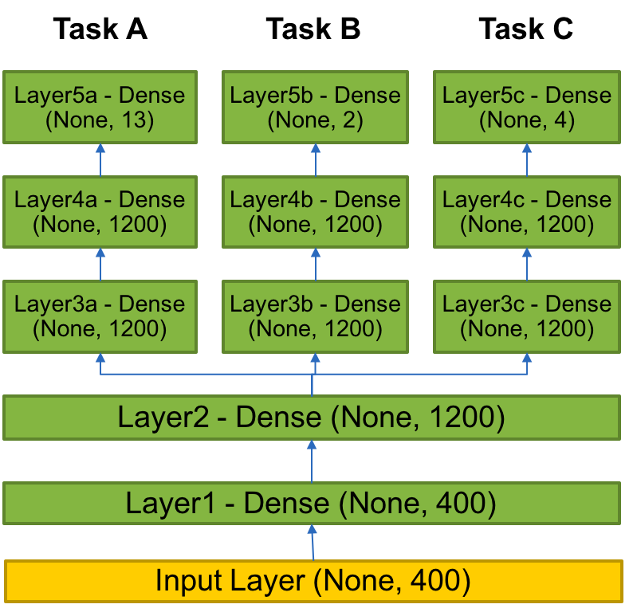
Example benchmark
P3B1
P3B1: Multi-task Deep Neural Net (DNN) for data extraction from clinical reports
Overview: Given a corpus of patient-level clinical reports, build a deep learning network that can simultaneously identify:(i) b tumor sites, (ii) t tumor laterality, and (iii) g clinical grade of tumors.
Relationship to core problem: Instead of training individual deep learning networks for individual machine learning tasks, Build a multi-task DNN that can exploit task-relatedness to simultaneously learn multiple concepts.
Expected outcome: Multi-task DNN that trains on same corpus and can automatically classify across three related tasks.

Slide 18
Original code
Hard coded hyperparameters
shared_nnet_spec= [ 1200 ]
individual_nnet_spec0= [ 1200, 1200 ]
individual_nnet_spec1= [ 1200, 1200 ]
individual_nnet_spec2= [ 1200, 1200 ]
individual_nnet_spec = [ individual_nnet_spec0, individual_nnet_spec1, individual_nnet_spec2 ]
learning_rate = 0.01
batch_size = 10
n_epochs = 10
dropout = 0.0
# Read files
from data_utils import get_file
origin = 'http://ftp.mcs.anl.gov/pub/candle/public/benchmarks/P3B1/P3B1_data.tgz’
data_loc = get_file('P3B1_data.tgz', origin, untar=True, md5_hash=None, cache_subdir='P3B1')

Slide 19
Default model file
P3B1
data_url = 'ftp://ftp.mcs.anl.gov/pub/candle/public/benchmarks/P3B1/’
train_data = 'P3B1_data.tar.gz’
model_name = 'p3b1’
learning_rate = 0.01
batch_size = 10
epochs = 10
drop = 0.0
activation = 'relu’
out_activation = 'softmax’
loss = 'categorical_crossentropy’
optimizer = 'sgd’
metrics = 'accuracy’
n_fold = 1
shared_nnet_spec = '1200’
ind_nnet_spec = '1200, 1200:1200, 1200:1200, 1200’
feature_names = 'Primary site:Tumor laterality:Histological grade’
timeout =1800
scaling = 'none’
output_dir = '.’
initialization='glorot_uniform’

Slide 20
Network specification
Shared layers
# input layer
layer = Input( shape = ( input_dim, ), name= 'input' )
shared_layers.append( layer )
# shared layers
for k in range( len( shared_nnet_spec ) ):
layer = dense( shared_nnet_spec[ k ], activation=gParameters['activation'],
name= 'shared_layer_' + str( k ) )( shared_layers[ -1 ] )
shared_layers.append( layer )
if gParameters['drop'] > 0:
layer = Dropout( gParameters['drop'] )( shared_layers[ -1 ] )
shared_layers.append( layer )
# individual layers
indiv_layers_arr = []
models = []

Slide 21
Network specification
Individual layers specified with Keras objects
for l in range( len( individual_nnet_spec ) ):
indiv_layers = [ shared_layers[-1] ]
for k in range( len( individual_nnet_spec[l] ) + 1 ):
if k < len( individual_nnet_spec[l] ):
layer = Dense( individual_nnet_spec[l][k],
activation=gParameters['activation’],
name= 'indiv_layer_%i_%i' % (l,k) ) \ # Function!
( indiv_layers[-1] )
indiv_layers.append( layer )
if gParameters['drop'] > 0:
layer = Dropout( gParameters['drop'] )( indiv_layers[-1] )
indiv_layers.append( layer )
else:
layer = Dense( n_out_nodes[l], activation=gParameters['out_activation’],
name= 'out_%i‘ % l ) \ # Function! ( indiv_layers[-1] )
indiv_layers.append( layer )
indiv_layers_arr.append( indiv_layers )
model = Model( inputs=[shared_layers[0]], outputs=[indiv_layers[-1]] )
models.append( model )

Slide 22
Parsing command line input
Overwrite the default model values with any command line options
(including specifying a new default model file)
# Parse common parameters
bmk.parse_from_common()
# Parse parameters that are applicable just to benchmark bmk.parse_from_benchmark()
# Get command-line parameters
args = bmk.parser.parse_args()
# Get parameters from configuration file
fileParameters = bmk.read_config_file(args.config_file)
#print ('Params:', fileParameters)
# Consolidate parameter set. Command-line parameters overwrite file configuration gParameters = args_overwrite_config(args, fileParameters)
print ('Params:', gParameters)
return gParameters

Slide 23
Modifying the model
Various ways to overwrite the default model file values
Provide a new default model specification
--config_file new_default_model.txt
Overwrite individual parameters in the default model
--learning_rate 0.1 –drop 0.1
Provides an easy way to perform individual experiments to probe the hyperparameter space
Provides the pathway for automated sweeps of hyperparameters
→ Supervisor workflows

Slide 24
CANDLE: WORKFLOWS

Slide 25
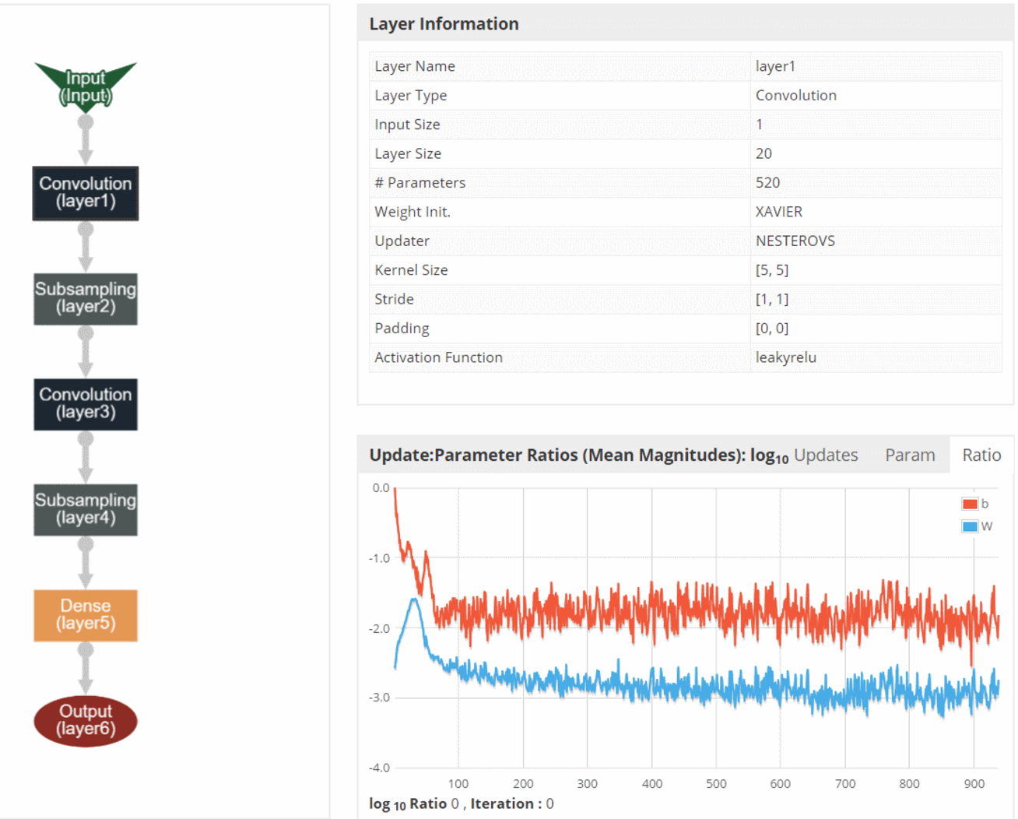
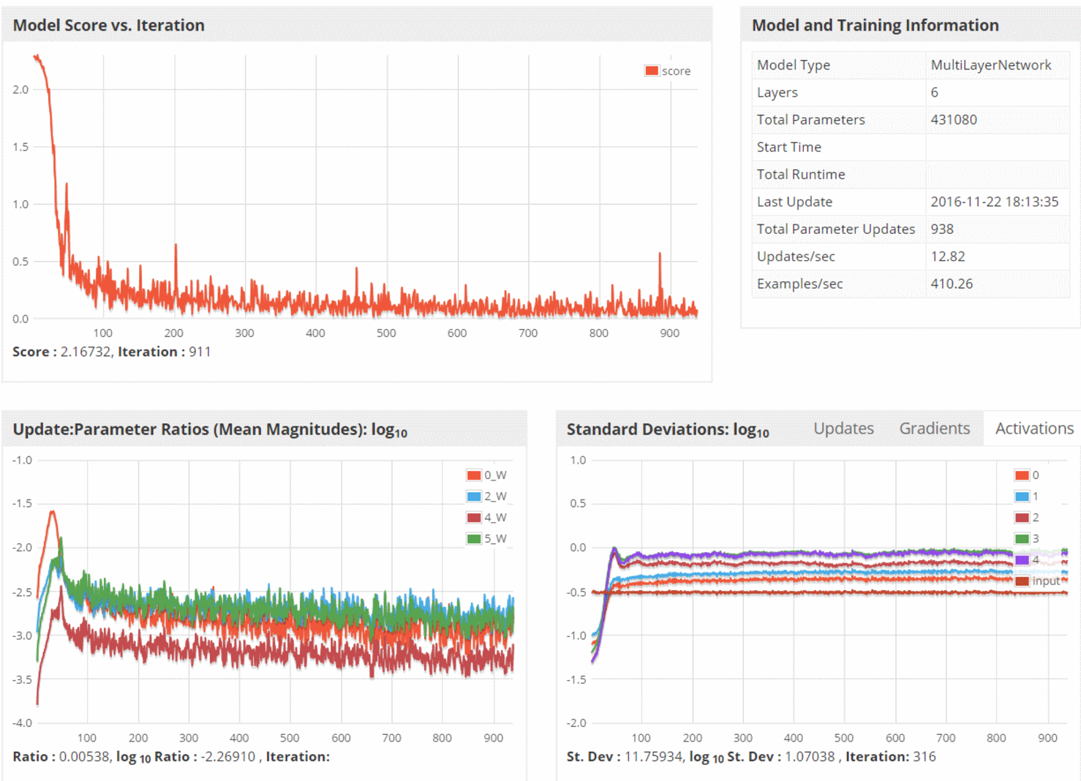
CANDLE System Overview
ML/DL Benchmarks
Pilot 1
Pilot 2
Pilot 3
CANDLE Database
CANDLE Specifications
Metadata Store
Model Store
Integrator Website
Benchmark Spec
Hyperparameter Spec
Hardware Spec
Benchmarks
Datasets
Models
Experiments
Runs
Model Descriptions
CANDLE Supervisor
Model Weights
Hyperparameter Optimization Frameworks
Hyperopt, mlrMBO, Spearmint
Workflow Manager
(Swift-T EMEWS)
Data API
ALCF
Theta, Cooley
NERSC
Cori
OLCF
Titan, SummitDev
Hardware Resources

Slide 26
Parallelism strategies
10,000 x 10-1000 x 10-100 = 1M – 1000M processing elements
Hyperparameter Search: up to ~10,000x
Depends on search strategy
Data Parallel: 10x-1000x
Data Parallel
10x-1000x
Model
Parallel
10x-100x
Model
Parallel
10x-100x
Model
Parallel
10x-100x
Model
Parallel
10x-100x
Model
Parallel
10x-100x
...
...
...

Slide 27
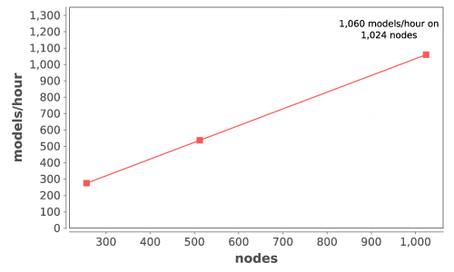
CANDLE Performance
Delivers 1+ petaflop!

Slide 28
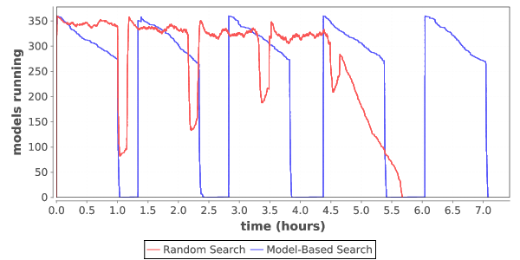
Load over time for search
Typical load plot for NT3 workflow on Cori

Slide 29
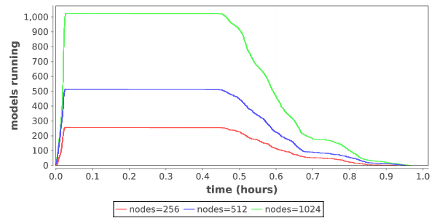
Ramp up / ramp down
Zoom in on single iteration on Titan

Slide 30
SYSTEMS CHALLENGES

Slide 31
Notes on requirements
Simulation Applications
64bit floating point
Memory Bandwidth
Random Access to Memory
Sparse Matrices
Distributed Memory jobs
Synchronous I/O multinode
Scalability Limited comm
Low Latency High Bandwidth
Large Coherency Domains help sometimes
O typically greater than I
O rarely read
Output is data
Big Data Applications
64 bit and Integer important
Data analysis Pipelines
DB including No SQL
MapReduce/SPARK
Millions of jobs
I/O bandwidth limited
Data management limited
Many task parallel
Large-data in and Large-data out
I and O both important
O is read and used
Output is data
Deep Learning Applications
Lower Precision (fp32, fp16)
FMAC @ 16 summing to 32
Inferencing can be 8 bit (TPU)
Scaled integer possible
Training dominates dev
Inference dominates pro
Data pipelines needed
Dense FP typical SGEMM
Small DFT, CNN
Ensembles and search
Single Models Small
I more important than O
Reuse of training data
Output is models

Slide 32
WORKFLOW support for ML frameworks
Concurrency:
Scalable task distributor
Intranode concurrency, accelerators left up to the framework
Multinode ML tasks are future work (already basically supported)
Data management:
Input staging methods have been developed
Intermediate caches via DataSpaces
Software integration:
Usually launch frameworks in separate process
Launching within process is a configuration challenge
Search methods launched within process

Slide 33

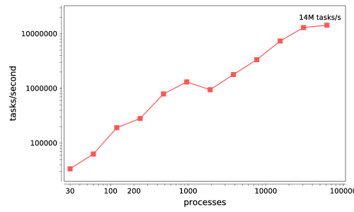


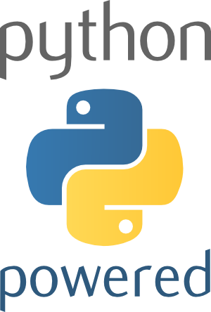



Swift/T: Enabling high-performance Scripted workflows
Supports tasks written in many languages
Write site-independent scripts
Automatic parallelization and data movement
Run native code, script fragments as applications
Rapidly subdivide large partitions for MPI jobs
Move work to data locations
Swift/T worker
Swift/T control process
Swift worker process
C
C++
Fortran
C
C++
Fortran
C
C++
Fortran
MPI
64K cores of Blue Waters
2 billion Python tasks 14 million Pythons/s
Interlanguage parallel scripting for distributed-memory scientific computing. Proc. WORKS @ SC 2015

Slide 34
The Swift programming model
All progress driven by concurrent dataflow
(int r) myproc (int i, int j)
{
int x = F(i);
int y = G(j);
r = x + y;
}
F() and G() implemented in native code or external programs
F() and G()run in concurrently in different processes
r is computed when they are both done
This parallelism is automatic
Works recursively throughout the program’s call graph

Slide 35
Language goals
Hierarchical, naturally parallel, script-like programming
Make it easy to run large batteries of external program or library executions
Provide rich programming language at the top level – fully generic
Support implicit concurrency and conventional programming constructs
Enable complex tasks based in other scripting languages (e.g., Python) or parallel MPI tasks

Slide 36
Swift syntax
Data types
int i = 4;
string s = "hello world";
file image<"snapshot.jpg">;
Shell access
app (file o) myapp(file f, int i)
{ mysim "-s" i @f @o; }
Structured data
typedef image file;
image A[];
type protein_run {
file pdb_in; file sim_out;
}
bag<blob>[] B;
Conventional expressions
if (x == 3) {
y = x+2;
s = strcat("y: ", y);
}
Parallel loops
foreach f,i in A {
B[i] = convert(A[i]);
}
Data flow
merge(analyze(B[0], B[1]),
analyze(B[2], B[3]));
Swift: A language for distributed parallel scripting. J. Parallel Computing 2011
Compiler techniques for massively scalable implicit task parallelism. Proc. SC 2014

Slide 37
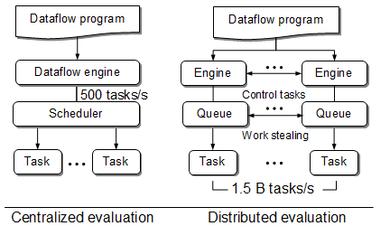
Centralized evaluation is a bottleneck at extreme scales
Had this (Swift/K):
Now have this (Swift/T):
Turbine: A distributed-memory dataflow engine for high performance many-task applications. Fundamenta Informaticae 28(3), 2013

Slide 38
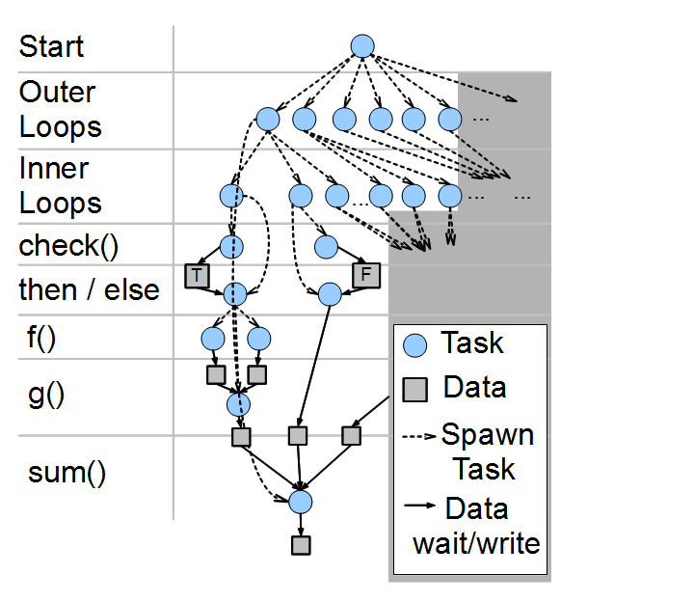
Swift/T: Fully parallel evaluation of complex scripts
int X = 100, Y = 100;
int A[][];
int B[];
foreach x in [0:X-1] {
foreach y in [0:Y-1] {
if (check(x, y)) {
A[x][y] = g(f(x), f(y));
} else {
A[x][y] = 0;
}
}
B[x] = sum(A[x]);
}
Swift/T: Scalable data flow programming for distributed-memory task-parallel applications . Proc. CCGrid, 2013.

Slide 39
Swift for Really Parallel Builds
Plus language features- typed files, arrays, string processing
App definitions app (object_file o) gcc(c_file c, string cflags[]) {
// Example:
// gcc -c -O2 -o f.o f.c
"gcc" "-c" cflags "-o" o c;
}
app (x_file x) ld(object_file o[], string ldflags[]) {
// Example:
// gcc -o f.x f1.o f2.o ...
"gcc" ldflags "-o" x o;
}
app (output_file o) run(x_file x) {
"sh" "-c" x @stdout=o;
}
app (timing_file t) extract(output_file o) {
"tail" "-1" o "|" "cut" "-f" "2" "-d" " " @stdout=t;
}
Swift code
string program_name = "programs/program1.c";
c_file c = input(program_name);
foreach O_level in [0:3] {
// Construct the compiler flags
string O_flag = "-O" + O_level;
string cflags[] = [ "-fPIC", O_flag ];
object_file o<my_object> = gcc(c, cflags);
object_file objects[] = [ o ];
string ldflags[] = [];
// Link the program
x_file x<my_executable> = ld(objects, ldflags);
// Run the program
output_file out<my_output> = run(x);
// Extract the run time from the program output
timing_file t<my_time> = extract(out);
}

Slide 40
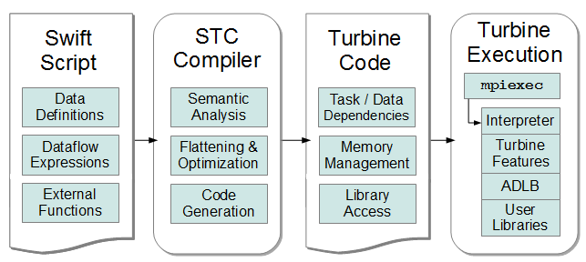
Swift/T Compiler and Runtime
Create/Store/Retrieve typed data
Manage arrays
Manage data-dependent tasks
STC translates high-level Swift expressions into low-level Turbine operations:

Slide 41
Accessing python from swift/t
global const string numpy = "from numpy import *\n\n";
typedef matrix string;
(matrix A) eye(int n) {
command = sprintf("repr(eye(%i))", n);
code = numpy+command;
matrix t = python(code);
A = replace_all(t, "\n", "", 0);
}
(matrix R) add(matrix A1, matrix A2) {
command = sprintf("repr(%s+%s)", A1, A2);
code = numpy+command;
matrix t = python(code);
R = replace_all(t, "\n", "", 0);
}
a1 = eye(3);
a2 = eye(3);
sum = add(a1, a2);
printf("2*eye(3)=%s", sum);

Slide 42
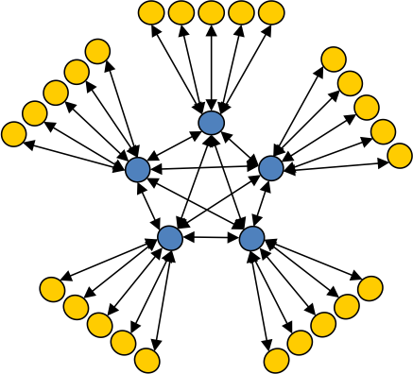
Asynchronous Dynamic Load Balancer
workers
ADLB for short
An MPI library for master-worker workloads in C
Uses a variable-size, scalable network of servers
Servers implement work-stealing
The work unit is a byte array
Optional work priorities, targets, types
For Swift/T, we added:
Server-stored data
Data-dependent execution
Parallel tasks
masters
Lusk et al. More scalability, less pain: A simple programming model and its implementation for extreme computing. SciDAC Review 17, 2010

Slide 43

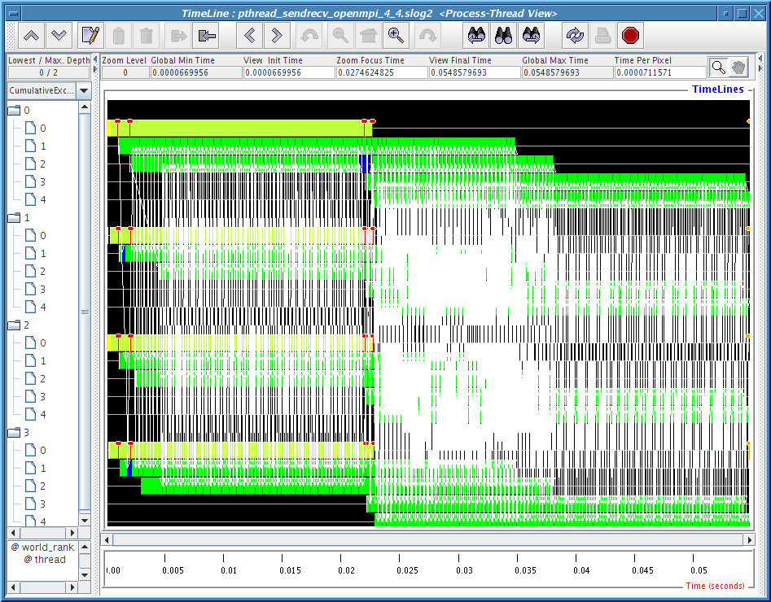
MPI: The Message Passing Interface
Programming model used on large supercomputers
Can run on many networks, including sockets, or shared memory
Standard API for C and Fortran; other languages have working implementations
Contains communication calls for
Point-to-point (send/recv)
Collectives (broadcast, reduce, etc.)
Interesting concepts
Communicators: collections of communicating processing and a context
Data types: Language-independent data marshaling scheme
Can recursively create subordinate MPI contexts in a variety of ways

Slide 44
Parallel tasks in CANDLE workflows
Complex concurrency structures
Model parallelism: running the same network across nodes
Library approach:
Use Swift/T @par syntax
Uses MPI 3 to dynamically create communicator from group
User task library accepts communicator via function input
Approach developed for other scientific computing cases, LAMMPS, NAMD, DIY, etc.
MPI_Launch approach
Use Swift/T launch() function
Creates MPI 3 group
Launches mpiexec on those resources, creating a new MPI_COMM_WORLD and separate processes (fault tolerance)
Works on clusters
Working with Cray on support – available soon

Slide 45
Extreme-scale model exploration with Swift (EMEWS)

Slide 46
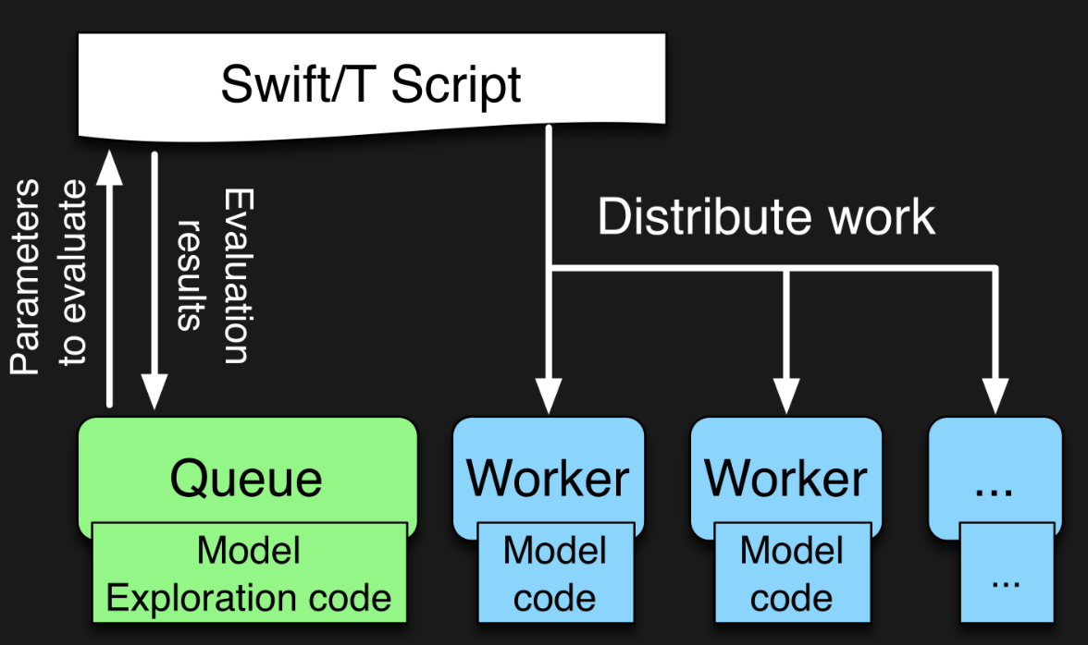

EMEWS workflow structure
The core novel contributions of EMEWS are shown in green, these allow the Swift script to access a running Model Exploration (ME) algorithm, and create an inversion of control (IoC) workflow
Both green and blue boxes accept existing multi-language code

Slide 47
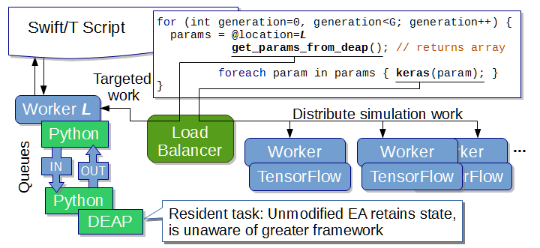
EMEWS: Extreme-scale model exploration workflows in Swift/T
To query the state of the EA, we designate one worker on location L for exclusive use by DEAP. Other optimizers can easily be used (e.g., mlrMBO in CANDLE)
http://www.mcs.anl.gov/~emews/tutorial

Slide 48
Previous work on HPC workflows
Other uses of workflows to control model exploration (ME) typically take one of two approaches
They provide rich support for arithmetic operations so that ME algorithms can be constructed (ported)
requires that algorithm be coded from scratch
impossible to reuse code in other languages
The ME algorithm is provided as a built-in feature of the system
does not allow the end users much control over the algorithm used
may require access to workflow system source code in order to incorporate external ME algorithms or to modify built-in algorithms
In both cases, the many libraries being actively developed and implemented as free and open source software in programming languages such as R and Python cannot be directly/easily utilized.

Slide 49
Summary of key system points
What about Swift/T enables CANDLE?
A workflow system that is actually a hierarchical programming language
Runs entirely on the compute nodes
Uses standard APIs for HPC (MPI), allows for minimal OS environment
Very scalable
Supports MPI tasks, embedded Python, R interpreters
What about EMEWS enables CANDLE?
Allows user to focus on two sequential codes
The optimizer
Their objective function code
Everything else is managed by the system

Slide 50
Features for Big Data analysis
Location-aware scheduling User and runtime coordinate data/task locations
Collective I/O User and runtime coordinate data/task locations
Application Dataflow, annotations
Application I/O hook
Runtime MPI-IO transfers
Runtime Hard/soft locations
Distributed data
Distributed data
Parallel FS
F. Duro et al. Flexible data-aware scheduling for workflows over an in-memory object store. Proc. CCGrid, 2016.

Slide 51
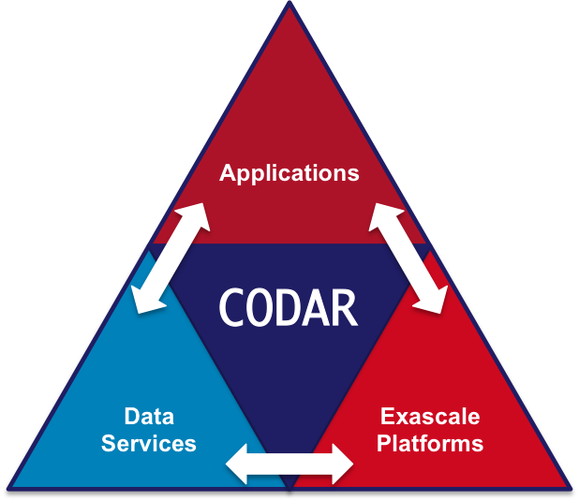
Interaction with ECP CODAR, ECP CANDLE
With Justin M. Wozniak (CANDLE) and Tong Shu (CODAR)
Swift/T training workflow
CANDLE workflows produce a great number of medium-sized ML models
Goal: Cache these on compute node storage for possible later use
Need to flush to global FS before end of run, but many models will be discarded
Plan: Integrate Swift/T workflow system used in CANDLE with Mochi client
Accelerate CANDLE workflow performance, enable novel training strategies (parameter sharing)
Provide an opportunity for workflow-based data analysis and I/O reduction
Demonstrate the utility of node-local storage for complex workflows
CANDLE benchmark
CANDLE
…
TensorFlow
TensorFlow
Good NN model
Mochi Services
Parallel FS

Slide 52
Thanks
Thanks to the organizers
Code and guides:
CANDLE GitHub Organization: https://github.com/ECP-CANDLE
Swift/T Home: http://swift-lang.org/Swift-T
EMEWS Tutorial: http://emews.org
This research was supported by the Exascale Computing Project (17-SC-20-SC), a joint project of the U.S. Department of Energy’s Office of Science and National Nuclear Security Administration, responsible for delivering a capable exascale ecosystem, including software, applications, and hardware technology, to support the nation’s exascale computing imperative.

Slide 53
TUTORIAL: SUPERVISOR

Slide 54
HANDS-ON TUTORIAL: SUPERVISOR
May be found here: https://github.com/ECP-CANDLE/Tutorials directory 2018/NIH
See the top-level README to get started with the installation

