Slide 1

MIGRATING YOUR DNN TO CANDLE
erhtjhtyhy
Rajeev jain
Principle Software Developer
Mathematics and Computer Science Division
jain@mcs.anl.gov
Friday, Oct 19th 2018,
ExaLearn Workshop, Argonne IL

Slide 2
Outline
Overview
An example: P1B3 Benchmark
Benefits of migrating your DNN to CANDLE
Testing Benchmarks and Supervisor
About T29res
Running t29 on your laptop
T29 code overview
How to make your code “CC” Candle Compliant?
Running on Theta:
“original” t29res and “migrated” - cc_t29res.py

Slide 3
Overview
CANDLE has a repository called Benchmarks:
Benchmarks consists of Pilot(s) projects: each pilot is focused on specific type of cancer data application.
It is coded in keras, can target multiple execution frameworks including Tensorflow, Theano, CNTK, mxNet etc. Each framework may have different default parameters
Provides an easy way to perform individual experiments to probe the hyperparameter space

Slide 4
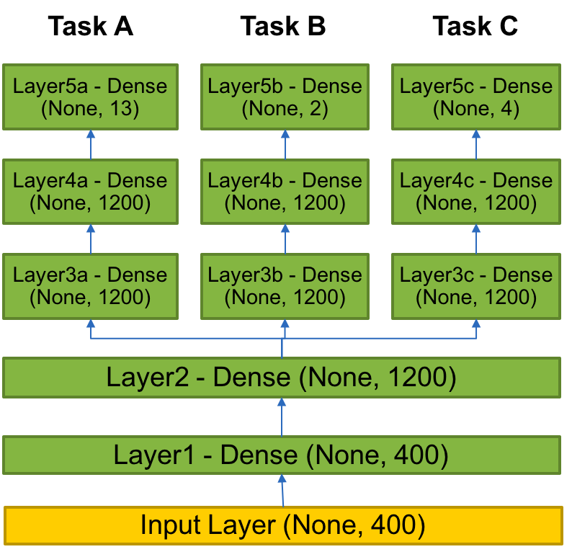
Example of a Benchmark:
P3B1: Multi-task Deep Neural Net (DNN) for data extraction from clinical reports
Overview: Given a corpus of patient-level clinical reports, build a deep learning network that can simultaneously identify:(i) b tumor sites, (ii) t tumor laterality, and (iii) g clinical grade of tumors.
Relationship to core problem: Instead of training individual deep learning networks for individual machine learning tasks, Build a multi-task DNN that can exploit task-relatedness to simultaneously learn multiple concepts.
Expected outcome: Multi-task DNN that trains on same corpus and can automatically classify across three related tasks.
– greater the number of layers, deeper the network

Slide 5
Benefits of migrating to CANDLE:
Consistent
Standardized network specification with a “default_model_file”
Standardized command line intercept protocol
Documentation: https://ecp-candle.github.io/Candle/html/index.html
Convenient
Pass arguments via command line
Overwrite individual parameters in the default model ‘--learning_rate 0.1 –drop 0.1’
Modify the default file
Provide a new default model specification ‘--config_file new_default_model.txt’
Allows for use of same defaults across frameworks
Ideal for testing the same problems with consistency on new DOE hardware

Slide 6
Benefits of migrating to CANDLE:
Provides various actively developed utility packages that promote reuse and no hardcoded values
Default_utils.py
File_utils.py
Data_utils.py
Keras_utils.py
and more https://ecp-candle.github.io/Candle/html/candle_lib
Provides the pathway for inferencing, data-parallelism, automated sweeps of hyperparameters
Availability of a robust framework for documentation and testing
Pre-existing for containers such as Singularity (Ex. machines such as Theta, Titan, Cori, summitdev)

Slide 7
Testing benchmarks and supervisor
git clone https://github.com/ECP-CANDLE/Benchmarks.git
cd Pilot1/NT3/
python nt3_baseline_keras.py
git clone https://github.com/ECP-CANDLE/Supervisor.git
cd workflows/mlrMBO
./test-1.sh nt3 local
<local> settings are specified in workflows/common/sh/ - env-local.sh and langs-app-local.sh, we have settings for Theta, Cori, Titan and Summitdev (under development)
Assuming you have swift-t with python+R and other python packages.
*trick for testing/development on laptops: head –n 200 train.csv > train.csv and head –n 40 test.csv > test.csv

Slide 8
About t29RES
Tumor cells genetic data and drug response.
All of this data is expressed as numbers!!
Shape (rows, columns):
Test file: (3572, 6213) ~ 22M numbers!
Train file: (14288, 6213) ~ 89M numbers!
Preparing the data: Combination drugs, average of response and lots of other refinement
Build a DNN to predict the response: 12 layers: combination of Input, dense, dropout. Tom will go over the details about distance between layers and other variables

Slide 9
DEMO: Run on laptop
git clone https://github.com/brettin/candle_tutorials.git
cd Topics/1_migrating_your_DNN_to_candle/original
python t29res.py
* Set “theta = False”, otherwise the code looks for thread settings.
**instructions for setting up dependencies:
https://github.com/brettin/candle_tutorials/blob/master/README.setup.linux

Slide 10
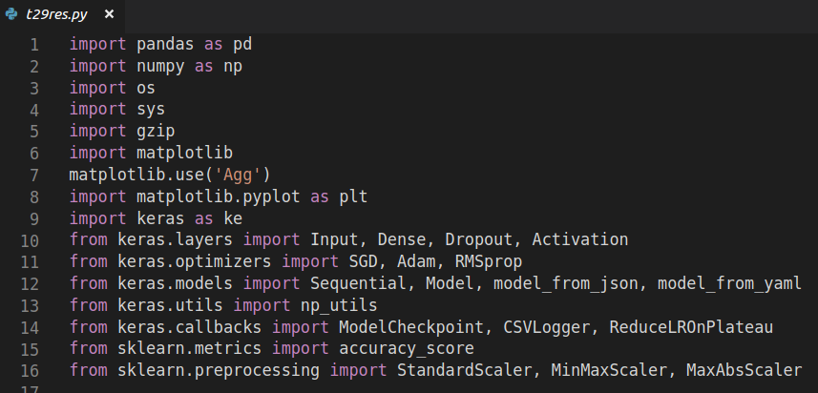
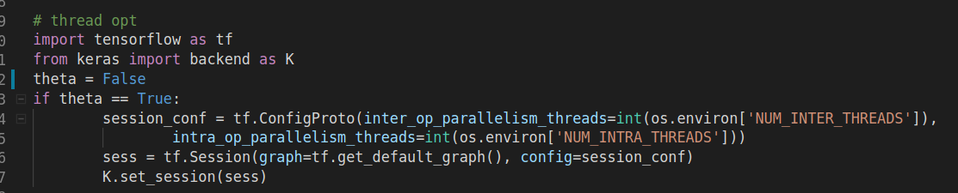
T29 CODE
Import headers
Settings related to
Thread specification
on Theta

Slide 11
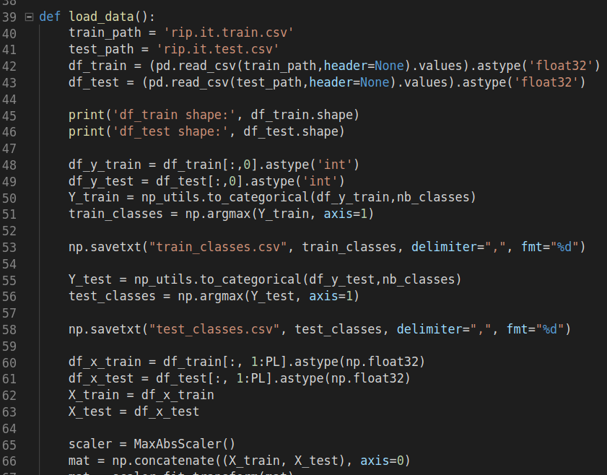
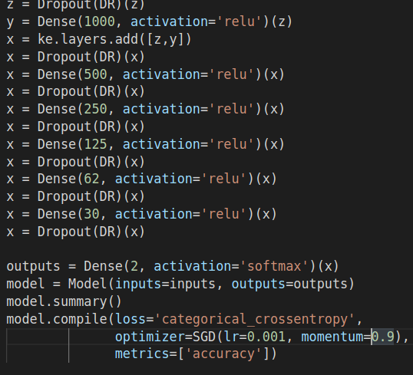
CODE
Load data, report shape etc.
Setup layers, activation etc.

Slide 12
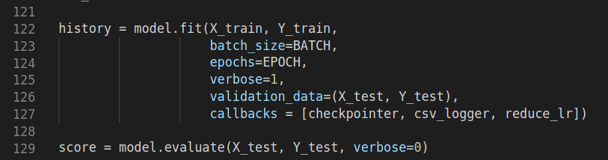
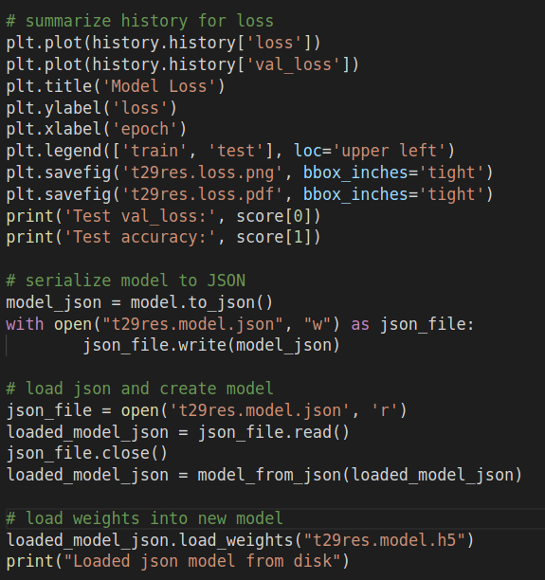
CODE
Actual function
call that
takes a lot of time
Write output files:
json, png, pdf, yaml, .h5 etc.
Helps analyze quickly understand results

Slide 13
How to make it candle compliant?
“import candle_keras” from Benchmarks/common
Write a function called initialize_parameters
Build a “candle_keras.Benchmark object (t29_common)
Specify any “additional_definitions” as a json (name, type, help..) and report via candle_keras object created in step 1. In our example there are two:
Connections
Distance
Now call “candle_keras.Benchmark.initialize_parameters” to obtain gParameters
Rewrite the “load” function with values from gParameters from B.
Function “f” and “warmup_scheduler” are not required.

Slide 14
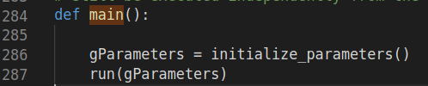
How to make it candle compliant? -2
initialize_parameters is the first call, it reads the <modelName>_default_model.txt file.
Python dictionary object: gParameters is returned by initialize parameters
run function:
setup the network (use values via gParameters)
candle_keras.keras.default.config (returns a dictionary)
candle_keras.build_optimizer (returns a keras optimizer function) See this https://ecp-candle.github.io/Candle/html/candle_lib/keras_utils.html#keras_utils.build_optimizer Exposes keras parameters nicely.
Model instantiate (set input and output), Create loggers
Calls to “model.fit” and finally “model.evaluate”
3 line code!

Slide 15
DEMO: Running t29 on theta
git clone https://github.com/brettin/candle_tutorials.git
cd Topics/1_migrating_your_DNN_to_candle/original
./submit-theta.sh
cd ../migrated/
./submit-theta.sh

Slide 16
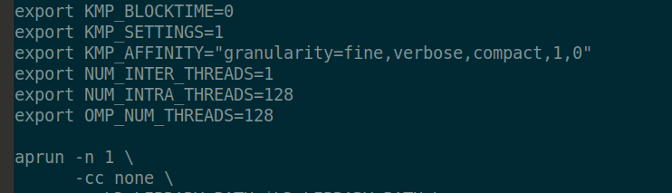
BENEFITS Revisited
task.sh used to specify directory to store results
Theta does not have GPUs, but we can still do threading:
Cannot launch as “python myDNN.py”, “aprun” needed, use option “–cc none” for threading specification and other macros

Slide 17
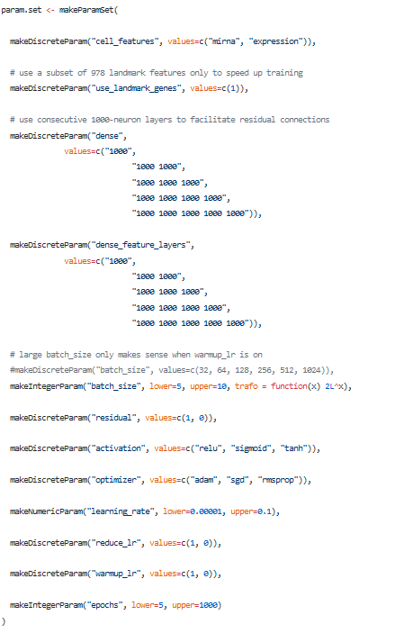
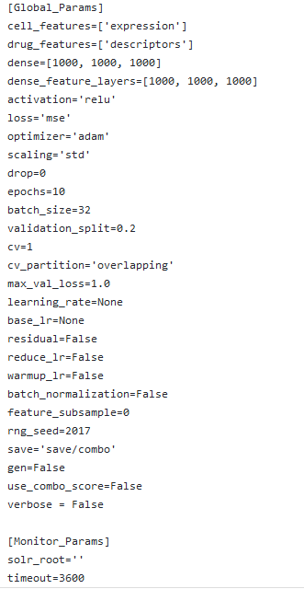
Parameters!
One to Many
Default “Benchmark” parameters for Pilot1 Combo
“Supervisor” sweeps utilizing mlrMBO

Slide 18
thanks

