Slide 1
Recognizing Handwritten Digits with Machine Learning

Slide 2
Project Background
Goal - Classify the preprocessed MNIST Handwritten Digit dataset
Experiment with different training sizes and hyper parameters
Compare different models
Explore SVM
Work with libraries like Sklearn and OpenCV

Slide 3
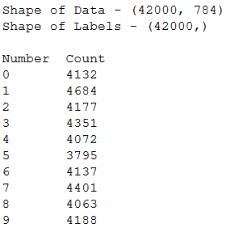
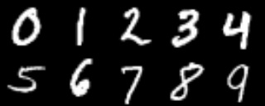
The Dataset
The MNIST (Modified National Institute of Standards) dataset
70,000 grayscale images of handwritten digits (shown below) (Training - 42,000, Testing - 28,000)
Each image is 28x28 pixels (784 pixels in all)
Pixel color represented by a value from 0 to 255
Pixel values and image labels (0 - 9) are represented in csv file
Each row in csv has 785 columns (label followed by pixel value)
Testing data same as training data, but without label

Slide 4
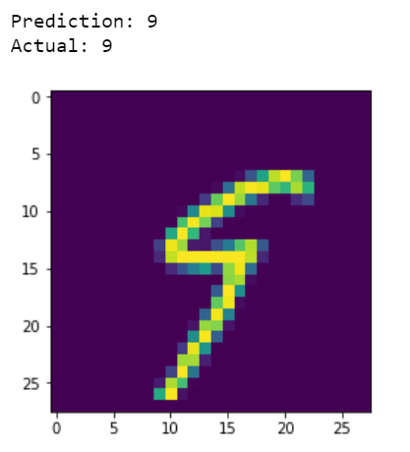
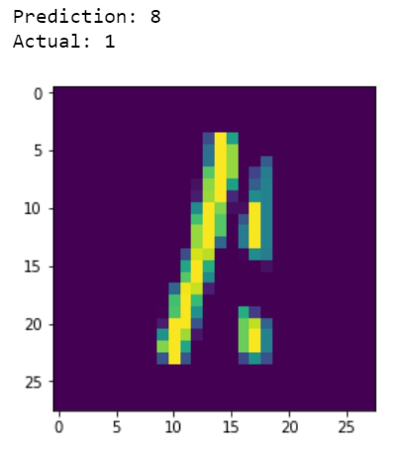
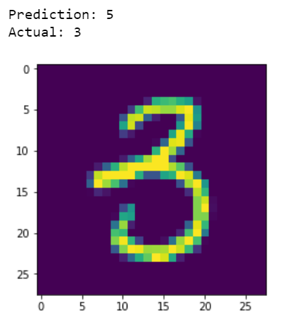
Challenges
Variation in handwriting (there may be numbers even humans struggle to recognize)
Noise affecting outcome
Anomaly Detection: model may identify a non-digit input as a digit

Slide 5
Existing Solutions
CNN
Perceptron
Logistic Regression
SVM

Slide 6

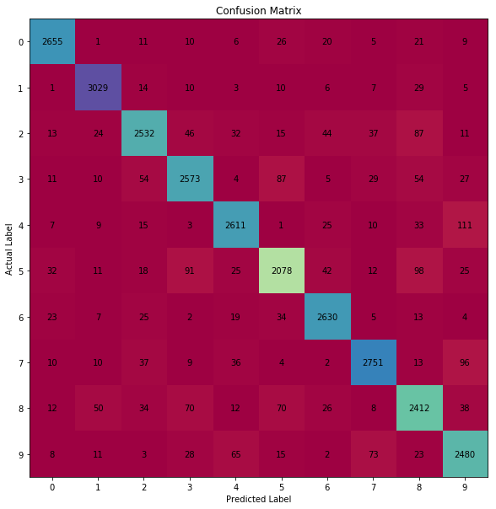
Logistic Regression
One vs. All
Simple model using sklearn
Score: 91.97% correct
We can do better

Slide 7
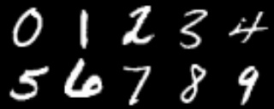
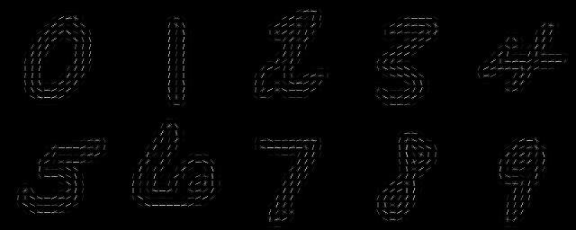
Our Approach
Support Vector Machine
Using Raw Pixels as Features
Using Histogram of Oriented Gradients as Features
Original Features
Hog Extracted Features

Slide 8
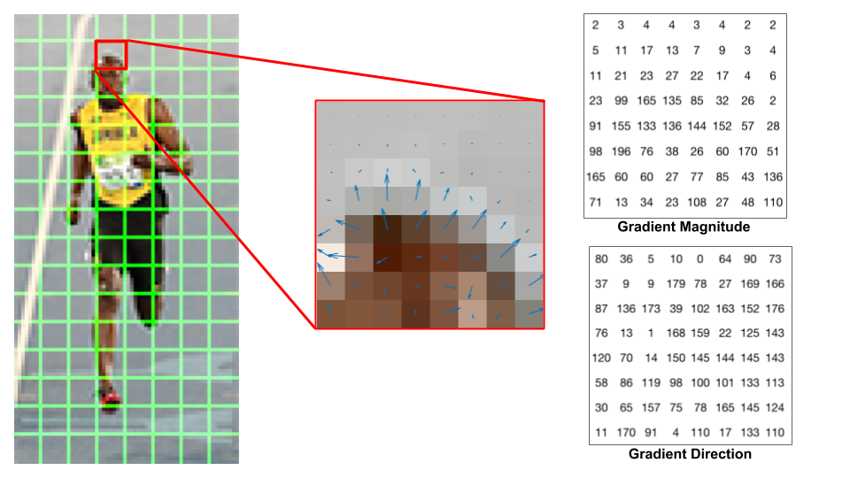
Feature Extraction
Histogram of oriented gradients
OpenCV implementation
Orientations = 9, ppc = (4,4), cpb = (2,2), norm = L2
New Feature shape - 1296
https://learnopencv.com/histogram-of-oriented-gradients/

Slide 9
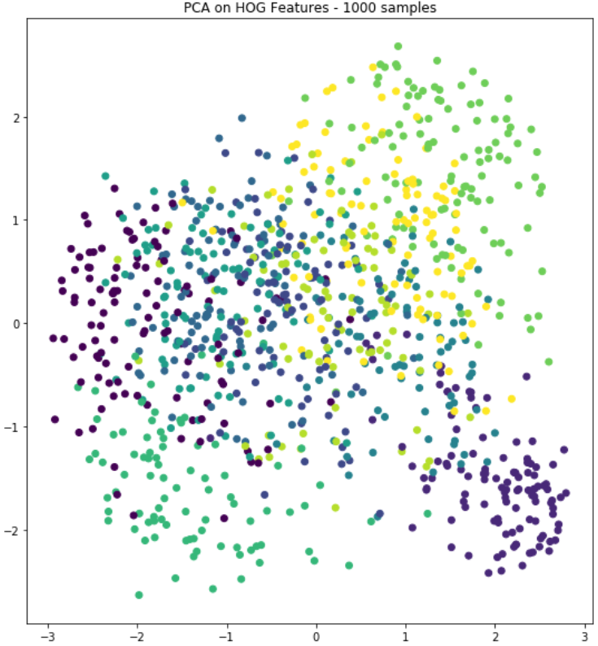
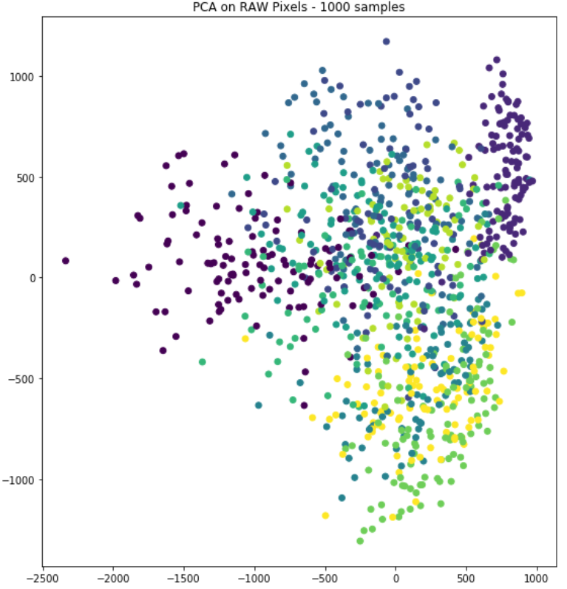
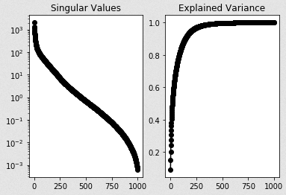
Visualizing the Dataset
Principal Component Analysis
HOG Features

Slide 10
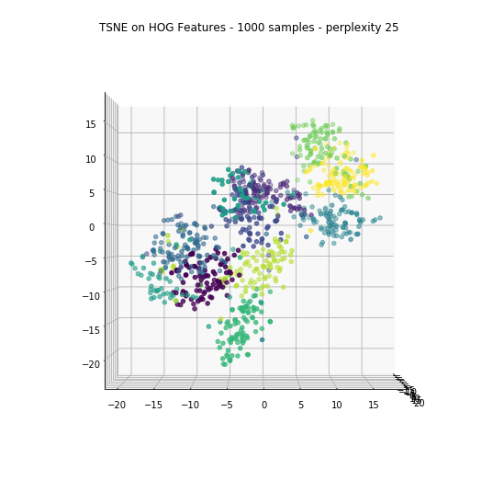
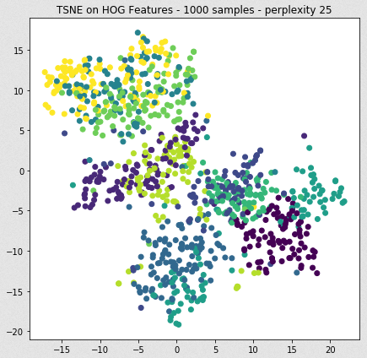

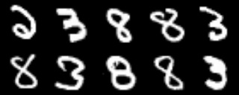
Visualizing the Dataset
t-SNE
Local Region - Upper
Local Region - Lower

Slide 11
SVM - Selecting Hyperparameters
Scikit-Learn SVM Implementation
Linear Kernel: C = [.01,.03,.1,.3,1,3,100]
RBF Kernel: C = [.01,.03,.1,.3,1,3,100] Gamma = [.001,.003,.01,.03,.1,.3,1]
3000 samples - 5 fold cross validation
HOG Features - 0.971 (+/-0.025) for {'C': 3, 'gamma': 0.03, 'kernel': 'rbf'}
Raw Pixel Features - 0.952 (+/-0.032) for {'C': 3, 'kernel': 'linear'}

Slide 12
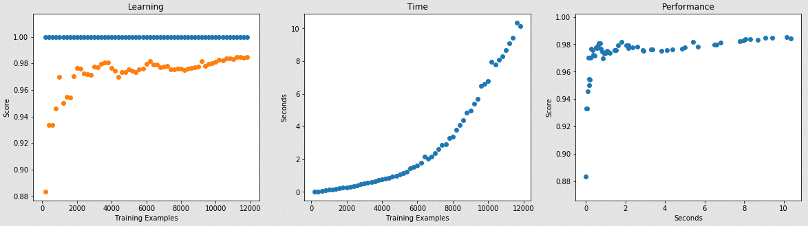
SVM - Learning Curves
Hog Features - 70/30 Training/Testing

Slide 13
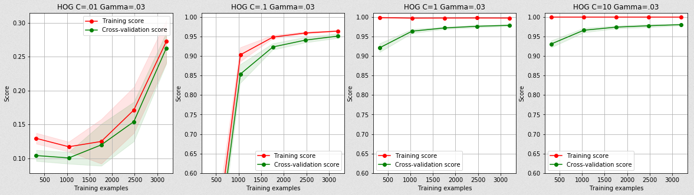
SVM - Learning Curves

Slide 14
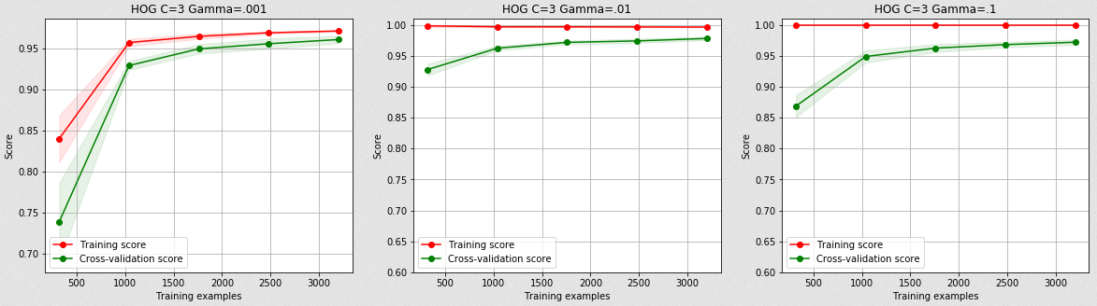
SVM - Learning Curves

Slide 15
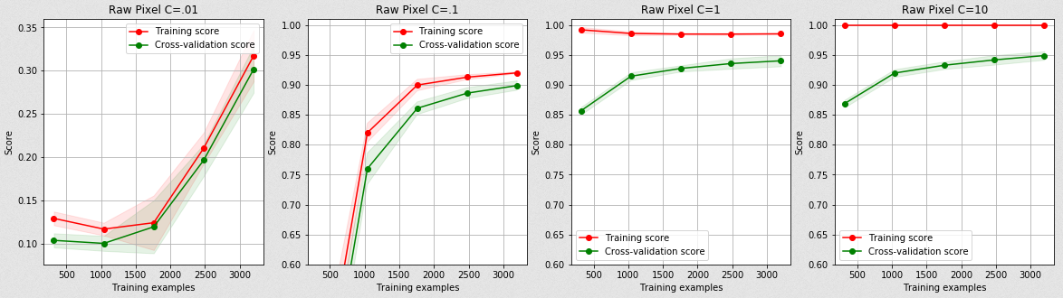
SVM - Learning Curves

Slide 16
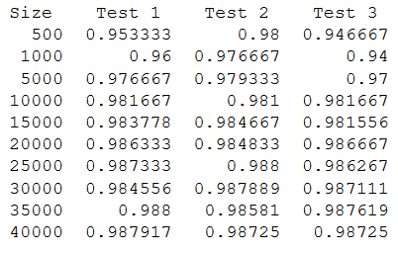
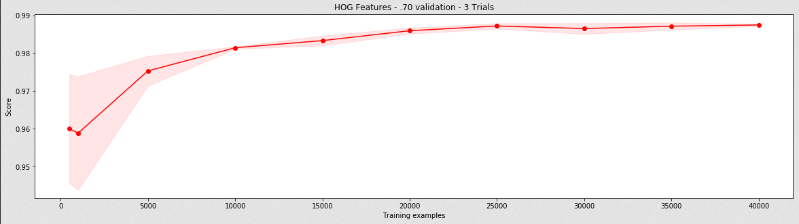
SVM - Learning Curves

Slide 17
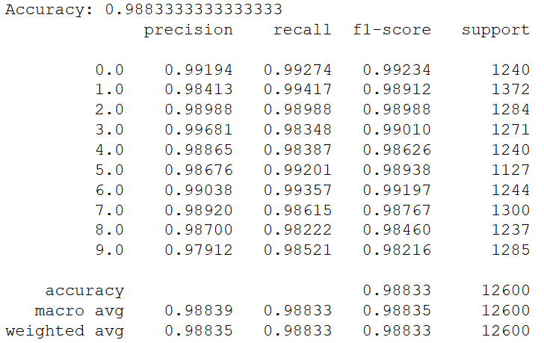
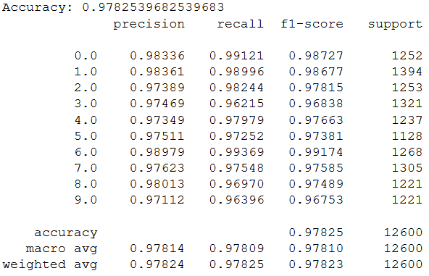
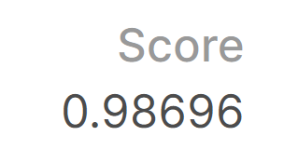
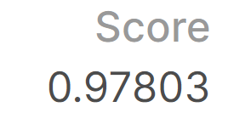
SVM - Final Results
Both trained with 70% of the 42000 training examples
HOG Features
Raw Pixel Features
Kaggle Test Scores

Slide 18
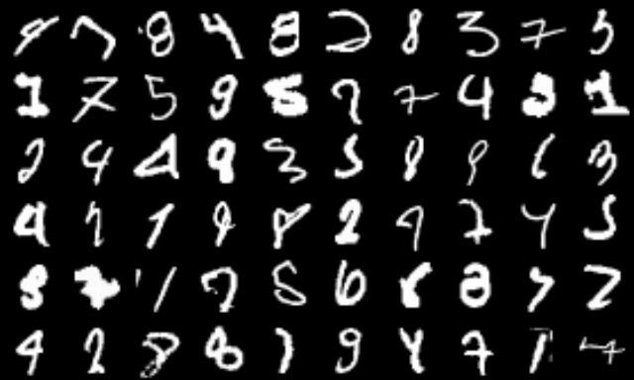
SVM - Misclassified Digits

Slide 19
Questions

