Slide 1
QPO of V404cyg during outburst

Slide 2
QPO and VLFN in the power spectrum of V404 Cyg detected with INTEGRAL ATel #7726
In addition to extreme flaring activity observed from the recurrent X-ray nova V404 Cyg/GS 2023+338 in radio, optical and X-ray bands (ATEL #7647, #7658, #7662, #7681, #7694, #7702, #7708, #7716, #7717) the source shows notable short-term variability on time scales of minutes and seconds.
Here we report the detection with INTEGRAL of two strong QPO peaks in the power spectrum of its hard X-ray emission (see the spectra obtained in the 20-80 and 80-200 keV bands). They are based on observations with the IBIS/ISGRI telescope on June 15-17, the ``white'' noise was subtracted. The QPO peaks are at frequencies 0.124+/-0.003 and 0.251+/-0.003 Hz, FWHM are equal to 0.009 and 0.024 Hz respectively. The second peak is at least 2 times stronger. The QPO frequencies are the same for two bands, but parameters of the low-frequency noise (LFN) which can be described by the King profile are different, in particular, the break frequency changes between 20-80 and 80-200 keV band in ~1.7 times, from 0.66 to 0.39 Hz. Another peculiarity of the spectra is the presence of a strong very low-frequency noise component (VLFN) in addition to the usual LFN component. It is power-law in a shape with a slope of about 1.6. Note however that another bright hard X-ray source Cyg X-1 was always in the field and could contaminate to VLFN.
It is remarkable that the presence of QPO in the X-ray power spectra of V404 Cyg/GS 2023+33 is accompanied by strong flaring activity of the source in the radio band (ATEL #7658, #7714). The correlation was observed earlier in other black hole transients.
8.04 3,98 second

Slide 3
DETECTION OF VERY LOW-FREQUENCY, QUASI-PERIODIC OSCILLATIONS IN THE 2015 OUTBURST OF V404 CYGNI
detection of a QPO at 18 mHz simultaneously with both Fermi/GBM and Swift/XRT, a rare but slowly growing new class of mHz-QPOs in BHXRBs linked to sources with a high orbital inclination.
Additionally, we find a duo of QPOs in a Chandra/ACIS observation at 73 mHz and 1.03 Hz, as well as a QPO at 136 mHz in a single Swift/ XRT observation that can be interpreted as standard Type-C QPOs.
55.5, 13.7, 0.97, 7.35 second

Slide 4
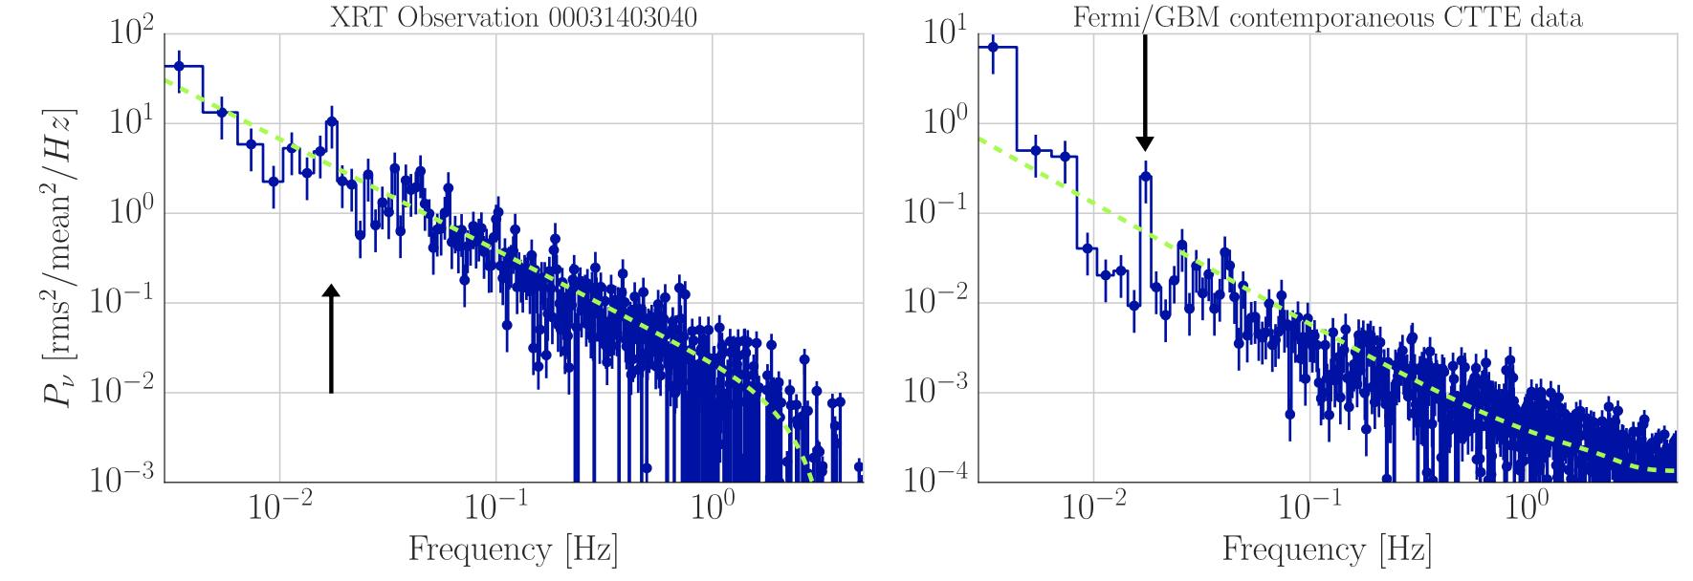
18mHz QPO?

Slide 5
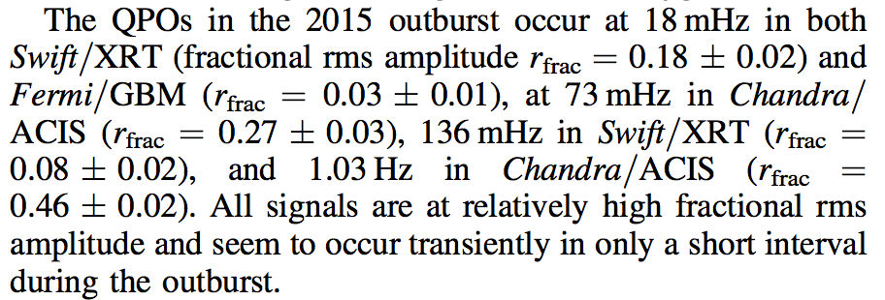
Type C QPO 0.1~30Hz?
these QPOs are likely highly transient, unlike most type-C QPOs
Type-A QPOs are very broad at a low amplitude and seen during the intermediate state around a centroid frequency of 6 Hz.
Type-B QPOs also appear at frequencies of ∼6 Hz, though narrower
Type-C QPOs, on the other hand, mostly occur in the intermediate and hard states at frequencies between 0.1 Hz and 30Hz

Slide 6
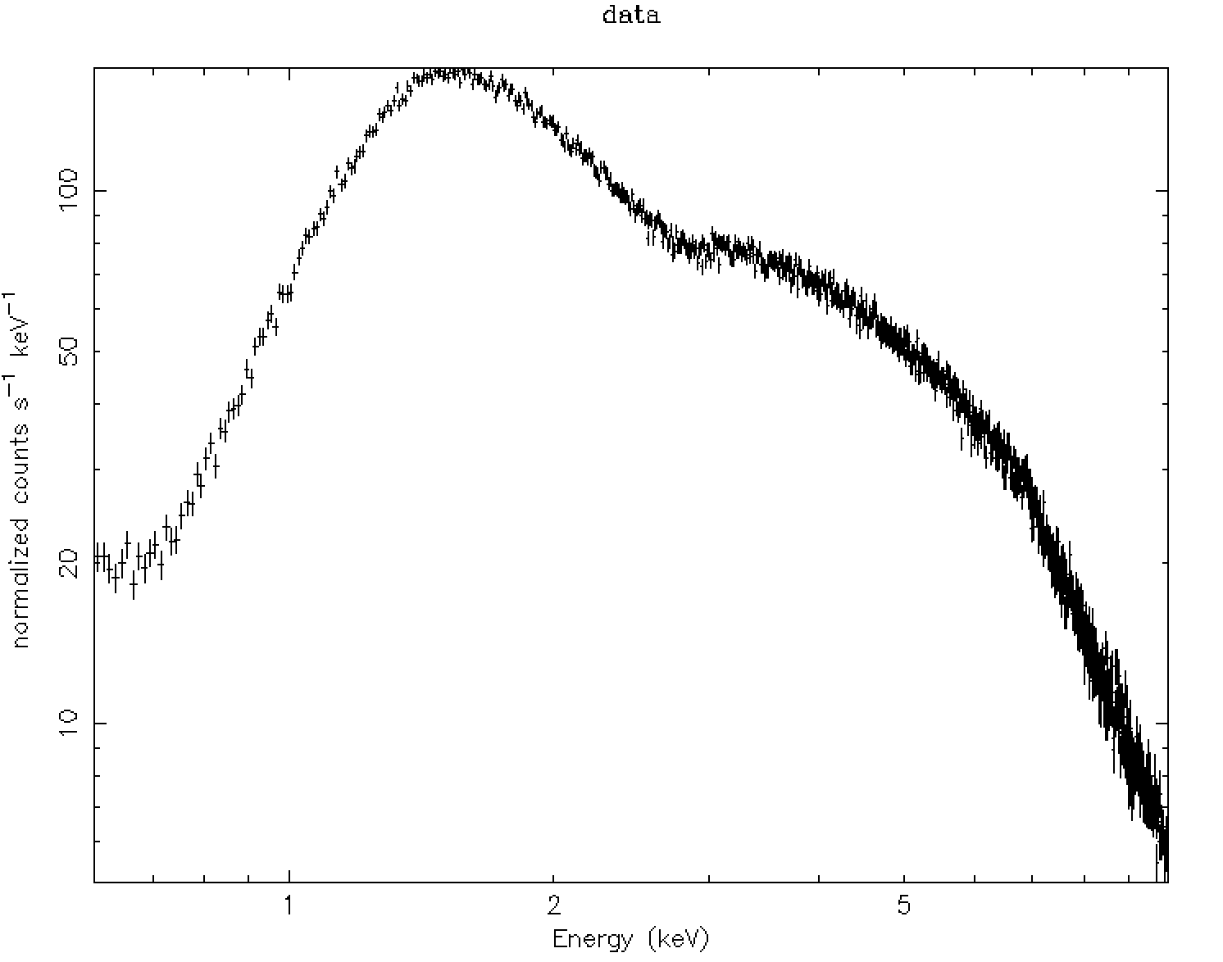
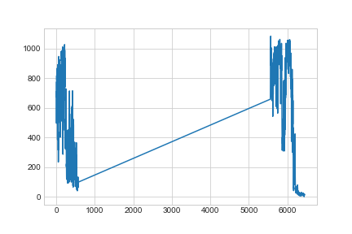
0620 00031403040_xrt
Spectrum has 745436 counts for 514.6 counts/sec
For pc> 0.6, wt >100 ; pile-up

Slide 7
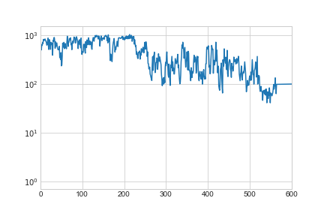
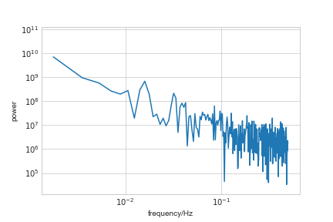
0620 00031403040_xrt lc and pds

Slide 8
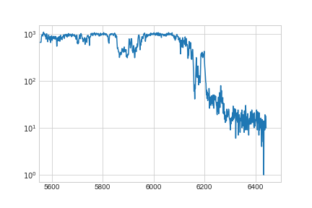
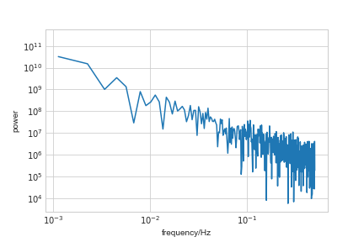
0620 lc and pds

Slide 9
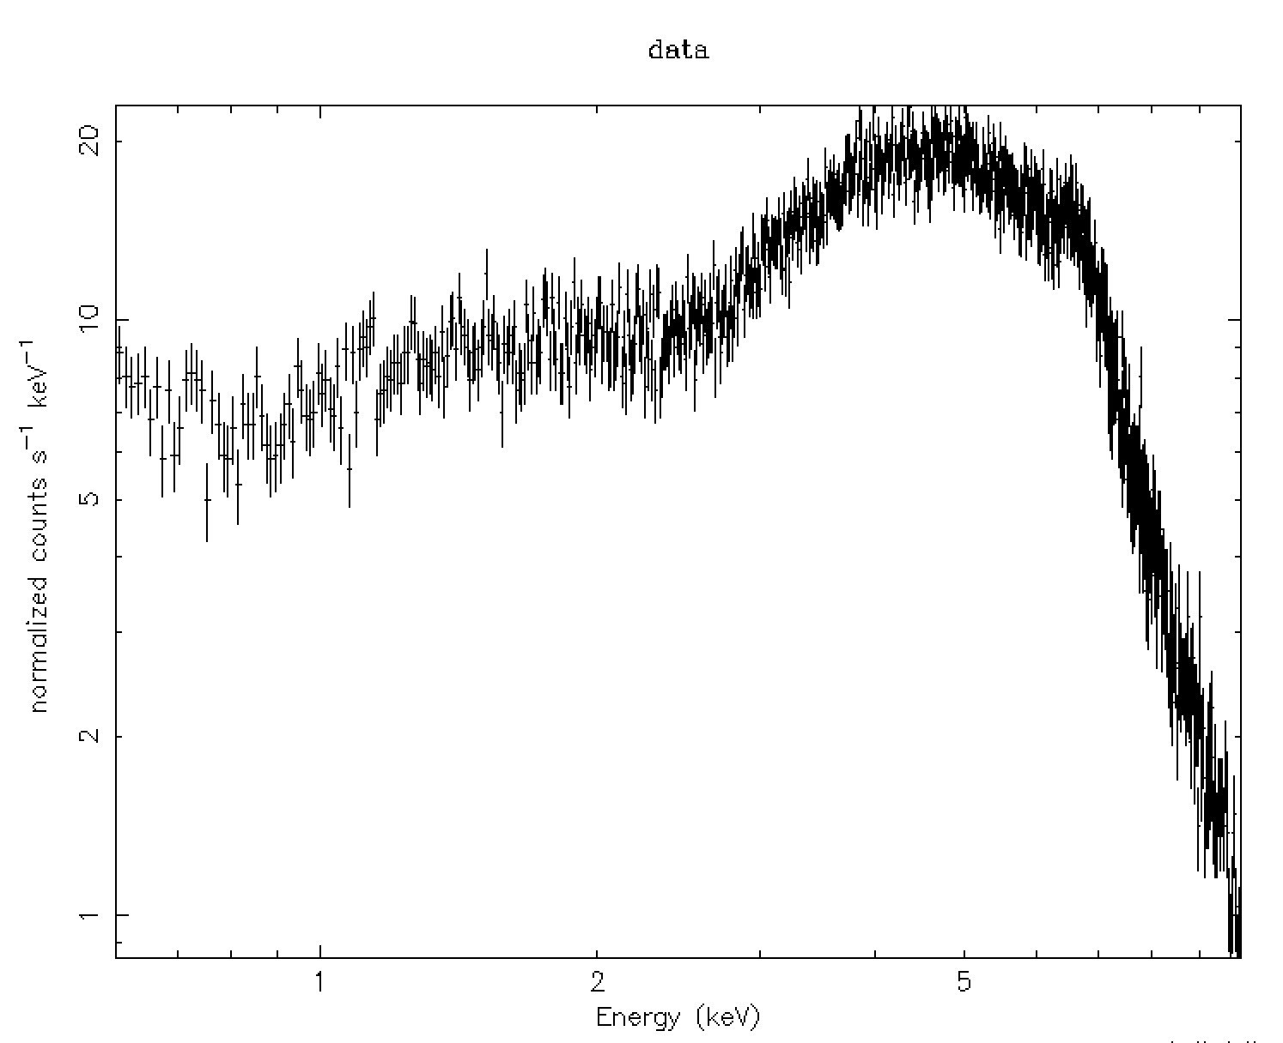
0622 wt 0.6-10.0keV

Slide 10
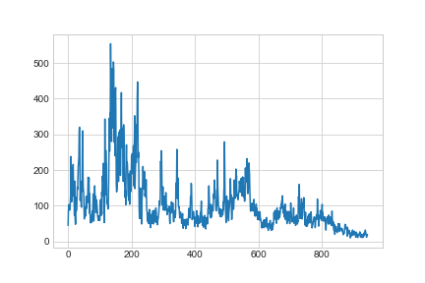
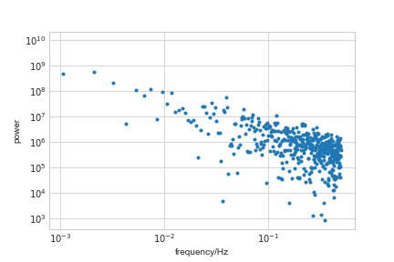
0622/00031403045 wt 0.6-10.0keV light curve and pds

Slide 11
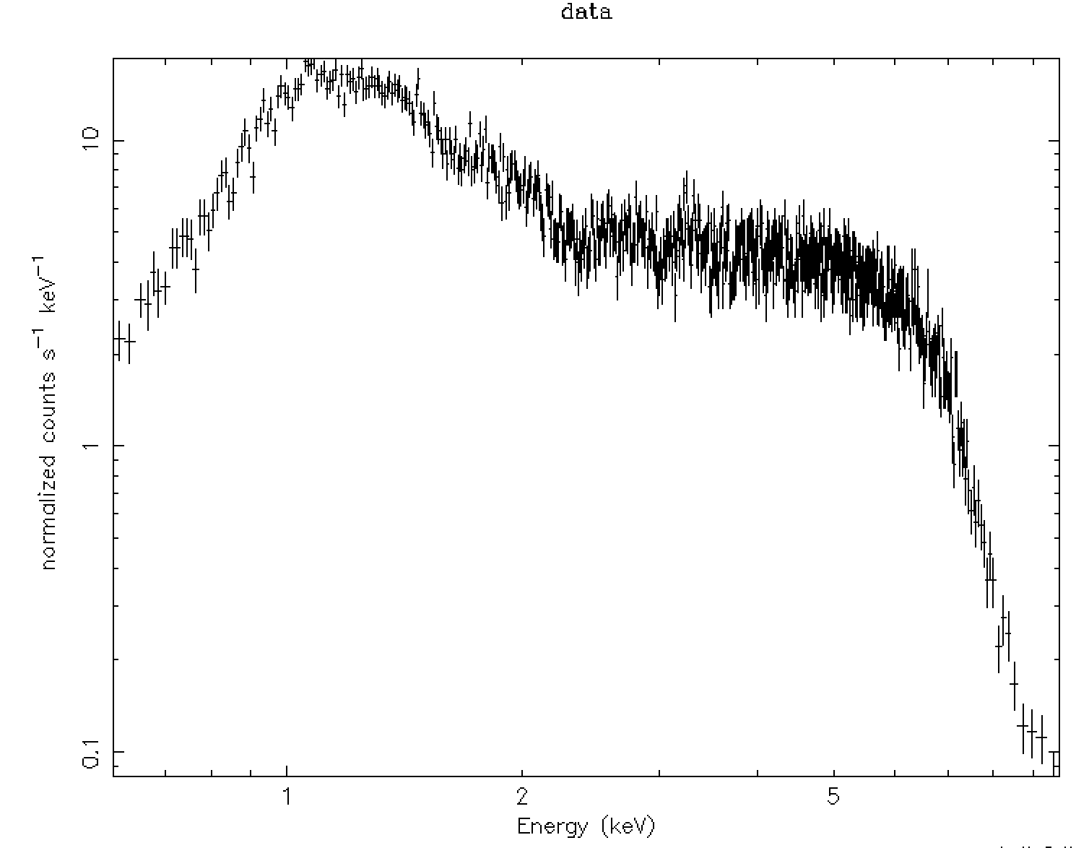
06/25_26
Fits light curve has 37514 counts for 36.43 counts/sec

Slide 12
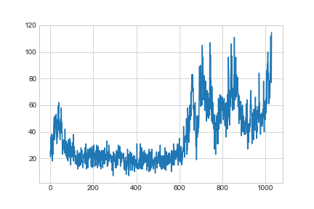
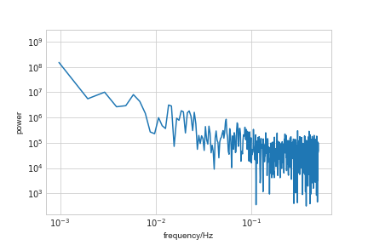
00031403055_xrt lc and pds

Slide 13
Discussion
accretion disk

Slide 14
Multicolour observations of V404 Cyg and J1118+480 with ULTRACAM
during the period 2002 Sep 9 to 13 using the Sloan u’, g’ and i’ filters
THE POWER DENSITY SPECTRUM
A QPO feature with a centroid frequency at 0.78 mHz (= 21.5mins)

Slide 15
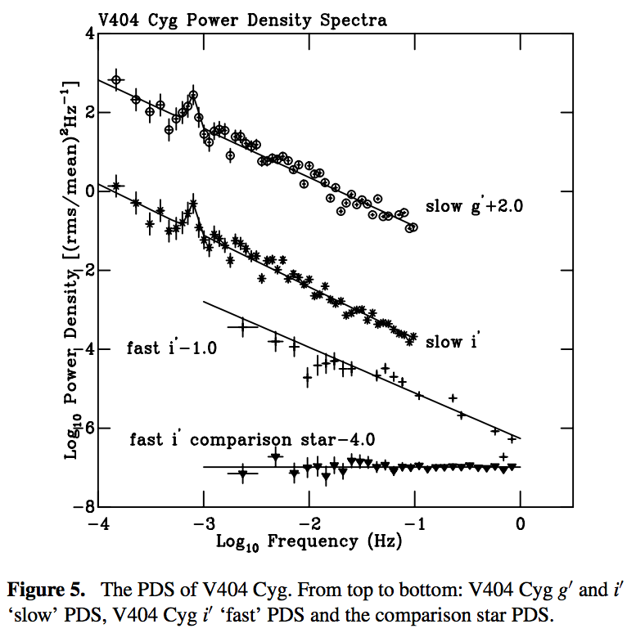

Slide 16
