Slide 1
Chandra X-ray / VLA radio data reduction for V404 cyg
Lv Bing

Slide 2
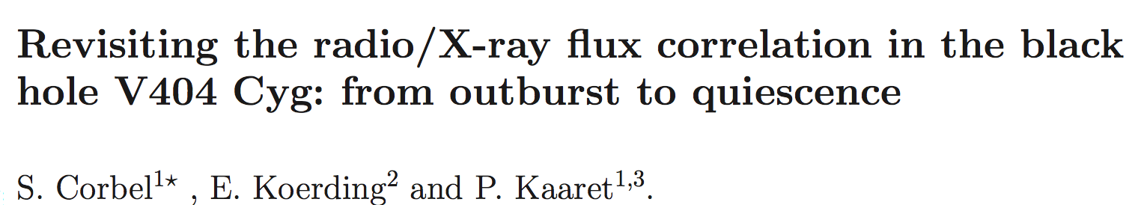
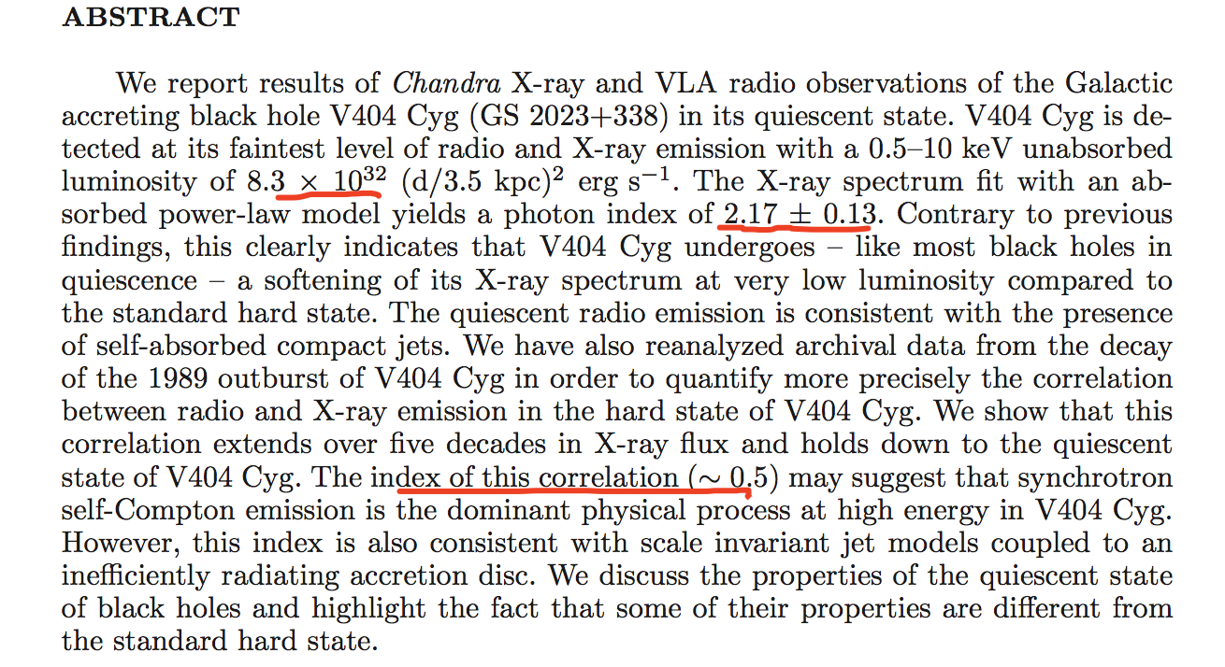

Slide 3
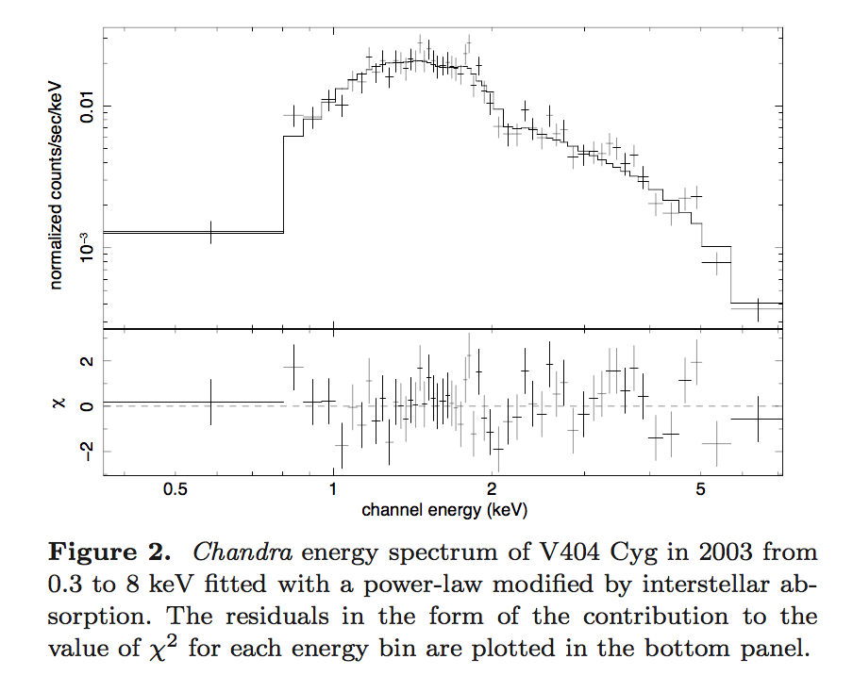

Slide 4
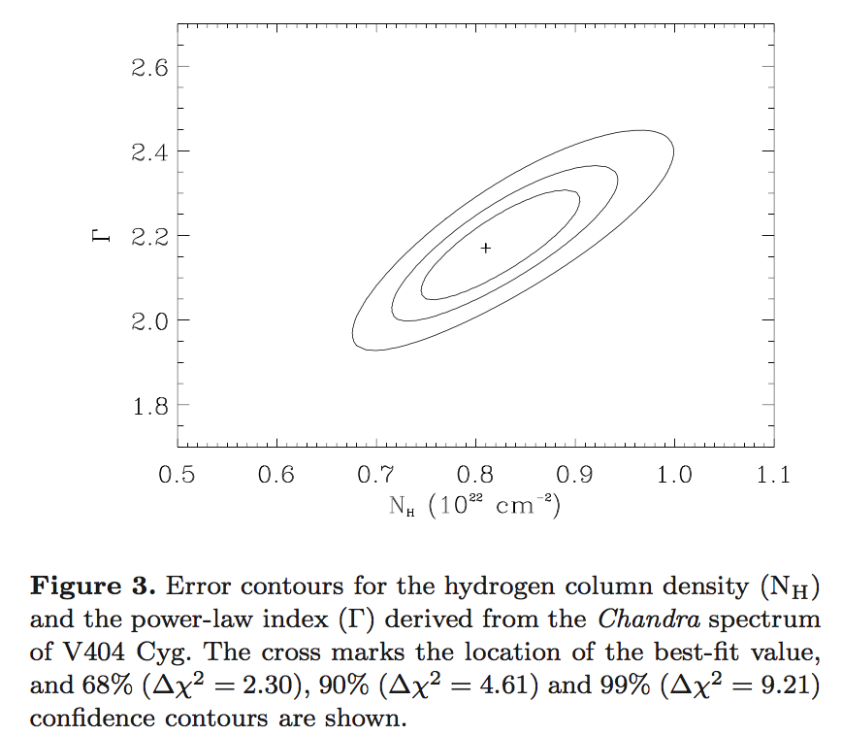

Slide 5
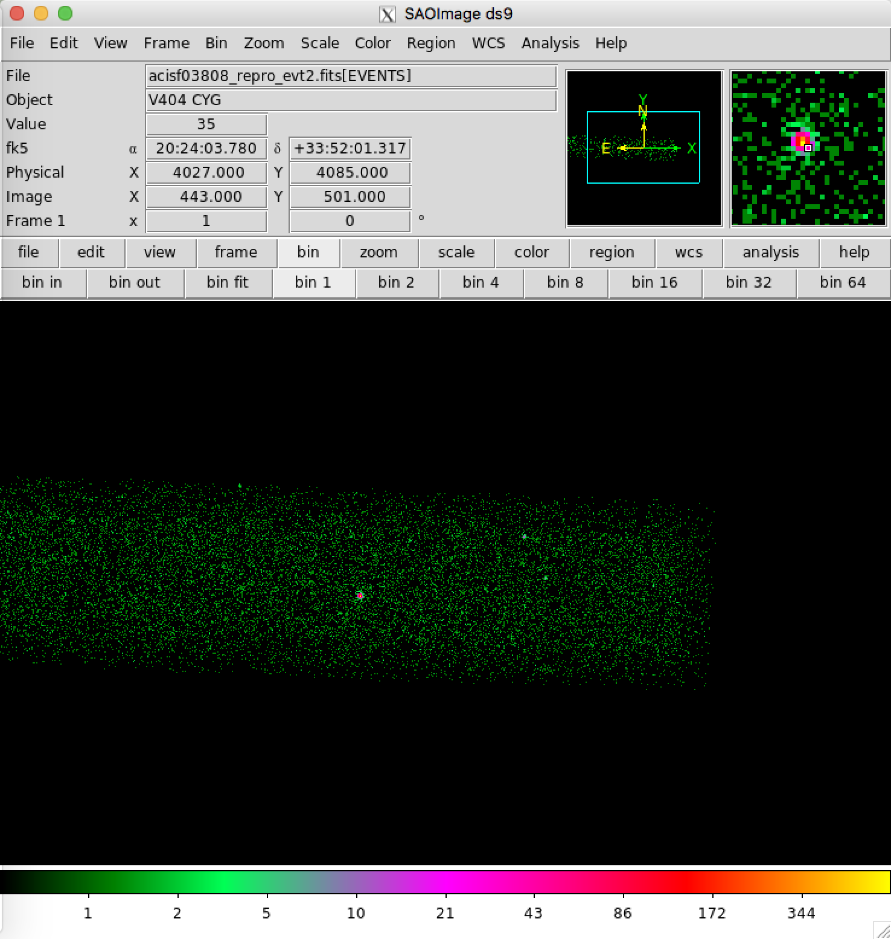
RA DEC 20h24m03.8s +33d52m02s

Slide 6
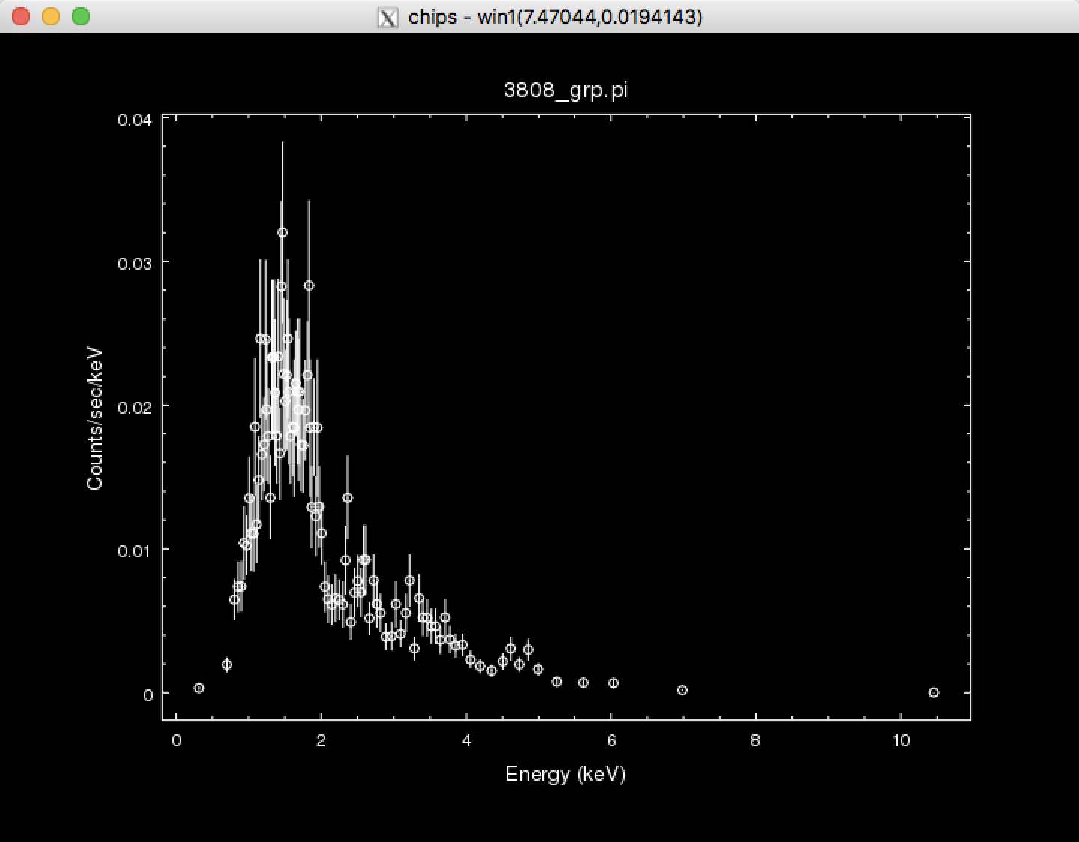
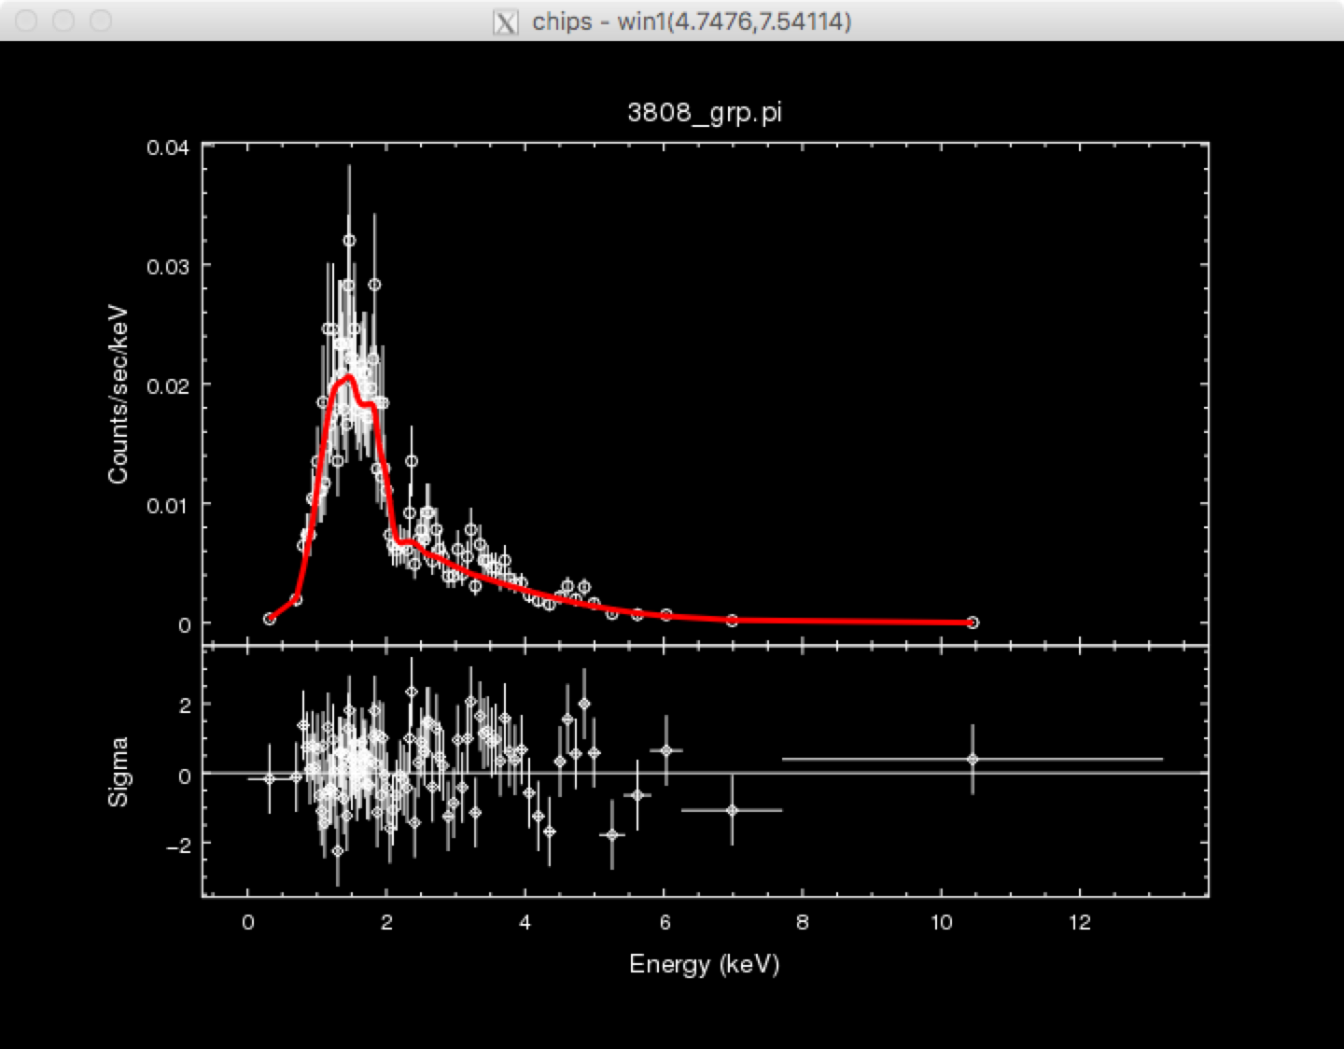
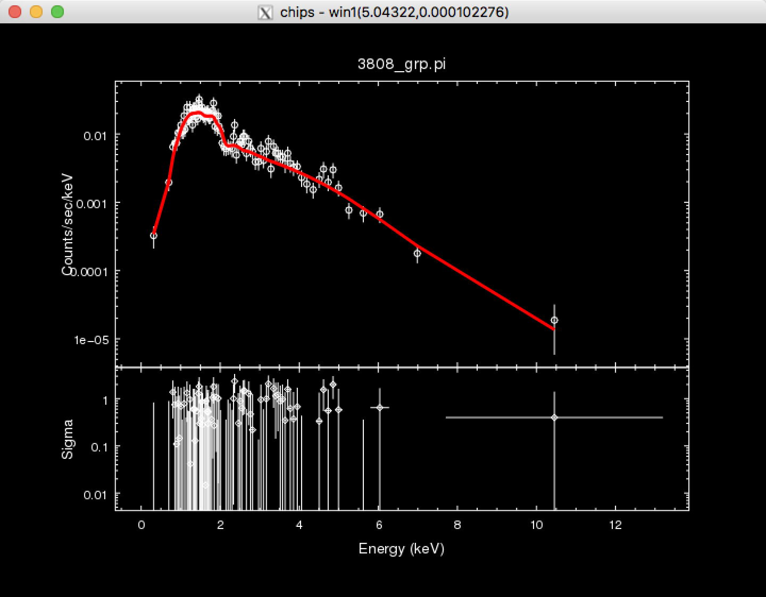

Slide 7
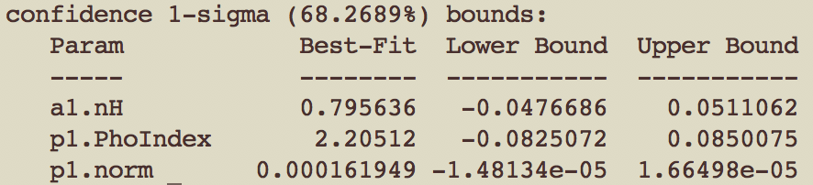
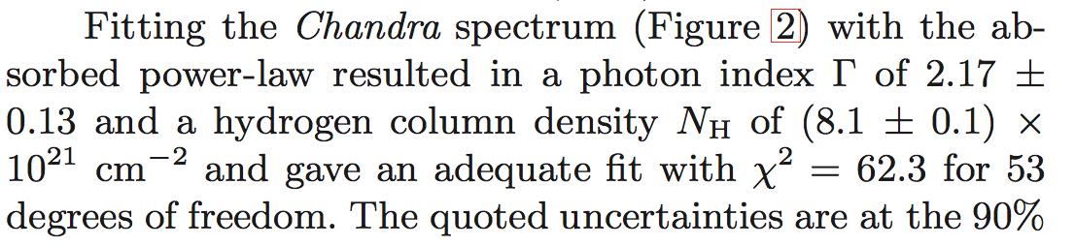
set_source(xsphabs.a1*xspowerlaw.p1)
sherpa-7> fit()
Initial fit statistic = 7.22463e+11
Final fit statistic = 95.119 at function evaluation 38
Data points = 101
Degrees of freedom = 98
Probability [Q-value] = 0.56359
Reduced statistic = 0.970602
Change in statistic = 7.22463e+11
a1.nH 0.795636
p1.PhoIndex 2.20512
p1.norm 0.000161949

Slide 8
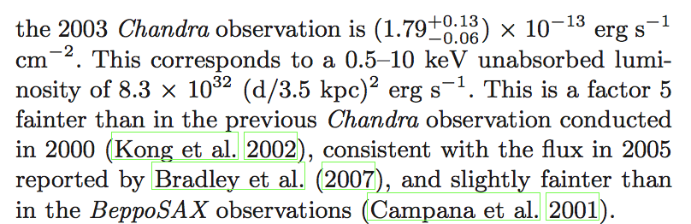
calc_energy_flux(0.3, 8.)
3.2196797833180645e-13
calc_photon_flux(0.3, 8.)
7.4751307596541286e-05
calc_energy_flux(3, 9.)
1.9559583763365476e-13

Slide 9
sample_flux(p1,3,9,confidence=90)
original model flux = 1.54322e-13, + -1.902e-14, - 1.902e-14
model component flux = 1.61052e-13, + -1.94911e-14, - 1.94911e-14
[array([ 1.54322490e-13, 1.35302526e-13, 1.35302526e-13]),
array([ 1.61051560e-13, 1.41560467e-13, 1.41560467e-13]),
array([[ 1.73342455e-13, 7.73938016e-01, 2.22683285e+00,
1.48544049e-04, 1.07896875e+02],
[ 1.35302526e-13, 8.44961538e-01, 2.31457504e+00,
1.34275264e-04, 2.21776311e+02]])]

Slide 10
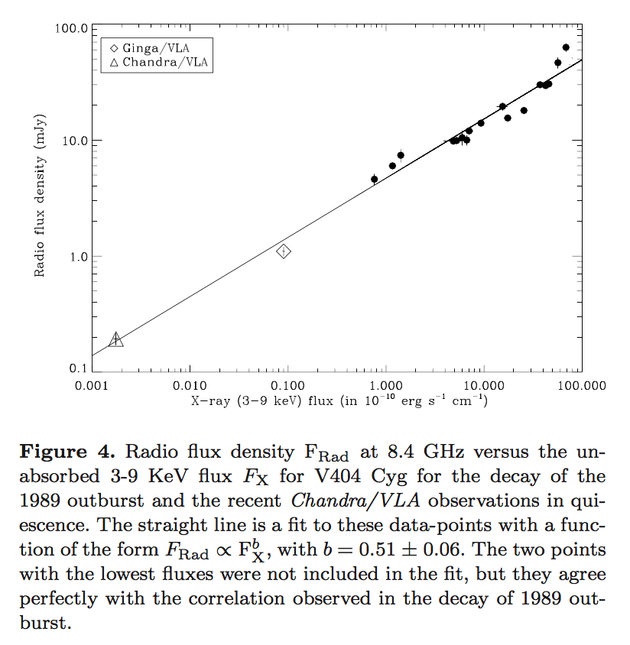

Slide 11
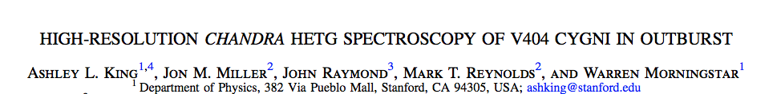

Slide 12
