Slide 1
Problem for RFI and Flux Calibration
And for chandra data reduction m33 as example
Lv Bing

Slide 2
RFI data flag
Flagging Modes : tfcrop
flagdata(vis='3c391_ctm_mosaic_10s_spw1.ms', spw='0', mode='tfcrop', action='calculate', display='data', extendflags=False)
- Calculates and applies flags in one pass through the MS
- Can operate on un-calibrated data and bandshapes
- Flag extension can be done via mode='extend’
flagdata(vis='xxx.ms', spw='0' ,mode='tfcrop', maxnpieces=4, action='calculate', extendflags=F,display='data')
Flagging Modes : rflag
- Can be run with 1 or 2 passes through the data
- Requires calibrated data.
- Flag extension can be done via mode='extend'
- Can flag short baselines if there is extended emission- Good for low level noisy RFI

Slide 3
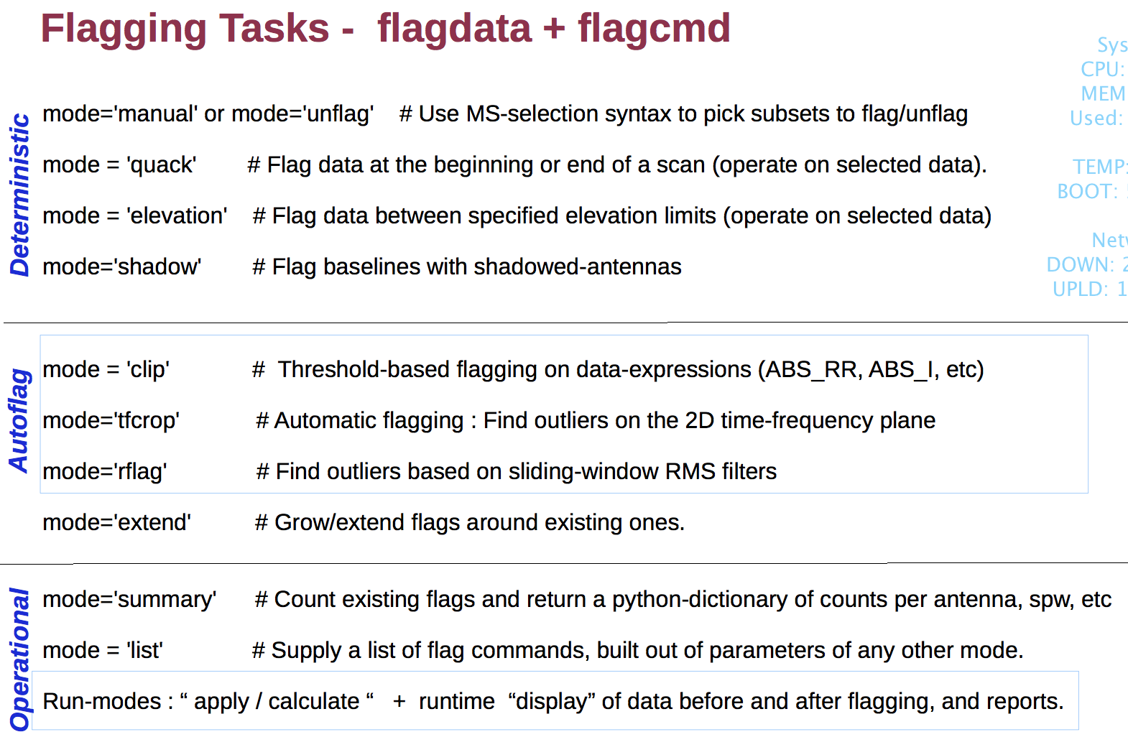

Slide 4
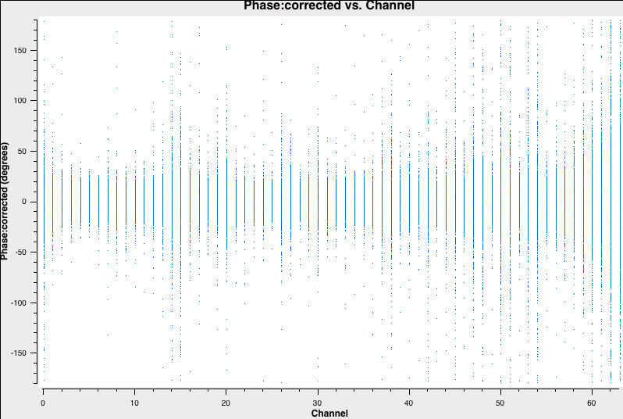

Slide 5
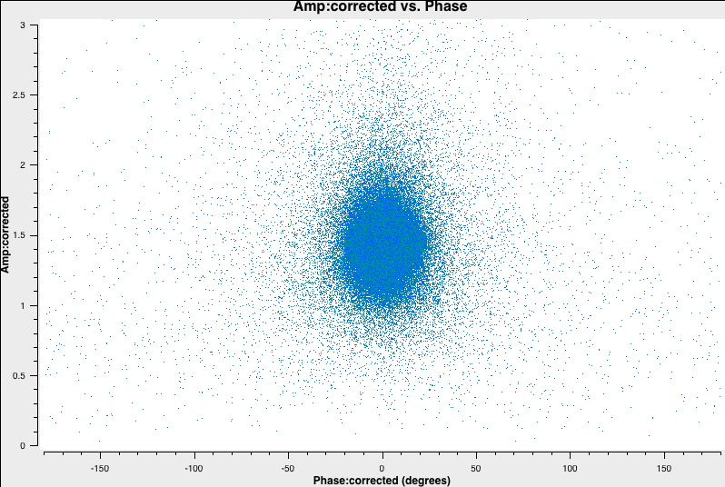

Slide 6
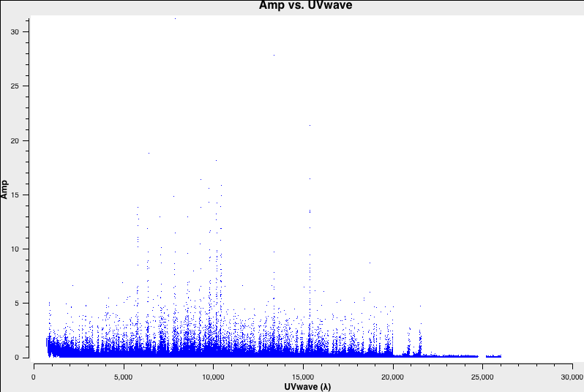
Not good RFI remove

Slide 7
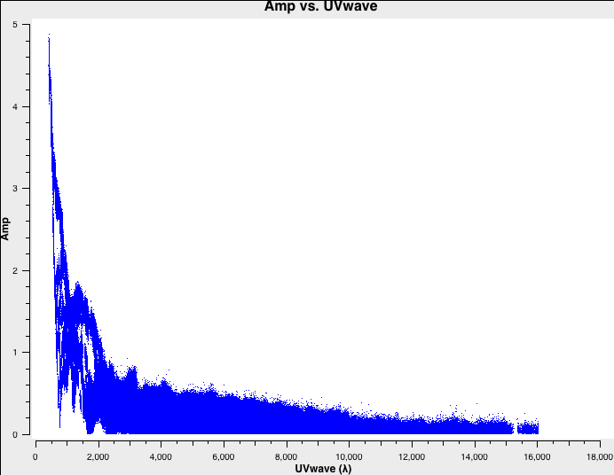
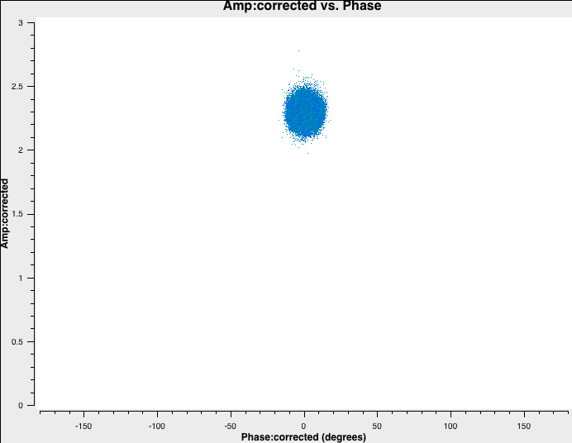
3c391 for 4.6GHz
Good example

Slide 8
4.6GHz and 7.5GHz
alpha1 = log(7.53261/5.5242)/log(4663.0/7436.0)
alpha = log(7.53261/7.6677)/log(4663.0/4536.0)
i0=7.6677i01=5.5242 # Stokes I value for spw 0 ch 0
c0=0.112 # Fractional polarization=11.2%
d0=33*pi/180 # polarization angle of 33 degrees converted to radians
setjy(vis='3c391_ctm_mosaic_10s_spw1.ms', field='J1331+3030', standard='manual', spw='0', fluxdensity=[i01,0,0,0], spix=[alpha1,0], reffreq='7436.0MHz', polindex=[c0,0], polangle=[d0,0], scalebychan=True, usescratch=False)
setjy(vis='3c391_ctm_mosaic_10s_spw1.ms', field='J1331+3030', standard='manual',spw='0', fluxdensity=[i0,0,0,0], spix=[alpha,0], reffreq='4536.0MHz',polindex=[c0,0], polangle=[d0,0],scalebychan=True, usescratch=False)

Slide 9
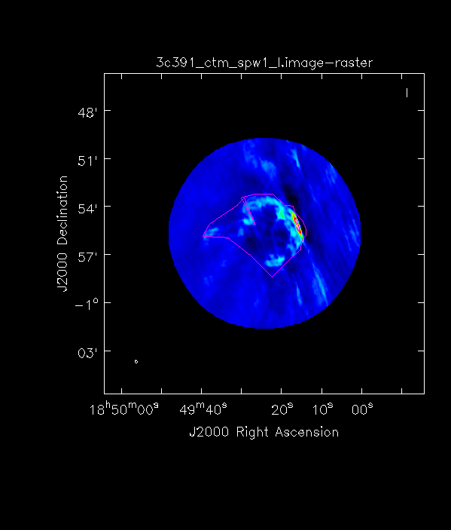

Slide 10
M33 of chandra
find_chandra_obsid m33
# obsid sepn inst grat time obsdate piname target
786 0.0 ACIS-S NONE 46.3 2000-08-30 McDowell M33
787 0.0 ACIS-S NONE 9.3 2000-01-11 McDowell "M33 X-8"
1730 0.0 ACIS-I NONE 49.4 2000-07-12 McDowell M33
2023 11.7 ACIS-I NONE 88.8 2001-07-06 Damiani "NGC 604"
3948 0.0 HRC-S NONE 4.2 2003-07-29 DUBUS "M33 X-8 (NUCLEUS)"

Slide 11
M33 data reduction
$ chandra_repro 3948 outdir=
$ dmlist 3948/primary/hrcf03948N007_evt2.fits.gz header,clean
$ ds9 3948/repro/hrcf03948_repro_evt2.fits
Create a region and save as src.reg
$ specextract "3948/repro/hrcf03948_repro_evt2.fits[sky=region(ds9_3948.reg)]" mysrc #ds9 a circle for 3948

Slide 12
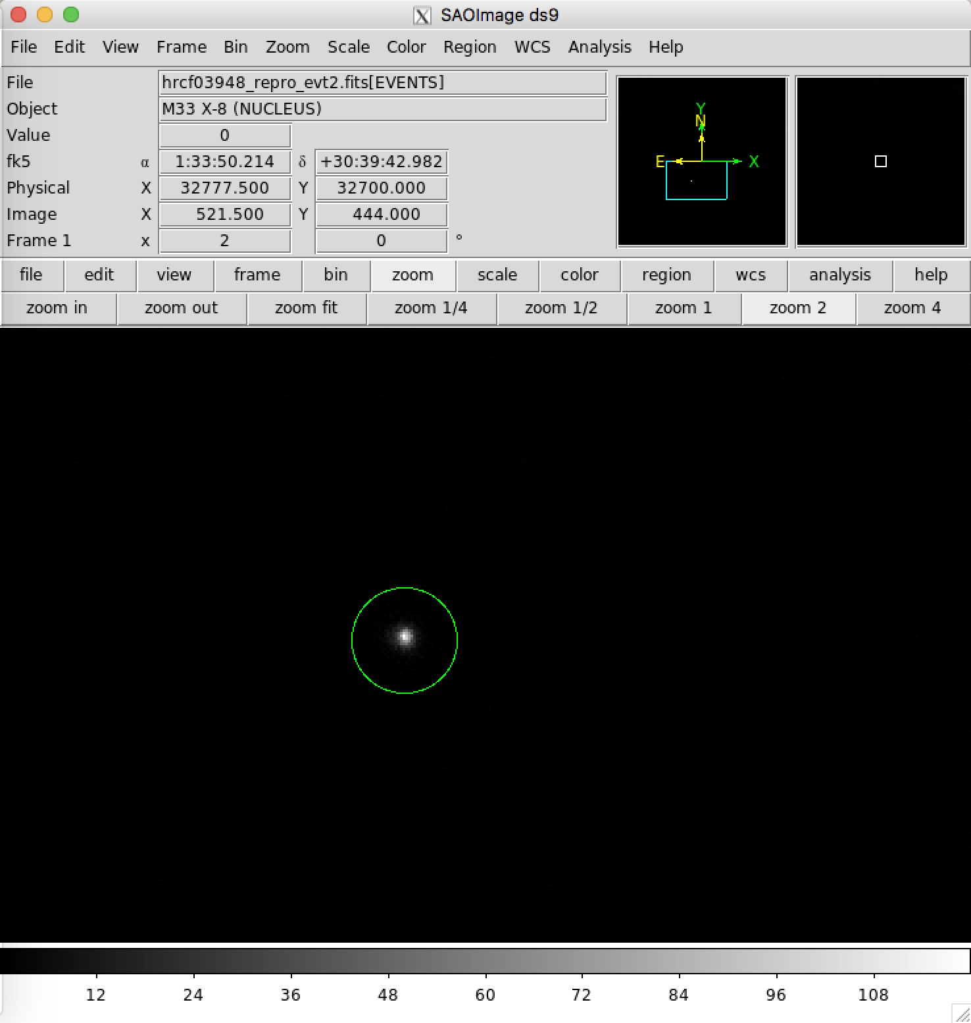

Slide 13
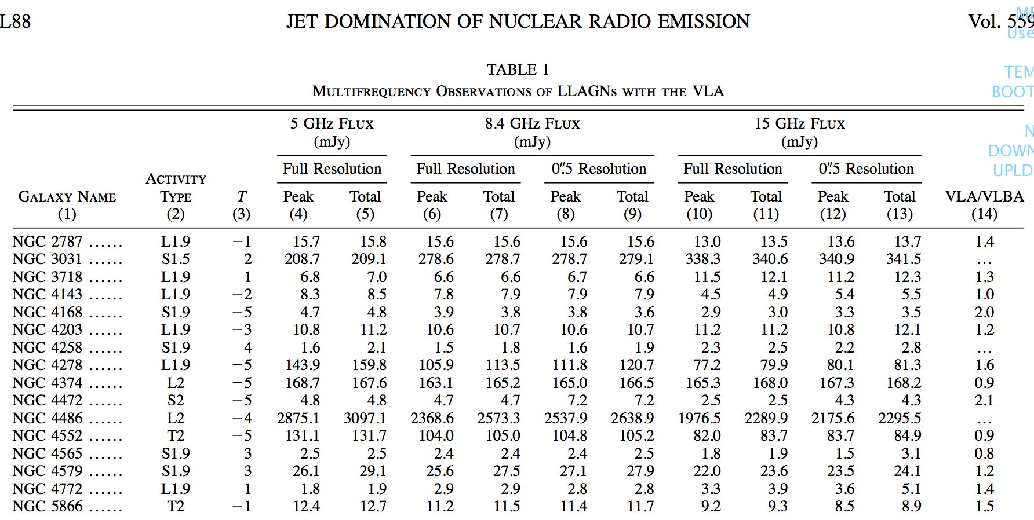
Radio core of AGNs

Slide 14
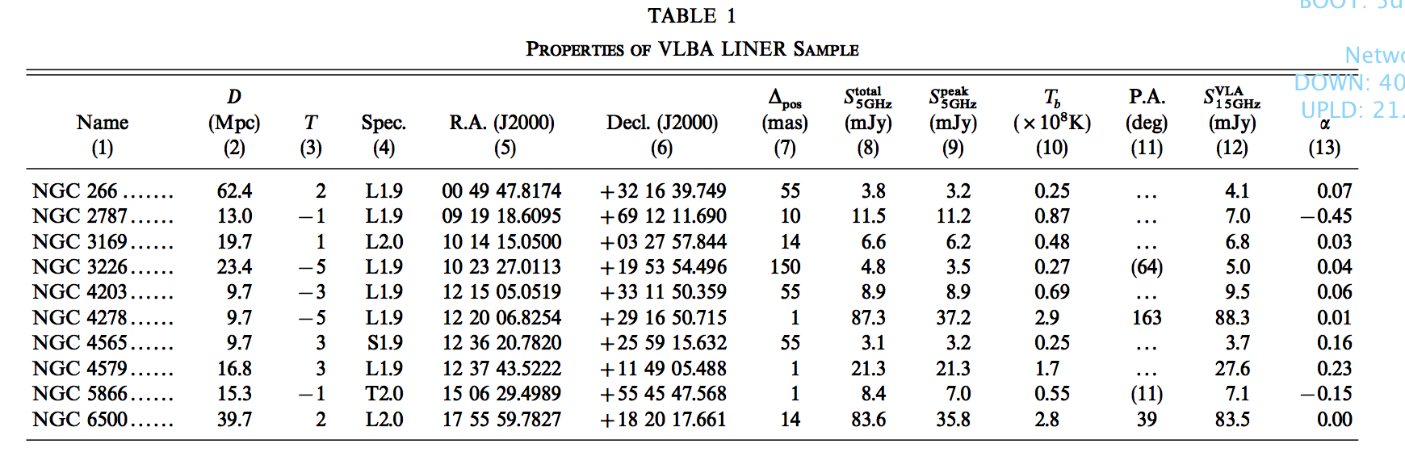

Slide 15
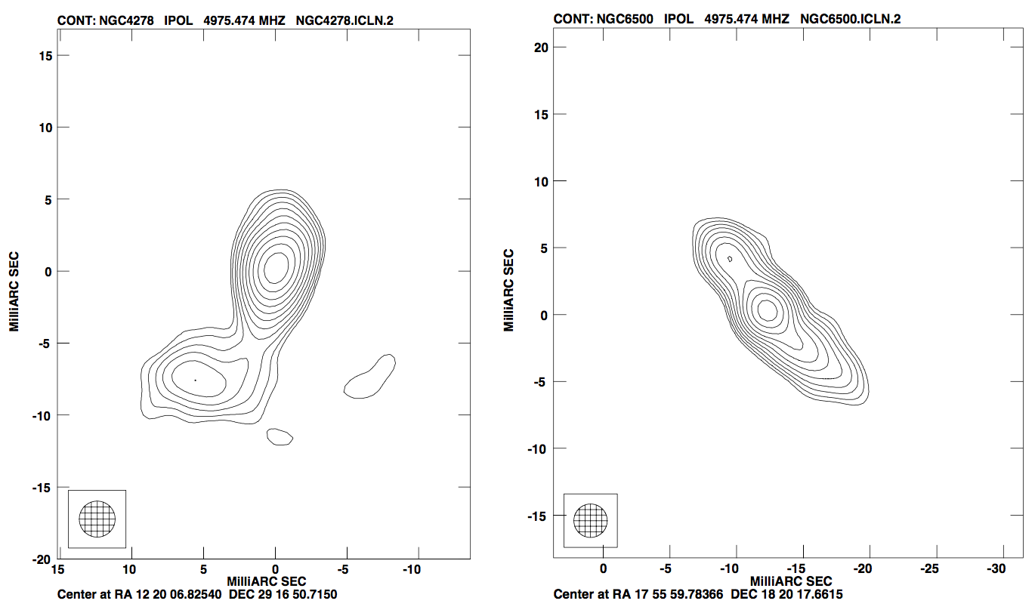

Slide 16
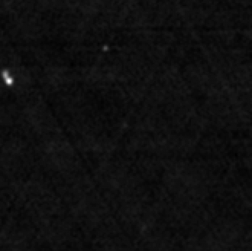
NGC 4395 of FIRST image

