Slide 1
Chandra X-ray data reduction
Lv Bing

Slide 2
Chandra Instruments
Advanced CCD Imaging Spectrometer (ACIS)
imaging wide fields (16x16 arc minutes)
High Resolution Camera (HRC)
highest spatial (<0.5 arc second) and temporal (16 msec) resolutions
largest field-of-view (31x31 arc minutes)
High Energy Transmission Grating (HETG)
Low Energy Transmission Grating (LETG)

Slide 3
M33 of chandra: a quick guide
find_chandra_obsid m33
# obsid sepn inst grat time obsdate piname target
786 0.0 ACIS-S NONE 46.3 2000-08-30 McDowell M33
787 0.0 ACIS-S NONE 9.3 2000-01-11 McDowell "M33 X-8"
1730 0.0 ACIS-I NONE 49.4 2000-07-12 McDowell M33
2023 11.7 ACIS-I NONE 88.8 2001-07-06 Damiani "NGC 604"
3948 0.0 HRC-S NONE 4.2 2003-07-29 DUBUS "M33 X-8 (NUCLEUS)"

Slide 4
M33 of chandra
# obsid sepn inst grat time obsdate piname target
6376 0.0 ACIS-I NONE 93.1 2006-03-03 Sasaki "M33 Field 1"
6377 0.0 ACIS-I NONE 92.9 2006-09-25 Sasaki "M33 Field 1"
6380 9.8 ACIS-I NONE 89.4 2005-09-23 Sasaki "M33 Field 3"
6383 9.1 ACIS-I NONE 97.8 2006-06-15 Sasaki "M33 Field 4"
6384 9.6 ACIS-I NONE 22.2 2005-10-01 Sasaki "M33 Field 5"
6385 9.6 ACIS-I NONE 90.0 2006-09-18 Sasaki "M33 Field 5"
6386 9.8 ACIS-I NONE 14.9 2005-10-31 Sasaki "M33 Field 6"
6387 9.8 ACIS-I NONE 77.3 2006-06-26 Sasaki "M33 Field 6"
6389 9.1 ACIS-I NONE 95.8 2006-11-28 Sasaki "M33 Field 7"
7170 9.6 ACIS-I NONE 41.0 2005-09-26 Sasaki "M33 Field 5"
7171 9.6 ACIS-I NONE 37.7 2005-09-29 Sasaki "M33 Field 5"
7196 9.8 ACIS-I NONE 22.8 2005-11-02 Sasaki "M33 Field 6"
7197 9.8 ACIS-I NONE 12.7 2005-11-03 Sasaki "M33 Field 6"
7198 9.8 ACIS-I NONE 21.8 2005-11-05 Sasaki "M33 Field 6"
7199 9.8 ACIS-I NONE 14.8 2005-11-06 Sasaki "M33 Field 6"
7208 9.8 ACIS-I NONE 11.5 2005-11-21 Sasaki "M33 Field 6"
7344 9.8 ACIS-I NONE 21.4 2006-07-01 Sasaki "M33 Field 6”

Slide 5
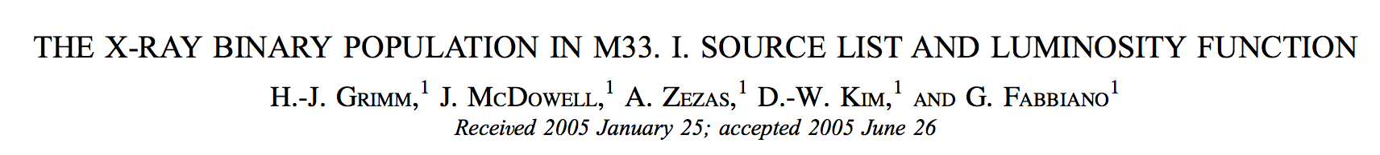
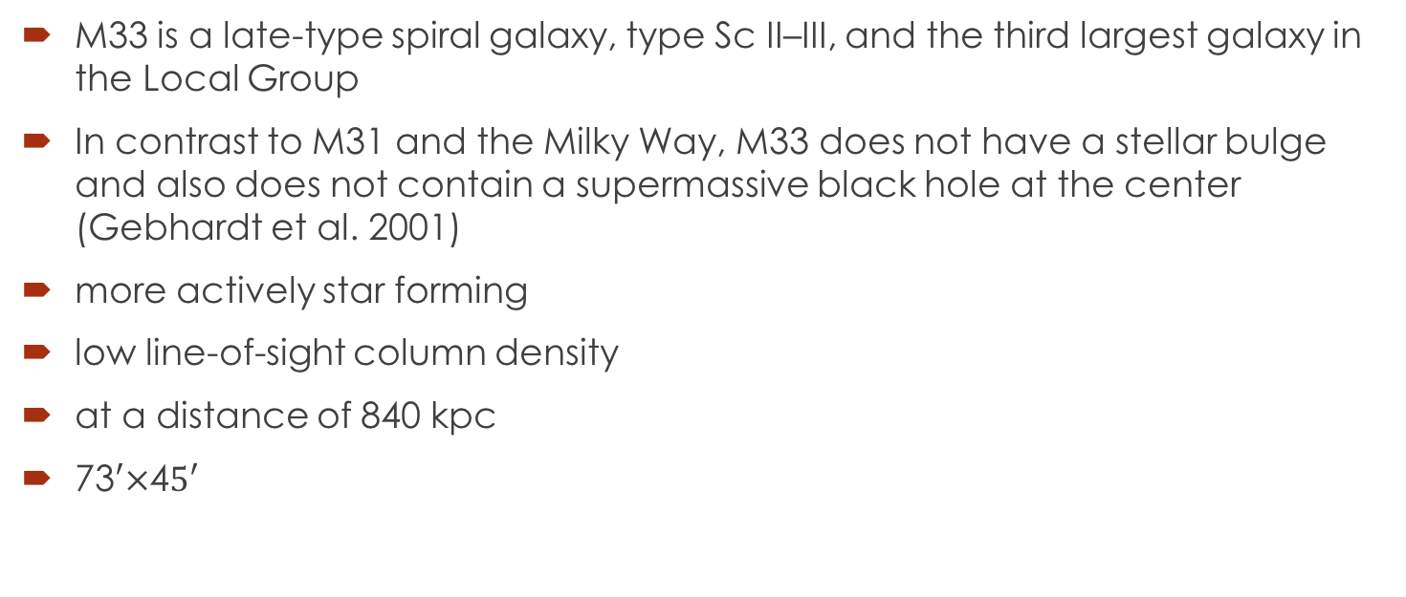
M33 is a late-type spiral galaxy, type Sc II–III, and the third largest galaxy in the Local Group
In contrast to M31 and the Milky Way, M33 does not have a stellar bulge and also does not contain a supermassive black hole at the center (Gebhardt et al. 2001)
more actively star forming
low line-of-sight column density
at a distance of 840 kpc
73$′×$4$5′$

Slide 6
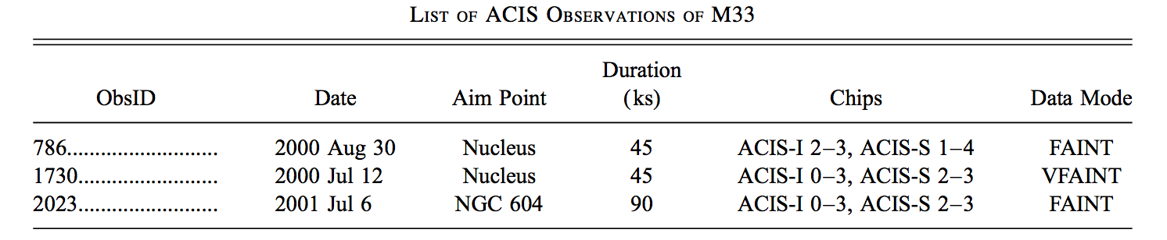
CHANDRA DATA AND ANALYSIS
Obsid 786 1730 2023 while 787 was disregarded
In this paper they present the source list, luminosities, X-ray luminosity functions, and identifications of X-ray point sources in M33.
An accompanying paper will investigate the detailed properties and X-ray spectra of the point source population

Slide 7
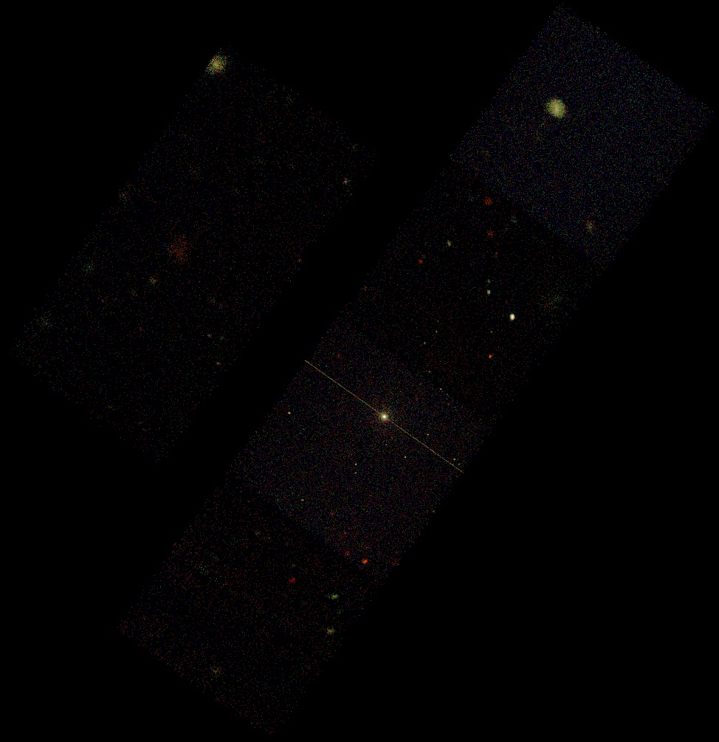
image

Slide 8
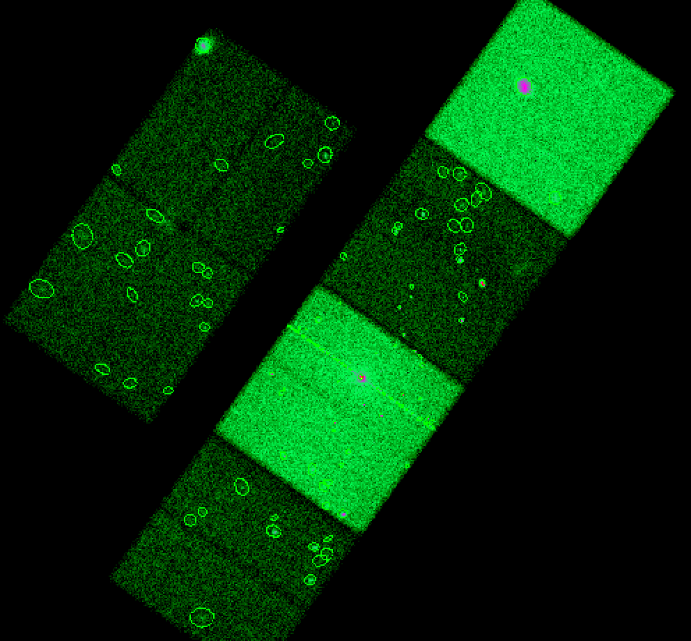
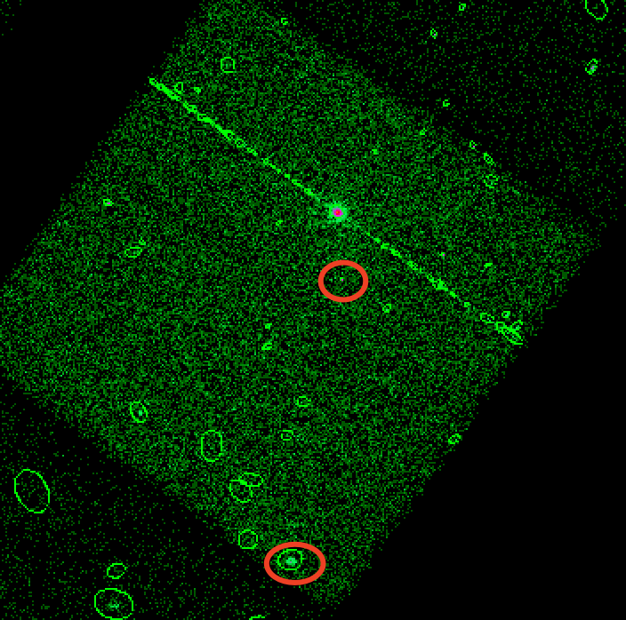
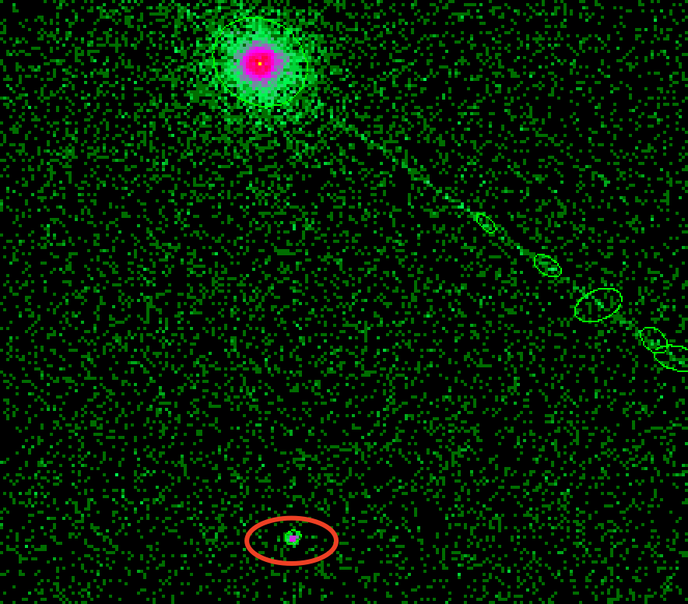
wavdetect

Slide 9
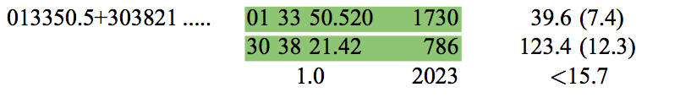
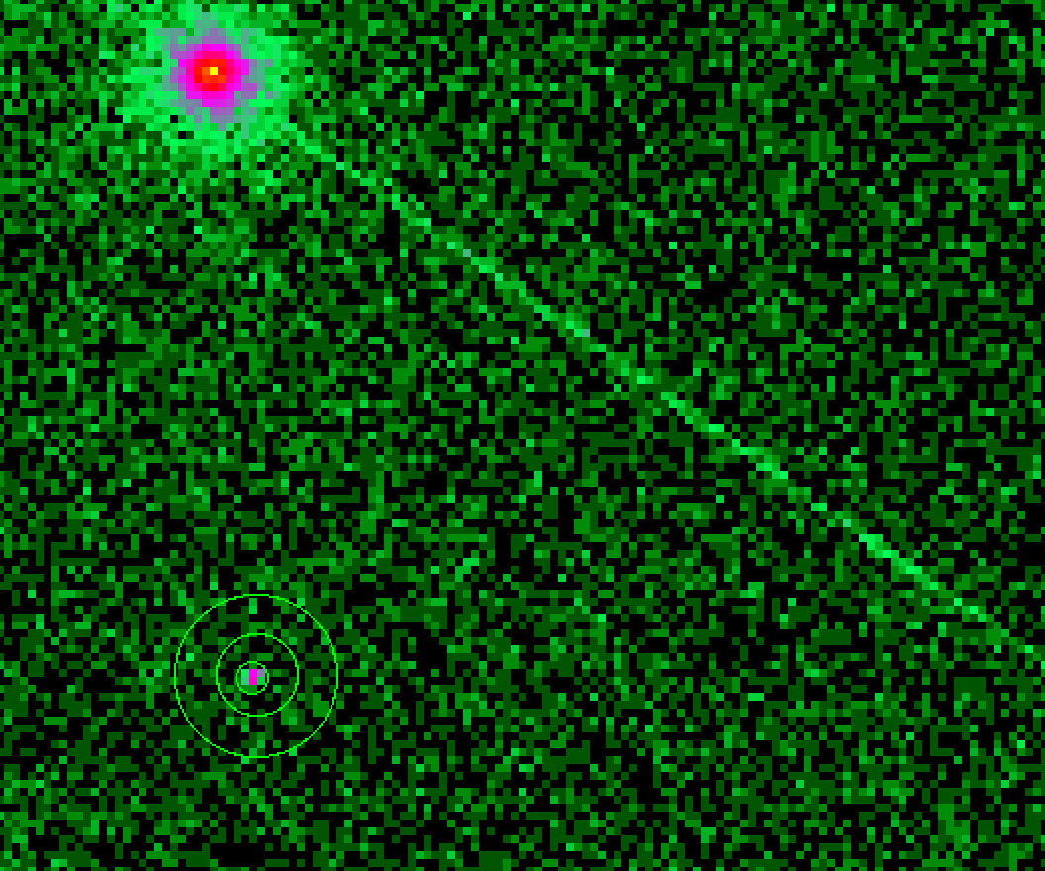
Select source region
and bkg region

Slide 10
Specextract
punlearn specextract
pset specextract infile="acisf00786_repro_evt2.fits[sky=region(src1.reg)]"
pset specextract bkgfile="acisf00786_repro_evt2.fits[sky=region(bkg1.reg)]"
pset specextract outroot=0786_spec1
pset specextract correctpsf=yes
pset specextract weight=no
specextract

Slide 11
Model spec and Sample flux
Sherpa:
load_data("0786_spec1_grp.pi”)
notice(0.3,8) or ignore(":0.3, 8.0:")
subtract()
set_stat("chi2datavar”)
set_source(xsphabs.a1*xspowerlaw.p1)
fit()
plot_fit_delchi()
conf()
calc_photon_flux(0.3, 8.)
calc_energy_flux(0.3, 8.)

Slide 12
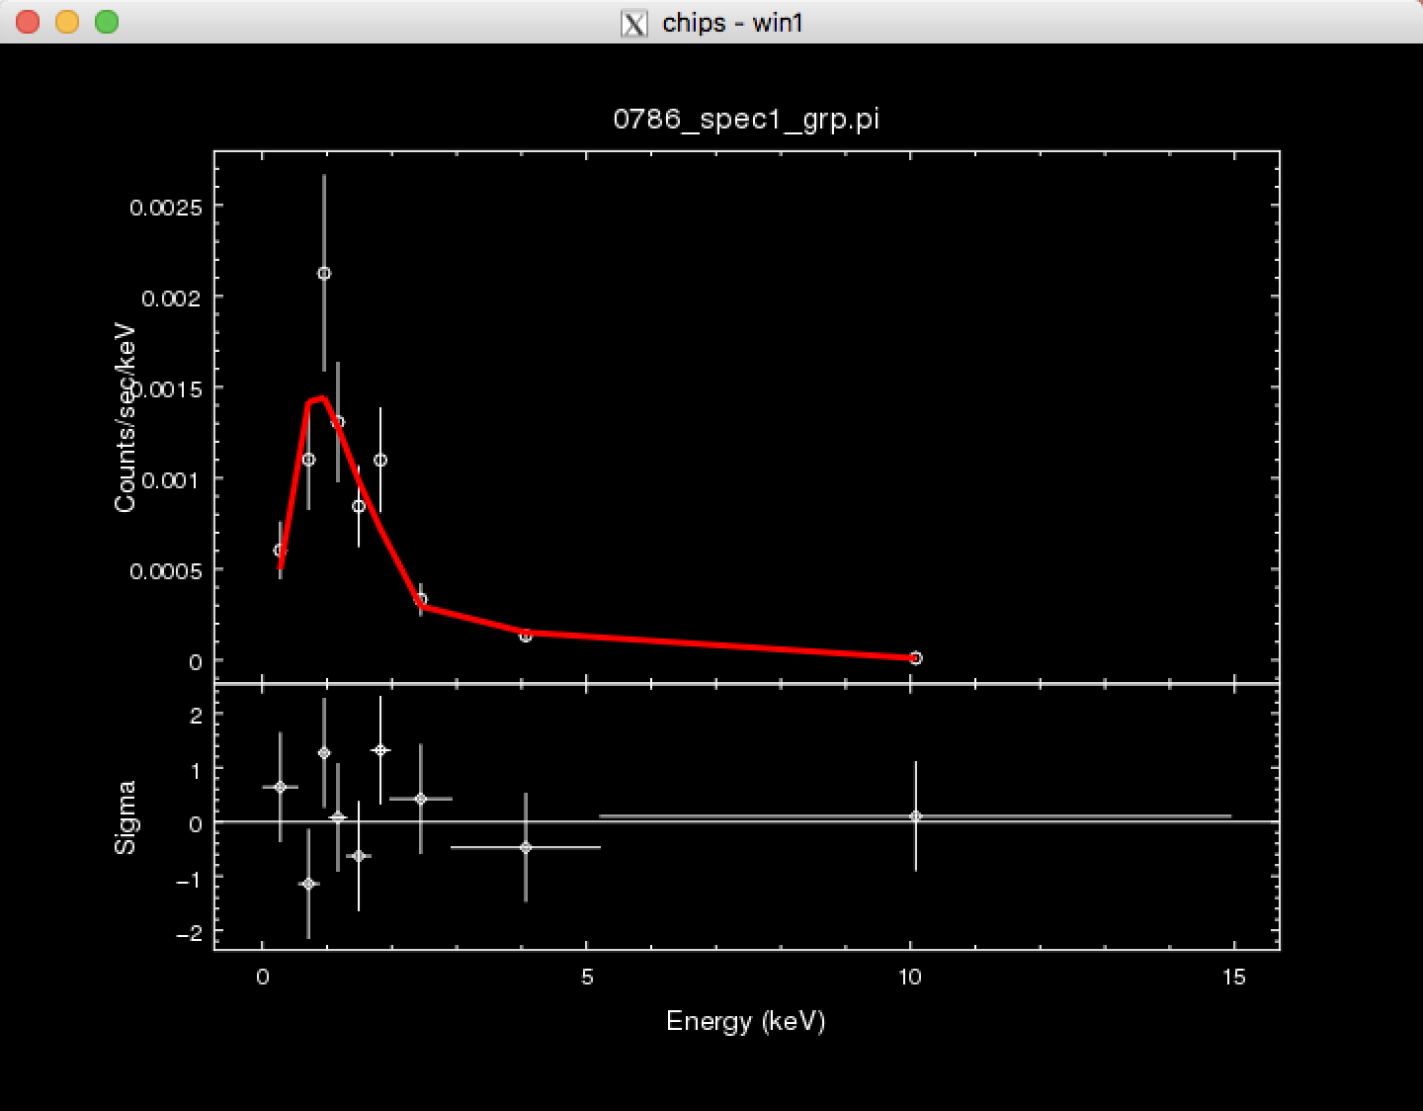
fit result
Dataset = 1
Method = levmar
Statistic = chi2datavar
Initial fit statistic = 83.558
Final fit statistic = 5.89105 at function evaluation 29
Data points = 9
Degrees of freedom = 6
Probability [Q-value] = 0.435505
Reduced statistic = 0.981841
Change in statistic = 77.667
a1.nH 0.0422219
p1.PhoIndex 1.33951
p1.norm 2.74909e-06

Slide 13
Flux and luminosity
sherpa-14> calc_photon_flux(0.3, 8.)
6.720616731667796e-06
sherpa-15> calc_energy_flux(0.3, 8.)
2.2068624791076954e-14
And
L=4*pi*r**2*flux=4*np.pi*(840*3.0856*10**21)**2*2.2*10**(-14)=1.857343402233576e+36
In paper the count flux and luminosity is 5.7e-6 counts/s/cm^2 and 1.02e36erg/s
As a rule of thumb, 100 counts correspond to a luminosity of (1-2) *10^36 ergs/ s
1.77

Slide 14
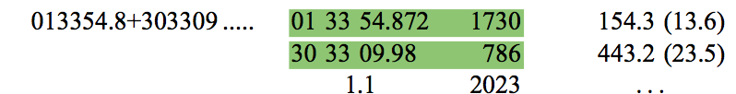
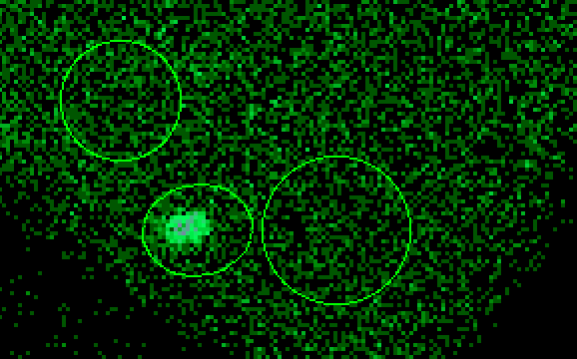
Select source region and bkg region

Slide 15
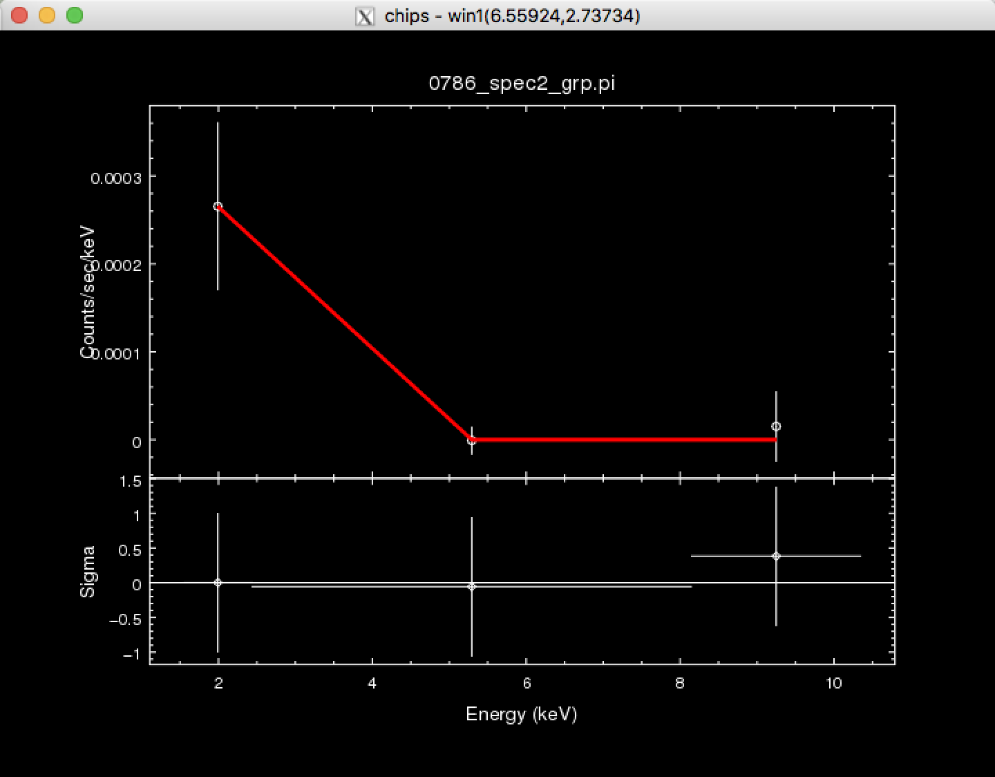
Specextract and model flux
load_data("0786_spec2_grp.pi")
sherpa-3> subtract()
sherpa-4> set_stat("chi2datavar")
sherpa-5> set_source(xsphabs.a1*xsbremss.p1)
sherpa-6> fit()
Data points = 3
Degrees of freedom = 0
Reduced statistic = nan
Change in statistic = 1.32285e+12
a1.nH 0.367363
p1.kT 0.141806
p1.norm 0.172128

Slide 16
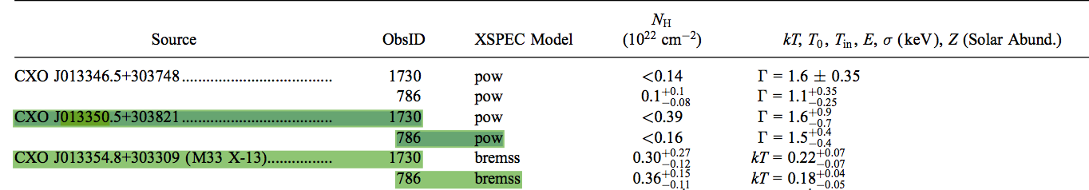
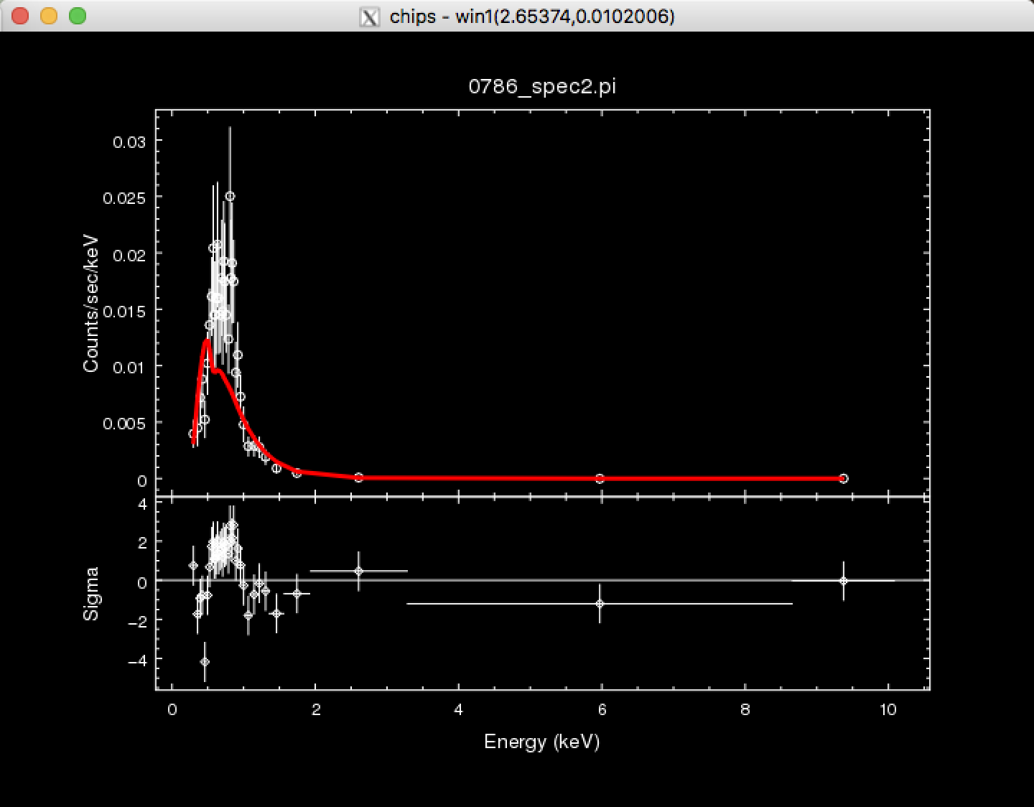
fit()
Data points = 38
Degrees of freedom = 35
Probability [Q-value] = 1.13131e-05
Reduced statistic = 2.34968
Change in statistic = 13.5382
a1.nH 0.246877
b1.kT 0.246002
b1.norm 0.000721041

Slide 17
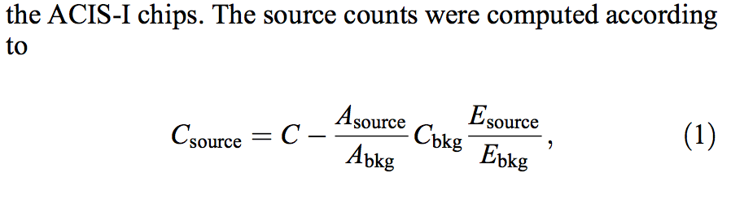
Flux and luminosity
sherpa-43> plot_fit_delchi()
sherpa-44> calc_photon_flux(0.3, 8.)
2.6671074e-05
sherpa-45> calc_energy_flux(0.3, 8.)
2.9220021431487298e-14
And
L=4*pi*r**2*flux=4*np.pi*(840*3.0856*10**21)**2*2.92*10**(-14)=2.46e36 erg/s
In paper the count flux and luminosity is 230e-7 counts/s/cm^2 and 4.08e36erg/s

Slide 18
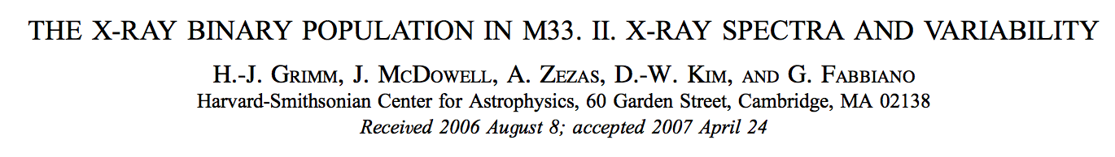
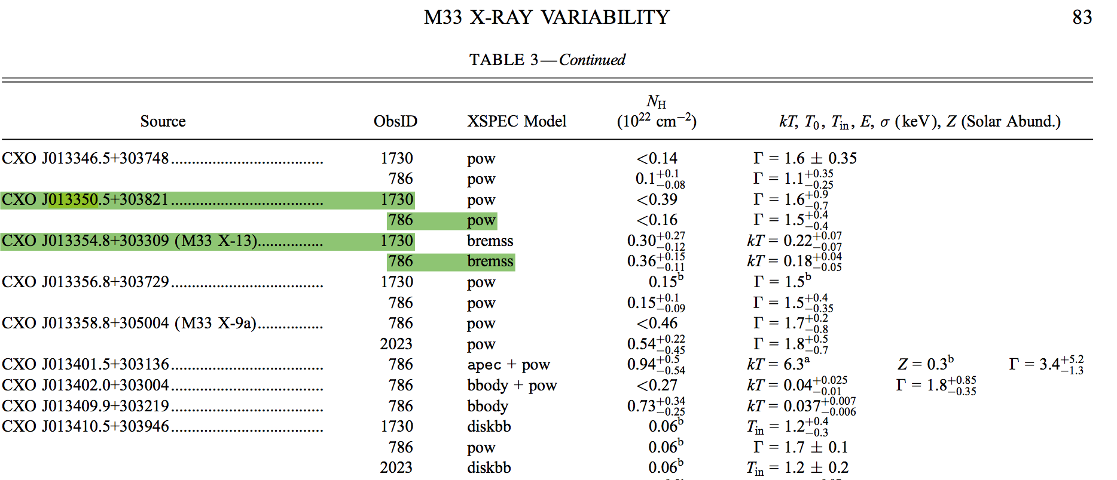

Slide 19
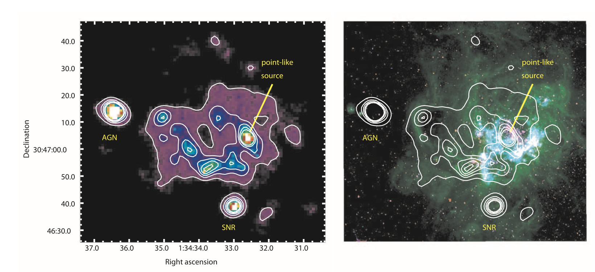
CHANDRA ACIS SURVEY OF M33 (ChASeM33): A FIRST LOOK

