Slide 1
Chandra X-ray data reduction
Lv Bing

Slide 2
Chandra Instruments
Advanced CCD Imaging Spectrometer (ACIS)
imaging wide fields (16x16 arc minutes)
High Resolution Camera (HRC)
highest spatial (<0.5 arc second) and temporal (16 msec) resolutions
largest field-of-view (31x31 arc minutes)
High Energy Transmission Grating (HETG)
Low Energy Transmission Grating (LETG)

Slide 3
M33 of chandra: a quick guide
find_chandra_obsid m33
# obsid sepn inst grat time obsdate piname target
786 0.0 ACIS-S NONE 46.3 2000-08-30 McDowell M33
787 0.0 ACIS-S NONE 9.3 2000-01-11 McDowell "M33 X-8"
1730 0.0 ACIS-I NONE 49.4 2000-07-12 McDowell M33
2023 11.7 ACIS-I NONE 88.8 2001-07-06 Damiani "NGC 604"
3948 0.0 HRC-S NONE 4.2 2003-07-29 DUBUS "M33 X-8 (NUCLEUS)"

Slide 4
M33 of chandra
# obsid sepn inst grat time obsdate piname target
6376 0.0 ACIS-I NONE 93.1 2006-03-03 Sasaki "M33 Field 1"
6377 0.0 ACIS-I NONE 92.9 2006-09-25 Sasaki "M33 Field 1"
6380 9.8 ACIS-I NONE 89.4 2005-09-23 Sasaki "M33 Field 3"
6383 9.1 ACIS-I NONE 97.8 2006-06-15 Sasaki "M33 Field 4"
6384 9.6 ACIS-I NONE 22.2 2005-10-01 Sasaki "M33 Field 5"
6385 9.6 ACIS-I NONE 90.0 2006-09-18 Sasaki "M33 Field 5"
6386 9.8 ACIS-I NONE 14.9 2005-10-31 Sasaki "M33 Field 6"
6387 9.8 ACIS-I NONE 77.3 2006-06-26 Sasaki "M33 Field 6"
6389 9.1 ACIS-I NONE 95.8 2006-11-28 Sasaki "M33 Field 7"
7170 9.6 ACIS-I NONE 41.0 2005-09-26 Sasaki "M33 Field 5"
7171 9.6 ACIS-I NONE 37.7 2005-09-29 Sasaki "M33 Field 5"
7196 9.8 ACIS-I NONE 22.8 2005-11-02 Sasaki "M33 Field 6"
7197 9.8 ACIS-I NONE 12.7 2005-11-03 Sasaki "M33 Field 6"
7198 9.8 ACIS-I NONE 21.8 2005-11-05 Sasaki "M33 Field 6"
7199 9.8 ACIS-I NONE 14.8 2005-11-06 Sasaki "M33 Field 6"
7208 9.8 ACIS-I NONE 11.5 2005-11-21 Sasaki "M33 Field 6"
7344 9.8 ACIS-I NONE 21.4 2006-07-01 Sasaki "M33 Field 6”

Slide 5
M33 data preparation
$ chandra_repro 3948 outdir=
$ dmlist 3948/primary/hrcf03948N007_evt2.fits.gz header,clean
$ ds9 3948/repro/hrcf03948_repro_evt2.fits
Create a region and save as src.reg
$ specextract "3948/repro/hrcf03948_repro_evt2.fits[sky=region(ds9_3948.reg)]" mysrc #ds9 a circle for 3948

Slide 6
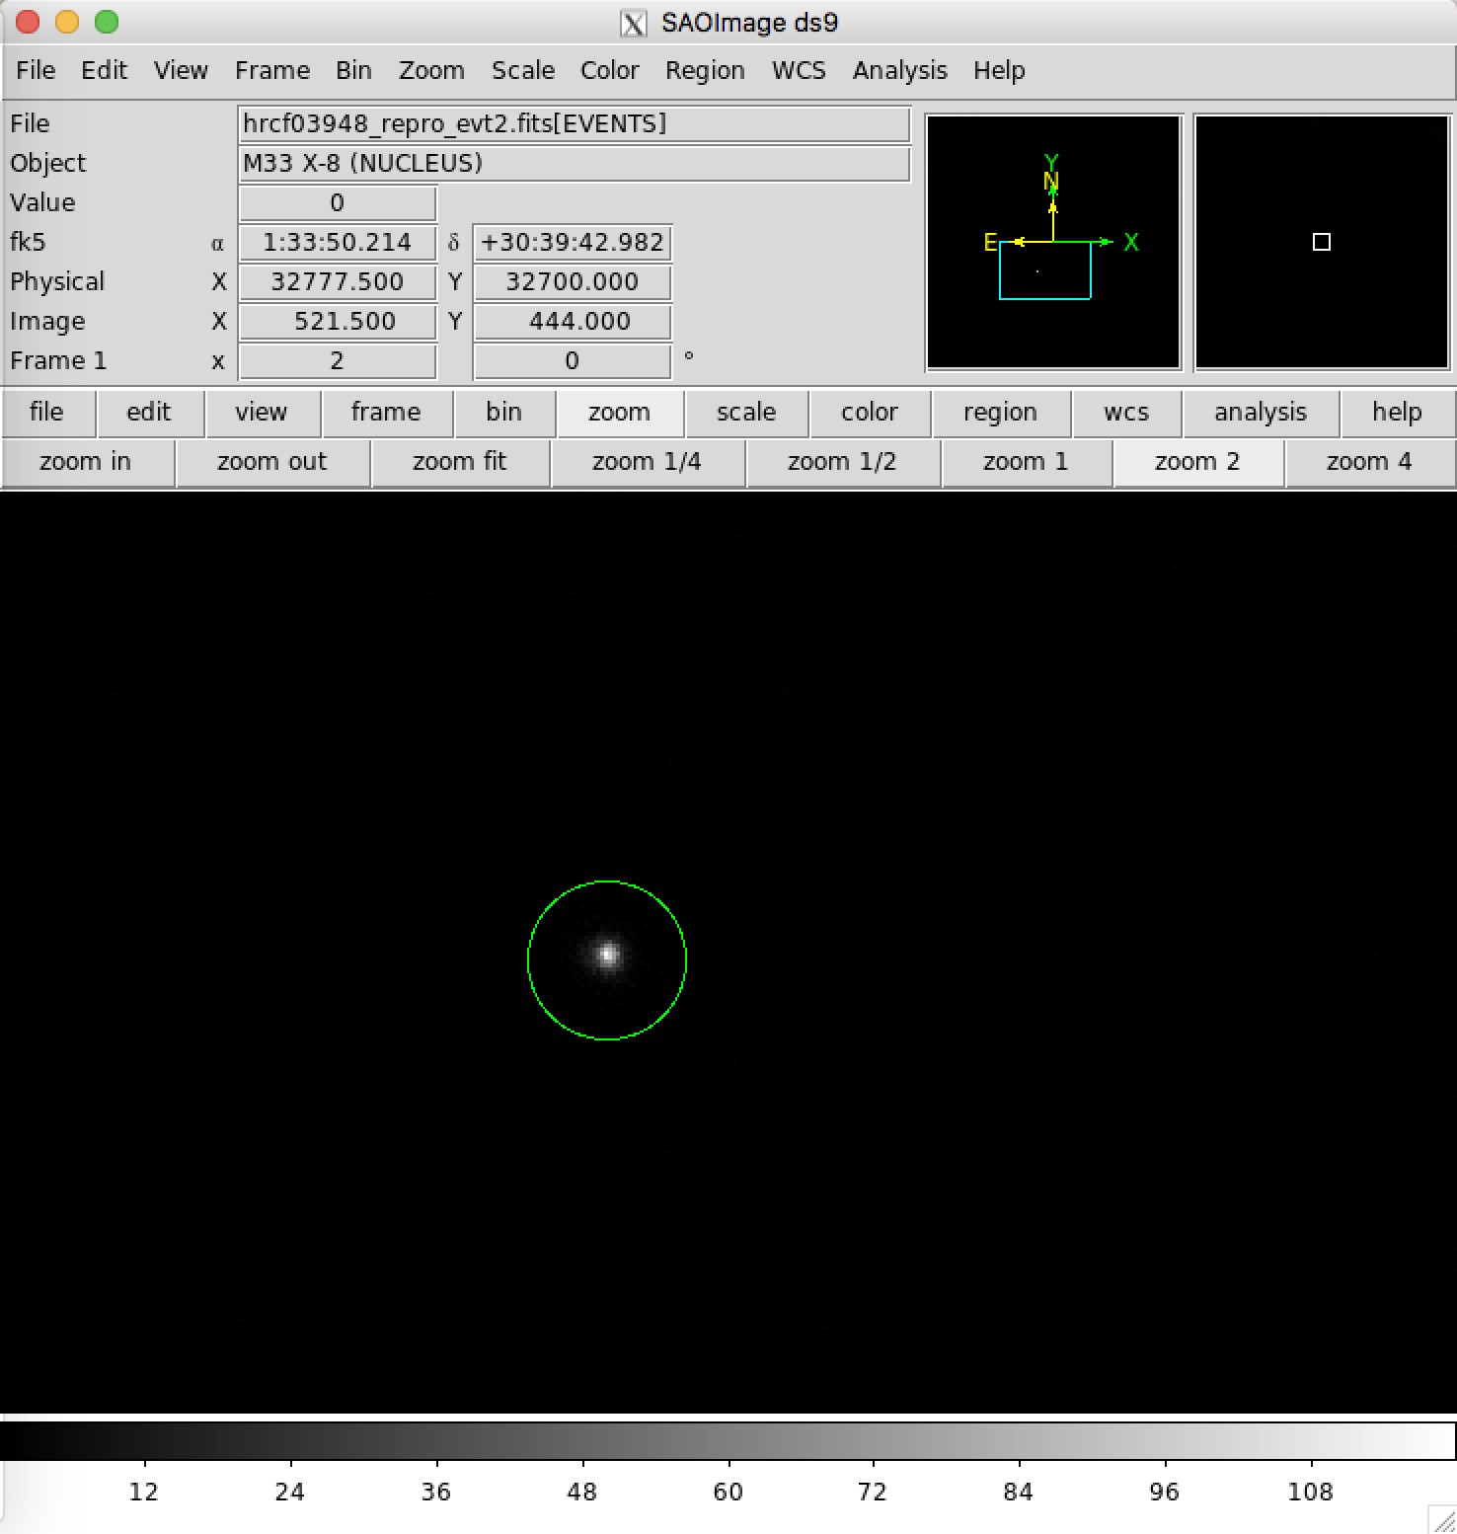
Image

Slide 7
convert count rate to flux
modelflux mysrc_0786.arf mysrc_0786.rmf emin=0.5 emax=7.0 rate=0.1 \ model='xspowerlaw.p1' paramval='p1.PhoIndex=2.0' absmodel='xsphabs.a1' absparams='a1.nH=0.02’
Model fluxes:
Rate (0.5,7)= 0.1 count s^-1
Photon Flux (0.5,7)= 0.00021129 photon cm^-2 s^-1
Energy Flux (0.5,7)= 4.9819e-13 erg cm^-2 s^-1
Unabsorbed model fluxes:
Rate (0.5,7)= 0.10629 count s^-1
Photon Flux (0.5,7)= 0.00022667 photon cm^-2 s^-1
Energy Flux (0.5,7)= 5.1629e-13 erg cm^-2 s^-1

Slide 8
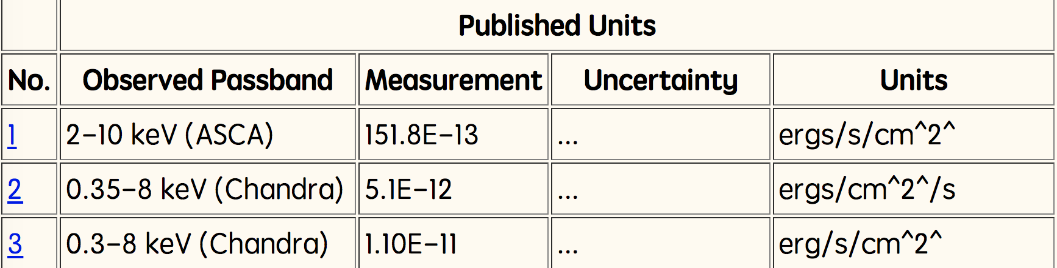
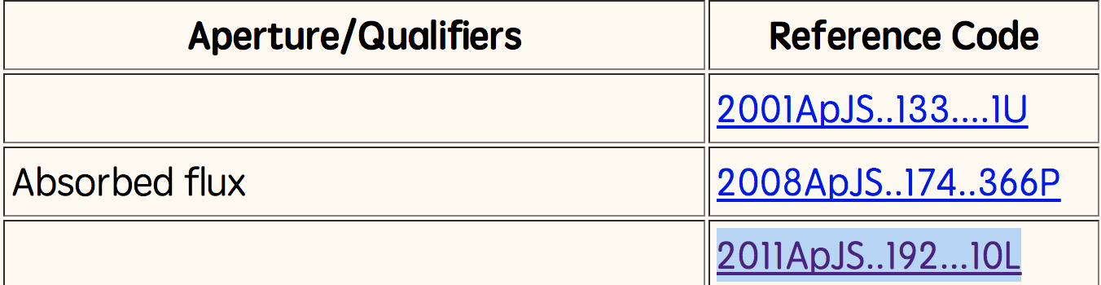
Data from NED for M333

Slide 9
estimate the flux for a point-like source
srcflux 786/repro/acisf00786_repro_evt2.fits '01:33:50,+30:39:36’ mysrc_0786
Summary of source fluxes
Position 0.5 - 7.0 keV
Value 90% Conf Interval
#0001|1 33 50.00 +30 39 36.0 Rate 6.82E-05 c/s (0,0.000174)
Flux 1.56E-15 erg/cm2/s (0,3.99E-15)
Mod.Flux 3.54E-16 erg/cm2/s (0,9.04E-16)
Unabs Mod.Flux 3.9E-16 erg/cm2/s (0,9.94E-16)

Slide 10
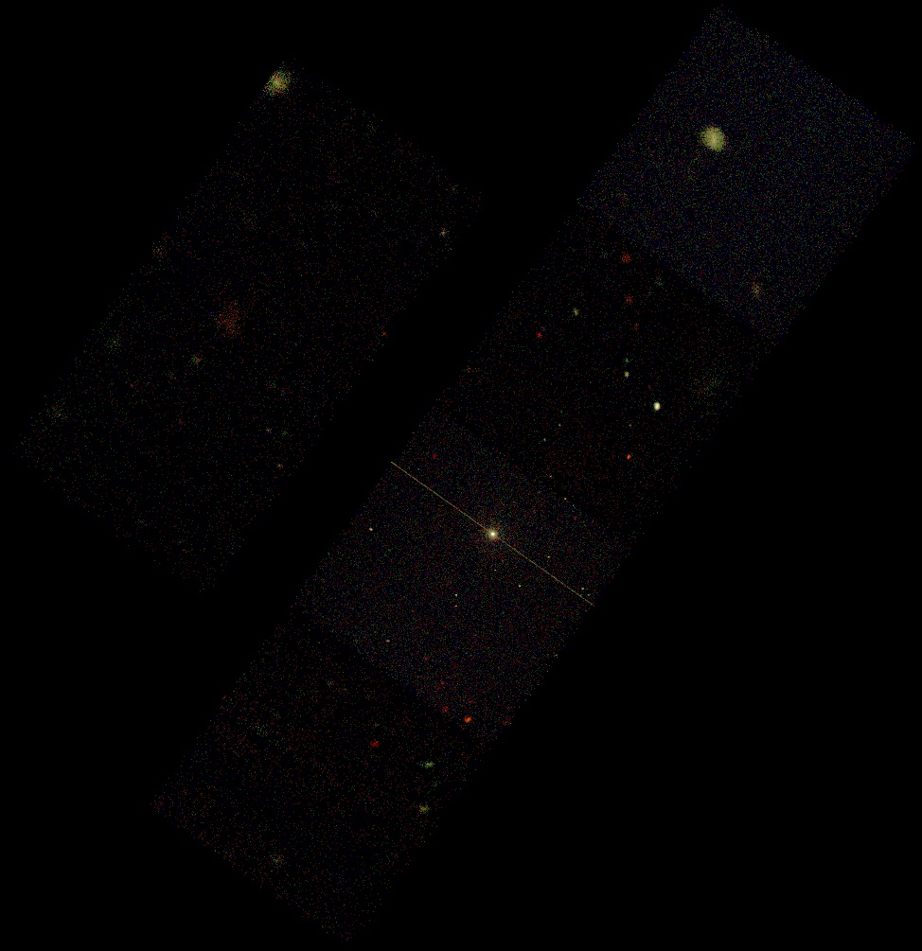
Create 3 color (RGB) image

Slide 11
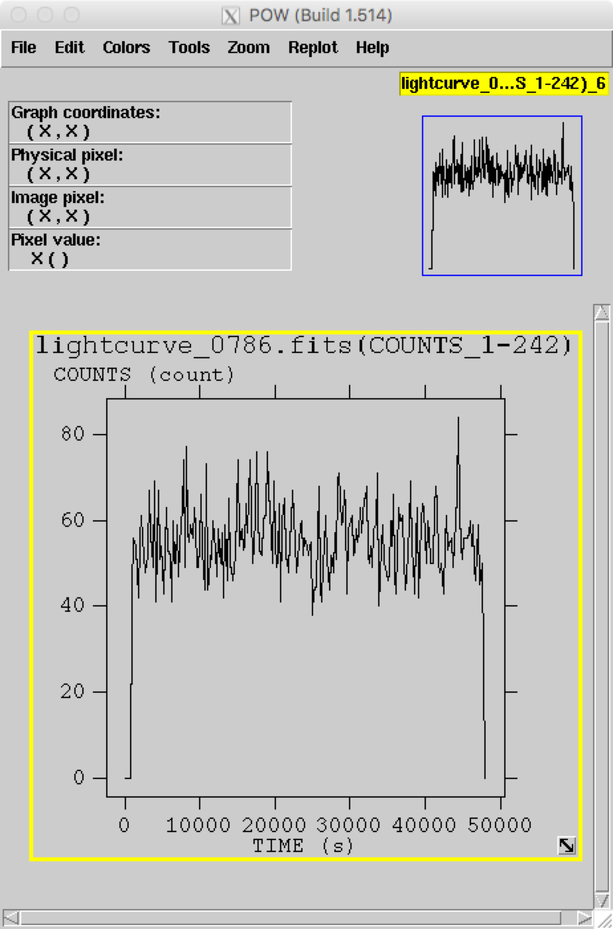
Light Curve

Slide 12
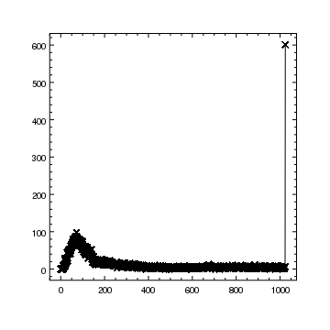
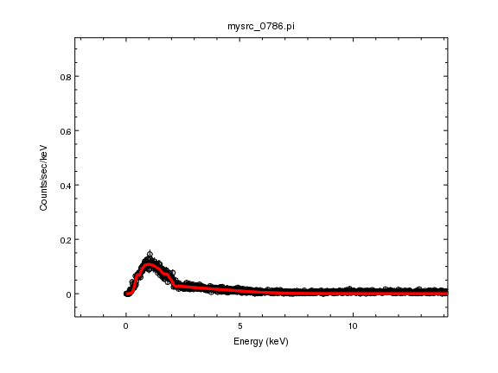
Spec fit plot

Slide 13
sherpa
load_data("mysrc_0786.pi")
read ARF file mysrc_0786.arf
read RMF file mysrc_0786.rmf
sherpa-2> set_source(xsphabs.a1*xspowerlaw.p1)
sherpa-3> a1.nH=0.1
sherpa-4> freeze(a1)
sherpa-5> fit()
Dataset = 1
Method = levmar
Statistic = chi2gehrels
Initial fit statistic = 1.6614e+11
Final fit statistic = 1752.67 at function evaluation 16
Data points = 1024
Degrees of freedom = 1022
Probability [Q-value] = 2.67753e-41
Reduced statistic = 1.71494
Change in statistic = 1.6614e+11
p1.PhoIndex 1.24797
p1.norm 0.000230253

Slide 14
plot_fit()
conf()
p1.PhoIndex lower bound:-0.0193801
p1.norm lower bound:-3.29055e-06
p1.PhoIndex upper bound:0.0193801
p1.norm upper bound:3.29055e-06
Dataset = 1
Confidence Method = confidence
Iterative Fit Method = None
Fitting Method = levmar
Statistic = chi2gehrels
confidence 1-sigma (68.2689%) bounds:
Param Best-Fit Lower Bound Upper Bound
----- -------- ----------- -----------
p1.PhoIndex 1.24797 -0.0193801 0.0193801
p1.norm 0.000230253 -3.29055e-06 3.29055e-06

Slide 15
