Slide 1

PowerShell & Microsoft Teams Slack who?!
Administration, notifications and Bots

Slide 2





$aboutMe = 'Brett Miller'
$Stats = @{
= ‘Senior SysAdmin at OpenText'
= '3 Years(ish) PS Trial & Error'
= '@BrettMiller_IT'
= 'https://github.com/brettmillerb'
= 'https://millerb.co.uk'
}
Notes:
OpenText for another 2 days.
Live Services Engineer for Sage

Slide 3
$Agenda
Microsoft Teams - What is it?
Powershell Administration Module
Webhooks
Bots (PoshBot - Brandon Olin @devblackops)
Questions ??

Slide 4
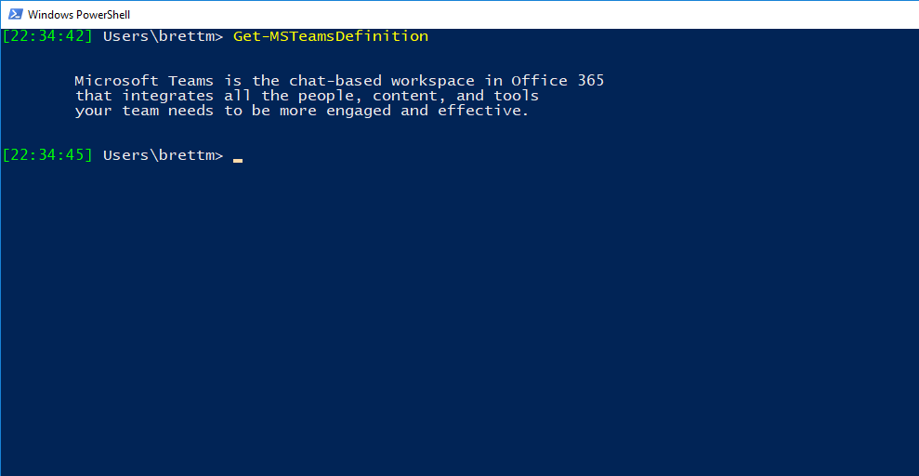
$whatIsMicrosoftTeams?
Notes:
Microsoft Teams is the chat-based workspace in Office 365 that integrated all the people, content and tools your team needs to be more engaged and effective.
It’s basically Microsoft’s version of Slack ☺
It comes free with most O365 levels of license and there is a roadmap for it to replace skype entirely.
It works in tandem with O365 groups and you get a group and sharepoint backend site/area for each time configured.

Slide 5
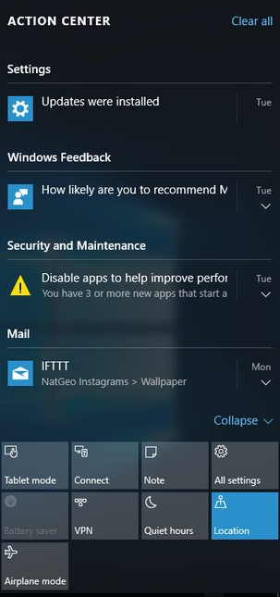


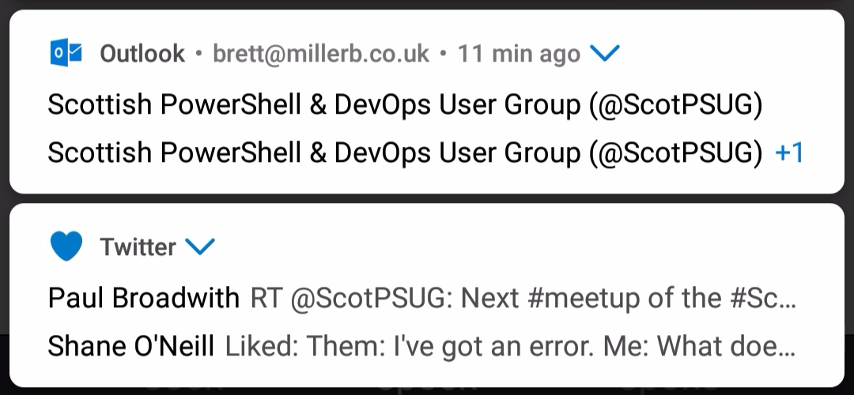
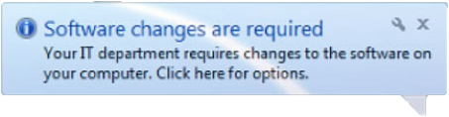

$notificationBombardment
$Tools = @(
'Slack',
'Teams',
'IRC',
'Skype',
'Email'
'Tickets',
'Phone',
'Console'
)
Notes:
Every day we’re bombarded from all angles with notifications vying for our attention.
Wouldn’t it be nice to have a single pane of glass?
Somewhere we can work happily from most of the day?
My wife also pointed out whilst I was sat creating this slide that the title looks like snotification bombardment! ☺

Slide 6
'MicrosoftTeams Module'
First iteration was terrible
Get-Team only returned teams you were a member of, pointless as an admin!
Functionality was limited and lots of errors
ObjectId or GUID are frequently used to identify teams or O365 groups ☹
Still limited functionality but good progress
Means you end up writing your own scripts/modules to wrap the existing commands
Notes:
First version was 0.9 and was terrible
Second iteration was 0.9.1 which was slightly better but still error prone
Newest version added the required functionality to Get-Team for admins \o/
But!!! There is no server side filtering and you have to return all teams and filter with Where-Object ☹

Slide 7
$QuickDemo

Slide 8
'Incoming Webhooks’
Useful for sending static cards to a channel
Output of automation scripts/notifications
SolarWinds/New Relic etc
support JSON HTTP POST commands
Can have multiple for different purposes
Totally customisable
Notes:
Webhooks are ideal for sending output of scripts or notifications from systems which support HTTP Post
SolarWinds notifications
Customisable as it is essentially just JSON
Limited authentication required. Good/Bad
Don’t commit webhook to Github ☺

Slide 9
$QuickDemo

Slide 10
'PoshBot - ChatOps’
Poshbot is a Powershell Module
Available in PSGallery
Class-based (PS 5+)
Uses Powershell Modules as commands
Modules from PSGallery or internal Repository
Builtin RBAC
Slack / Teams / Gchat
Windows PowerShell & Core
Notes:
First version was 0.9 and was terrible
Second iteration was 0.9.1 which was slightly better but still error prone
Newest version added the required functionality to Get-Team for admins \o/
But!!! There is no server side filtering and you have to return all teams and filter with Where-Object ☹

Slide 11
$QuickDemo

Slide 12
$Questions

Slide 13
$Contact = @{
Twitter = '@BrettMiller_IT'
Github = 'https://github.com/brettmillerb'
PsSlack = 'powershell.slack.com'
UkSlack = 'getpsuguk.slack.com'
Blog = 'https://millerb.co.uk'
}

