Slide 1
Useful Notifications with Microsoft Teams
Interact, collaborate and ChatOps
Notes:
Chatops is a thing (apparently)

Slide 2


About Me – Brett Miller
System Administrator at OpenText
2 Years(ish) Powershell Experience Trial & Error
Twitter – @BrettMiller_IT
GitHub – https://github.com/brettmillerb
Notes:
Been at OpenText since October 2017
Worked for Balfour Beatty prior to that
Technically a Senior SysAdmin but only because I’m grey at 31

Slide 3


Do we use and love Slack?
Collaboration Tools
Do we have to use Teams?
Notes:
We all love and have been using Slack
Lots of community channels for SQL DBATools, Powershell, MacAdmins (weirdos), InfoSec type teams
Teams a little bit behind the curve in terms of publicly accessible but enterprise adoption.
Free with O365 licenses

Slide 4
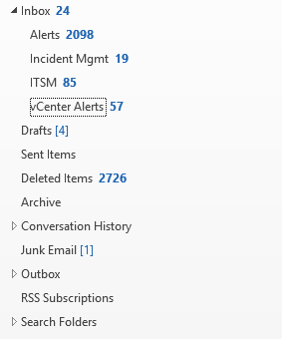
Who has an inbox like this?
Notes:
Pro-active Monitoring
OMS
Zabbix
SCOM
Incident Mgmt Notifications
Outages and Technical Bridges
ITSM Ticket reminders
Tickets assigned
Tickets Updated
Tickets close to SLA
Other Miscellaneous Stuff

Slide 5
Useful Notifications with MSTeams
Incoming Webhooks
Outgoing Webhooks (New)
Emailing channels (a bit rubbish)
Bots and the Bot Framework
Notes:
Incoming Webhooks have been around since GA (What I will focus on)
Outgoing Webhooks announced two weeks ago
Name (Name of Bot) - @Mention
Callback URL (Endpoint to receive Messages)
Description
Profile Pic
Email channels GA – bit rubbish
Bots and Bot Framework GA

Slide 6
Incoming Webhook
You can have as many incoming webhooks as you like (I think)
Webhooks are on a per channel basis
Ways to interact with your webhook
Zapier (Webform)
Nintex Workflow Cloud
Powershell
It’s not an email
Notes:
Nintex Workflow Cloud
Zapier
Don’t know what either of these things are!
POWERSHELL!!!

Slide 7
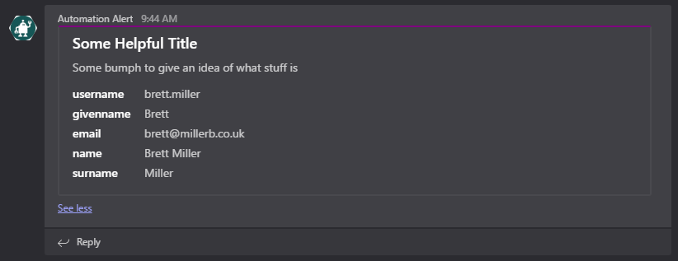
Demo Stuff

Slide 8
Questions?

Slide 9
Links and Things
Twitter - @BrettMiller_IT
Demo Code - https://github.com/brettmillerb/Presentations
Project - https://github.com/brettmillerb/msteams
Get-PSUGUK - get-psuguk.slack.com
Powershell - powershell.slack.com

