Slide 1

EDGE Solvers using BFloat16
Shima Bani

Slide 2
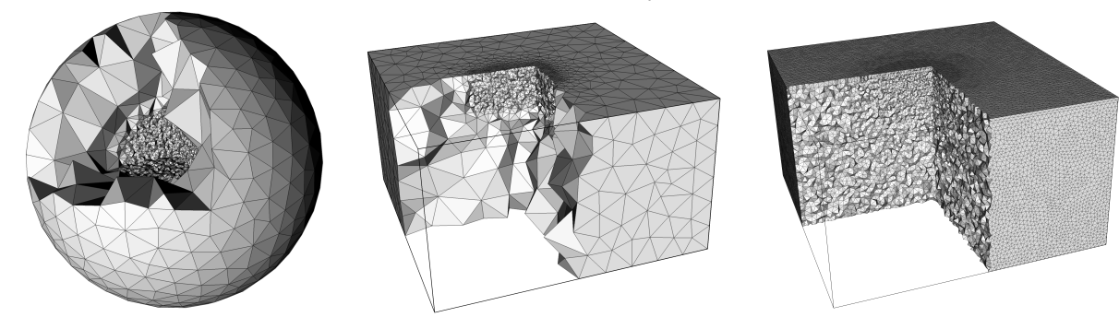
EDGE​
Breuer, Alexander, Alexander Heinecke, and Yifeng Cui. "EDGE: Benchmarking the Seismic Wave Propagation Solver." Proceedings of the 11th National Conference in Earthquake Engineering, Earthquake Engineering Research Institute, Los Angeles, CA. 2018.
Extreme-Scale Discontinuous Galerkin Environment (EDGE) EDGE is a software framework designed for solving partial differential equations (PDEs) using the discontinuous Galerkin (DG) method.
A specific type of PDEs that EDGE is designed to handle are wave equations.​
Considering wave propagation through materials that exhibits elastic and inelastic (anelastic) behaviors.​
EDGE solves the three-dimensional wave equations in velocity-stress form.​
The solver uses unstructured tetrahedral meshes for spatial discretization and a sophisticated grouped local time stepping scheme to advance the Degrees of Freedom (DOFs) in time.
The numerical discretization in EDGE is split into a time kernel, a volume kernel, and a surface kernel.

Slide 3
The DG method is a numerical technique for solving PDEs that discretizes the domain into smaller elements and approximates the solution using piecewise polynomials within each element.
It is particularly well-suited for problems with complex geometries, discontinuities, and high-order accuracy requirements. such as fluid dynamics, solid mechanics, electromagnetics
EDGE provides a software environment that enables researchers and engineers to develop and run DG-based simulations.
Wave equations in a medium with both elastic and inelastic effects describe the propagation of waves through a material that exhibits both elastic and inelastic behaviors. These equations are commonly used in various fields such as seismology, acoustics, and materials science.
Elastic effects refer to the behavior of a material where it can undergo deformation under stress but can return to its original shape when the stress is removed. In the context of wave propagation, elastic effects determine the speed and nature of the waves, such as the speed of sound or the propagation of seismic waves through solid materials.
Inelastic effects, on the other hand, involve the dissipation of energy within the material due to various mechanisms like internal friction, hysteresis, or irreversible deformations. These effects result in the attenuation or damping of waves as they propagate through the medium.
When both elastic and inelastic effects are present, the wave equations must take into account the interplay between these two behaviors. This typically involves incorporating additional terms or parameters that represent the dissipation or energy loss within the material.

Slide 4
The specific form of the wave equations in a medium with both elastic and inelastic effects depends on the nature of the material, the type of waves being considered, and the mathematical model being used. Different approaches, such as viscoelastic or anelastic models, may be employed to describe the combined behavior of the material accurately.
Understanding wave equations in such mediums is crucial for applications like earthquake seismology, where the presence of both elastic and inelastic effects plays a significant role in characterizing seismic wave propagation and predicting ground motion. Additionally, it is relevant in the study of wave attenuation, material characterization, and the behavior of waves in complex media with varying degrees of elasticity and inelasticity.
This statement describes the methodology used by the solver to solve a problem using unstructured tetrahedral meshes and a grouped local time stepping scheme.
Unstructured tetrahedral meshes refer to a discretization technique where the computational domain is divided into tetrahedral elements that do not have a regular or structured arrangement. These meshes are flexible and can represent complex geometries more accurately than structured meshes.
The solver utilizes these unstructured tetrahedral meshes for spatial discretization. This means that the domain is divided into a collection of tetrahedra, and the equations governing the problem are solved within each tetrahedral element.
To advance the Degrees of Freedom (DOFs) in time, the solver employs a sophisticated grouped local time stepping scheme. DOFs represent the variables or unknowns in the problem that need to be solved for at each point in space and time. The solver updates these DOFs over time to simulate the evolution of the problem.
The grouped local time stepping scheme is a method that allows for different time steps to be used in different regions of the computational domain. Instead of using a uniform time step throughout the entire domain, the solver adapts the time step locally based on the requirements of each region. This can improve computational efficiency by allowing smaller time steps in regions that require more accuracy or have rapidly changing phenomena, while larger time steps can be used in more stable or less dynamic regions.
Overall, this approach combines the use of unstructured tetrahedral meshes for spatial discretization with a grouped local time stepping scheme to efficiently solve the problem by accurately representing complex geometries and adapting the time step locally to optimize computational efficiency.

Slide 5
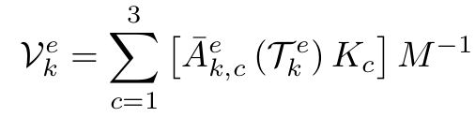
Example
The elastic version of the volume kernel:
T ∈ R^{9×B}
k _{(parameter)}
Ā ∈ R^{9×9}
K ∈ Q^{B×B} with c ∈ {1, 2, 3}
M⁻¹ ∈ Q^{B×B}
Notes:
T ∈ R9×B: The time-integrated DOFs which are the result of the time kernel
k (parameter) is the identifier of the considered tetrahedron.
Ā ∈ R9×9: Element-local linear combinations of the elastic Jacobians.
K ∈ QB×B with c ∈ {1, 2, 3}: Three stiffness matrices defined by means of a unique reference tetrahedron.
M−1 ∈ QB×B: Inverse of diagonal mass matrix.

Slide 6
Single precision floating point
A normalized FP32 number:
Simulations in EDGE use normalized FP32 numbers.
The use of the FP32 precision for storing data and all computations has been extensively verified in various benchmarks accessing the accuracy of seismic solver.
1 bit 8 bits 23 + 1 bits
Sign
Exponent
Mantissa

Slide 7
In structural analysis and mechanics, the stiffness matrix is a mathematical representation of the stiffness of a structure or system. It is also known as the flexibility matrix in some contexts. The stiffness matrix describes the relationship between the forces acting on a structure and the resulting displacements.​​
The stiffness matrix is typically used in finite element analysis (FEA) and other numerical methods to solve complex structural problems. It allows engineers to break down a complex structure into smaller elements and analyze their behavior individually.​​
​​
In a two-dimensional system, the stiffness matrix is a 4x4 matrix, while in a three-dimensional system, it becomes a 6x6 matrix. The values in the stiffness matrix represent the stiffness coefficients or spring constants of the structure or system. These coefficients quantify how the forces applied to the structure translate into displacements or deformations.​​
The stiffness matrix is derived from the properties of the individual elements and their connectivity within the structure. The assembly of all element stiffness matrices results in the global stiffness matrix, which represents the overall stiffness of the structure.​​
Once the stiffness matrix is established, it can be used to solve for the displacements, strains, stresses, and other structural responses of interest. By applying appropriate boundary conditions and external loads, engineers can analyze the behavior of structures under various conditions and make informed design decisions.​​
This means that the used CPUs operate in flush-to-zero (FTZ) and denormals-are-zero (DAZ) mode.​​

Slide 8
a growing number of CPUs and SoCs are being equipped with on-chip matrix engines targeting AI workloads.
Often times these matrix engines operate on BF16 input matrices and accumulate the resulting matrix matrix product in FP32 precision.
a BF16 number has one bit for the sign, 8 bits for the exponent and 7 bits for the fraction. normalized BF16 numbers, meaning that we assume a total of 8 mantissa bits.
Using matrix instructions on BF16 data may significantly increase the respective floating-point throughput over traditional FP32 fused-multiply-add vector instructions.

Slide 9
the theoretical throughput increases by 16 × when using BF16 matrix instructions over FP32 vector instructions. In the case of AWS’s Graviton3 processor a theoretical increase of 4 × is possible. with little impact on the accuracy.
“simply” requires an updated software backend
Instead, we present a novel approach which splits the FP32 operations into multiple BF16 operations for increased accuracy.

Slide 10
The general idea of our approach is to temporarily split the FP32 DOFs and time integrated DOFs into multiple BF16 numbers
truncates the lowest 16 bits
Example
1.7845 = 00111111111001000110101001111111
Truncate
1.78125 = 00111111111001000000000000000000
1.7845 - 1.78125 = 0.00325 ≈ 00111011010100110000000000000000 (0.00321960449219) 0.00323486

Slide 11
We showed that with about eliminating the 10 bits an just keeping 14 bits (2 BF16 we can get a comparable accuracy for representing each fp32 value)

Slide 12
EDGE’s performance heavily relies on small matrix-matrix multiplications
C = AB
A might represent the time integrated DOFs Tke of element k and B a stiffness matrix Kc
Our approach exploits that all of B’s entries are rational numbers.
A rational number can be written as the fraction p/q of the two integers p and q with q ̸= 0.

Slide 13
B:,2 = (− 1/18, 2/1 , 1/10 , 1/15 , 3/8 ). In that case only 2/1 and 3/8 can be stored exactly as BF16 or FP32 numbers other is not possible because of rounding mainly.
− 1/18 = −0.055555556
2/1 = 2
1/10 = 0.1
1/15 = 0.066666667
3/8 = 0.375

Slide 14
The first step of our scaling approach performs a prime factorization of the denominators.
B:,2 = (− 1/ 2·3·3 , 2/1 , 1/2·5 , 1/3·5 , 3/ 2·2·2)
Next, we derive a minimal scaling factor such that all prime numbers in the denominators except 2 cancel out. s2 = 3 · 3 · 5 = 45
s2 =(− 5/2 ,90/ 1 , 9/ 2 , 3/ 1 , 135 /2·2·2 ).
The scaled example column can be stored exactly using BF16 numbers.

Slide 15
In the general case we apply the scaling procedure for every of B’s columns and obtain the n factors s1 , . . . , sn. S = diag(s1 , . . . , sn )
B ∗ = BS
C = AB = ABSS ⁻¹ = (AB∗ ) S ⁻¹
splitting matrix A into L BF16 matrices
(AB ∗ ) S −1 = sigma l=1... L Al B ∗ S −1 . 1 ≤ L ≤ 3

Slide 16
For the ADER-DG solver EDGE, we might not be able to store all values B ∗ exactly using the BF16 format.
This case might occur when a numerator became too large after the scaling procedure.
For example
assume that q = 2 · 2 · 2 for a scaled number, then:
p/q = 2⁻³ · p
A BF16 number has 8 mantissa bits (including hidden bit) which means that all scaled numbers with p < 256 can be represented exactly.
For p = 255 all mantissa bits in the BF16 format are set to 1
p = 257 is the first numerator for which BF16 is insuﬀicient.

Slide 17
Ways to handle
First, we may simply follow the approach and split B ∗ into multipleBF16 matrices.
A two-way split is suﬀicient for all rational matrices considered in this work.

Slide 18
Second, we might follow a more selective approach.
For this we analyze B ∗ ’s rows and only select those which cannot be stored exactly in the BF16 format.
For example, assume this is the case for rows three and seven of matrix B ∗
B ∗∗ = BF 16 (B ∗ ) , B3,:− BF 16(B3,:), B7,:− BF 16(B7,:) .
Now, if all of B ∗∗ ’s values can be stored in BF16, we would simply add respective columns to Al
Ãl = BF 16 (Al ) , Al3,: − BF 16(Al3,: ), Al7,: − BF 16(Al7,: )
Notes:
If the added rows of B ∗∗ can be represented in the BF16 format, we have
found a way to recover the lost precision. Since B ∗ ∗ is derived upfront for our
workload, the overhead is limited to a gather operation on matrices Al during the
split procedure and a respectively increased reduction dimension K in the small
matrix-matrix multiplications.

Slide 19
If the added rows of B ∗∗ cannot be represented in the BF16 format, one would proceed with a third level accordingly.
However, this case does not occur for any of the scaled rational matrices used in this work.

Slide 20
BF16 matrix engines for the matrix-matrix multiplications in EDGE’s time, volume and local part of the surface kernel which involve a rational matrix.
Assuming O = 5 for EDGE’s elastic volume kernel, we have B(5) = 35.
However, the stiffness matrices Kc have a zero block starting at row 20
we obtain m = 20, n = 9 and k = 35
Total of 3 ·20 · 9 · 35 · 2 = 37, 800 FP32 FLOPS which are replaced by our BF16 approach
The multiplications with matrices Āek,c requires another 3 · 20 · 9 · 9 · 2 = 9, 720 FP32 FLOPS which remain in FP32 arithmetic.
In summary, our approach replaces about 80% of the FP32 FLOPS by computations using BF16 matrix engines.

Slide 21
3d plane
The highly synthetic three-dimensional plane waves setup tests the convergence properties of elastic wave propagation solvers
These waves propagate diagonally through the cubic computational domain at constant speeds.

Slide 22
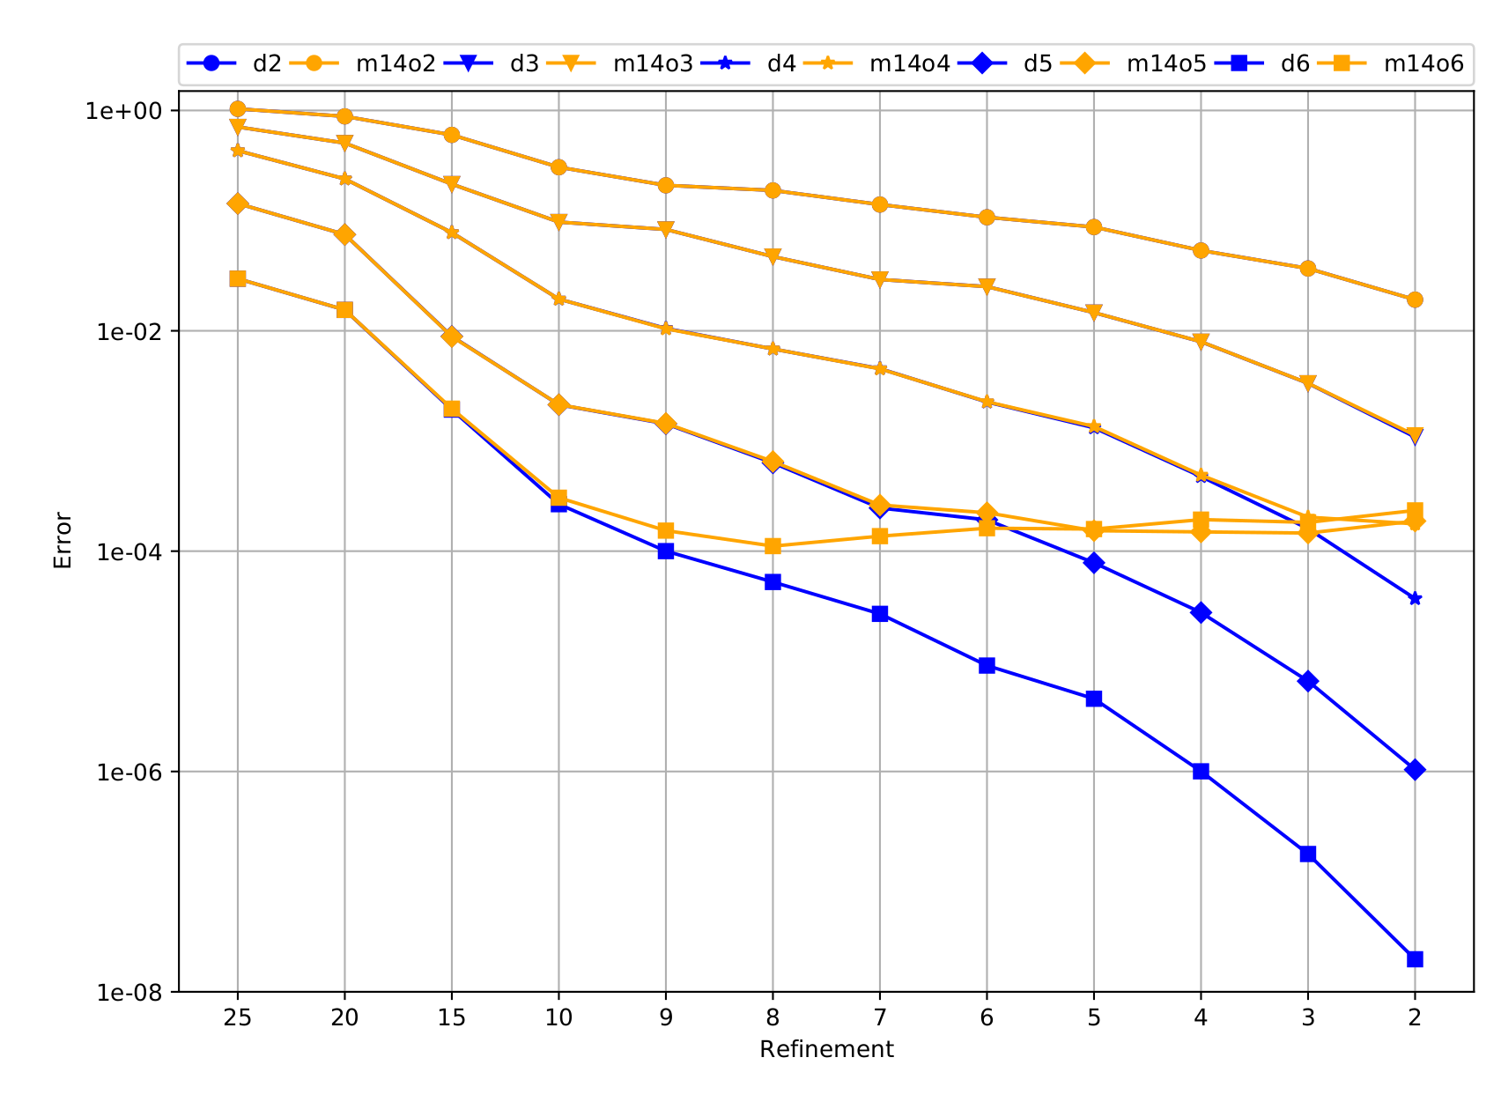
Plane wave 3D

Slide 23
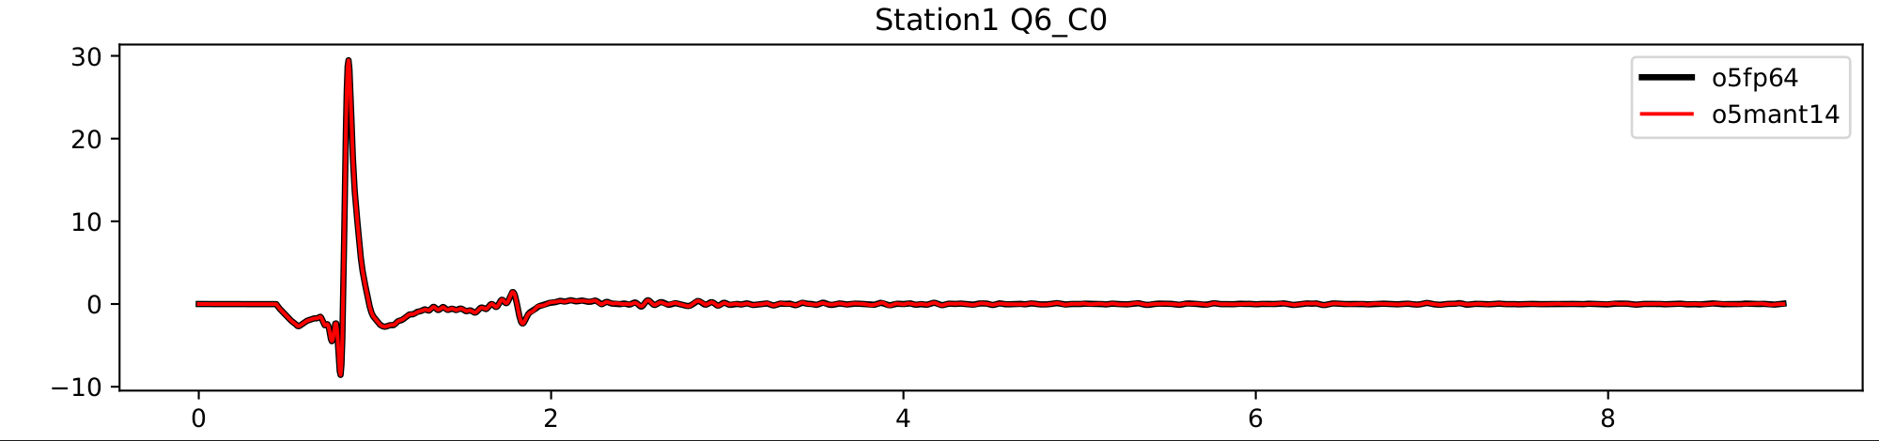
Loh1 - Layer Over Halfspace 1

Slide 24
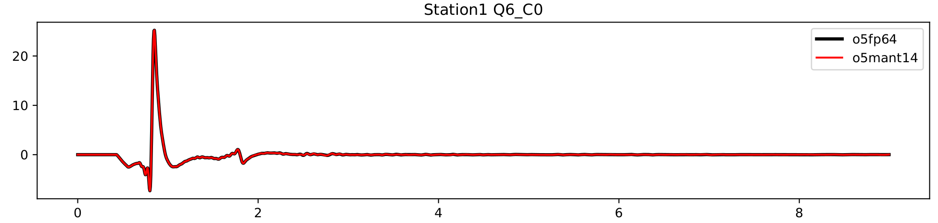
Loh3 - Layer Over Halfspace 3

Slide 25
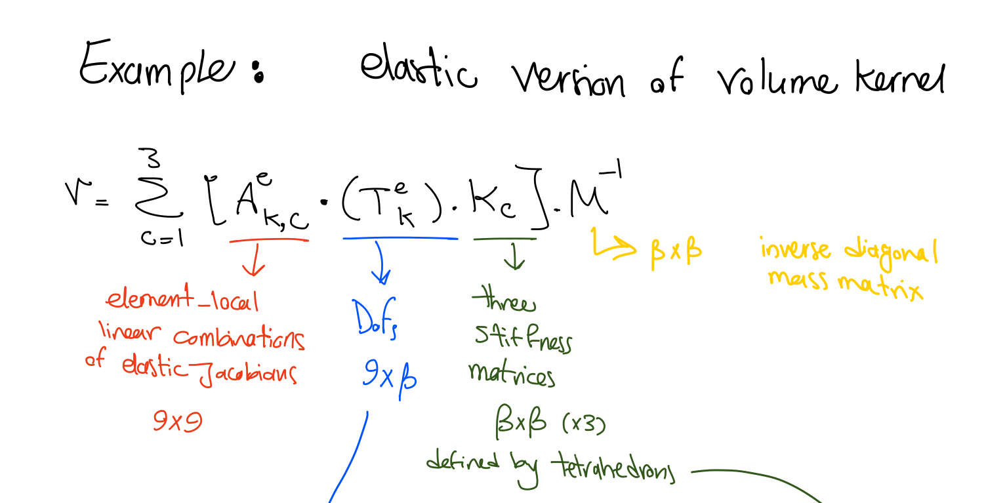


Summary

Slide 26
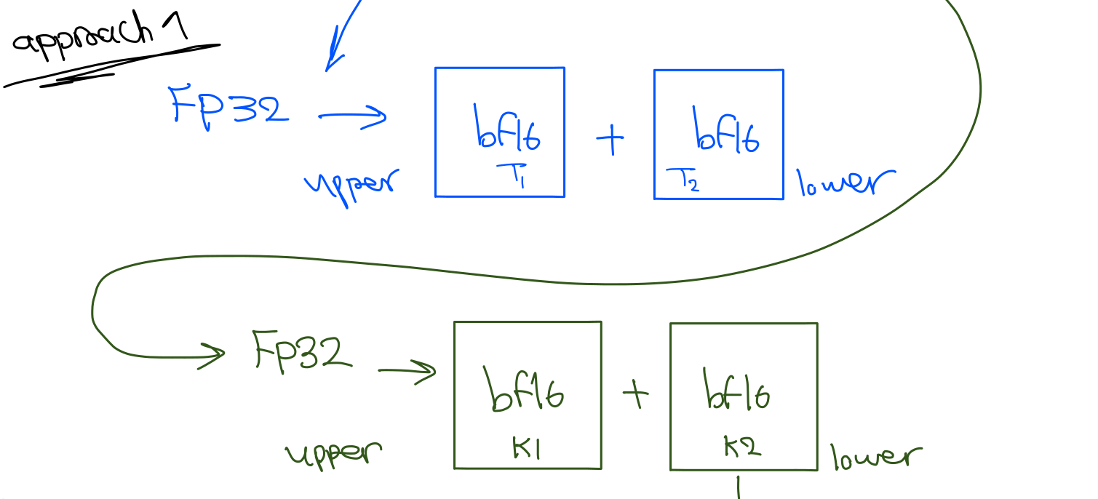





Slide 27
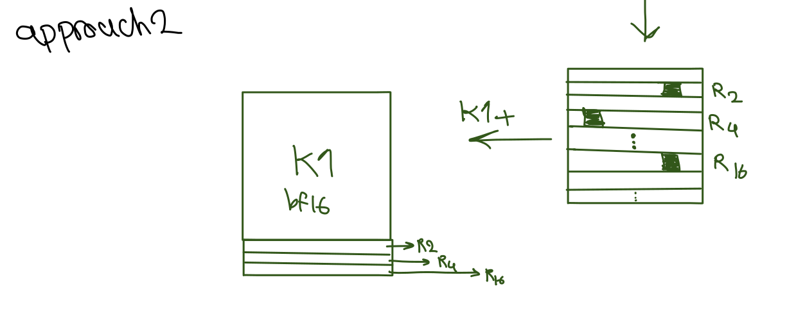



Slide 28
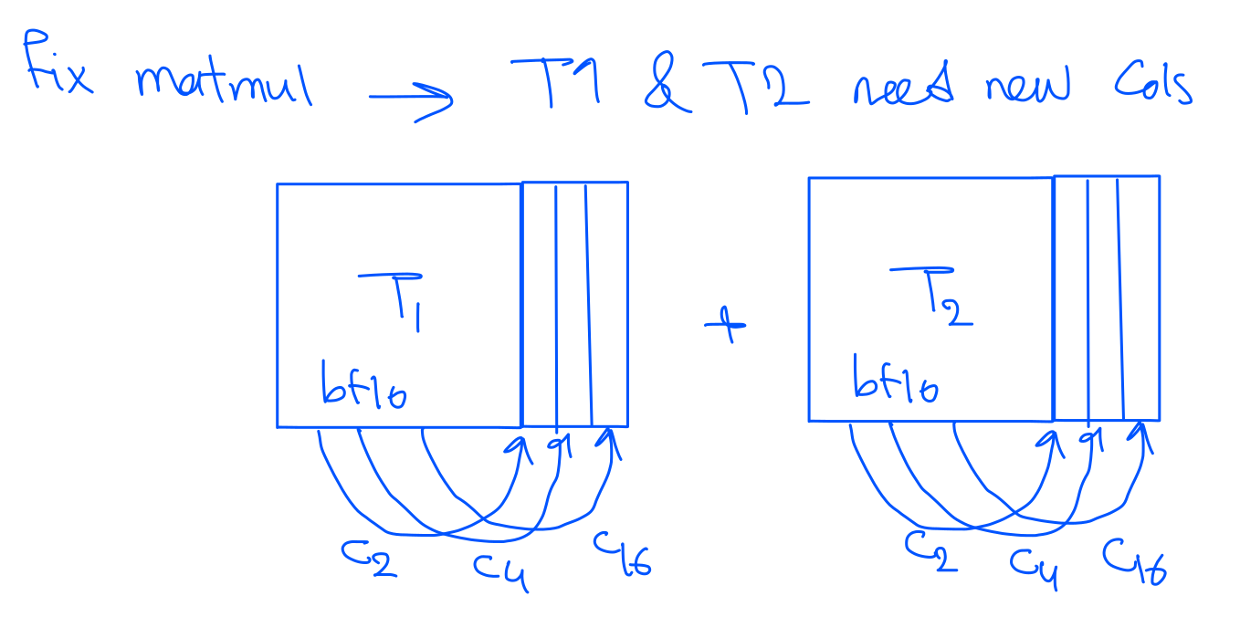

Slide 29
