Slide 1

PSP (JAVA) • COURSE CODE 26SC1101E
Blood Bank Inventory
& Donor Matcher
A Java console application for donor records, inventory tracking and compatibility-based stock lookup
TEAM 07
B. Revanth Kumar | 2620030100
B. Naga Chaitanya | 2620030407
P. Rohan | 2620030090
PROJECT COVERAGE
CO1
CO2
CO3
CO4
CO5
CO6
Java basics
Control flow
Arrays & methods
OOP & errors
Files & strings
Collections & streams
K L Deemed to be University • Problem Solving Using Programming (Java)
11/10/2026
Blood Bank Inventory & Donor Matcher
1
Notes:
Introduce the project as Team 07’s Java console application. State the three team members and describe the progression from CO1–CO3 fundamentals to CO4–CO6 object-oriented design, files, collections and streams. Explain that this is an academic prototype, not a clinical transfusion system.

Slide 2
Abstract
A small console-based system for organizing donor details and available blood stock
The Blood Bank Inventory & Donor Matcher is a Java-based application developed to simplify the management of donor information and blood-group records. The system allows users to enter and store donor names and blood groups in an organized manner.
It provides a simple way to view donor details and search for donors based on a required blood group. This reduces the time and effort needed for manual searching of donor records, especially when a matching blood group is required.
The project demonstrates important Java programming concepts such as arrays, variables, Scanner input, loops, conditional statements, searching, and array traversal. Overall, the application provides a simple and organized approach to maintaining donor records and finding matching donors
11/10/2026
Blood Bank Inventory & Donor Matcher
2
Notes:
The original abstract identifies donor management, stock tracking, compatibility matching, issue/donation activities and reports as project goals. The implementation is a Java console application with text-file persistence. Distinguish implemented functionality from future ideas such as SMS dispatch alerts or online reservations.

Slide 3
Understanding the Problem Statement
Translate a real workflow into a repeatable program
01 DONOR LOOKUP
02 STOCK ORGANIZATION
03 EXPIRY & LOW STOCK
04 COMPATIBILITY
Searching a paper list manually takes time when a blood group is needed.
Units, batch IDs and expiry dates must be stored consistently.
Staff need visibility into scarce or soon-to-expire batches.
A recipient request must be checked against available compatible stock.
PROBLEM → PROGRAM
Enter
records
Validate
input
Store
records
Search /
match
Issue /
report
→
→
→
→
PROJECT OBJECTIVE
Reduce manual searching and keep donor, batch, expiry and issue records organized in a single, maintainable Java program.
Expected benefit: better organization and faster record lookup in a prototype — not a claim of clinical safety or measured hospital impact.
11/10/2026
Blood Bank Inventory & Donor Matcher
3
Notes:
Explain the four pain points represented on this slide and follow the five-step flow. The program accepts records, validates fields, persists data, searches compatible stock, and produces issue/report output. The intended benefit is reducing manual effort in a learning prototype; do not claim real clinical outcomes.

Slide 4
CO1 — Java Foundations & IPO
CO1: Translate a real-world problem into an algorithm and Java program using data types, expressions and console I/O
BLOODBANK.JAVA — ADD DONOR EXCERPT
DATA TYPES
System.out.print("Enter donor ID: ");
String id = sc.nextLine();
System.out.print("Enter donor name: ");
String name = sc.nextLine();
System.out.print("Enter age: ");
int age = sc.nextInt();
sc.nextLine();
String group = sc.nextLine().toUpperCase();
if (findGroup(group) == -1) return;
donorId[donorCount] = id;
donorName[donorCount] = name;
donorAge[donorCount] = age;
donorGroup[donorCount] = group;
donorCount++;
int
String
age • units • menu choice
donor ID • name • group • phone
INPUT → PROCESS → OUTPUT
INPUT
Scanner / prompts
ID, name, age, group
PROCESS
Validate and build
a Donor object
OUTPUT
Success / eligibility
message
→
→
CO1 concepts: class structure, variables, String/int data types, Scanner-based console interaction and sequential processing.
11/10/2026
Blood Bank Inventory & Donor Matcher
4
Notes:
Presenter note for CO1: The addDonor method collects values through console prompts, uses int for age and String for textual fields, constructs a Donor object, and passes it to BloodBank. The helper methods perform input validation. Relate this to the IPO model: input fields are read, validation/object creation is the process, and a confirmation/eligibility message is the output.

Slide 5
CO2 — Selection & Iteration
CO2: Design control flow using selection and iteration, with clear decisions and termination
MENU LOOP AND SWITCH — BLOODBANK.JAVA (OMITTED CASES SHOWN AS ...)
CONTROL FLOW
do {
System.out.println("1. Add Donor");
...
System.out.println("8. Save and Exit");
...
choice = sc.nextInt();
sc.nextLine();
switch (choice) {
case 1: addDonor(); break;
...
case 7: issueBlood(); break;
case 8: saveDonors(); saveStock(); break;
}
} while (choice != 8);
Display
menu
Validate
choice
Run selected
operation
Return to menu
or exit
→
→
→
INSUFFICIENT-STOCK CHECK — BLOODBANK.JAVA
if (total < needed) {
System.out.println("Issue cancelled. Only " + total
+ " compatible unit(s) available. "
+ "Stock was not changed.");
return;
}
IF / VALIDATION
LOOP / TERMINATION
STOCK DECISION
Checks age range, phone length, blood group and positive unit count.
The do-while menu repeats until option 8 saves and exits.
If compatible stock is insufficient, the issue is cancelled before units are deducted.
11/10/2026
Blood Bank Inventory & Donor Matcher
5
Notes:
Presenter note for CO2: The submitted BloodBank.java uses a do-while loop to repeat the menu until option 8 is selected. A switch statement selects operations such as addDonor() and issueBlood(). The program checks numeric menu input with hasNextInt(). In issueBlood(), total compatible units are counted first. If total is less than needed, the method prints a cancellation message and returns before changing stock.

Slide 6
CO3 — Arrays, Methods & Traversal
CO3: Use one-dimensional and two-dimensional arrays with loops and methods to process donor and stock data
ACTUAL ARRAYS — BLOODBANK.JAVA
2D BOOLEAN ARRAY — COMPATIBILITY ROW → COLUMN
A+
A-
B+
B-
Y = true in the current code array • – = false
A+
A-
B+
B-
AB+
AB-
O+
O-
AB+
AB-
O+
O-
A+
Y
–
–
–
–
–
–
–
A-
Y
Y
–
–
–
–
–
–
ARRAY DECLARATION — BLOODBANK.JAVA
B+
–
–
Y
–
–
–
–
–
static String[] groups = {
"A+", "A-", "B+", "B-",
"AB+", "AB-", "O+", "O-"
};
static int[] stock = new int[8];
B-
–
–
Y
Y
–
–
–
–
AB+
Y
–
Y
–
Y
–
–
–
AB-
Y
Y
Y
Y
Y
Y
–
–
O+
Y
–
–
–
–
–
Y
–
O-
Y
Y
Y
Y
Y
Y
Y
Y
The groups array stores eight labels; stock uses the same index for each unit count. The program searches and updates these arrays with loops. This version does not use recursion.
Table reflects the current Java array values only; it is not clinical transfusion guidance.
11/10/2026
Blood Bank Inventory & Donor Matcher
6
Notes:
Presenter note for CO3: BloodBank.java declares an eight-element String array named groups, an int array named stock, and a two-dimensional boolean array named compatible. The table shows the values in the submitted compatibility array in the same row and column order as groups. Methods use loops to search donors and process stock. There is no recursive donor counter in the submitted Java file. The compatibility matrix is only a programming example and must not be used for real transfusion decisions.

Slide 7
CO4 — Validation & Error Handling
The submitted single-class program uses conditions, Scanner checks and file exceptions; it does not define separate domain classes
PROGRAM STRUCTURE
main()
menu loop
Static methods
add / search / issue
File methods
read / write text
Files actually used: donors.txt • inventory.txt
calls
load / save
ARRAYS & INPUT CHECKS
Donor arrays
Compatibility
Input validation
File exceptions
FILE LOADING
IDs • names • ages • groups • phones
boolean compatible[8][8]
Duplicate ID • age • group • phone • units
FileNotFoundException • NumberFormatException
Missing files are tolerated; invalid numeric records are ignored.
indexed by count
Blood stock
groups[] • stock[]
VALIDATION EXAMPLE — BLOODBANK.JAVA
The program uses one class with static arrays and methods. Invalid inputs are rejected; missing files are tolerated on first run, and invalid numeric file values are ignored.
if (age < 18 || age > 65) {
System.out.println("For this demo, age must be between 18 and 65.");
return;
}
11/10/2026
Blood Bank Inventory & Donor Matcher
7
Notes:
Presenter note for CO4: The uploaded BloodBank.java is a single class with static arrays and methods; it does not contain the Person, Donor, BloodInventory, FileStorage, PrintableRecord or record classes shown in the earlier draft. It validates age, blood group, phone length, duplicate donor IDs and positive unit counts. Numeric console input is checked with Scanner.hasNextInt(). File operations catch FileNotFoundException, and malformed numeric values encountered while loading are ignored through NumberFormatException handling.

Slide 8
CO5 — Strings, Searching & File I/O
Parse simple text records, search arrays and preserve donor and stock data in local files
SAVED DONOR RECORDS — BLOODBANK.JAVA
STRING CLEANUP
PARSE / BUILD
static void saveDonors() {
try {
PrintWriter out = new PrintWriter("donors.txt");
for (int i = 0; i < donorCount; i++) {
out.println(donorId[i] + "|" + donorName[i]
+ "|" + donorAge[i] + "|" + donorGroup[i]
+ "|" + donorPhone[i]);
}
out.close();
} catch (FileNotFoundException e) {
System.out.println("Could not save donor file.");
}
}
toUpperCase() standardizes blood-group input; equalsIgnoreCase() checks donor IDs without case sensitivity.
split("\\|") separates saved fields; Integer.parseInt() converts age and stock text into numbers.
ARRAY SEARCH
FILE ACCESS
for loops scan donor arrays by blood group; findGroup() searches the eight supported labels.
Scanner reads File data; PrintWriter writes text. FileNotFoundException is caught, and streams are closed explicitly.
LOCAL TEXT FILES
donors.txt
inventory.txt
no donation file
no issue file
Missing files are tolerated on first run; malformed rows or invalid numeric values are skipped while loading.
11/10/2026
Blood Bank Inventory & Donor Matcher
8
Notes:
Presenter note for CO5: The submitted program stores donor and inventory data in donors.txt and inventory.txt using PrintWriter. It reads files with Scanner and File, splits donor records on the pipe character, and converts age or unit strings with Integer.parseInt(). Donor searching uses loops over arrays; findGroup() checks the supported group labels. The code does not use Path, Files, UTF-8 buffered readers, String.join, StringBuilder, Comparator or sorting APIs.

Slide 9
CO6 — Array-Based Record Processing
This version processes donor and stock data with fixed-size arrays, loops and local file storage
Donor arrays
groups[]
ACTUAL ARRAY SEARCH — BLOODBANK.JAVA
ID, name, age, group and phone stored by index
Eight supported blood-group labels
boolean found = false;
for (int i = 0; i < donorCount; i++) {
if (donorGroup[i].equals(wanted)) {
System.out.println(donorId[i] + " - " + donorName[i]
+ " - " + donorGroup[i] + " - " + donorPhone[i]);
found = true;
}
}
if (!found) {
System.out.println("No donor found for " + wanted);
}
stock[]
File storage
Available unit totals indexed by blood group
donors.txt and inventory.txt preserve records
SEARCH STEPS
Array
Loop through
Compare group
Print match
Result
→
→
→
→
The uploaded BloodBank.java uses arrays and loops; it does not currently implement List, Set, Map, lambdas or Java Stream APIs.
11/10/2026
Blood Bank Inventory & Donor Matcher
9
Notes:
Presenter note for this slide: The actual source stores donor details in parallel arrays and uses a loop to compare each donor blood group against the requested group. It prints matching donors or a no-match message. Stock is stored in an integer array indexed by the groups array. The submitted file does not implement Java Collections, lambdas or streams; those would be future extensions, not current features.

Slide 10
System Architecture & Main Workflow
A console menu calls the domain logic; local files preserve the records
Main.java
12-option menu
BloodBank.java
validation + rules
Domain objects
Donor / Inventory / Records
FileStorage.java
UTF-8 text persistence
calls
manages
reads / writes
→
→
→
LOCAL FILES
donors.txt
inventory.txt
donations.txt
issues.txt
REQUEST-TO-ISSUE WORKFLOW
1 Request
2 Filter
3 Sort
4 Check
5 Commit
recipient group + units
→
compatible + non-expired
→
nearest expiry first
→
enough units in total?
→
deduct + record issue
Safety design in code: total stock is checked before any batch units are deducted; a failed request returns without changing stock.
11/10/2026
Blood Bank Inventory & Donor Matcher
10
Notes:
Walk from the UI to the service logic: Main reads menu choices and delegates operations to BloodBank. The domain classes model donors, stock batches and history records. FileStorage reads and writes four local text files. For an issue, the service filters compatible non-expired stock, sorts by earliest expiry first, sums available units, and only then deducts and creates an issue record if enough stock exists.

Slide 11
Blood Matching & Inventory Rules
The current program applies simplified red-cell compatibility and stock-control logic
SUPPORTED BLOOD GROUPS
ISSUE RULES
A+
A−
B+
B−
Only compatible batches with units > 0 are considered.
Expired batches are excluded from match candidates.
AB+
AB−
O+
O−
Compatible batches are sorted by earliest expiry first.
Request is cancelled when total compatible stock is insufficient; no partial deduction occurs.
LOW-STOCK ALERT
EXPIRY WARNING
DONATION WAIT RULE
Shows blood groups with fewer than 5 available, non-expired units.
Lists batches that are still valid and expire within the next 7 days.
The academic demo blocks repeat donation if less than 56 days have passed.
IMPORTANT LIMITATION
This is educational compatibility logic only. Actual transfusions require blood-bank laboratory testing / crossmatching and professional authorization.
11/10/2026
Blood Bank Inventory & Donor Matcher
11
Notes:
Explain that the program supports eight blood groups and contains a donor-to-recipient boolean compatibility matrix. In the current implementation, only non-expired batches with positive stock are candidates; candidates are sorted by earliest expiry first. Requests are validated in total before any deduction. The report thresholds are under 5 units for low stock and a 7-day expiry warning. The 56-day rule is based on the assignment handout and is not a complete medical eligibility assessment. Actual transfusions require professional testing and approval.

Slide 12
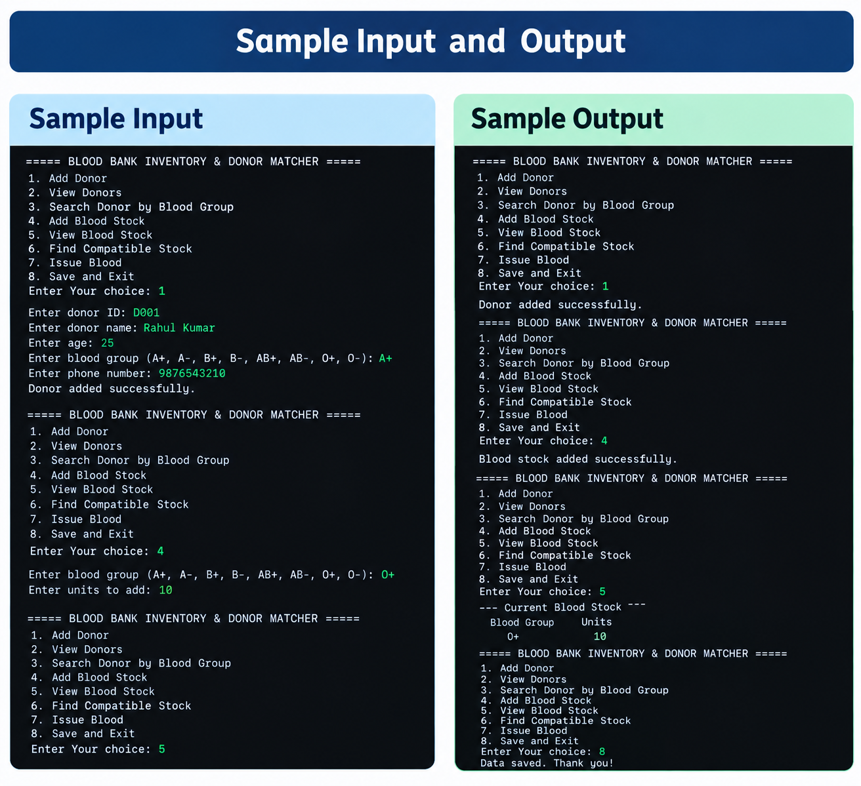
Sample Input & Output
Reproducible demonstration using fictional records and the current Java source
FORMATTED SAMPLE CONSOLE RUN — VERIFIED AGAINST LOCAL EXECUTION
TEST 1 — REQUEST 2 UNITS
--- Add Donor ---
Donor ID: D001
Donor Name: Rahul Kumar
Age: 22
Blood Group: O-
Phone Number: 9876543210
Last donation date: -
Donor added successfully.
Donation eligibility today: Eligible
--- Add Blood Stock Batch ---
Batch ID: B001 | Group: O- | Units: 3
Expiry: 2027-01-01
Blood stock batch added successfully.
Blood issued successfully.
Issue: ISS-0001 | Recipient Group: AB+
Units: 2 | Date: 2026-10-11 | Batches: B001:2
Issue cancelled. Compatible, non-expired stock has
only 1 unit(s); 2 were requested. No stock was changed.
Final stock: B001 | O- | Units: 1
O− batch begins with 3 units. Request for AB+ succeeds; B001 decreases to 1 unit.
TEST 2 — REQUEST 2 MORE
Only 1 compatible unit remains. The request is cancelled and no additional stock is deducted.
Fictional inputs. Issue date reflects local execution on 11 October 2026. This is a formatted text transcript, not a screenshot.
Verified behavior: stock goes 3 → 1 after the first issue and stays at 1 after the insufficient-stock request.
11/10/2026
Blood Bank Inventory & Donor Matcher
12
Notes:
Describe the repeatable sample. Donor D001 is Rahul Kumar, age 22, group O− and a fictional phone number. Batch B001 begins with 3 units and expiry 2027-01-01. Requesting 2 units for AB+ creates issue ISS-0001 and leaves 1 unit. A second request for 2 units is cancelled; the returned message states that no stock was changed. This workflow was executed locally against the current Java source on 2026-10-11.

Slide 13
Conclusion, Limitations & Future Scope
One project demonstrates the progression from programming fundamentals to integrated Java APIs
WHAT THE PROJECT DEMONSTRATES
CO1–CO3
CO4
CO5–CO6
Console I/O, control flow, modular methods, recursion, arrays and search.
Domain classes, encapsulation, inheritance, interfaces and exception handling.
Strings, sorting, file persistence, typed collections, lambdas and Stream reports.
CURRENT LIMITATIONS
FUTURE SCOPE — NOT IMPLEMENTED
• Console-only interface
• Delimiter-based local text files, not a database
• No login, roles, web access or SMS
• Simplified transfusion compatibility / eligibility logic
• Database-backed storage and audit logs
• Role-based access and secure authentication
• Notifications and reservation workflow
• More automated unit/integration testing
• Clinical workflow integration under professional oversight
Takeaway: the same blood-bank problem can connect every course outcome through incremental, readable Java code.
11/10/2026
Blood Bank Inventory & Donor Matcher
14
Notes:
Conclude by summarizing how the project extends the first CO1–CO3 donor-search exercise into a fuller model with OOP, exception handling, file persistence, collections and streams. Clearly state the limitations. Database storage, roles, auditing, notifications and clinical integration are future possibilities only and should not be presented as implemented features.

Slide 14
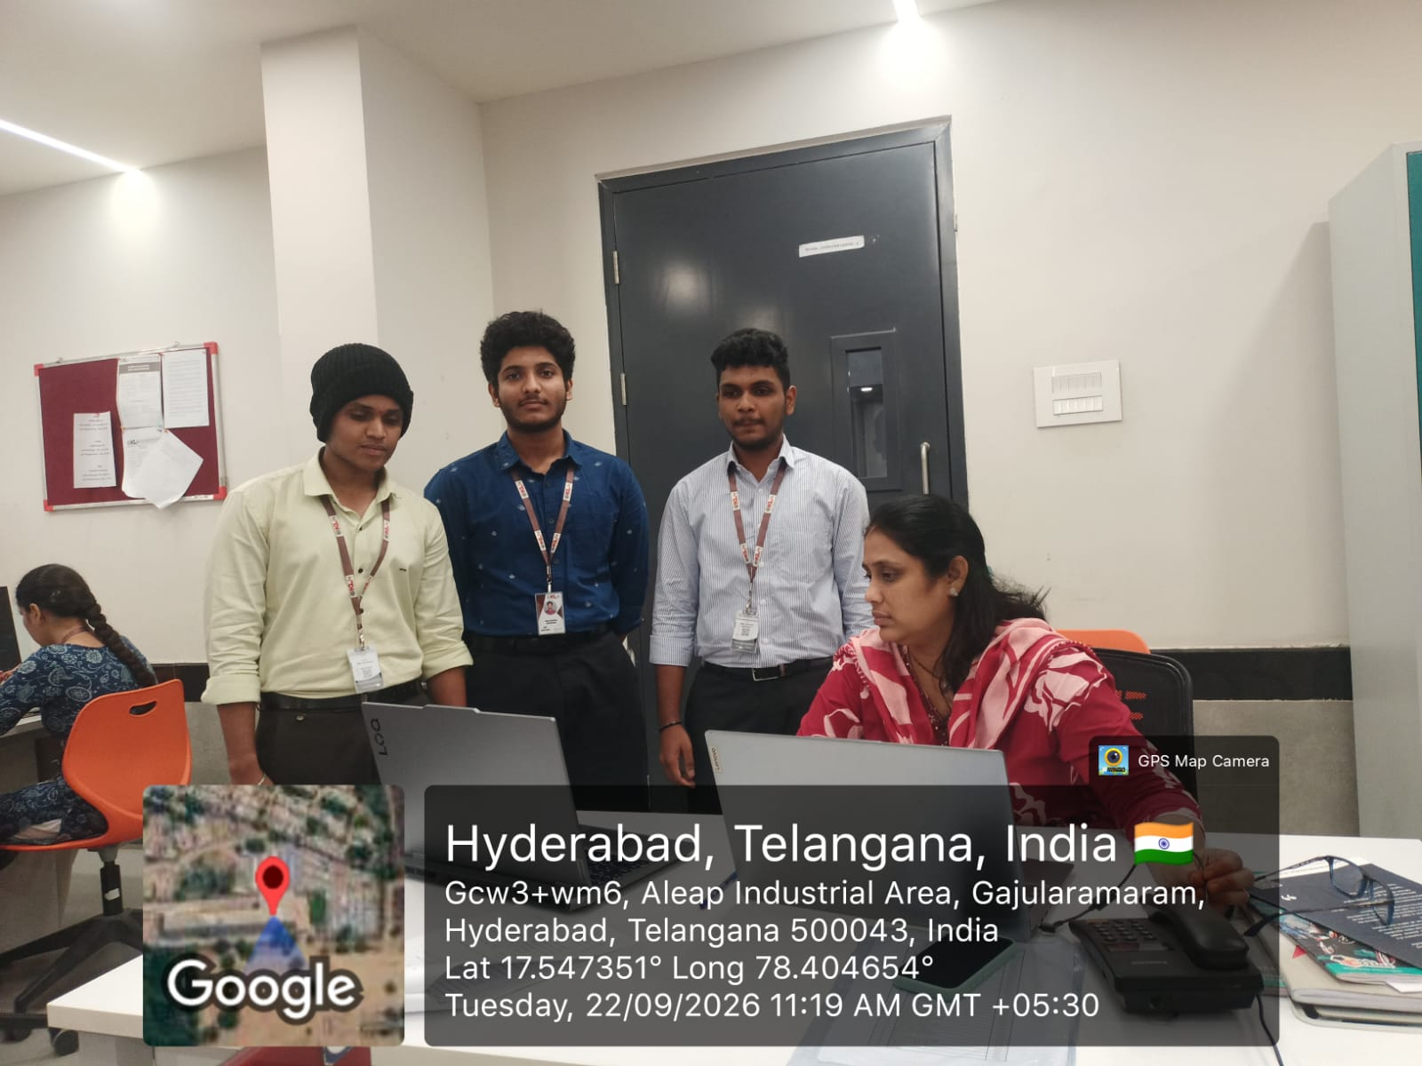
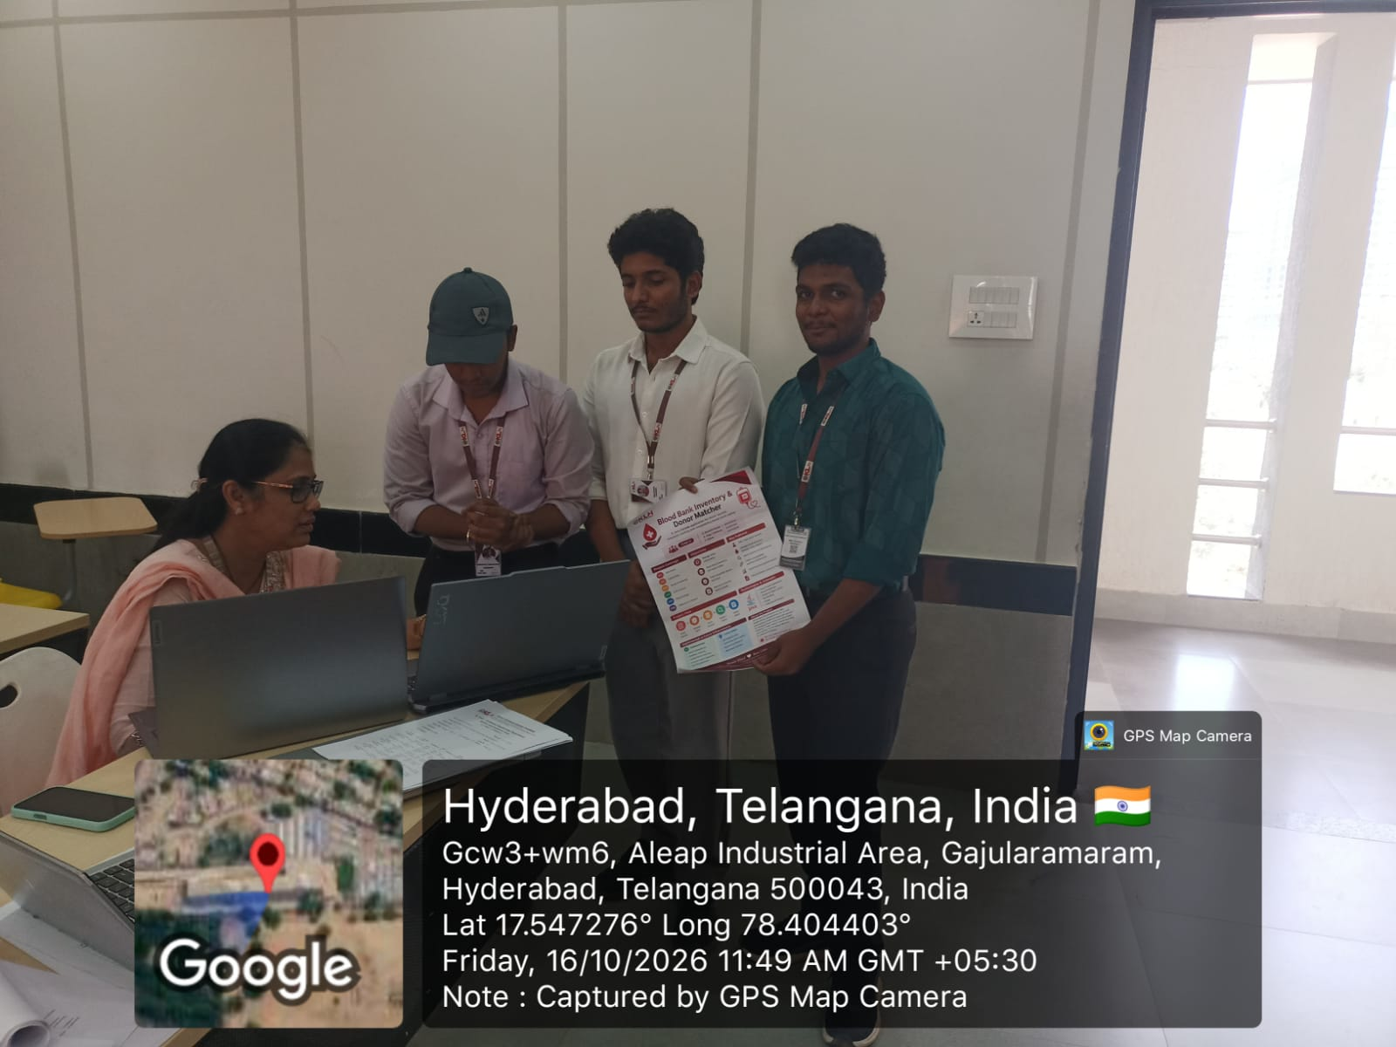
Project Photo & GitHub Repository
Team 07 • Project demonstration / lab context
BLOOD BANK INVENTORY
& DONOR MATCHER
GITHUB REPOSITORY
Open project repository ↗
github.com/brevanth12/
Y26_KLH_PSPJ_TEAM_07_BLOOD_BANK_INVENTORY_DONOR_MATCHER
Project/lab photograph reused from the supplied first presentation
Thank you
11/10/2026
Blood Bank Inventory & Donor Matcher
15
Notes:
Close the presentation by showing the project/lab photograph already present in the first submitted deck and the existing GitHub repository URL. The URL is clickable. The photograph is reused from the supplied presentation; no new geotag or location claim has been added. Invite questions about any of the six course outcomes.

