Slide 1
HW 4: OOP version
Artem

Slide 2
Plan:
Convert array-based code into class-based (OOP).
Create Pet and ArtemDude classes.
Add move() and show() methods.
Use arrays of objects instead of separate arrays.
Add random color & speed on collision.

Slide 3
Sprint 1:
Sprint 1 – Display characters
Display the Pet and ArtemDude characters. Each character has position (x, y) and size (d). Use simple functions pet() and artem() to draw them. No movement yet – only static display. Goal: learn how to draw two different objects.

Slide 4
Pet pet;
ArtemDude artem;
void setup() {
size(800, 600);
float mx = random(width);
float my = random(height);
float md = 10;
float cx = random(width);
float cy = random(height);
float cd = 5;
pet = new Pet(mx, my, md);
artem = new ArtemDude(cx, cy, cd);
background(255, 244, 189);
}
void draw() {
background(255, 244, 189);
pet.show();
artem.show();
}
class ArtemDude {
float x, y;
float d;
ArtemDude(float startX, float startY, float startD) {
x = startX;
y = startY;
d = startD;
}
void show() {
fill(255,220,180);
strokeWeight(2);
triangle(x-15*d, y+20*d, x+15*d, y+20*d, x, y); // body
fill(255);
rect(x-5*d, y+9*d, 4*d, 2*d); // left eye
rect(x+1*d, y+9*d, 4*d, 2*d); // right eye
stroke(0);
line(x+1*d, y+8*d, x+5*d, y+8*d); // eyebrow right
line(x-5*d, y+8*d, x-1*d, y+8*d); // eyebrow left
fill(40,150,180);
circle(x-2.7*d, y+10*d, 1.4*d); // pupil left
circle(x+3.4*d, y+10*d, 1.6*d); // pupil right
fill(255);
ellipse(x, y+16*d, 8*d, 3*d); // mouth
fill(240);
rect(x-0.5*d, y+14.6*d, 1.5*d, 2*d); // tooth
}
}
class Pet {
float x, y;
float d;
Pet(float startX, float startY, float startD) {
x = startX;
y = startY;
d = startD;
}
void show() {
fill(255,160,60);
circle(x, y, d*10); // face
ellipse(x, y+d, d*5, d*4); // muzzle
fill(0);
ellipse(x, y-0.5*d, d*2, d); // nose
circle(x+d*2, y-d*2, 0.5*d); // right eye
circle(x-d*2, y-d*2, 0.5*d); // left eye
}
}

Slide 5
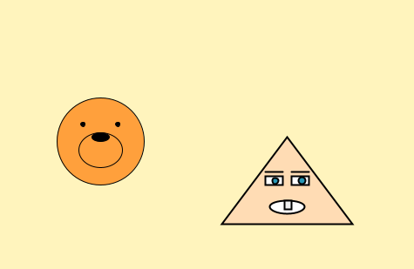

Slide 6
Sprint 2
Sprint 2 – Add movement
Make the two characters move and bounce from walls. Add velocity variables (vx, vy). Use draw() loop to update their position. Add movePet() and moveArtem() functions. Goal: create continuous movement and reflection.

Slide 7
Pet pet;
ArtemDude artem;
void setup() {
size(800, 600);
float mx = random(width);
float my = random(height);
float md = 10;
float mvx = random(3, 6);
float mvy = random(3, 6);
pet = new Pet(mx, my, md, mvx, mvy);
float cx = random(width);
float cy = random(height);
float cd = 5;
float cvx = random(3, 6);
float cvy = random(3, 6);
artem = new ArtemDude(cx, cy, cd, cvx, cvy);
}
void draw() {
background(50, 80, 20);
pet.move();
artem.move();
pet.show();
artem.show();
}
class ArtemDude {
float x, y;
float d;
float vx, vy;
ArtemDude(float startX, float startY, float startD, float startVX, float startVY) {
x = startX;
y = startY;
d = startD;
vx = startVX;
vy = startVY;
}
void move() {
x += vx;
y += vy;
if (x > width - 50 || x < 50) {
vx = -vx;
}
if (y > height - 50 || y < 50) {
vy = -vy;
}
}
void show() {
fill(255,220,180);
strokeWeight(2);
triangle(x-15*d, y+20*d, x+15*d, y+20*d, x, y); // body
fill(255);
rect(x-5*d, y+9*d, 4*d, 2*d); // left eye
rect(x+1*d, y+9*d, 4*d, 2*d); // right eye
stroke(0);
line(x+1*d, y+8*d, x+5*d, y+8*d); // eyebrow right
line(x-5*d, y+8*d, x-1*d, y+8*d); // eyebrow left
fill(40,150,180);
circle(x-2.7*d, y+10*d, 1.4*d); // pupil left
circle(x+3.4*d, y+10*d, 1.6*d); // pupil right
fill(255);
ellipse(x, y+16*d, 8*d, 3*d); // mouth
fill(240);
rect(x-0.5*d, y+14.6*d, 1.5*d, 2*d); // tooth
}
}
class Pet {
float x, y;
float d;
float vx, vy;
Pet(float startX, float startY, float startD, float startVX, float startVY) {
x = startX;
y = startY;
d = startD;
vx = startVX;
vy = startVY;
}
void move() {
x += vx;
y += vy;
if (x > width - 50 || x < 50) {
vx = -vx;
}
if (y > height - 50 || y < 50) {
vy = -vy;
}
}
void show() {
fill(255,160,60);
circle(x, y, d*10); // face
ellipse(x, y+d, d*5, d*4); // muzzle
fill(0);
ellipse(x, y-0.5*d, d*2, d); // nose
circle(x+d*2, y-d*2, 0.5*d); // right eye
circle(x-d*2, y-d*2, 0.5*d); // left eye
}
}

Slide 8
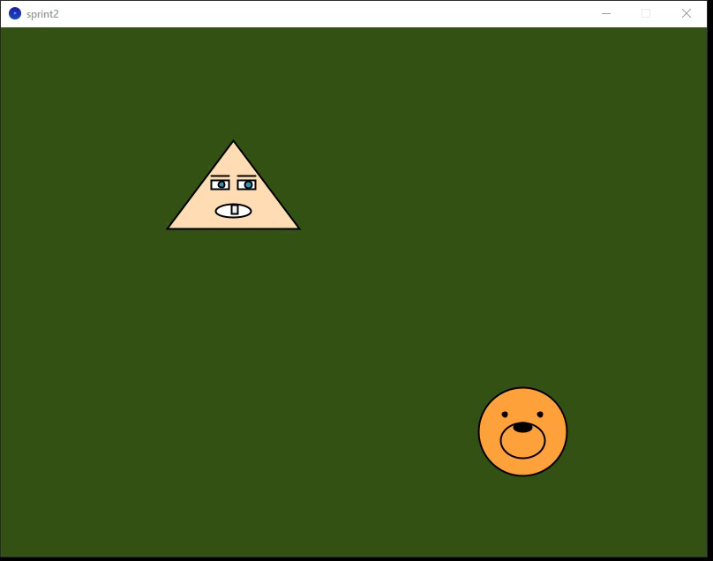

Slide 9
Sprint 3
Sprint 3 – Color and size change
When characters hit left or right walls, change color. When they hit top or bottom walls, make them shrink. Add one more variable for color (cFlag). Modify move functions to include color and size. Goal: make collisions visible through visual changes.

Slide 10
Pet pet;
ArtemDude artem;
void setup() {
size(800, 600);
float mx = random(width);
float my = random(height);
float md = 10;
float mvx = random(3, 6);
float mvy = random(3, 6);
int mc = 0;
pet = new Pet(mx, my, md, mvx, mvy, mc);
float cx = random(width);
float cy = random(height);
float cd = 5;
float cvx = random(3, 6);
float cvy = random(3, 6);
int cc = 0;
artem = new ArtemDude(cx, cy, cd, cvx, cvy, cc);
}
void draw() {
background(50, 80, 20);
pet.move();
artem.move();
pet.show();
artem.show();
}
class ArtemDude {
float x, y;
float d;
float vx, vy;
int cFlag;
ArtemDude(float startX, float startY, float startD, float startVX, float startVY, int startC) {
x = startX;
y = startY;
d = startD;
vx = startVX;
vy = startVY;
cFlag = startC;
}
void move() {
x += vx;
y += vy;
// по X + смена цвета
if (x > width - 50) {
x = width - 50;
vx = -abs(vx);
cFlag = 1 - cFlag;
} else if (x < 50) {
x = 50;
vx = abs(vx);
cFlag = 1 - cFlag;
}
// по Y + уменьшение
if (y > height - 50) {
y = height - 50;
vy = -abs(vy);
d = d * 0.9;
} else if (y < 50) {
y = 50;
vy = abs(vy);
d = d * 0.9;
}
}
void show() {
if (cFlag == 0) fill(255);
else fill(120);
strokeWeight(2);
triangle(x-15*d, y+20*d,
x+15*d, y+20*d,
x, y); // body
fill(255);
rect(x-5*d, y+9*d, 4*d, 2*d); // left eye
rect(x+1*d, y+9*d, 4*d, 2*d); // right eye
stroke(0);
line(x+1*d, y+8*d, x+5*d, y+8*d); // eyebrow right
line(x-5*d, y+8*d, x-1*d, y+8*d); // eyebrow left
fill(40,150,180);
circle(x-2.7*d, y+10*d, 1.4*d); // pupil left
circle(x+3.4*d, y+10*d, 1.6*d); // pupil right
fill(255);
ellipse(x, y+16*d, 8*d, 3*d); // mouth
fill(240);
rect(x-0.5*d, y+14.6*d, 1.5*d, 2*d); // tooth
}
}
class Pet {
float x, y;
float d;
float vx, vy;
int cFlag;
Pet(float startX, float startY, float startD, float startVX, float startVY, int startC) {
x = startX;
y = startY;
d = startD;
vx = startVX;
vy = startVY;
cFlag = startC;
}
void move() {
x += vx;
y += vy;
// по X
if (x > width - 50) {
x = width - 50;
vx = -abs(vx);
cFlag = 1 - cFlag;
} else if (x < 50) {
x = 50;
vx = abs(vx);
cFlag = 1 - cFlag;
}
// по Y
if (y > height - 50) {
y = height - 50;
vy = -abs(vy);
d = d * 0.9;
} else if (y < 50) {
y = 50;
vy = abs(vy);
d = d * 0.9;
}
}
void show() {
if (cFlag == 0) fill(255, 255, 0);
else fill(255, 0,255);
circle(x, y, d*10); // face
ellipse(x, y+d, d*5, d*4); // muzzle
fill(0);
ellipse(x, y-0.5*d, d*2, d); // nose
circle(x+d*2, y-d*2, 0.5*d); // right eye
circle(x-d*2, y-d*2, 0.5*d); // left eye
}
}

Slide 11
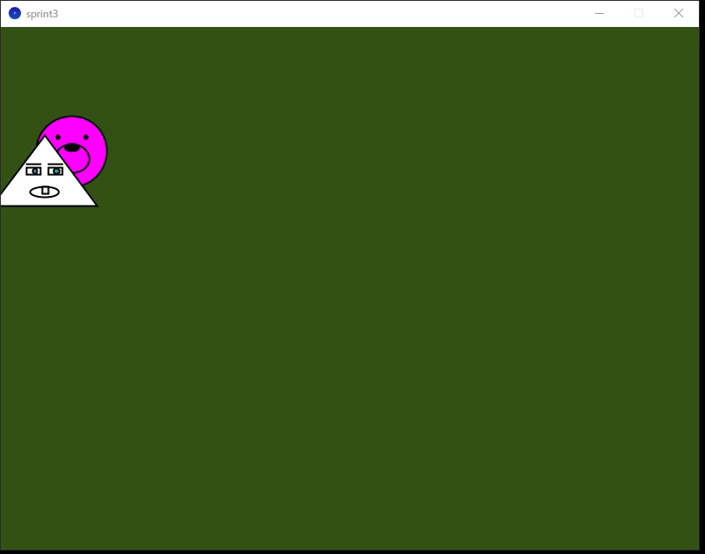
Sprint 3

Slide 12
Sprint 4
Sprint 4 – Convert to OOP
Convert the array version into object-oriented form. Create classes Pet and ArtemDude. Move all data and behavior into each class. Replace arrays of values with arrays of objects. Goal: make cleaner, structured, and reusable code.

Slide 13
int N = 5;
Pet[] pets;
ArtemDude[] guys;
void setup() {
size(800, 600);
pets = new Pet[N];
guys = new ArtemDude[N];
for (int i = 0; i < N; i++) {
float startX1 = random(width);
float startY1 = random(height);
float startD1 = 10;
int startC1 = 0;
float startVX1 = random(-6, -3);
float startVY1 = random(3, 6);
pets[i] = new Pet(startX1, startY1, startD1, startVX1, startVY1, startC1);
float startX2 = random(width);
float startY2 = random(height);
float startD2 = 10;
int startC2 = 0;
float startVX2 = random(-6, -3);
float startVY2 = random(3, 6);
guys[i] = new ArtemDude(startX2, startY2, startD2, startVX2, startVY2, startC2);
}
}
void draw() {
background(50, 80, 20);
// moving all
for (int i = 0; i < N; i++) {
pets[i].move();
guys[i].move();
}
// drawing all
for (int i = 0; i < N; i++) {
pets[i].show();
guys[i].show();
}
}
class ArtemDude {
float x, y;
float d;
float vx, vy;
int cFlag;
ArtemDude(float startX, float startY, float startD, float startVX, float startVY, int startC) {
x = startX;
y = startY;
d = startD;
vx = startVX;
vy = startVY;
cFlag = startC;
}
void move() {
if (x > width - 50 || x < 50) {
vx = -vx;
cFlag = (cFlag + 1) % 2;
}
if (y > height - 50 || y < 50) {
vy = -vy;
d = d * 0.9;
}
x += vx;
y += vy;
}
void show() {
if (cFlag == 0) fill(255);
else fill(120);
strokeWeight(2);
triangle(x-15*d, y+20*d,
x+15*d, y+20*d,
x, y); // body
fill(255);
rect(x-5*d, y+9*d, 4*d, 2*d); // left eye
rect(x+1*d, y+9*d, 4*d, 2*d); // right eye
stroke(0);
line(x+1*d, y+8*d, x+5*d, y+8*d); // eyebrow right
line(x-5*d, y+8*d, x-1*d, y+8*d); // eyebrow left
fill(40,150,180);
circle(x-2.7*d, y+10*d, 1.4*d); // pupil left
circle(x+3.4*d, y+10*d, 1.6*d); // pupil right
fill(255);
ellipse(x, y+16*d, 8*d, 3*d); // mouth
fill(240);
rect(x-0.5*d, y+14.6*d, 1.5*d, 2*d); // tooth
}
}
class Pet {
float x, y;
float d;
float vx, vy;
int cFlag;
Pet(float startX, float startY, float startD, float startVX, float startVY, int startC) {
x = startX;
y = startY;
d = startD;
vx = startVX;
vy = startVY;
cFlag = startC;
}
void move() {
if (x > width - 50 || x < 50) {
vx = -vx;
cFlag = (cFlag + 1) % 2;
}
if (y > height - 50 || y < 50) {
vy = -vy;
d = d * 0.9;
}
x += vx;
y += vy;
}
void show() {
if (cFlag == 0) fill(255, 255, 0);
else fill(255, 0,255);
circle(x, y, d*10); // face
ellipse(x, y+d, d*5, d*4); // muzzle
fill(0);
ellipse(x, y-0.5*d, d*2, d); // nose
circle(x+d*2, y-d*2, 0.5*d); // right eye
circle(x-d*2, y-d*2, 0.5*d); // left eye
}
}

Slide 14
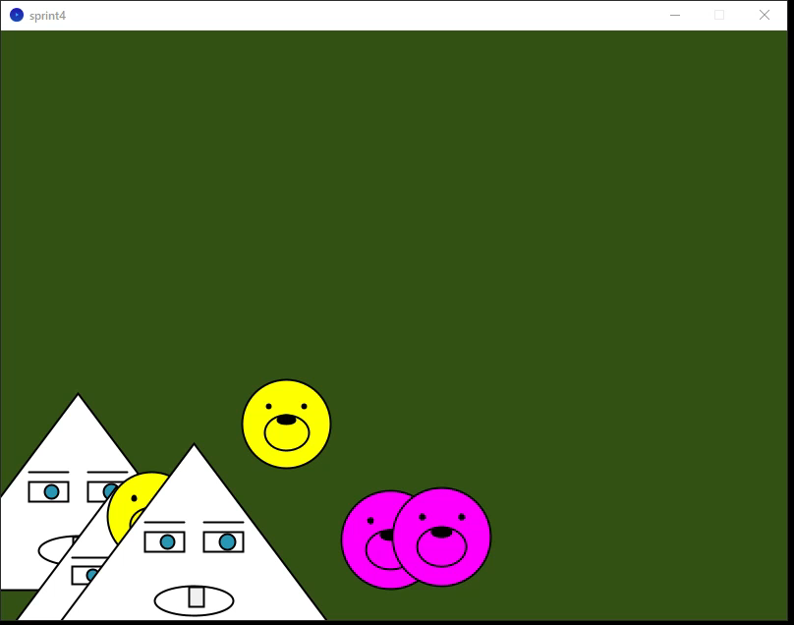

Slide 15
Feeling (and question)
Feeling
Understanding how OOP makes the program cleaner and easier to expand.
Each object moves and draws itself, no more repeated code.
Question
How can I reuse common code for both classes without repeating move()?

Slide 16
Extra
What would you do if you added Sprint 5? Write down your idea and you'll get a bonus of up to 5 points. Implementing it will earn you a bonus of up to 5 points.
Idea: I would add random color or speed changes every time an object bounces off a wall. It would make the movement look more dynamic and unpredictable.
Extra – Random speed and color
Add random color and random speed when bouncing. Characters now move in a more dynamic and natural way. Code stays short thanks to the OOP structure. This became Sprint 5 extension. Goal: make the animation more interesting and lively.

Slide 17
Sprint 5
Sprint 5 – OOP Conversion
Replaced arrays with object arrays ( Pet[], ArtemDude[]).
Each object stores its own data (x, y, vx, vy, d, cFlag).
Movement and drawing are now methods.
Added random color and speed on bounce.

Slide 18
int N = 5;
float SPEED_MIN = 2;
float SPEED_MAX = 9;
Pet[] pets;
ArtemDude[] guys;
void setup() {
size(800, 600);
pets = new Pet[N];
guys = new ArtemDude[N];
for (int i = 0; i < N; i++) {
float x1 = random(width);
float y1 = random(height);
float d1 = 10;
int c1 = 0;
float vx1 = random(-6, -3);
float vy1 = random(3, 6);
pets[i] = new Pet(x1, y1, d1, vx1, vy1, c1);
float x2 = random(width);
float y2 = random(height);
float d2 = 10;
int c2 = 0;
float vx2 = random(-6, -3);
float vy2 = random(3, 6);
guys[i] = new ArtemDude(x2, y2, d2, vx2, vy2, c2);
}
}
void draw() {
background(50,80,20);
for (int i = 0; i < N; i++) {
pets[i].move();
guys[i].move();
}
for (int i = 0; i < N; i++) {
pets[i].show();
guys[i].show();
}
}
class ArtemDude {
float x, y, d, vx, vy;
int cFlag;
ArtemDude(float sx, float sy, float sd, float svx, float svy, int sc) {
x = sx; y = sy; d = sd; vx = svx; vy = svy; cFlag = sc;
}
void move() {
if (x > width - 50 || x < 50) {
vx = -vx;
cFlag = int(random(2));
vx *= random(0.8, 1.3);
if (abs(vx) < SPEED_MIN) vx = SPEED_MIN * sign(vx);
if (abs(vx) > SPEED_MAX) vx = SPEED_MAX * sign(vx);
}
if (y > height - 50 || y < 50) {
vy = -vy;
d *= 0.9;
cFlag = int(random(2));
vy *= random(0.8, 1.3);
if (abs(vy) < SPEED_MIN) vy = SPEED_MIN * sign(vy);
if (abs(vy) > SPEED_MAX) vy = SPEED_MAX * sign(vy);
}
x += vx;
y += vy;
}
void show() {
if (cFlag == 0) fill(255);
else fill(120);
strokeWeight(2);
triangle(x-15*d,y+20*d,x+15*d,y+20*d,x,y);
fill(255);
rect(x-5*d,y+9*d,4*d,2*d);
rect(x+1*d,y+9*d,4*d,2*d);
stroke(0);
line(x+1*d,y+8*d,x+5*d,y+8*d);
line(x-5*d,y+8*d,x-1*d,y+8*d);
fill(40,150,180);
circle(x-2.7*d,y+10*d,1.4*d);
circle(x+3.4*d,y+10*d,1.6*d);
fill(255);
ellipse(x,y+16*d,8*d,3*d);
fill(240);
rect(x-0.5*d,y+14.6*d,1.5*d,2*d);
}
float sign(float v) {
return v < 0 ? -1 : 1;
}
}
class Pet {
float x, y, d, vx, vy;
int cFlag;
Pet(float sx, float sy, float sd, float svx, float svy, int sc) {
x = sx; y = sy; d = sd; vx = svx; vy = svy; cFlag = sc;
}
void move() {
if (x > width - 50 || x < 50) {
vx = -vx;
cFlag = int(random(2));
vx *= random(0.8, 1.3);
if (abs(vx) < SPEED_MIN) vx = SPEED_MIN * sign(vx);
if (abs(vx) > SPEED_MAX) vx = SPEED_MAX * sign(vx);
}
if (y > height - 50 || y < 50) {
vy = -vy;
d *= 0.9;
cFlag = int(random(2));
vy *= random(0.8, 1.3);
if (abs(vy) < SPEED_MIN) vy = SPEED_MIN * sign(vy);
if (abs(vy) > SPEED_MAX) vy = SPEED_MAX * sign(vy);
}
x += vx;
y += vy;
}
void show() {
if (cFlag == 0) fill(255,255,0);
else fill(255,0,255);
circle(x,y,d*10);
ellipse(x,y+d,d*5,d*4);
fill(0);
ellipse(x,y-0.5*d,d*2,d);
circle(x+d*2,y-d*2,0.5*d);
circle(x-d*2,y-d*2,0.5*d);
}
float sign(float v) {
return v < 0 ? -1 : 1;
}
}

Slide 19
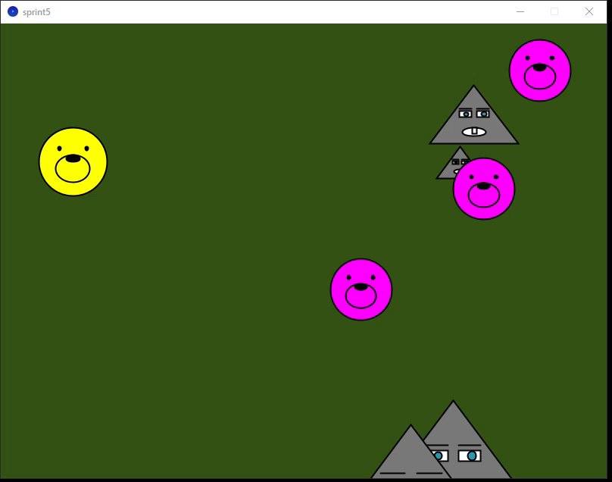

Slide 20
All source code
The full project is uploaded to GitHub: https://github.com/brevno-project/Java

